Slide 1
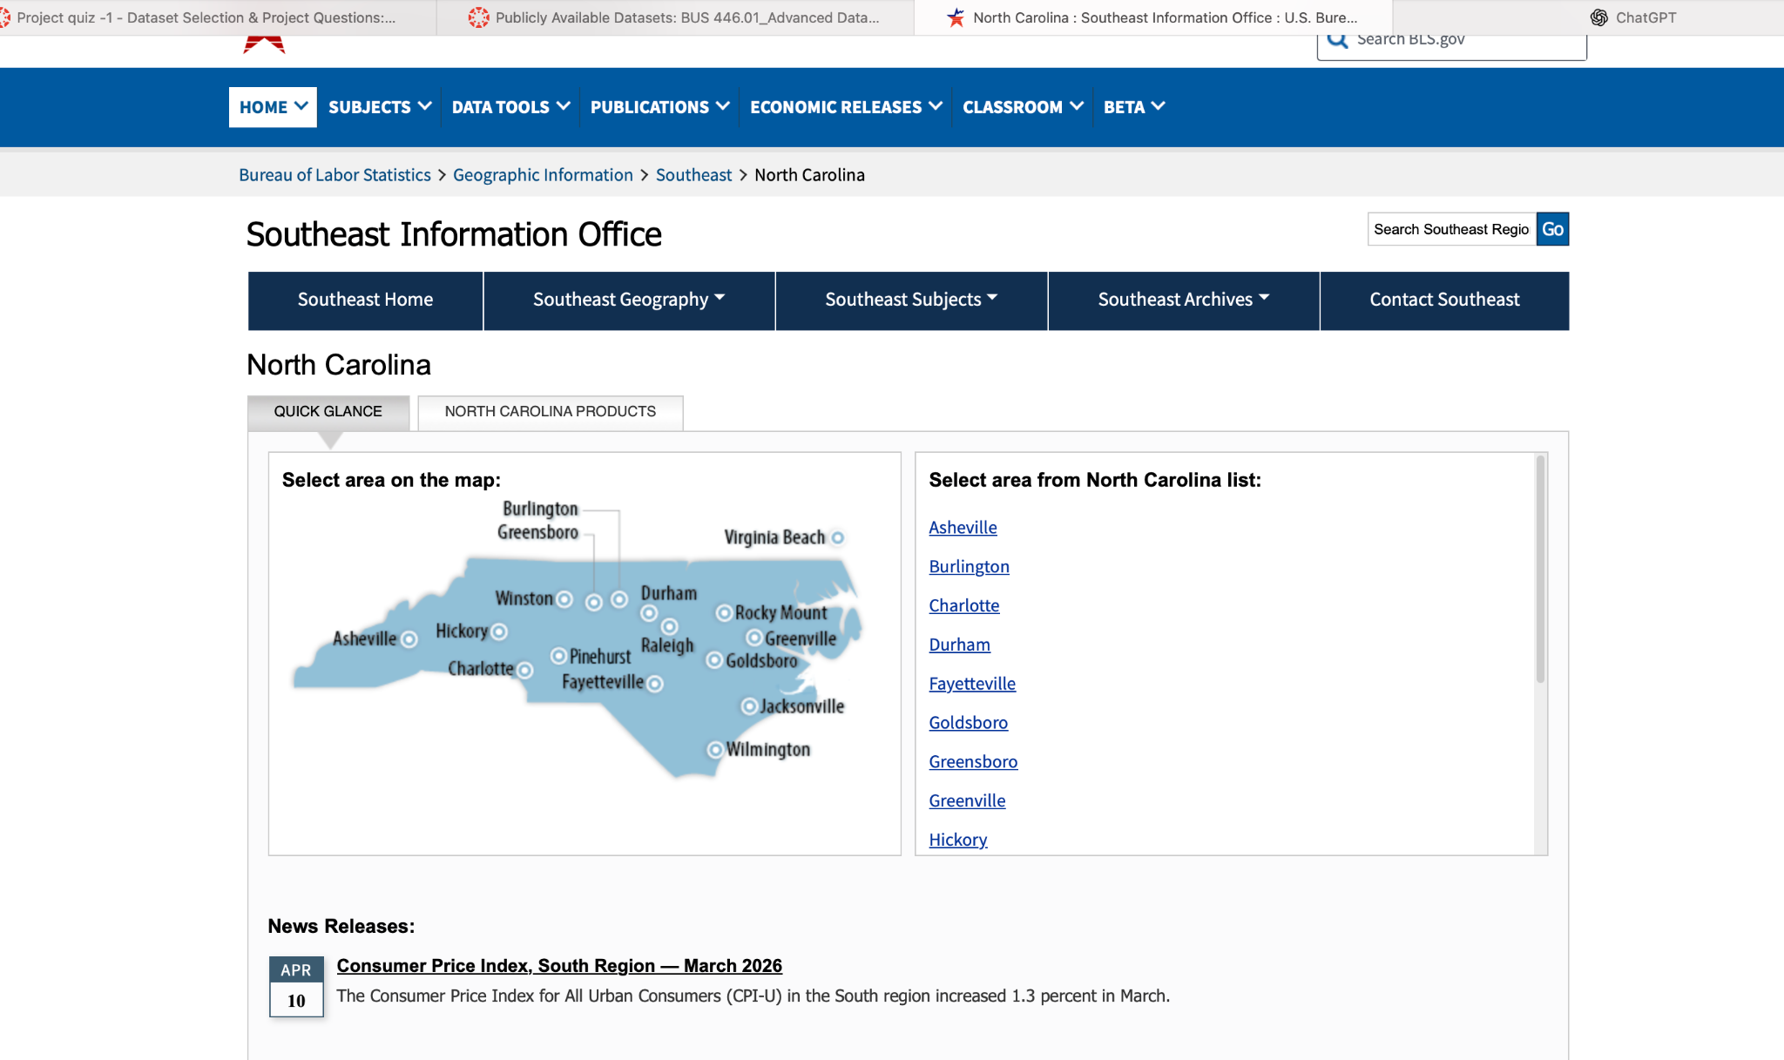
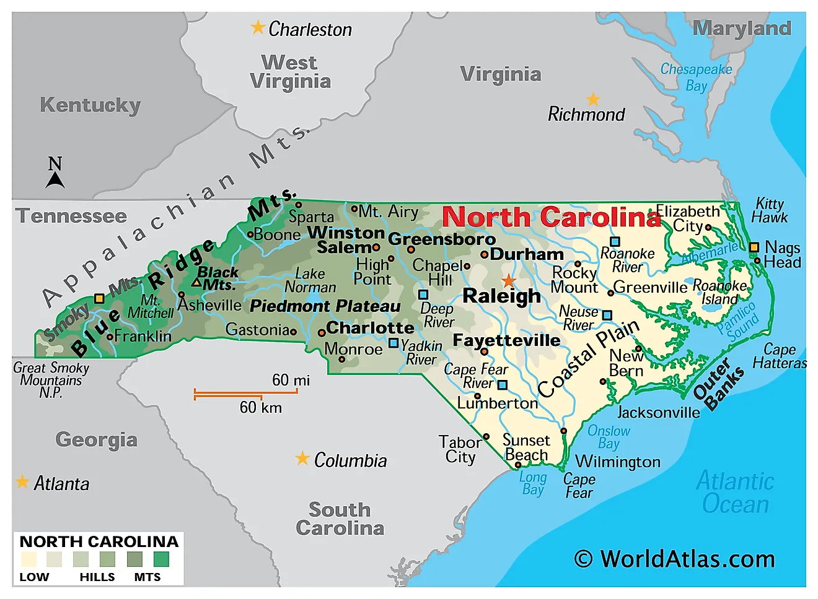
North Carolina Labor Market Trends
Analyzing unemployment, employment levels, wage growth, and economic shocks (2016-2026)
BLS labor market data
Tableau data analysis
Group: Claudia & the others
Course: BUS 446
BUS 446 Final Project | North Carolina labor market analysis
01
Notes:
Open by introducing the project as a business analytics portfolio case focused on North Carolina labor market conditions.

Slide 2
Project Objective & Core Questions
What the project is about and why the analysis matters
Business objective
The goal of this project is to understand how key labor market variables interact and change over time. The analysis will focus on identifying patterns between employment, unemployment, and wage growth.
Q1 How has the unemployment rate in North Carolina changed from 2016 to 2026, and what overall trends can be observed in the labor market during this period ?
Trend
analysis
Relationship
testing
Business
insight
Q2 What relationship exists between employment levels and average hourly wages in North Carolina, and can increases in employment help explain wage growth ?
The value of the project is not only showing trends, but explaining what those trends imply for workforce planning, wage pressure, and economic resilience.
Q3 Are changes in unemployment associated with noticeable changes in employment levels and wages, particularly during periods of economic disruption or recovery ?
BUS 446 Final Project | North Carolina labor market analysis
02

Slide 3
Dataset Introduction
Sources, variables, and limitations
Primary dataset
U.S. Bureau of Labor Statistics (BLS) data on North Carolina labor market trends.
Main variables
Year/month, unemployment rate, employment level, and average hourly wages.
Supporting data
Data.gov and cost-of-living context used to support and validate insights.
Limitations
Data is aggregated, may require cleaning, and may not reflect local-level differences.
Data sources and methods are documented in the GitHub README to ensure transparency and reproducibility.
BUS 446 Final Project | North Carolina labor market analysis
03

Slide 4
Analytical Approach
From raw data to business conclusions
1
2
3
4
5
Collect data
Clean & join
Build Tableau views
Regression test
Interpret insights
BLS public datasets focused on North Carolina labor market
Standardized dates, units, and variables across datasets
Created trend lines and visuals for employment and wages
Measured how employment levels impact wage growth
Connected results to real business implications
The analysis combines visualization and regression to explain how employment levels influence wage growth over time.
BUS 446 Final Project | North Carolina labor market analysis
04

Slide 5
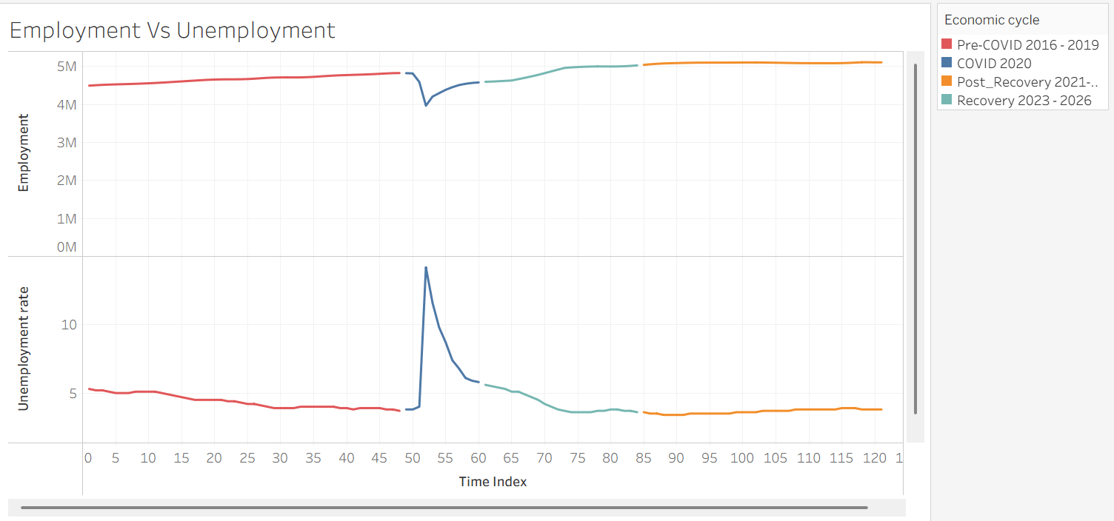
Tableau Dashboard 1: Labor Market Trends
This chart tracks employment and unemployment in North Carolina from 2016-2026. The two variables move in opposite directions, consistent with standard labor market dynamics.
PLACEHOLDER
Tableau: line chart showing unemployment rate, employment level, and average hourly wage over 2015–2024
Pre‑2020: Stable employment with low unemployment
2020: Sharp drop in employment and spike in unemployment (COVID‑19 shock)
Post‑2020: Gradual employment recovery and declining unemployment
BUS 446 Final Project | North Carolina labor market analysis
05
Notes:
Talk track
• Point out the overall direction ofeach variable
• Identify years with major shifts
• Explain whether wage growthmoves with or againstunemployment changes
Recommended Tableau design
Use consistent axis labels,readable titles, clear colors, andannotations for major economicshock periods.

Slide 6
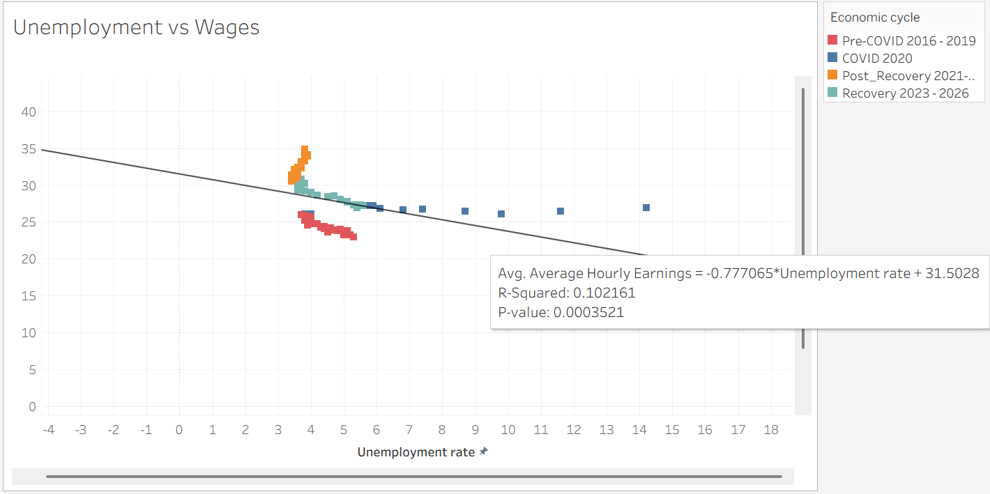
Research Question 1: Unemployment vs. Wages
How strongly are unemployment changes related to average hourly wages?
A negative relationship suggests that wages tend to be higher when labor markets are tighter (lower unemployment). In this data, wages increase as unemployment falls, but the relationship is relatively weak, indicating that wage growth is influenced by additional factors.
PLACEHOLDER
Tableau scatterplot:
Unemployment rate vs. average hourly wage
Add trend line + R²
Trend‑line direction: Negative
Correlation: Negative (implied by slope)
R²: 0.10
Statistical significance: p < 0.001
The relationship is statistically significant but explains a limited share of wage variation.
From 2016–2026, unemployment fluctuated—rising sharply during 2020 and declining during recovery—while average hourly wages steadily increased. The relationship appears weak because unemployment explains only about 10% of wage variation, suggesting other economic forces play a larger role.
BUS 446 Final Project | North Carolina labor market analysis
06
Notes:
What to explain
A negative relationship would suggest wages rise whenlabor markets are tighter. A weak relationship meanswage movement may depend on other factors, such asinflation, industry mix, or productivity.
Evidence to report
Correlation coefficient, trend-line direction, R², and onesentence interpreting practical meaning.
Conclusion format
“From 2015–2024, unemployment [rose/fell/fluctuated],while wages [rose/fell]. The relationship appears[strong/moderate/weak] because …”

Slide 7
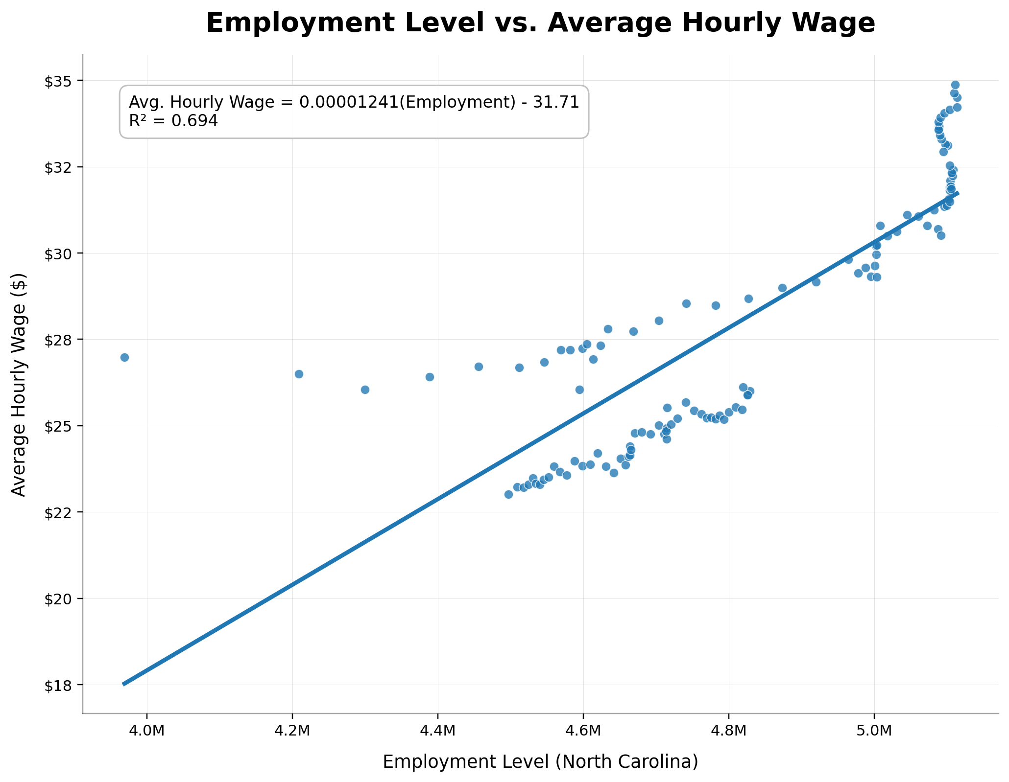
Research Question 2: Employment Levels & Wage Growth
Can employment help predict wage increases?
Regression model idea
Avg. Hourly Wage = β₀ + β₁(Employment Level) + ε
PLACEHOLDER
Excel chart:
Employment level vs. average hourly wage
Regression equation shown
Interpretation
Positive relationship: higher employment → higher wages
Effect is meaningful but not perfect
Other factors also influence wage growth
Include from Excel
Slope (β₁): Positive
R²: 0.694 (~69%)
Meaning: Employment strongly helps predict wages
BUS 446 Final Project | North Carolina labor market analysis
07

Slide 8
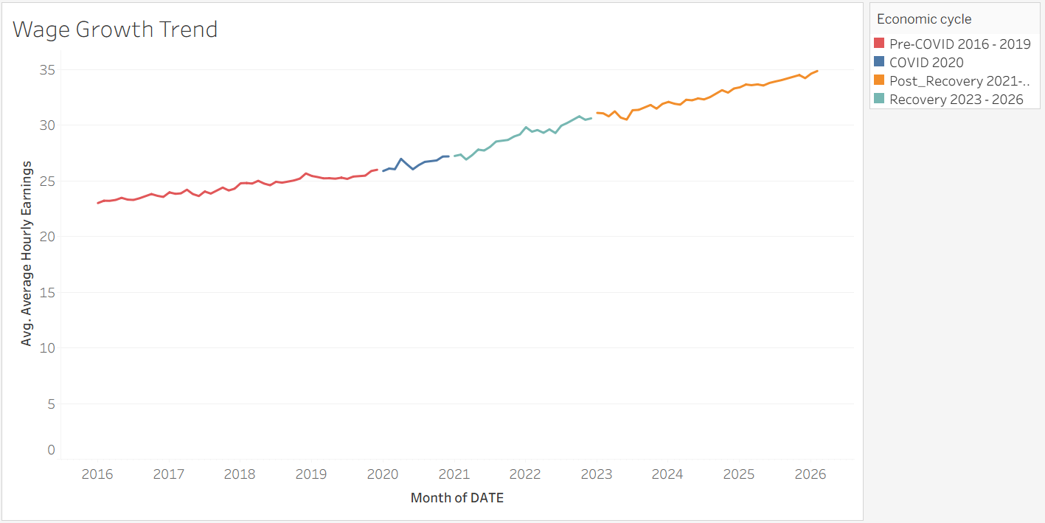
Research Question 3: Wage Growth Trend
Do major shocks align with visible labor market shifts?
Annotation ideas
• 2020 COVID labor-market disruption
• Recovery period
• Wage acceleration or stabilization
• Employment rebound
PLACEHOLDER
Tableau annotated time-series dashboard:
Highlight 2020 shock and recovery period
Average hourly wages rose steadily across all periods, accelerating after 2020, suggesting wage growth continued despite COVID-related labor disruptions.
.
BUS 446 Final Project | North Carolina labor market analysis
08

Slide 9
Key Findings & Business Implications
Replace bracketed text with final numbers after Tableau/Excel analysis
Finding 1
Unemployment decreased overall (2016-2026)
Wages increased during the same period
Moderate relationship between unemployment and wages
Finding 2
Employment is positively related to wages
Regression shows a strong relationship (R² ≈ 0.69)
Employment meaningfully predicts wage growth
Finding 3
Economic shocks caused noticeable shifts
Biggest impact around 2020 (COVID period)
Employment and wages were both affected
Implications for decision-makers
Portfolio message
Employers: expect wage increases when employment rises
Workforce planners: track employment + unemployment together
Analysts: use multiple indicators, not just one
Project is clear and easy to follow
Data, visuals, and methods are well organized
Conclusions are supported and easy to understand
BUS 446 Final Project | North Carolina labor market analysis
09

Slide 10
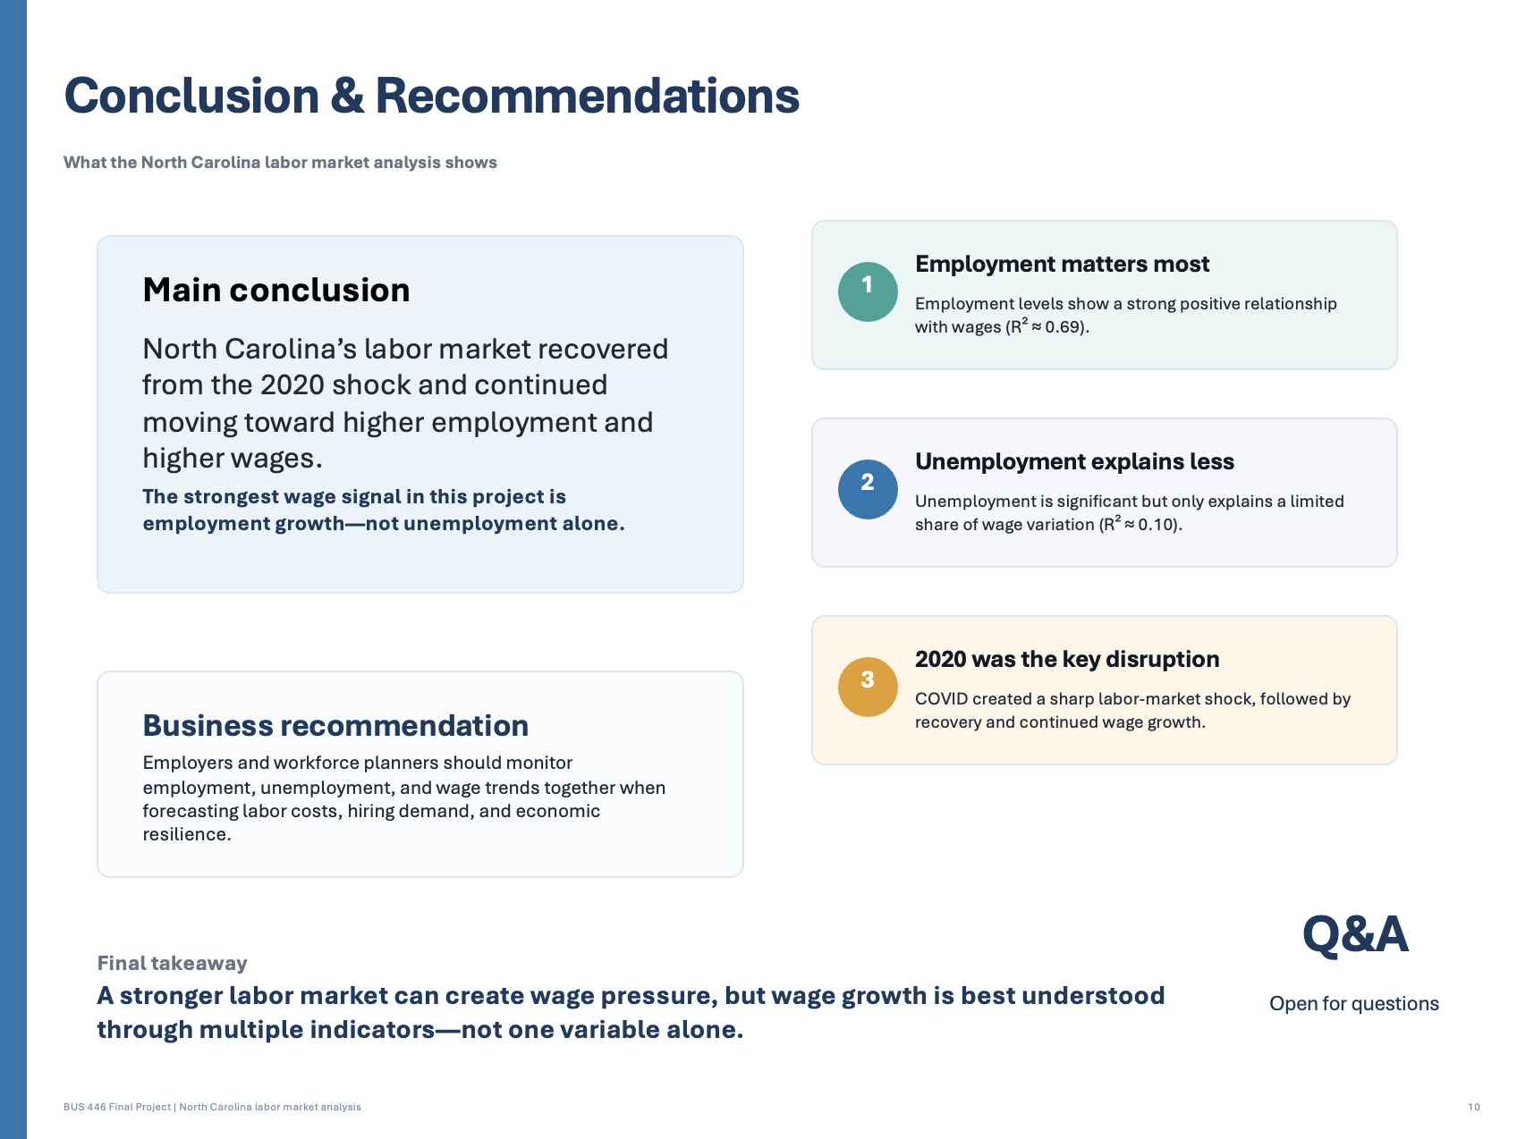
GitHub Repository & Final Submission Checklist
What to upload for the final deliverable
✓
Dataset (Excel file used)
Closing statement
Analyzes NC labor market trends (2015–2024)
Links unemployment, employment, and wages
Shows impact of economic shocks (2020)
Organized in a clear, professional GitHub portfolio
✓
Presentation slides (PowerPoint)
✓
Working file (Excel/Tableau)
✓
README (questions, method, findings)
✓
Business report (conclusions + recommendations)
Q&A
Open for questions
✓
Visuals (charts/screenshots)
BUS 446 Final Project | North Carolina labor market analysis
10

