Slide 1


Final Presentation - Research Topic 2
A usable spatial data publication platform
Teun van Sprundel
Matthew Pegels
Notes:
1 00:00 01:00 Welcome
Welcome
My name is Teun van Sprundel and this is my colleague Matthew Pegels.
We are working at Spotzi BV.
Today we’re giving a presentation about our topic in the geonovum research:
A usable spatial data publication platform
We will show you what we’ve been doing in de past two months for this project and will demo some of our final results and two use cases to demo our newest application.

Slide 2
Content of the presentation
About Spotzi?
About the testbed
Geonovum Testbed - Results
Use case bicycle stands
Use case felling a tree
Optional: Show extra features
Topic Challenges
Conclusion
Questions?
Notes:
2 01:00 02:00 Content
Content of the presentation:
Spotzi
Topic 2
Our tasks:
User management
Workflows and toolchains
Searchable data
Linking data

Slide 3


FIND, ANALYZE AND VISUALIZE LOCATION DATA.
1 + 1 = 2
ANALYSING
Notes:
Spotzi
Find
Analyze
Visualize

Slide 4
TESTBED Topic #2:
A usable spatial data publication platform
This research topic is about a platform approach for spatial data on the web, making it easy to find and use.
Easy to find
Government as a platform
Deliver report and finish
Notes:
7 04:30 06:00 Research Topic 2
About the topic
Platform approach for spatial data on the web
The goal of this topic
The leading perspective of this research topic is using the data, i.e. the user leading perspective. Its goal is to find out how to make spatial data easy to find and more specifically to explore the idea of ‘government as a platform’ i.e. make data easier to use by providing not only the data itself but also a community surrounding it. Given the fact that now there are disparate data sources full of opaque data, what needs to be done differently and by whom?
Questions for this topic that we need to investigate
What should a governmental data dissemination platform look like?
How can metadata be made crawlable and indexable by search engines?
How can users be allowed to expand authoritative data?
How can information instead of data be made crawlable?
What can we learn from OpenStreetmap’s data model and search APIs

Slide 5
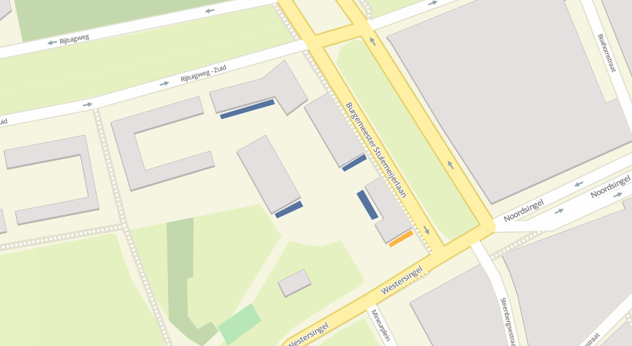
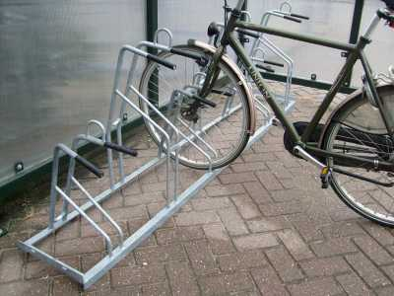
TESTBED Topic #2: Use-Case #1: Bicycle Stands
Situation: What, Where, Why?
Background: The municipality is restructuring a part of Bergen op Zoom. A citizen wants to know what happens at the other side of the street; He proposes to change the location of the bicycle stands after the restructuration is finished.
Notes:
12 25:30 27:30 Linked data
NEXT:
DEMO: 27:30 30:00 Information

Slide 6
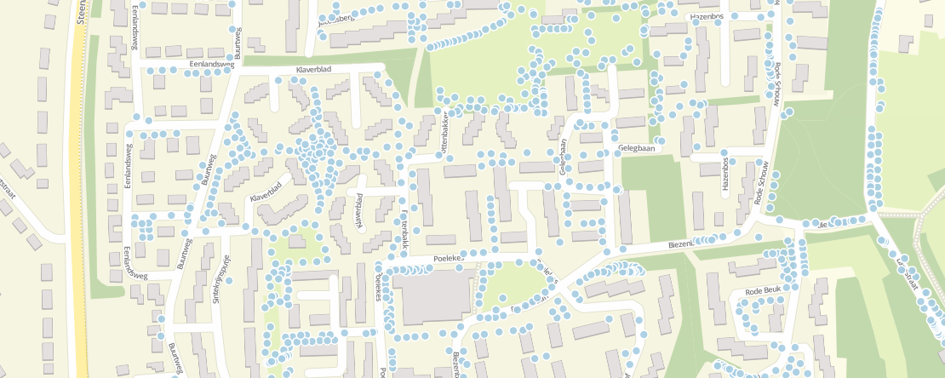
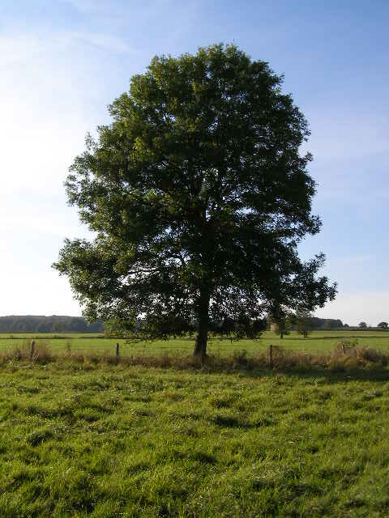
TESTBED Topic #2: Use-Case #2: Felling a Tree
Situation: What, Where, Why?
Background: A citizen in the municipality of Bergen op Zoom wants to make an application for a logging concession.
Notes:
12 25:30 27:30 Linked data
NEXT:
DEMO: 27:30 30:00 Information

Slide 7
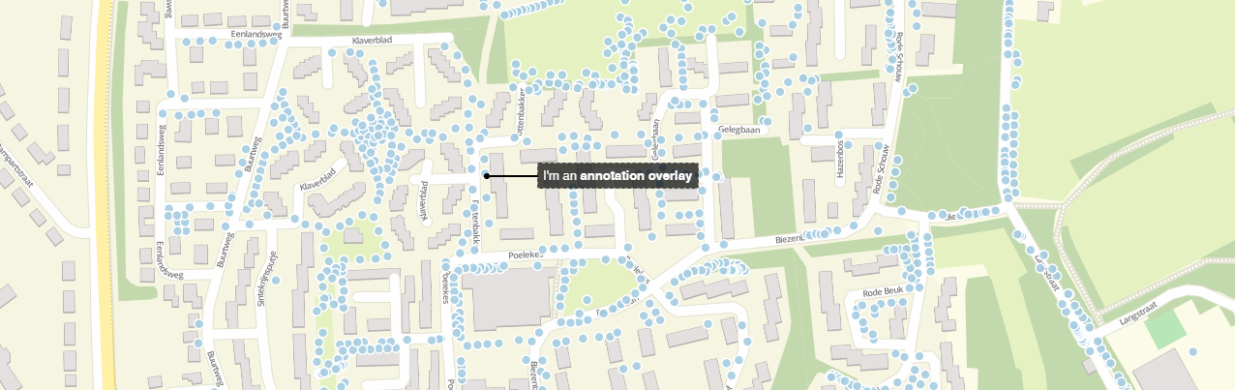
TESTBED Topic #2: Some extra features for municipalities
Label Functionality in the BAG (Advanced Editing)
Annotation Functionality in the Bag (Advanced Editing)
Legend, Callout, Hover etc. etc.
Notes:
12 25:30 27:30 Linked data
NEXT:
DEMO: 27:30 30:00 Information

Slide 8
TESTBED Topic #2: Topic Challenges
Challenge 1: The data and the usability of the tool should be as understandable as possible for both citizens and municipal / government. Talking as a citizens.
Challenge 2: Retention of data quality if the citizen is going to interfere with the public data.
Challenge 3: Possibilities of Linked Data
Notes:
12 25:30 27:30 Challenges
Challenge 1: The data and the usability of the tool should be as understandable as possible for both citizens and municipal / government. Talking as a citizens.
Challenge 2: Retention of data quality if the citizen is going to interfere with the public data.
Challenge 3: No compliance in data sets and data types for each municipality creates differences in public data.

Slide 9
TESTBED Topic #2: Conclusion
Platform to create and visualize data
User friendly, easy to use
A lot of possibilities
Notes:
12 25:30 27:30 Linked data
NEXT:
DEMO: 27:30 30:00 Information

Slide 10
Thank You
Notes:
12 25:30 27:30 Linked data
NEXT:
DEMO: 27:30 30:00 Information

