Slide 1


Slide 2


Slide 3
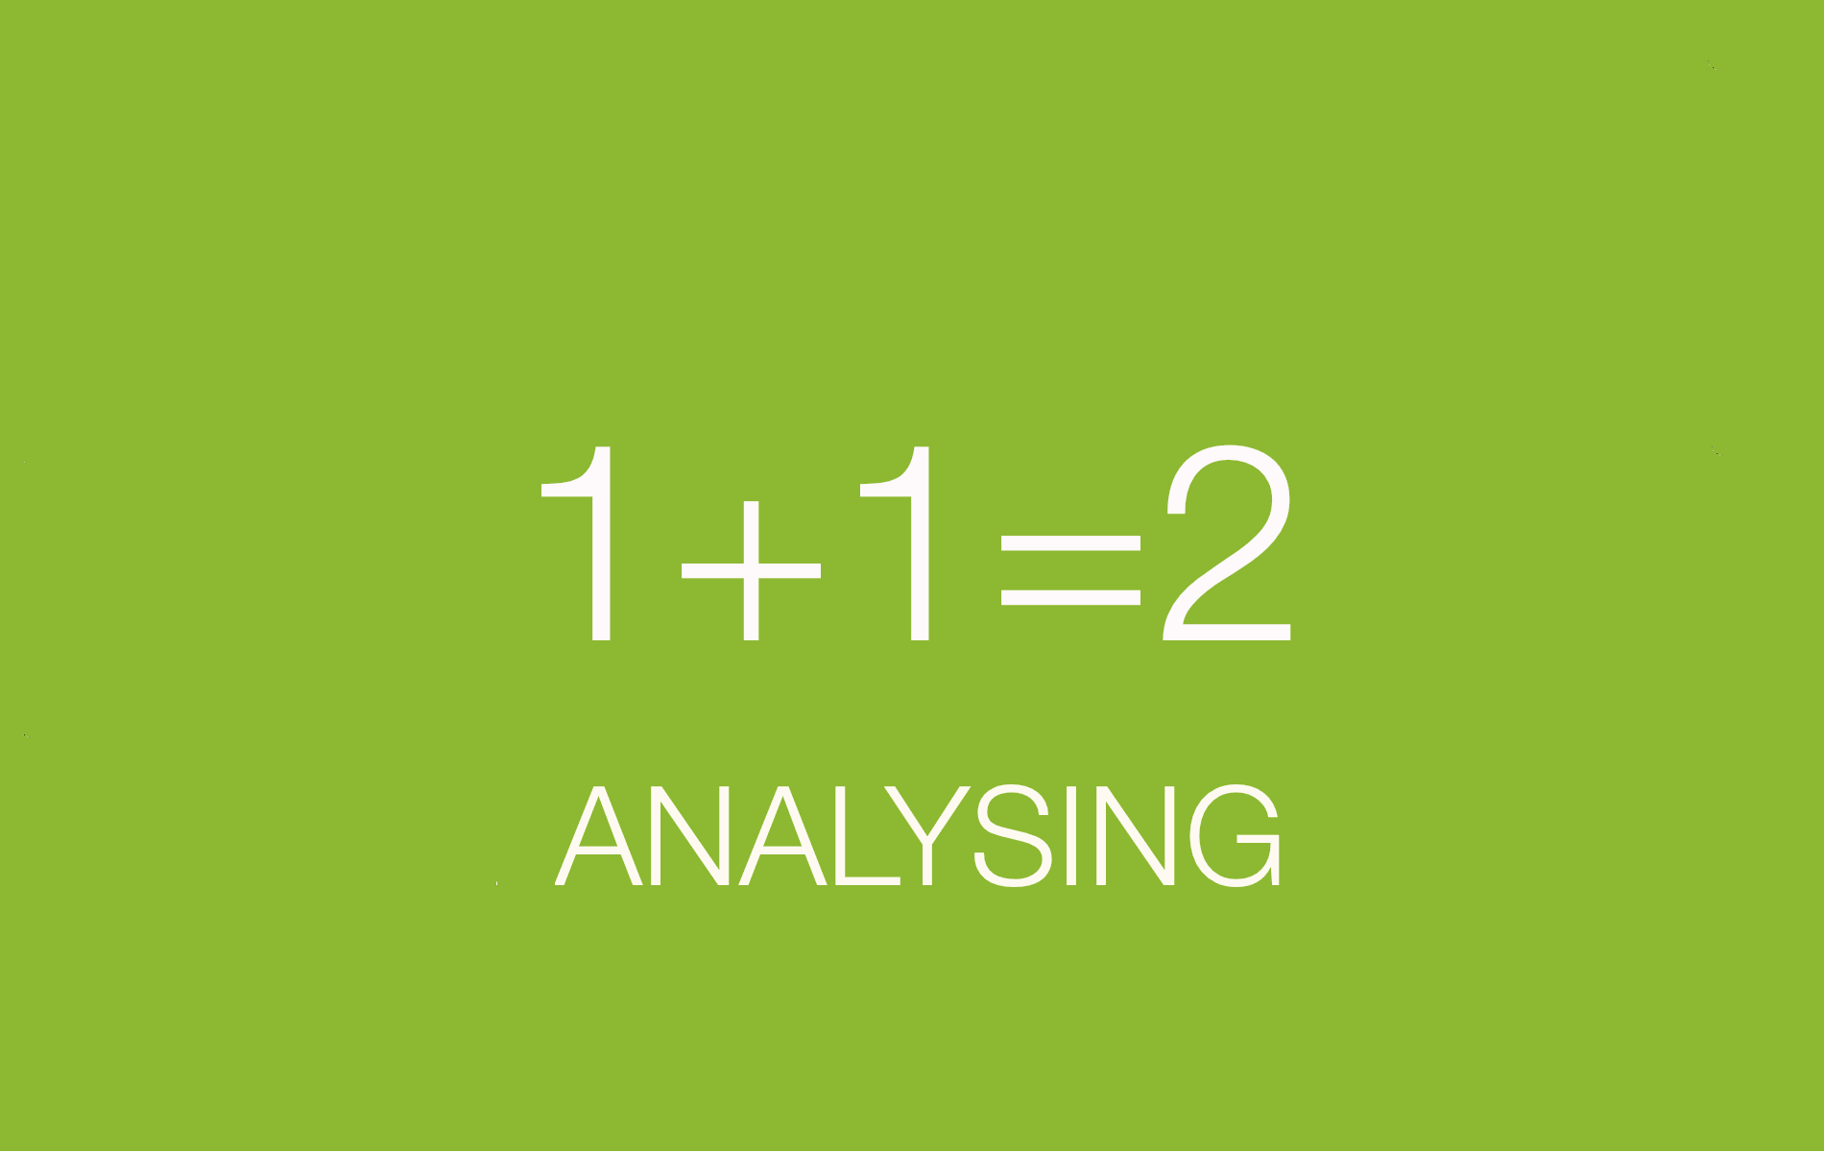

Slide 4


Slide 5


Slide 6


Slide 7


Slide 8


Government

Slide 9

Research topic #2: A usable spatial data publication platform

Slide 10
Multiple users
GIS experts and non geo users
Easy to use
Accessible
Community

Slide 11
