Slide 1

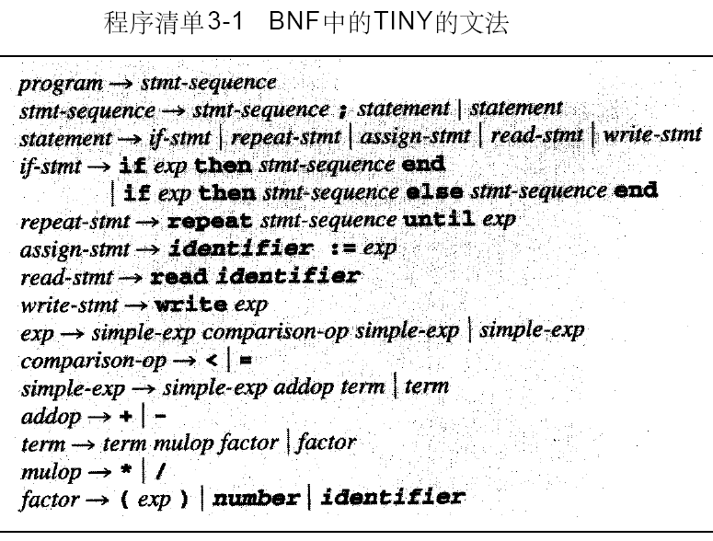
P97
TINY 样本语言的语法规则

Slide 2
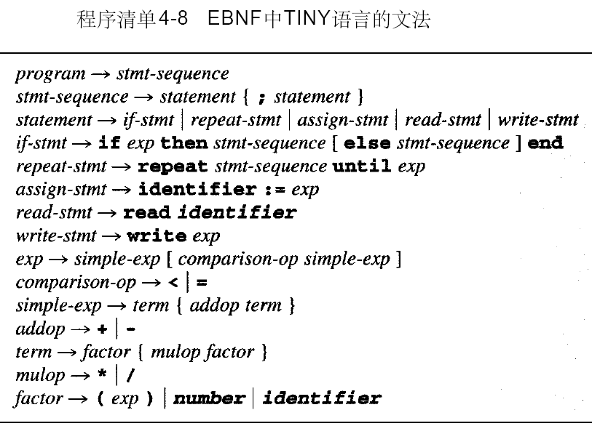
P136

Slide 3
附录B
P394
961: statement( )
977: if_stmt( )
991: repeat_stmt( )
PARSE.C

