Slide 1
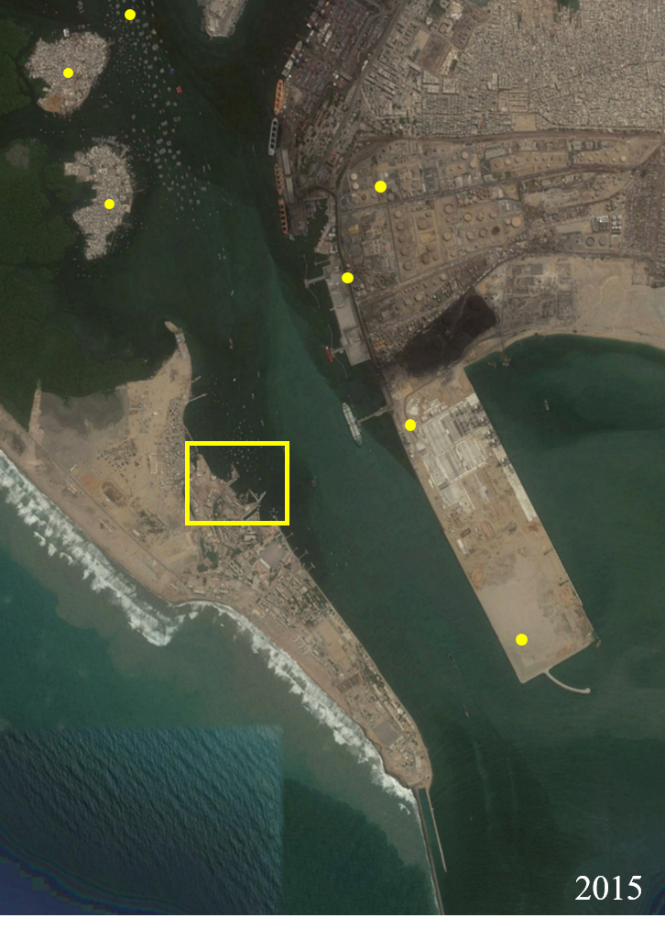
The last wave under the British Raj Haider Hasan Department of Civil Engineering NED University of Engineering & Technology

Slide 2
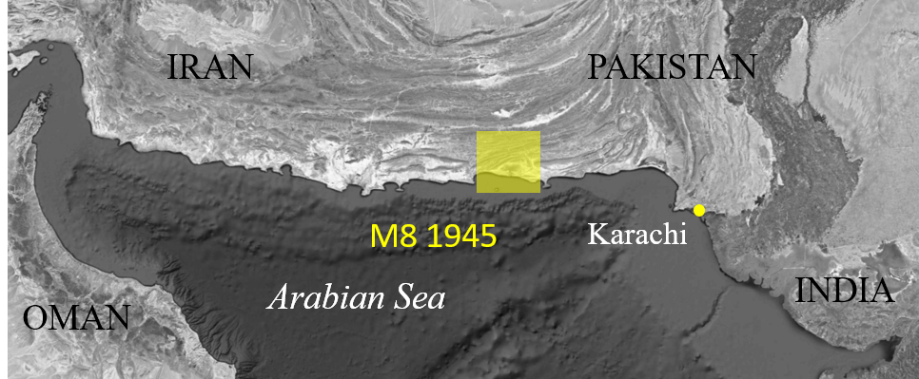
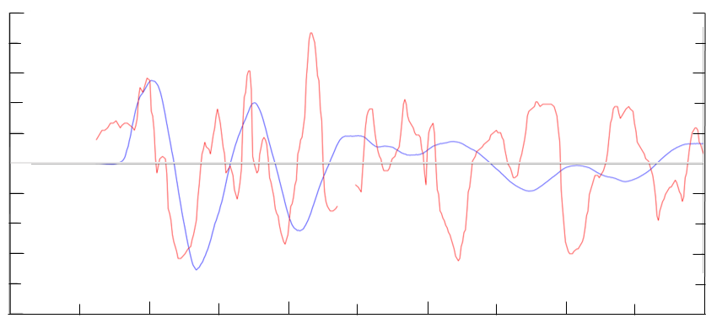
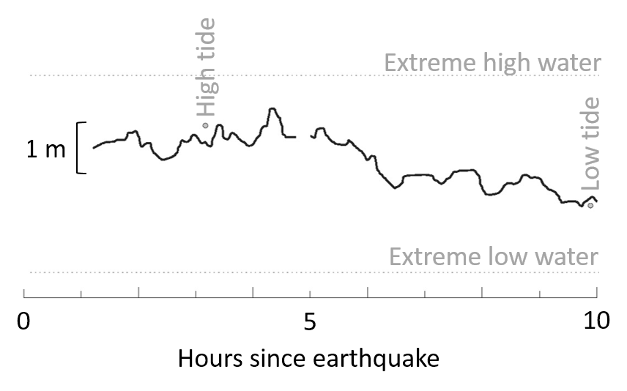
Delayed slide?
1 m
Detided marigram
Geoclaw purely tectonic
Incomplete marigram

