Slide 1

The U.S. Senate
Bob Hammond
Lawrence Yates
Lori Bruce

Slide 2

Database Plan
Create a database that contains information about the U.S. Senators

Slide 3


Source Data
.csv
html

Slide 4
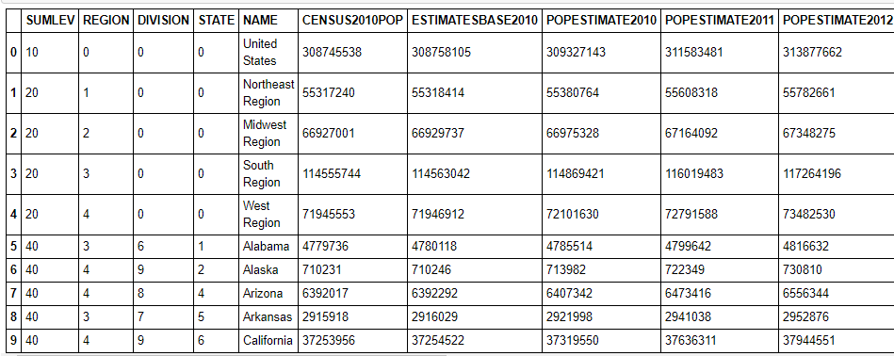
Original Content from the Census Bureau
Data Clean Up
Read the csv into a Pandas data frame
Reviewed the columns.
Captured the columns that would become part of the final csv.
Renamed the columns.
Checked the count and data types.
Dropped unnecessary rows.
Reindexed and renumbered columns.
Rearranged and renamed the columns to allow for a smooth transition into the new database.
Returned a clean csv file to the Resources folder.
Columns continued until year 2020 with 56 rows

Slide 5
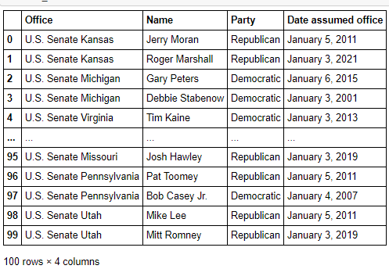
Content from the BALLOTPEDIA
Data Clean Up
Scraped the U.S. Senators from the Ballotpedia website by storing the URL in a Pandas data frame.
Grabbed the senators table from the website and stored it into a data frame.
Viewed the table and decided to split the content of the office column on the spaces between words.
Created two new columns and then split the state column which created another new column.
Dropped the unnecessary columns. Renamed the columns for smooth transition into the database.
Joined the two data frames and reviewed the content.
Converted the senator data frame into a cleaned csv.

Slide 6

Using PgAdmin we created the senator_db relational database and used SQL to create the tables and set the primary keys.
Using jupyter notebook we added code to connect to the database and populate the tables.
We then performed a few queries to validate the usability of the newly created database.

