Slide 1
HIP.markets
Community-backed HIP-3 markets on Hyperliquid.
Fund the market operator. Share the builder fees.
HIP.markets hackathon submission | 01

Slide 2
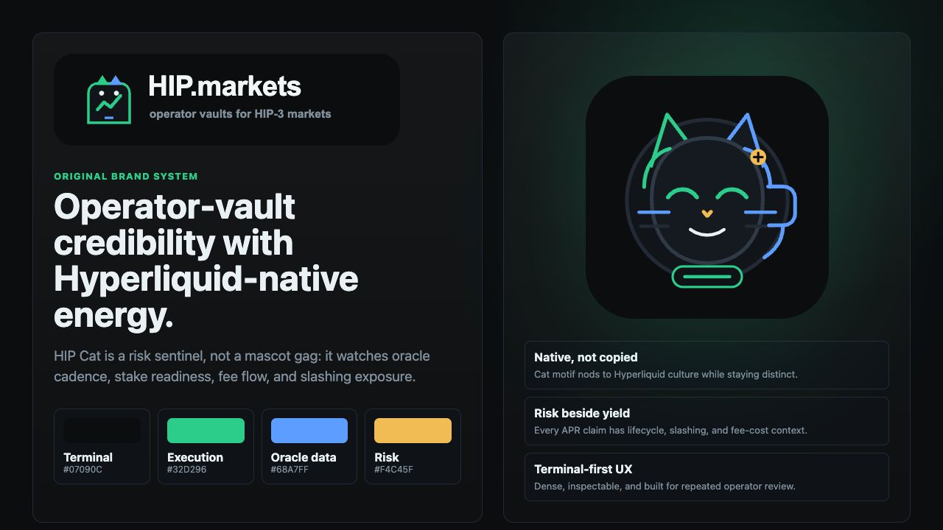
Brand System
Original terminal-native brand for an operator-vault product.
HIP Cat is a risk sentinel, not a yield mascot.
Mint = execution, blue = oracle data, amber = risk.
HIP.markets hackathon submission | 02

Slide 3
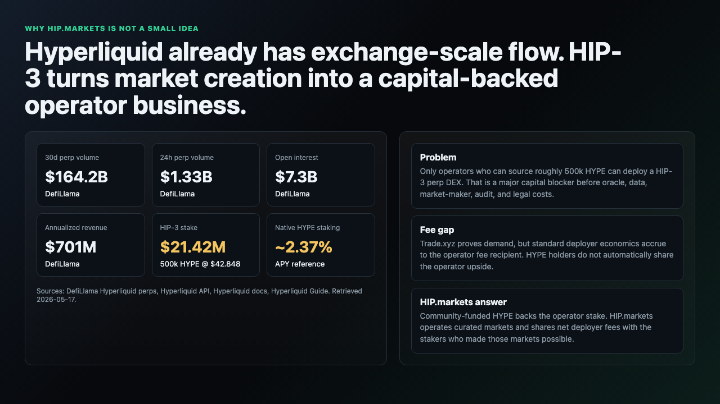
Hyperliquid Is Already Exchange-Scale
DefiLlama reference: $164.2B 30d perp volume, $1.33B 24h perp volume, and $7.3B open interest.
HIP-3 builders are plugging into proven exchange-scale flow, not an empty ecosystem.
The question is who can finance, operate, and risk-manage new markets.
HIP.markets hackathon submission | 03

Slide 4
The 500k HYPE Blocker
HIP-3 mainnet requires 500,000 HYPE staked per perp DEX.
At $42.848 HYPE, that is roughly $21.42M before oracle, maker, data, legal, audit, and incident costs.
HIP.markets turns that blocker into a community-backed operator stake.
HIP.markets hackathon submission | 04

Slide 5
Why HYPE Holders Care
Current HYPE staking references are around 2.37% APY.
HIP.markets offers higher-risk exposure to net deployer fees from markets that stakers help enable.
This is exchange-operator underwriting, not passive liquid staking.
HIP.markets hackathon submission | 05

Slide 6
Operator Fees Should Not Be Invisible
Trade.xyz proves HIP-3 can attract real demand.
Under the standard operator model, deployer fees accrue to the operator fee recipient.
HIP.markets changes the design: community HYPE funds the stake, HIP.markets operates the DEX, and net deployer fees can flow back to stakers.
HIP.markets hackathon submission | 06

Slide 7
Jeff Yan-Inspired Product Bar
Do not look like a yield wrapper; look like an underwriting and operator business.
Treat 500k HYPE as a quality filter, not a loophole.
Reliability beats launch count: fewer markets, better oracles, clearer fee accounting.
HIP.markets hackathon submission | 07

Slide 8
Proof Flywheel
Capped HYPE commitments prove depositor demand.
First-three-market readiness proves operator judgment.
Oracle uptime and fee epochs prove reliability.
Net deployer fees prove economic value and attract more HYPE and maker depth.
HIP.markets hackathon submission | 08

Slide 9
The Problem
HIP-3 DEXs need 500,000 HYPE staked.
Stake is only the start: operators also need oracles, liquidity, risk controls, and fee accounting.
Stakers need slashing risk beside APR.
HIP.markets hackathon submission | 09

Slide 10
Product Thesis
HIP.markets is not passive liquid staking.
HIP.markets is the operator.
Users back the HIP.markets deployer stake and share net deployer fees.
HIP.markets hackathon submission | 10

Slide 11
Why Now
Hyperliquid has moved from one exchange into market infrastructure.
HIP-3 lets specialist operators list new perpetual markets while HyperCore provides execution rails.
The bottleneck shifts to capital, oracle operations, and operator credibility.
HIP.markets hackathon submission | 11

Slide 12
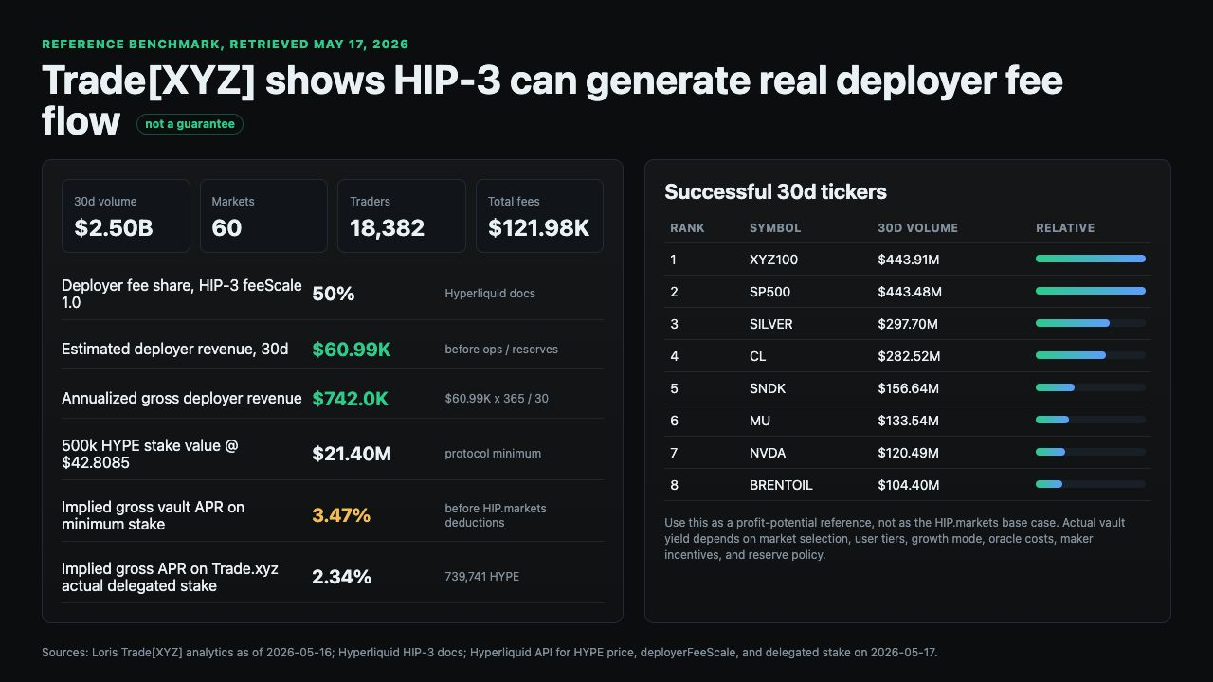
Trade.xyz Reference
60 markets, $2.50B 30-day volume, and $121.98K total 30-day fees.
Estimated deployer revenue: $60.99K over 30 days before operating costs.
Gross implied APR: 3.47% on the 500k HYPE minimum stake at $42.8085 HYPE.
HIP.markets hackathon submission | 12

Slide 13
Successful Market Pattern
Trade.xyz's highest-volume tickers are not only crypto assets.
XYZ100 and SP500: roughly $444M each over 30 days.
SILVER, CL, SNDK, MU, NVDA, BRENTOIL, CBRS, INTC, and GOLD show RWA-style breadth.
HIP.markets should launch where oracle confidence, liquidity, and narrative demand overlap.
HIP.markets hackathon submission | 13

Slide 14
Revenue Interpretation
HIP-3 deployer share is fixed at 50% from the deployer perspective.
Trade.xyz reports deployerFeeScale = 1.0.
Gross revenue is not distributable profit until oracle, data, maker, legal, reserve, and incident costs are deducted.
HIP.markets hackathon submission | 14

Slide 15
UI Benchmark
trade.xyz proves serious HIP-3 markets need trading-terminal density.
Useful patterns: market rail, order ticket, positions tabs, account modes, Ghost Mode observability, explicit warnings.
HIP.markets hackathon submission | 15

Slide 16
UX Translation
Market rail -> first-three-market launch rail.
Order ticket -> HYPE deposit ticket.
Positions panel -> vault shares, fee history, oracle updates, market launches.
Ghost Mode -> operator monitor.
HIP.markets hackathon submission | 16

Slide 17
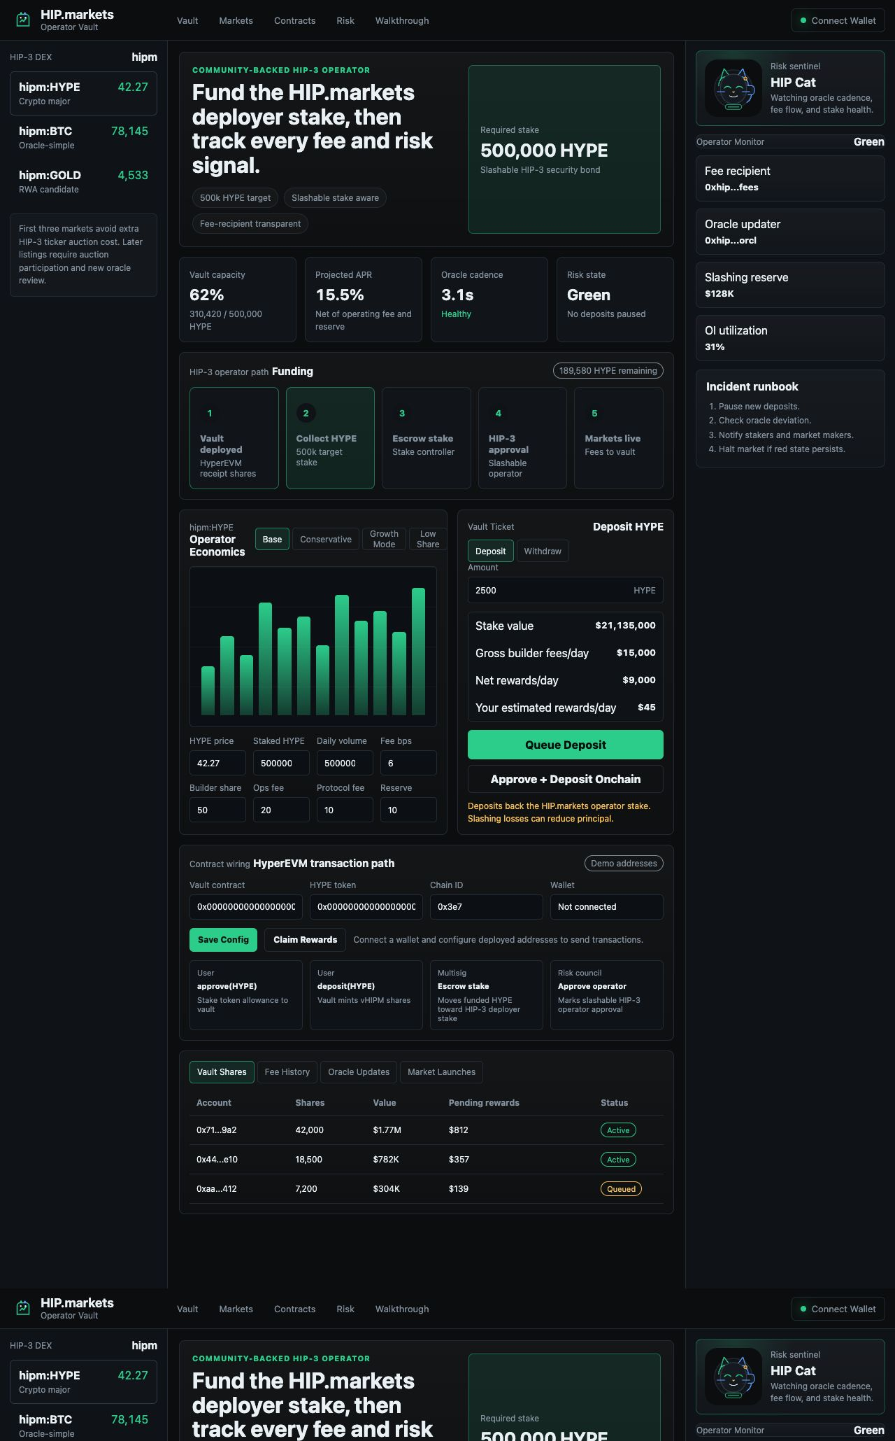
Demo Walkthrough
The first screen is the usable operator console, not a landing page.
Vault capacity, APR, oracle cadence, risk state, market rail, fee model, deposit ticket, and monitor are visible in one workflow.
HIP.markets hackathon submission | 17

Slide 18
Demo: Fee Model
Judges can change HYPE price, staked HYPE, daily volume, fee bps, builder share, operating fee, protocol fee, and reserve.
APR updates instantly.
HIP.markets hackathon submission | 18

Slide 19
Demo: Deposit Ticket
Mirrors a trading order pane.
Amount input, deposit/withdraw mode, fee summary, user rewards estimate, and slashing warning.
HIP.markets hackathon submission | 19

Slide 20
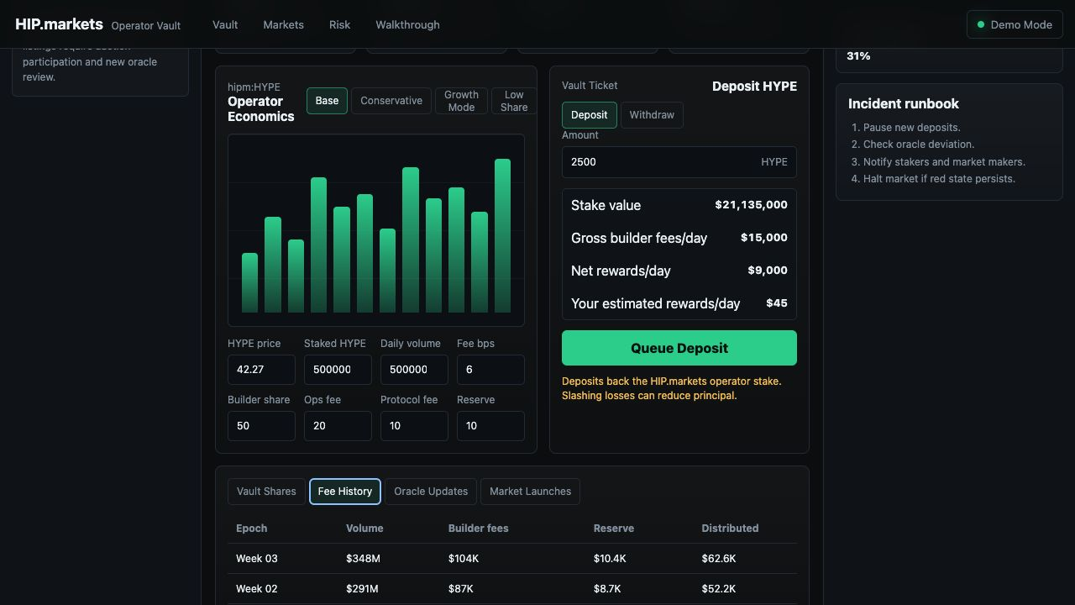
Demo: Audit Ledger
Fee sharing becomes an inspectable ledger.
Vault shares, fee history, oracle updates, and market launch readiness expose operator behavior.
HIP.markets hackathon submission | 20

Slide 21
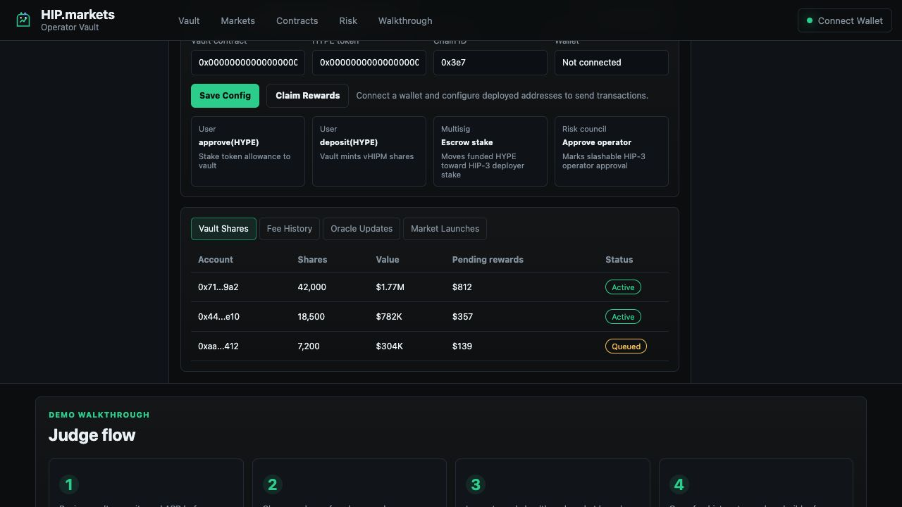
Demo: Contract Wiring
Wallet-aware flow: connect wallet, configure vault/token addresses, approve HYPE, deposit, and claim rewards.
The UI also shows which actions still require operator multisig and risk-council execution.
HIP.markets hackathon submission | 21

Slide 22
Contract Depth
Vault now models vHIPM receipt shares, vault caps, withdrawal queues, reward accounting, and slash losses.
Operator lifecycle: funding, stake-ready, stake-escrowed, approved, live, wind-down, and slashed.
Registry tracks launch checklist, fee epochs, oracle health, market status, and risk state.
HIP.markets hackathon submission | 22

Slide 23
System Flow
1. HYPE holders deposit into the HyperEVM vault.
2. Vault backs HIP.markets deployer stake.
3. Operator multisig escrows funded HYPE to the deployer stake controller.
4. Risk council records HIP-3 operator approval.
5. HIP.markets launches markets, traders generate fees, and net rewards distribute after deductions.
HIP.markets hackathon submission | 23

Slide 24
Economics
Base model: 500k HYPE, $50M daily volume, 6 bps fee, 50% deployer share.
After 40% operating/protocol/reserve deductions: approximately 15% net APR.
Trade.xyz trailing fees imply approximately 3.47% gross APR on the minimum stake.
Sensitivity matters more than headline APR.
HIP.markets hackathon submission | 24

Slide 25
Risk Controls
Start with oracle-simple markets.
Avoid extra ticker auction costs at launch.
Cap open interest, publish addresses, maintain reserve, pause deposits during incidents.
HIP.markets hackathon submission | 25

Slide 26
Cost Stack
The 500k HYPE stake is the entry ticket, not the full cost of business.
Budget for oracle relayers, licensed data, maker incentives, infrastructure, key management, audits, legal work, and incident reserves.
HIP.markets hackathon submission | 26

Slide 27
MVP
One HIP.markets-operated DEX.
One HYPE vault.
First three markets.
Weekly distributions.
Public dashboard.
No third-party operator financing.
HIP.markets hackathon submission | 27

Slide 28
Roadmap
V1: prove operator vault and fee sharing.
V2: more HIP.markets market vaults and automated fee verification.
V3: risk tranching, secondary shares, HIP-4, possible third-party financing once the trust model is mature.
HIP.markets hackathon submission | 28

Slide 29
Competitive Position
trade.xyz and HyENA operate markets directly.
HIP.markets also operates markets directly, but adds user-funded HYPE stake and transparent fee sharing.
The wedge is making HYPE holders economic backers of the operator.
HIP.markets hackathon submission | 29

Slide 30
Ask
HYPE holders for capped beta.
Market makers for first markets.
Oracle and data partners.
Security reviewers.
Hyperliquid feedback on custody and fee routing.
HIP.markets hackathon submission | 30

Slide 31
Closing
HIP.markets turns builder-deployed markets into a community-backed operator business.
The first job is operating markets safely.
HIP.markets hackathon submission | 31

