Slide 1

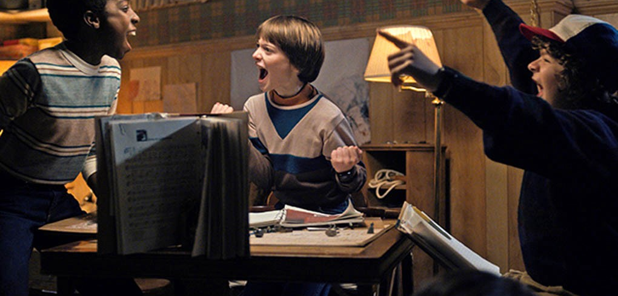
Bootcamp Project One
Heather, Jarvis, Alan

Slide 2
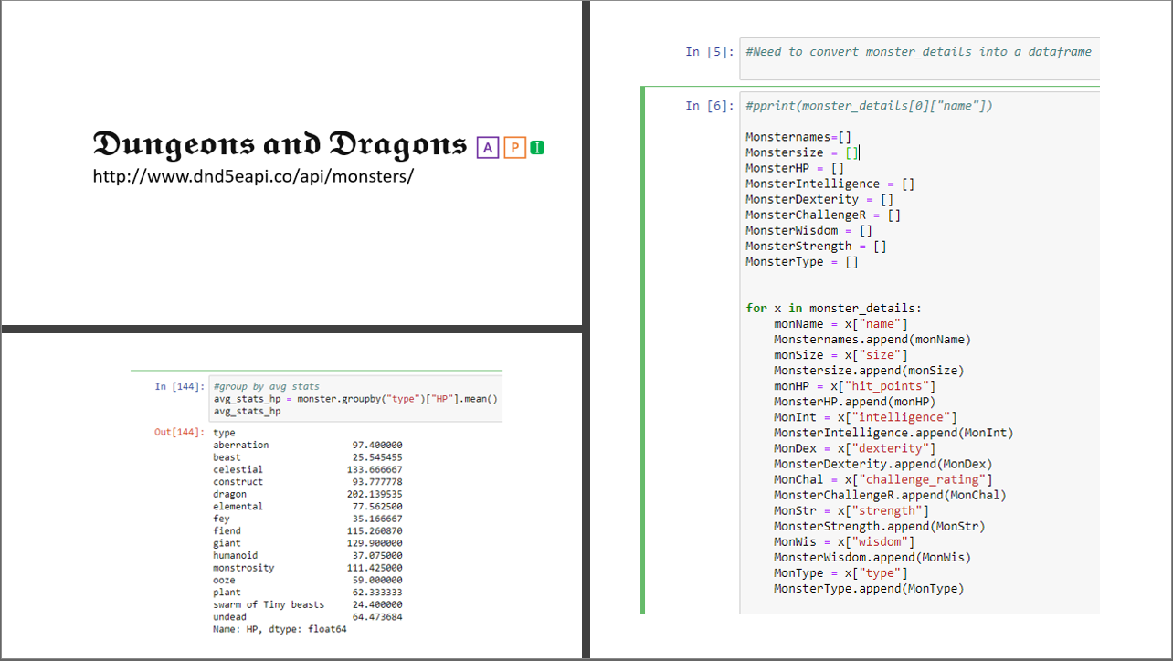

Slide 3

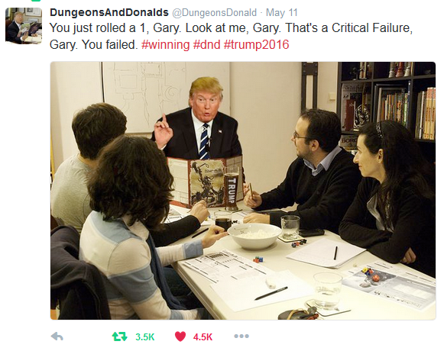

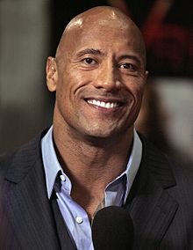
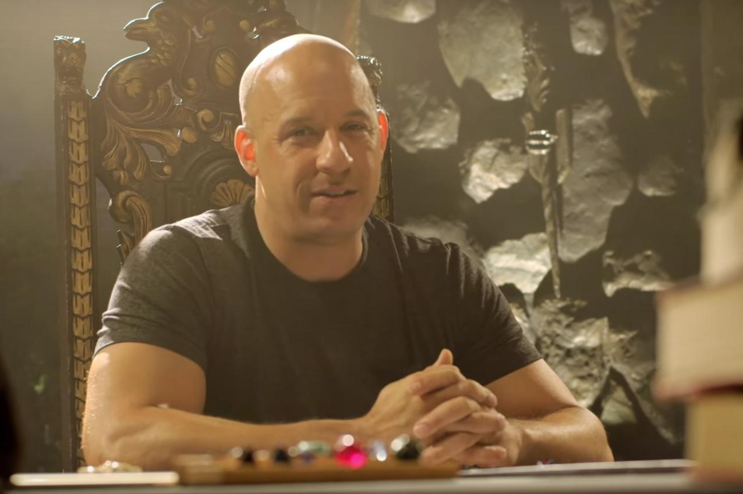

𝔚𝔥𝔞𝔱 𝔦𝔰 𝔇𝔲𝔫𝔤𝔢𝔬𝔫𝔰 𝔞𝔫𝔡 𝔇𝔯𝔞𝔤𝔬𝔫𝔰

Slide 4

🅸🅼🅰🅶🅸🅽🅴

Slide 5
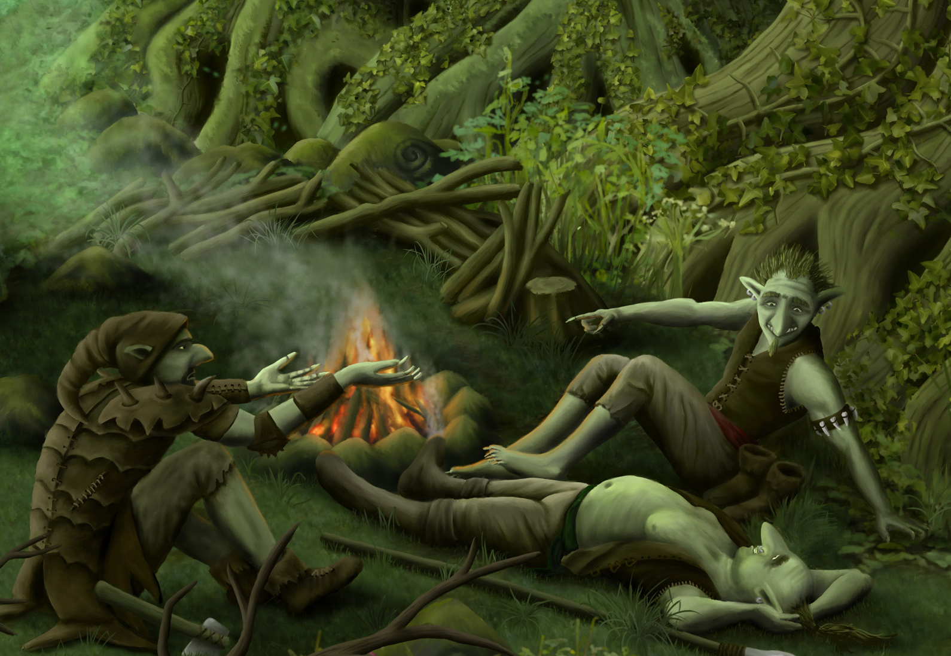


Slide 6
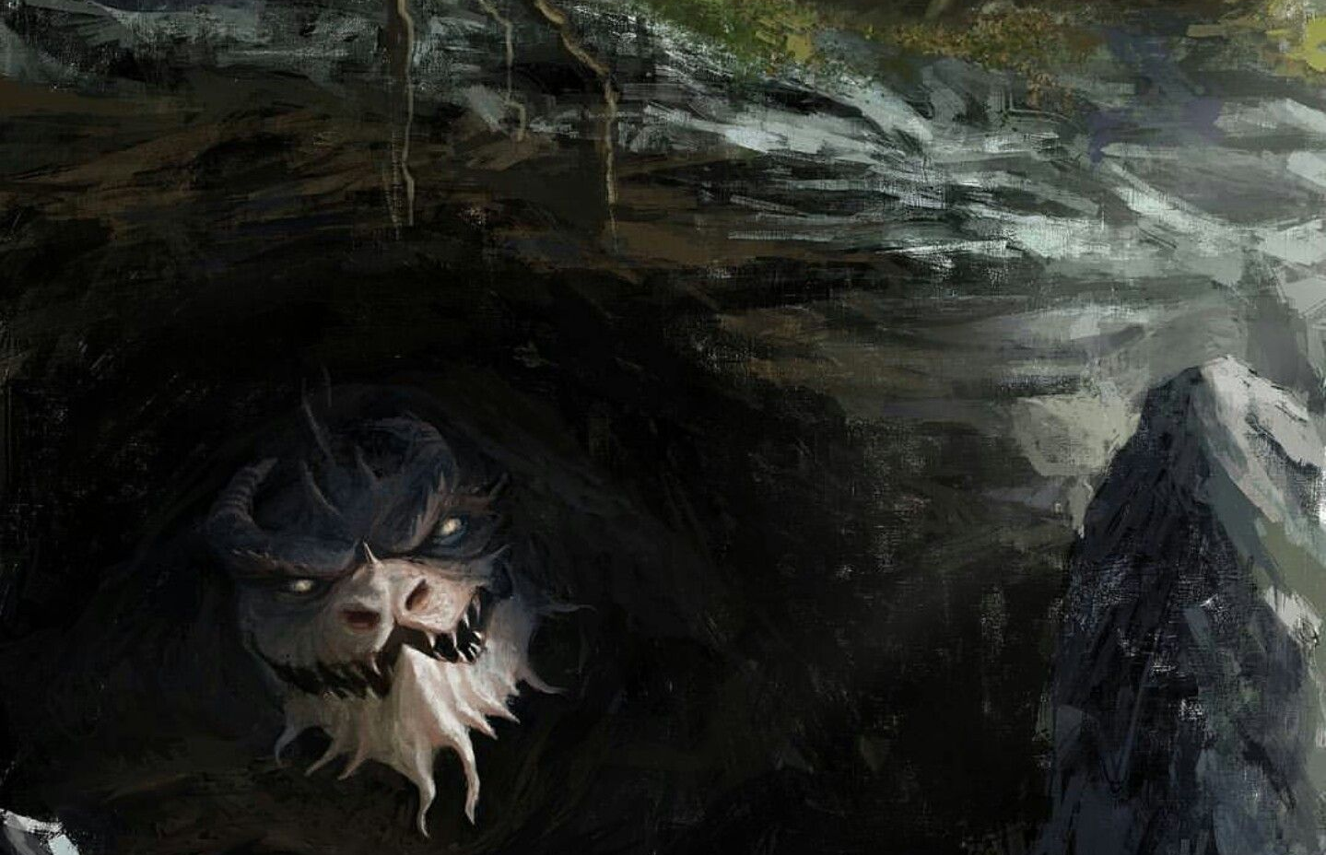

Slide 7

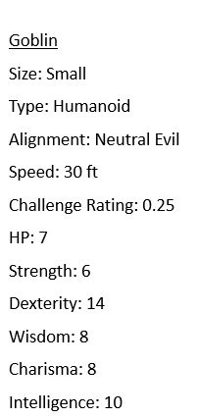
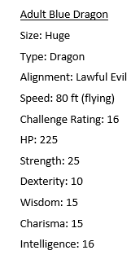
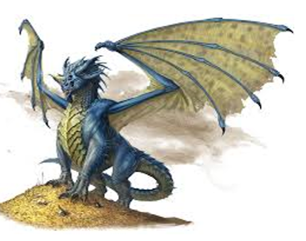
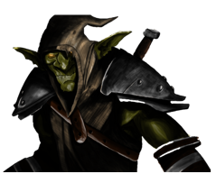

Slide 8

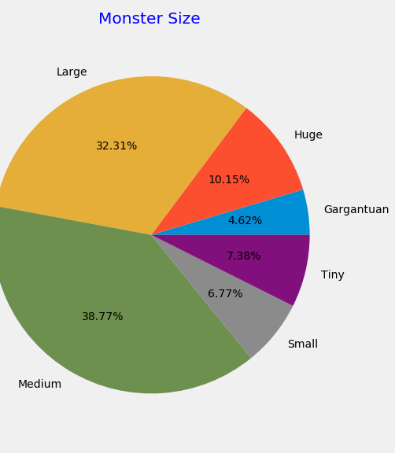
Group by Monster Size Categorization and representing Count
Breakout understanding compared to initial assumptions.
What does this data tell us about D and D base monster breakout and how can that impact games?

Slide 9
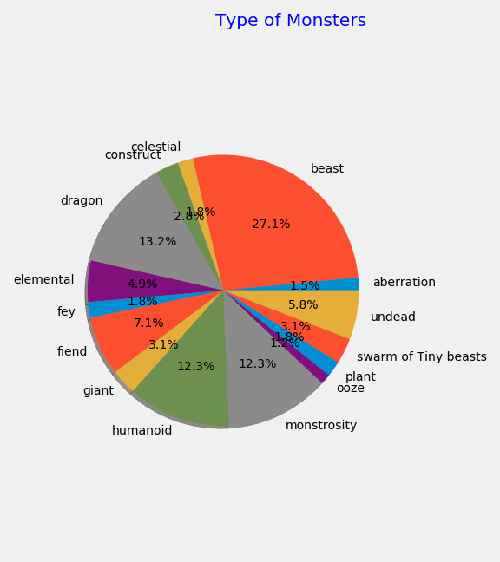
Grouped by Monster Types and representing counts of type
Breakout understanding compared to initial assumptions.
Impact to the game as a player.
Potential for the Dungeon Master to consider these probabilities when making their story come to life.

Slide 10

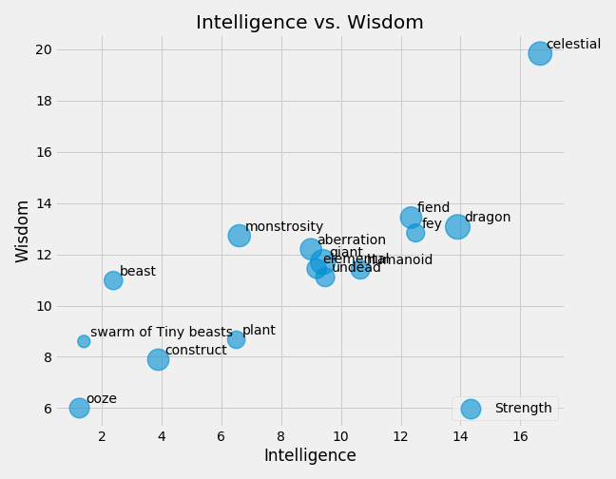
Grouped by Monster Types and representing mean of Wisdom, Intelligence, and Strength within the type
Questions we had:
Is there a correlation between wisdom and Intelligence?
Does Strength play a roll in intelligence and Wisdom?
Where is the general mean or mid point of Wisdom and Intelligence and who are the outliers?

Slide 11
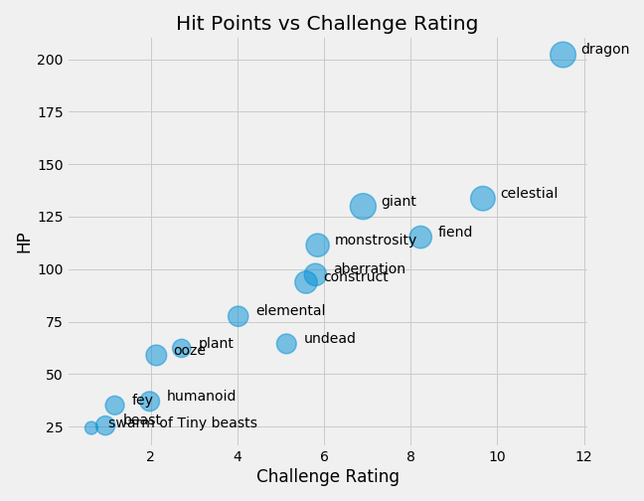
Grouped by Monster Types and representing mean of Hit Points and Challenge Rating.
Questions we had:
Is there a correlation between Hit Points and Challenge Rating?
Where is the general mean or midpoint of Wisdom and Intelligence and who are the outliers?

Slide 12
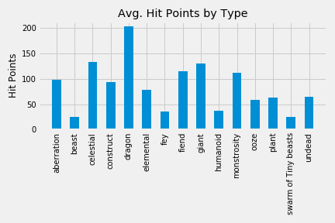


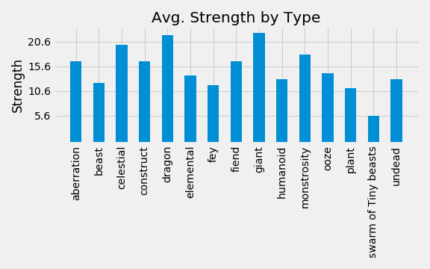
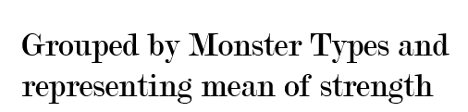
Questions we had:
Is there a correlation between Hit Points and Strength.
Where is the general mean or mid point of both Strength and Hit Points?
Do the strongest Monsters also have the highest HP on average?

Slide 13


While beasts and swarms of beasts make up almost a third of all monsters in the game Dragons and Celestials are the monsters you should be most concerned with since they are predominate outliers.
Intelligence is far more common then wisdom even in a game of make belief.
Ultimately we learned that there are a lot of cool monsters in Dungeons and Dragons that provide a solid foundation for any epic tale from start to end.

