Slide 2
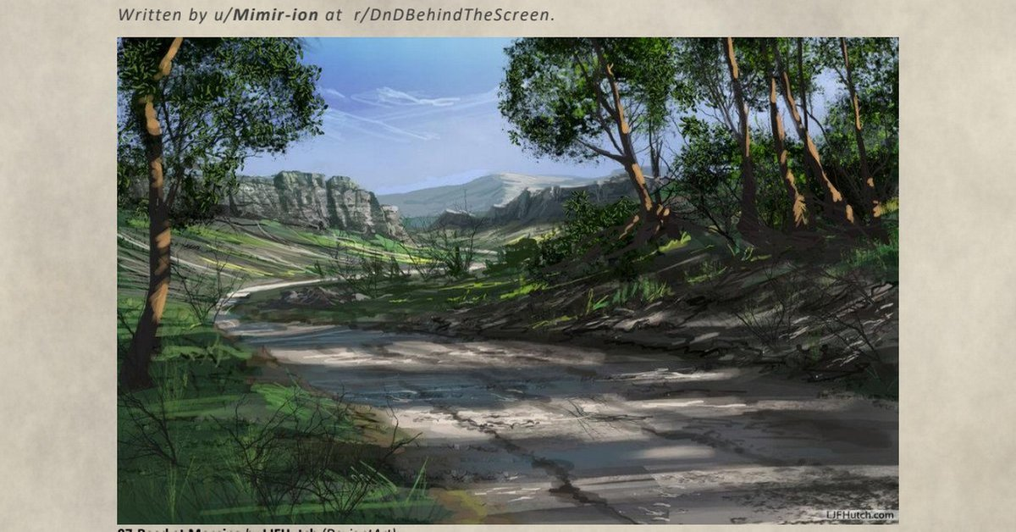
Imagine ….

Slide 3
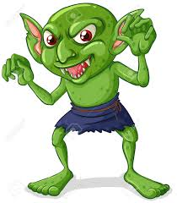
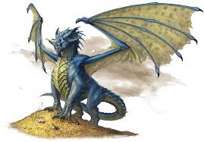
Monster count: 325
Adult Blue Dragon
Size: Huge
Type: Dragon
Alignment: Lawful Evil
Speed: 80 ft (flying)
Challenge Rating: 16
HP: 225
Strength: 25
Dexterity: 10
Wisdom: 15
Charisma: 15
Intelligence: 16
Goblin
Size: Small
Type: Humanoid
Alignment: Neutral Evil
Speed: 30 ft
Challenge Rating: 0.25
HP: 7
Strength: 6
Dexterity: 14
Wisdom: 8
Charisma: 8
Intelligence: 10

Slide 4
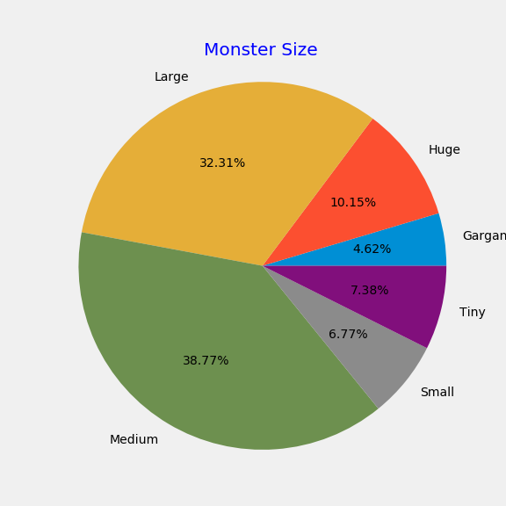
Size

Slide 5
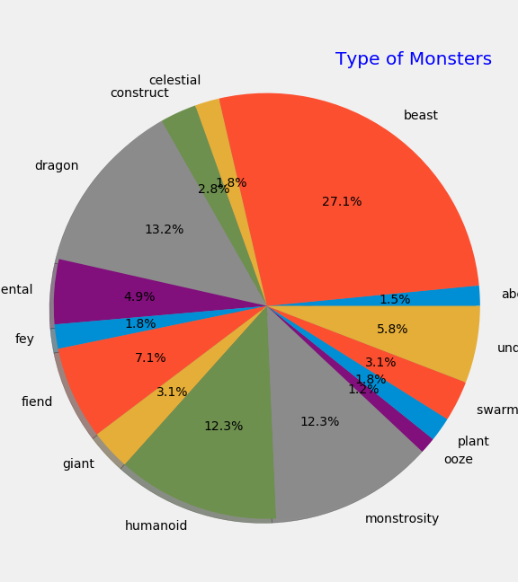
Group by monster type

Slide 6
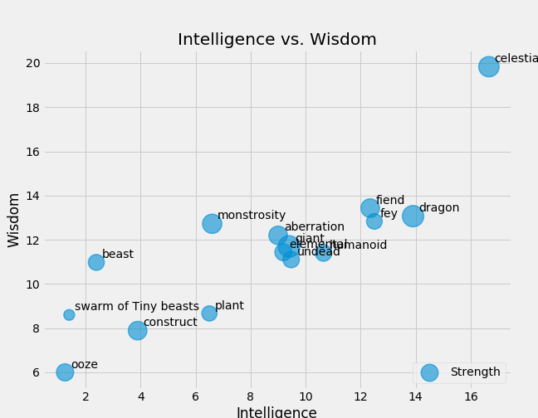
Strength by type

Slide 7
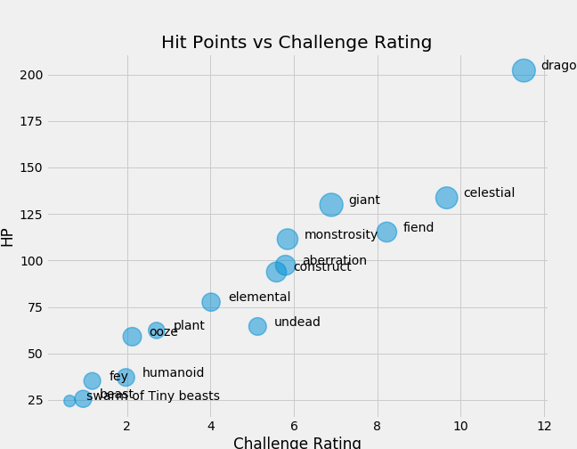

Slide 8
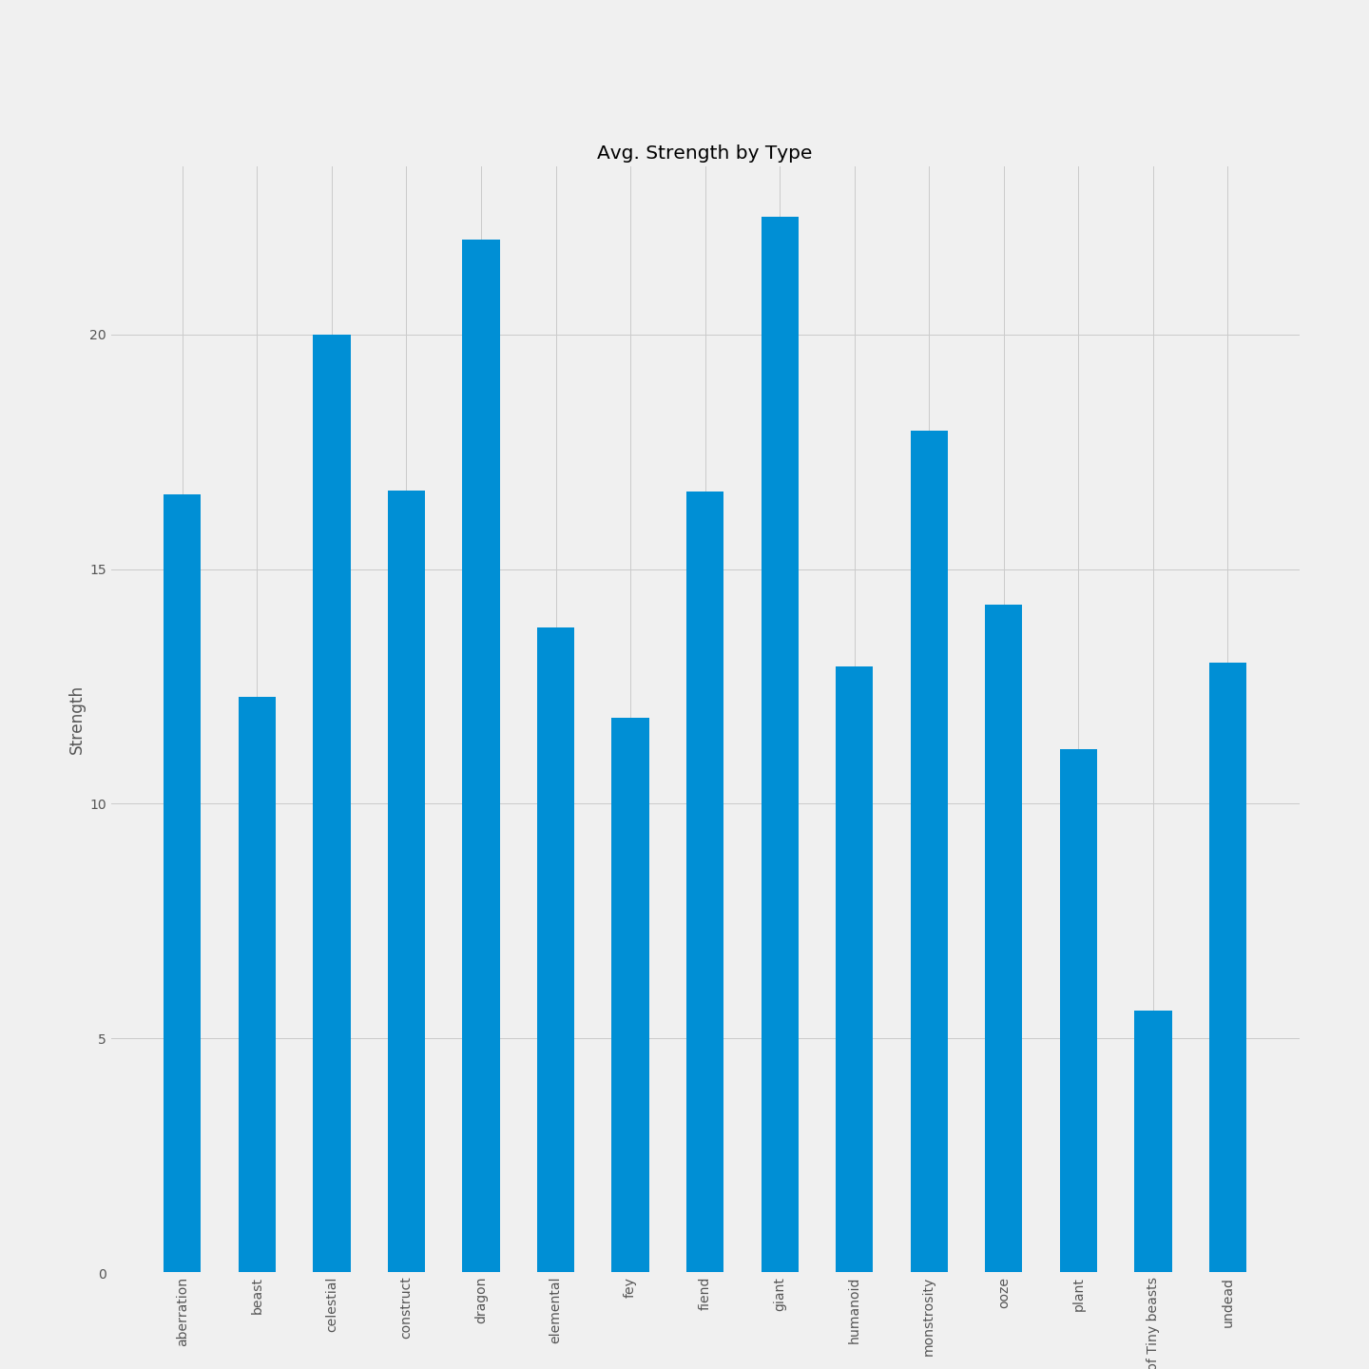
Strength by type

Slide 9
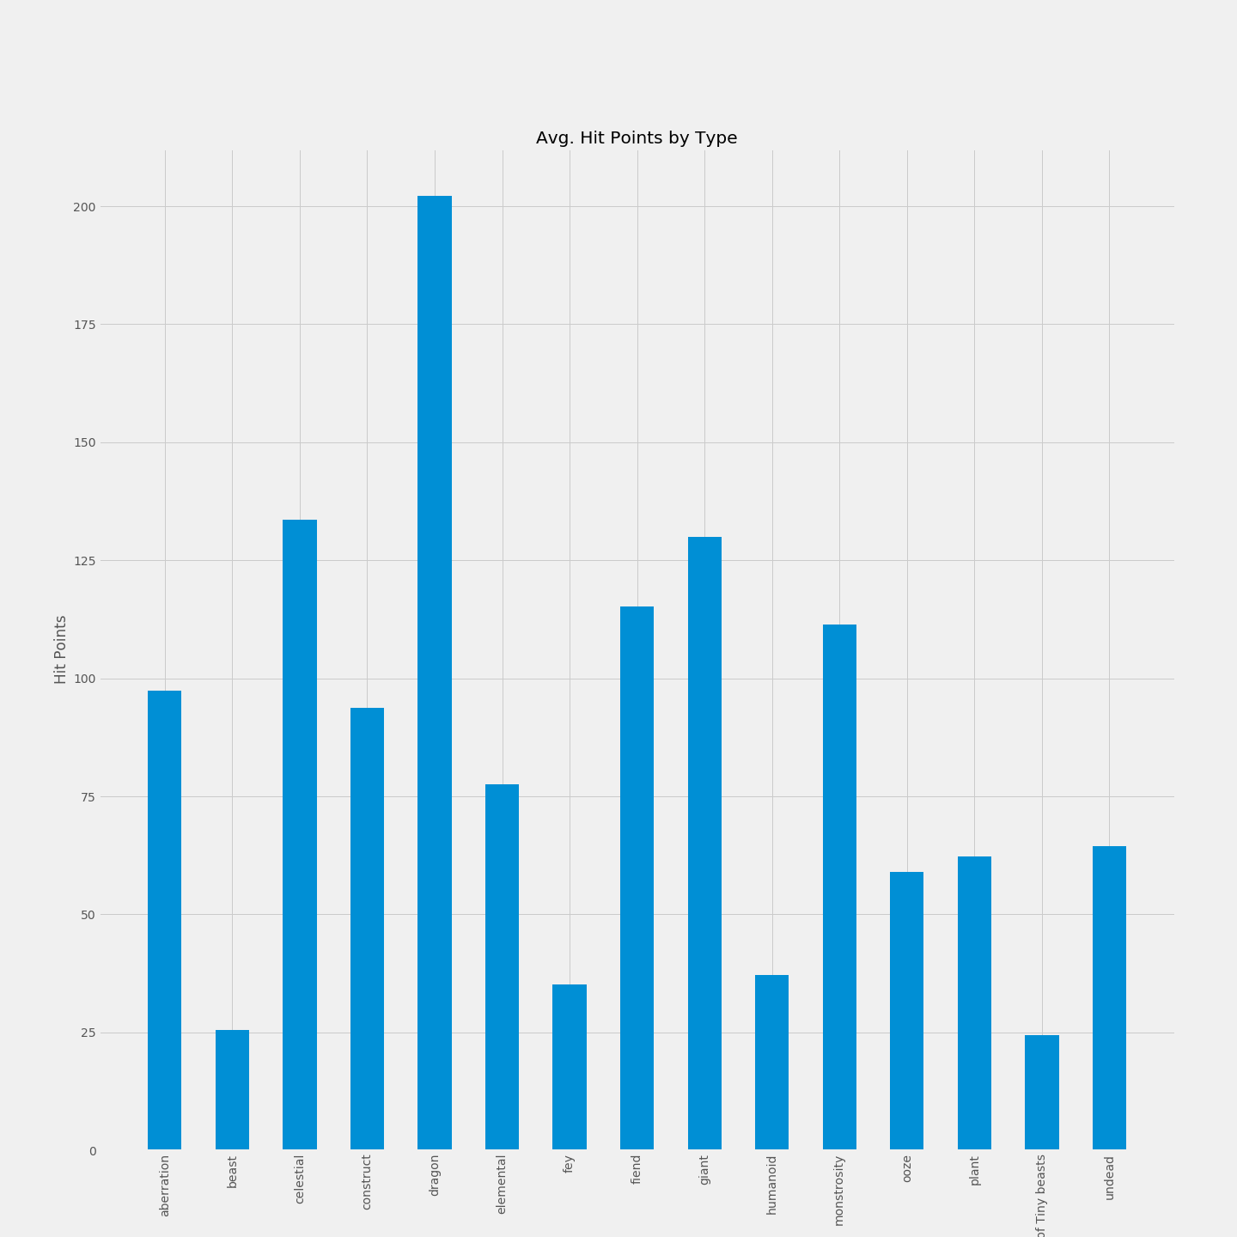
HP by type

Slide 10
Conclusions

