Slide 1
Differential Amplifier, Feedback, servo-control
Diff. Amp, e.g. INA105
READ BEFORE CLASS:
https://www.electrical4u.com/differential-amplifier/
+V
input
2
7
5, 6
3
1
4
-V
-10V
Offset, pot
+10V

Slide 2
Diff. Amp, e.g. INA105
+V
input
2
7
5, 6
3
1
4
-V
-10V
Offset, pot
+10V

Slide 3
Biax:
Let’s look at the vertical ram
Start with a balanced system, so that the servo error signal is zero. This means that the command and feedback are the same.
What is the output voltage of the DCDT ____
Now let’s look at what happens to the DCDT output when we offset the signal using just the offset pot.
After turning the pot 360° what is the output voltage of the DCDT ____
Is that what you expected?
Now let’s lock the ram –or just turn off the hyd. power supply.
After turning the pot 360° what is the output voltage of the DCDT ____ Is that what you expected?
+V
input
2
7
DCDT signal to servo amp
(servo feedback)
5, 6
3
1
4
-V
-10V
Offset, pot
+10V

Slide 4
Biax
Let’s look at the vertical ram
Where can the command originate?
__________________________
Where can the feedback originate?
__________________________
Let’s use Panel for the command and Disp for the feedback.
Start with a balanced system, so that the servo error signal is zero. This means that the command and feedback are the same.
Increase the voltage to the command.
What happens to the output voltage of the feedback (DCDT) ? _________
+V
Command
7
5, 6
to servo valve
1
4
Feedback
-V

Slide 5
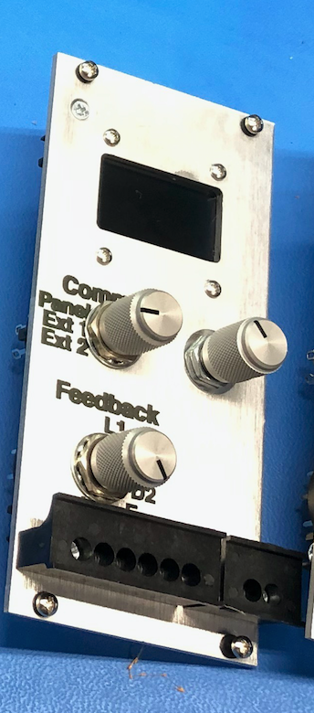
Biax
Let’s look at the vertical ram
Where can the command originate?
__________________________
Where can the feedback originate?
__________________________
Let’s use Panel for the command and Disp for the feedback.
Start with a balanced system, so that the servo error signal is zero. This means that the command and feedback are the same.
Increase the voltage to the command.
What happens to the output voltage of the feedback (DCDT) ? _________
+V
Command
7
5, 6
to servo valve
1
4
Feedback
-V

Slide 6
Biax
Now let’s send a continuously varying signal into the command
Let’s use Ext2 for the command and Disp for the feedback.
Start with a balanced system, so that the servo error signal is zero. This means that the command and feedback are the same.
Send in 10 digital counts per second
What happens to the output voltage of the feedback (DCDT) ? _________
+V
Command
7
5, 6
to servo valve
1
4
Feedback
-V

Slide 7
Biax
Now let’s look at what happens when we lock the system and change the command
Let’s use Ext2 for the command and Disp for the feedback.
Start with a balanced system, so that the servo error signal is zero. This means that the command and feedback are the same.
Lock the ram and then send in 1000 counts to the command.
Is it a good idea to unlock the ram right now? (yes/no)
What happens when you unlock?
What is the output voltage of the feedback (DCDT) ? _________
+V
Command
7
5, 6
to servo valve
1
4
Feedback
-V

Slide 8
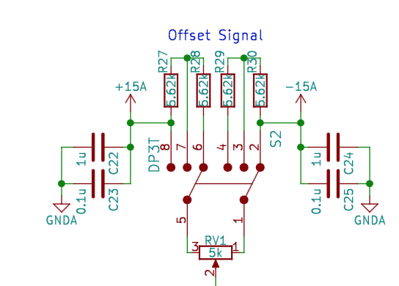
+V
input
2
7
5, 6
3
1
4
-V
Homework
Analyze this circuit and determine the voltage at:
Pin 1 in switch position 1, 2 and 3
Pin 5 in switch position 1, 2 and 3

Slide 9
Diff. Amp, e.g. INA105
+V
input
2
7
5, 6
3
1
4
-V

