Slide 1
p5475 – Overview
Problem: Perm. = 0 during p5369. No change in perm. in response to NS & PP oscillations.
Purpose: Measure permeability & oscillate pore pressure in ex-situ fractured sample used for p5369.
Question: Can the observation in p5369 be replicated using the same WG fractured sample?

Slide 2
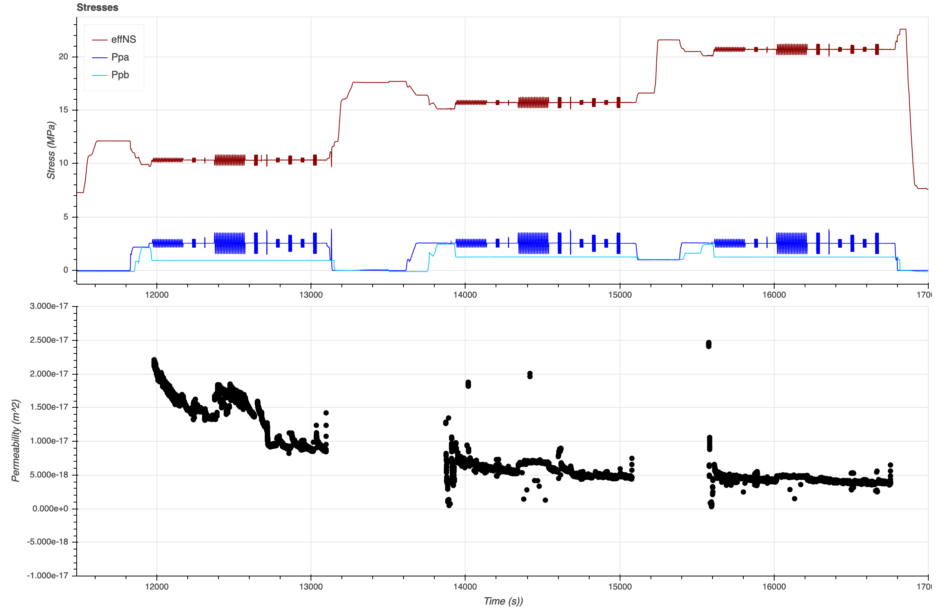
Abridged version of PP oscillation protocol from p5369.
Flow too quick @ 5MPa
Steady-state flow condition: |ΔQ|/Qa ≤ 5%

Slide 3
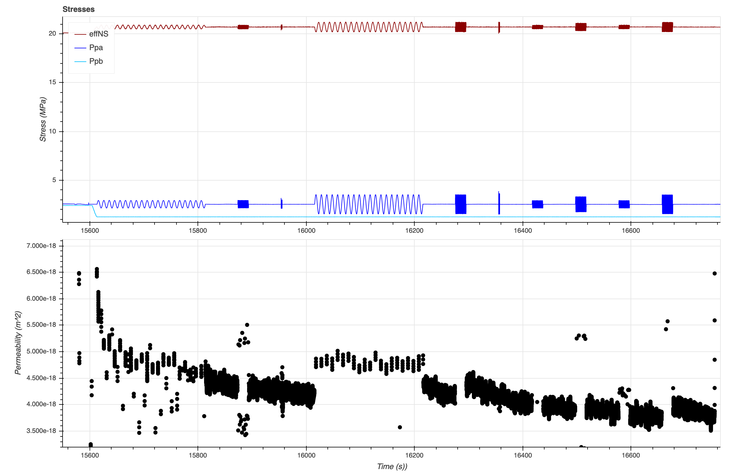
0.1 Hz
1 Hz
10 Hz

Slide 4
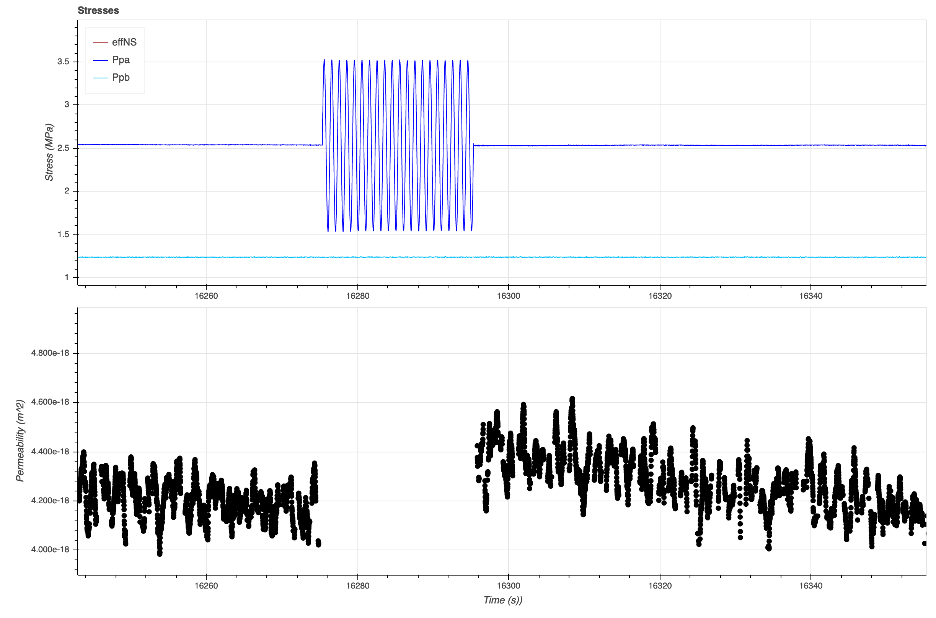
1 Hz, 1 MPa
Great, this is familiar!

Slide 5
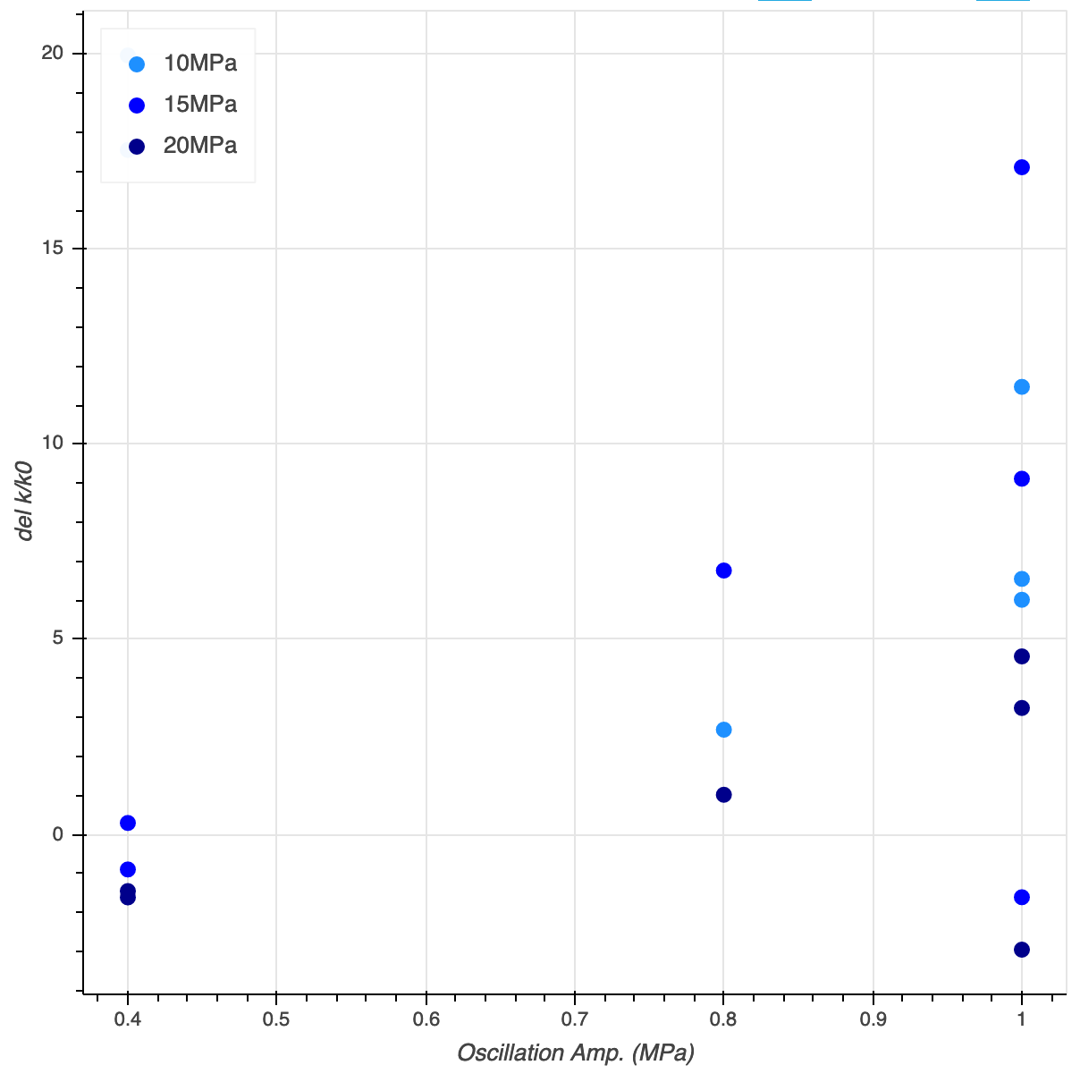

Slide 6
Experimental Plan – p5369
5, 10, 15, 20 MPa
Run 1: Amp1, Amp2, Amp3
Run 2: F1, F2
Run 3: Amp2, F2
Run 4: Amp4, Amp5, Amp6
Run 5: F3, F4
Run 6: Amp5, F4
Normal Stress Oscillations
Amp1 = [0.2, 0.4, 0.6, 0.4, 0.8, 0.4, 1.0] MPa @ 0.1 Hz Amp2 = [0.2, 0.4, 0.6, 0.4, 0.8, 0.4, 1.0] MPa @ 1.0 Hz Amp3 = [0.2, 0.4, 0.6, 0.4, 0.8, 0.4, 1.0] MPa @ 10 Hz
F1 = [0.1, 1.0, 10] Hz @ 0.4 MPa F2 = [0.1, 1.0, 10] Hz @ 1.0 MPa
Pore Pressure Oscillations
Amp4 = [0.2, 0.4, 0.6, 0.4, 0.8, 0.4, 1.0] MPa @ 0.1 Hz Amp5 = [0.2, 0.4, 0.6, 0.4, 0.8, 0.4, 1.0] MPa @ 1.0 Hz Amp6 = [0.2, 0.4, 0.6, 0.4, 0.8, 0.4, 1.0] MPa @ 10 Hz
F3 = [0.1, 1.0, 10] Hz @ 0.4 MPa F4 = [0.1, 1.0, 10] Hz @ 1.0 MPa

Slide 7
Experimental Plan – p548x
Pore Pressure Oscillations
Amp1 = [0.2, 0.3, 0.4, 0.5, 0.4, 0.6, 0.4, 0.7, 0.4, 0.8, 0.4, 1.0]MPa @ 1.0 Hz
F1 = [0.1, 1.0, 5] Hz @ 0.4 MPa F2 = [0.1, 1.0, 5] Hz @ 1.0 MPa
10 MPa
Run 1: Amp1 Run 2: F1, F2
12.5 MPa
Run 3: Amp1 Run 4: F1, F2
15 MPa
Run 5: Amp1 Run 6: F1, F2
17.5 MPa
Run 7: Amp1 Run 8: F1, F2
20 MPa
Run 9: Amp1 Run 10: F1, F2
Estimated Time: ~ 45min/Run
Schedule
Day 1: Prep
Day 2: Run 1 - 4
Day 3: Run 5 -10
Day 4: Cleanup

