Slide 1
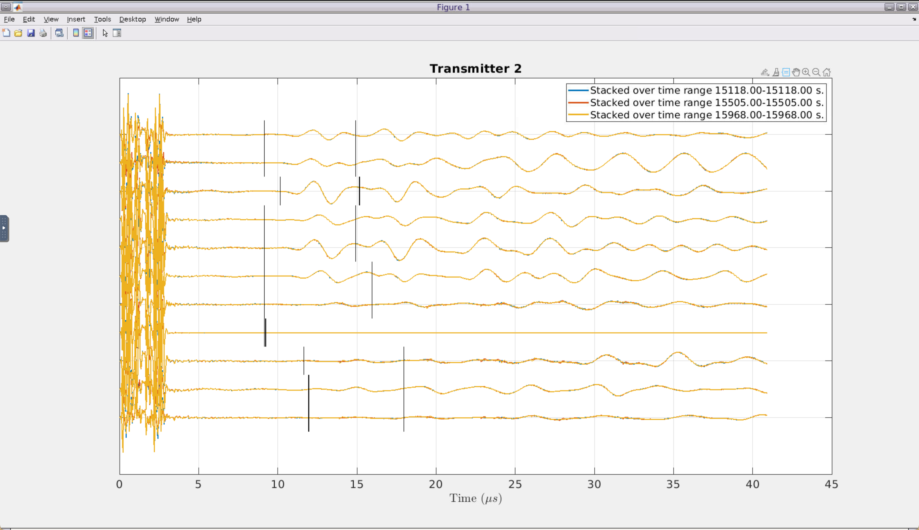

Slide 2
p5483
p5369
10
9
8
4
7
3
6
5
4
2
3
2
1
1
8
7
3
6
5
4
2
3
2
1
1

Slide 3
p5483 – run1
p5369b – run7

Slide 4
p5483 – run1
p5369b – run7

