Slide 1
Experimental Plan – p56XX
Sawcut @ 600 grit
NS Oscillations
Amp1 = [0.2, 0.3, 0.4, 0.5, 0.4, 0.6, 0.4, 0.7, 0.4, 0.8, 0.4, 1.0]MPa @ 1 Hz Amp2 = [0.2, 0.4, 0.6, 0.8, 1.0]MPa @ 1.0Hz x 2 [1, 1, 1, 1] MPa
PP Oscillations
Amp3 = [0.2, 0.3, 0.4, 0.5, 0.4, 0.6, 0.4, 0.7, 0.4, 0.8, 0.4, 1.0]MPa @ 1 Hz Amp4 = [0.2, 0.4, 0.6, 0.4, 0.8, 0.4, 1.0]MPa @ 1.0Hz
10 MPa
Run 1: Amp1 Run 2: Amp2 Run 3: Amp3 Run 4: Amp4
15 MPa
Run 5: Amp1 Run 6: Amp2 Run 7: Amp3 Run 8: Amp4
20 MPa
Run 9: Amp1 Run 10: Amp2 Run 11: Amp3 Run 12: Amp4
Schedule
Day 1: Prep
Day 2: Run 1 - 12
Day 3: Cleanup
Day 4: Buffer
~2.75 hrs./stress level

Slide 2
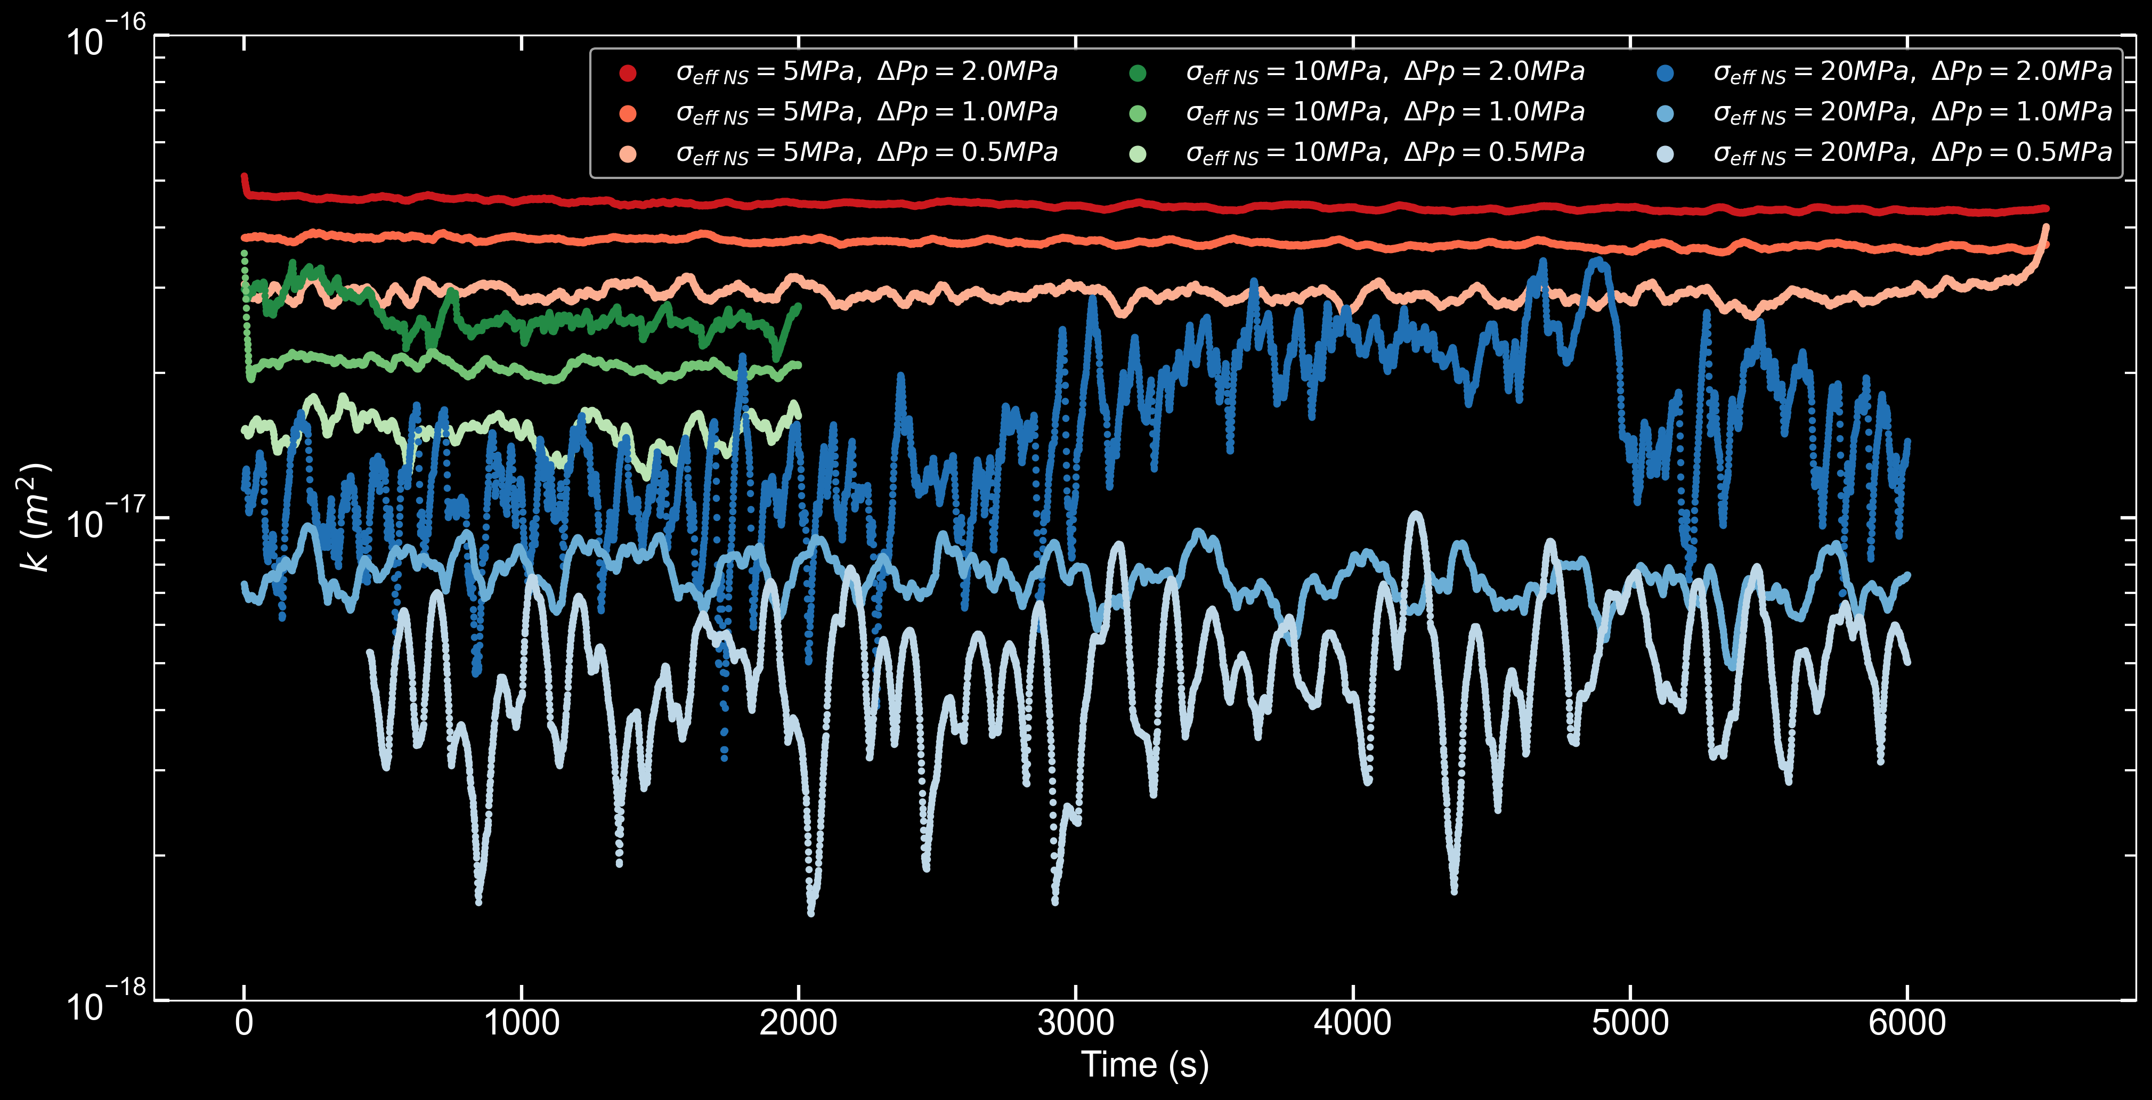
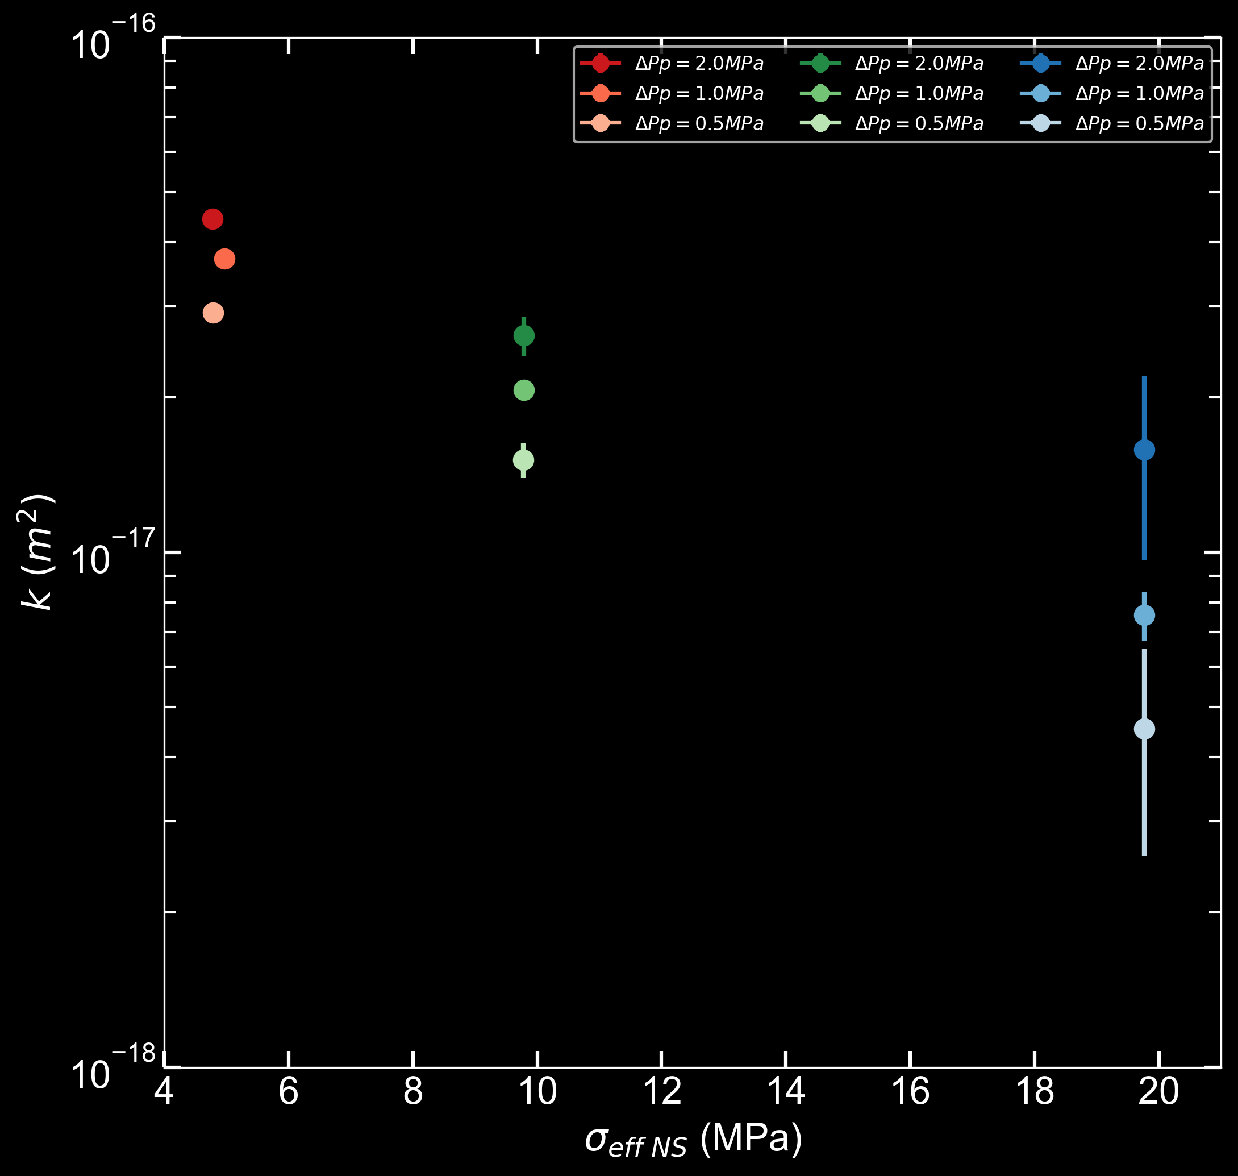
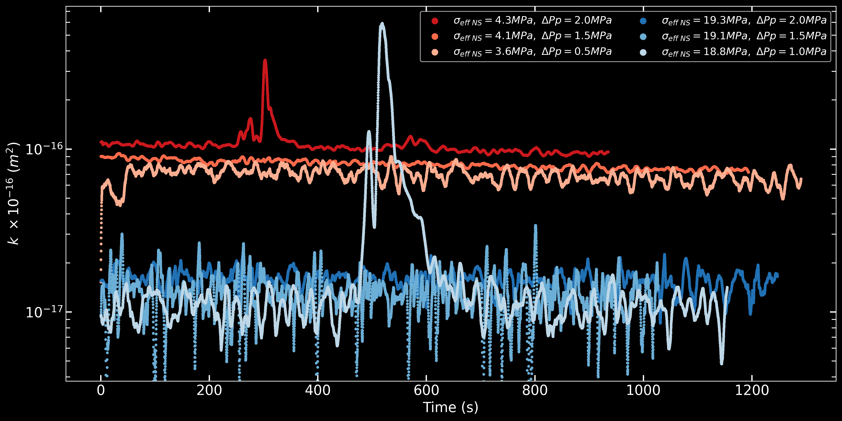
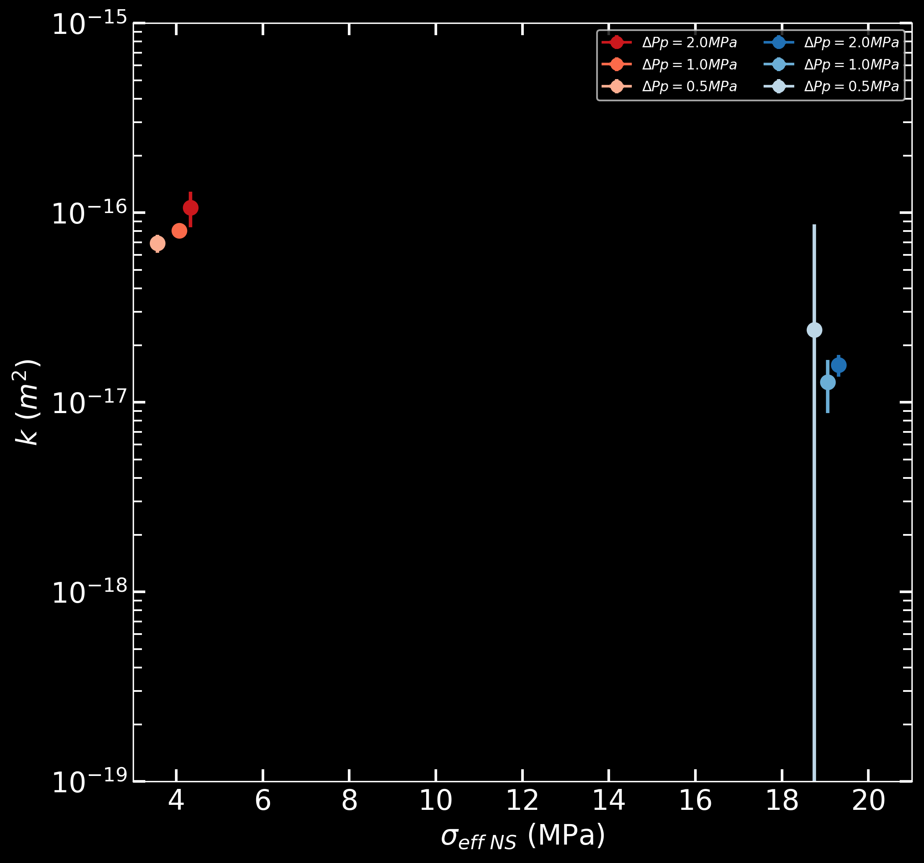
p5462
p5458

Slide 3
Relevant Info & Questions
Part of this project would be to use pressure sensitive film to characterize stress-area
This can inform which PZTs to use. I’’m thinking just the middle column will be sufficient
We’re at ~89% usage of database — maybe increase storage capacity (25TB to 30TB…?)
I plan to do this after AGU — 18-21 December. I can do the pressure sensitive film part this week.
Permeability — I’m going through some old slide decks to confirm, but yes I think that I’ve checked the permeability. It is very important, especially regarding Pp oscillations. I’ll talk more about this on Wednesday.
Oscillation Protocol and Amplitudes — Maybe I could modify Amp2,4 so that I focus on larger amplitudes. Irreversibility is most apparent at the larger oscillation amplitudes, so maybe just repeating 1MPa is sufficient.
Something like...
[1, 1, 1, 1, 1, 1, 1]MPa @ 1 Hz
OR
[0.8, 1, 0.8, 1, 0.8, 1]MP @ 1 Hz
Stress Levels — My main motivation for 3 stress levels is to keep the experiment short enough to be completed in 1 day to prevent unnecessarily long holds and/or load/reloads. After I use pressure sensitive film, I will have a better idea if small changes in contact area are resolvable.

