Slide 1
Experiments p5607 & p5608 – A quick look
 | p5607 | p5608
Roughness | Sawcut @ 600 grit
Osc. Type | NS | Pp
Directory Size | 1557179138 Bytes | 1628900162 Bytes
Receivers
Transmitters

Slide 2
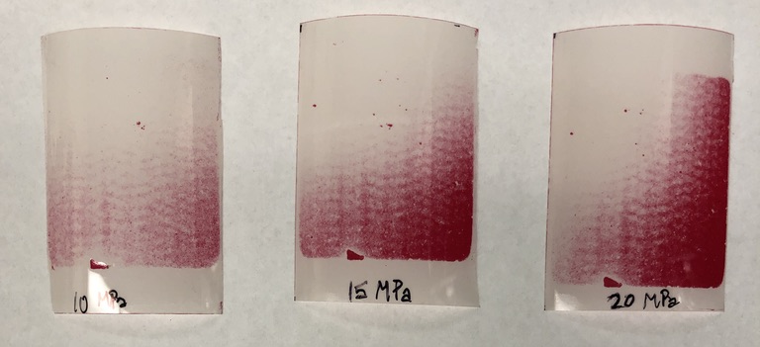
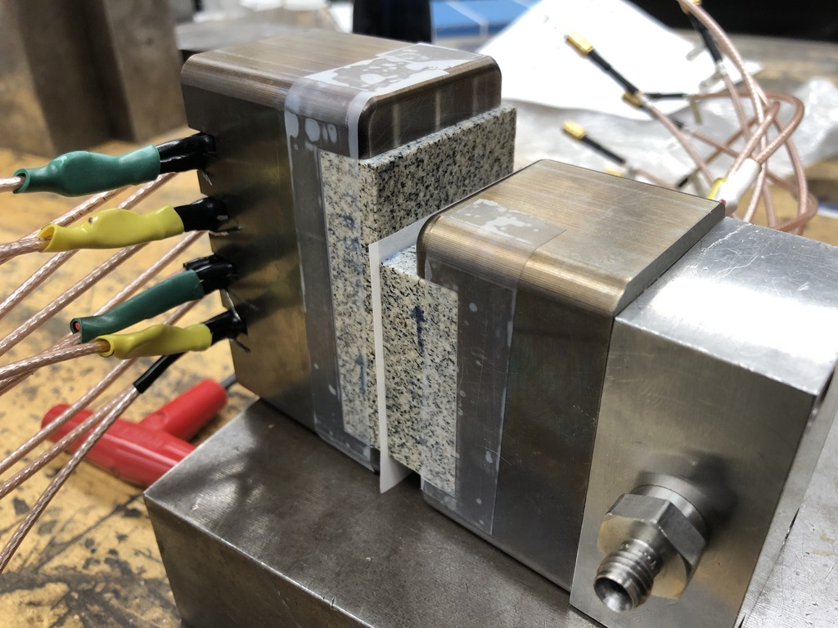
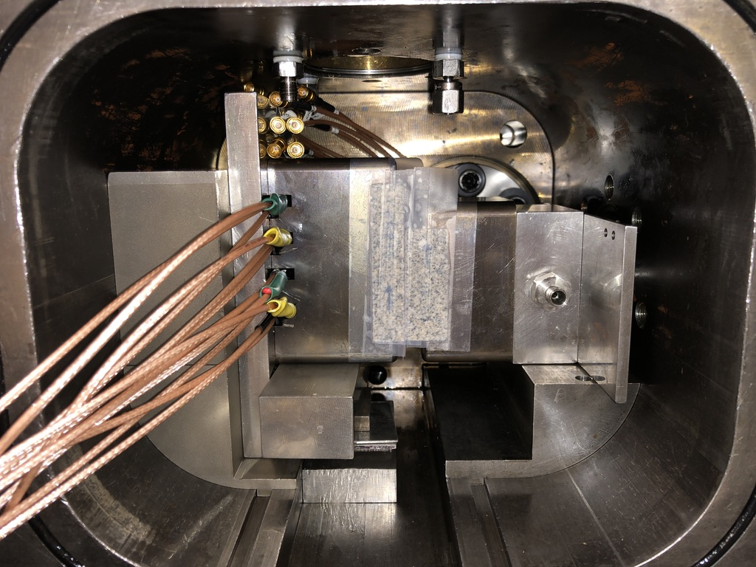
p5605 – pressure sensitive film
Follow-up with pressure films in vertical configuration outside vessel

Slide 3
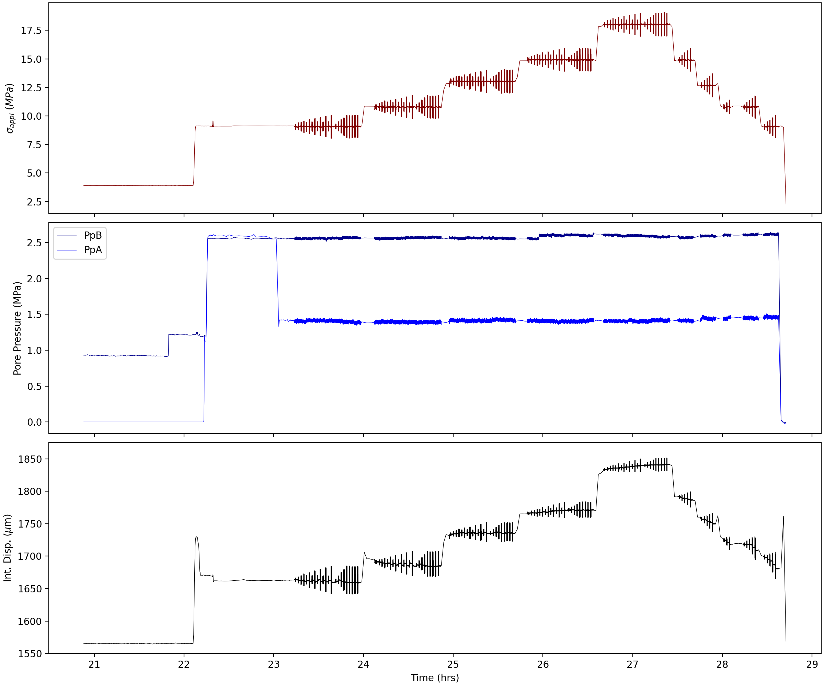
p5607

Slide 4
Relevant Info & Questions
Part of this project would be to use pressure sensitive film to characterize stress-area
This can inform which PZTs to use. I’’m thinking just the middle column will be sufficient
We’re at ~89% usage of database — maybe increase storage capacity (25TB to 30TB…?)
I plan to do this after AGU — 18-21 December. I can do the pressure sensitive film part this week.
Permeability — I’m going through some old slide decks to confirm, but yes I think that I’ve checked the permeability. It is very important, especially regarding Pp oscillations. I’ll talk more about this on Wednesday.
Oscillation Protocol and Amplitudes — Maybe I could modify Amp2,4 so that I focus on larger amplitudes. Irreversibility is most apparent at the larger oscillation amplitudes, so maybe just repeating 1MPa is sufficient.
Something like...
[1, 1, 1, 1, 1, 1, 1]MPa @ 1 Hz
OR
[0.8, 1, 0.8, 1, 0.8, 1]MP @ 1 Hz
Stress Levels — My main motivation for 3 stress levels is to keep the experiment short enough to be completed in 1 day to prevent unnecessarily long holds and/or load/reloads. After I use pressure sensitive film, I will have a better idea if small changes in contact area are resolvable.

Slide 5
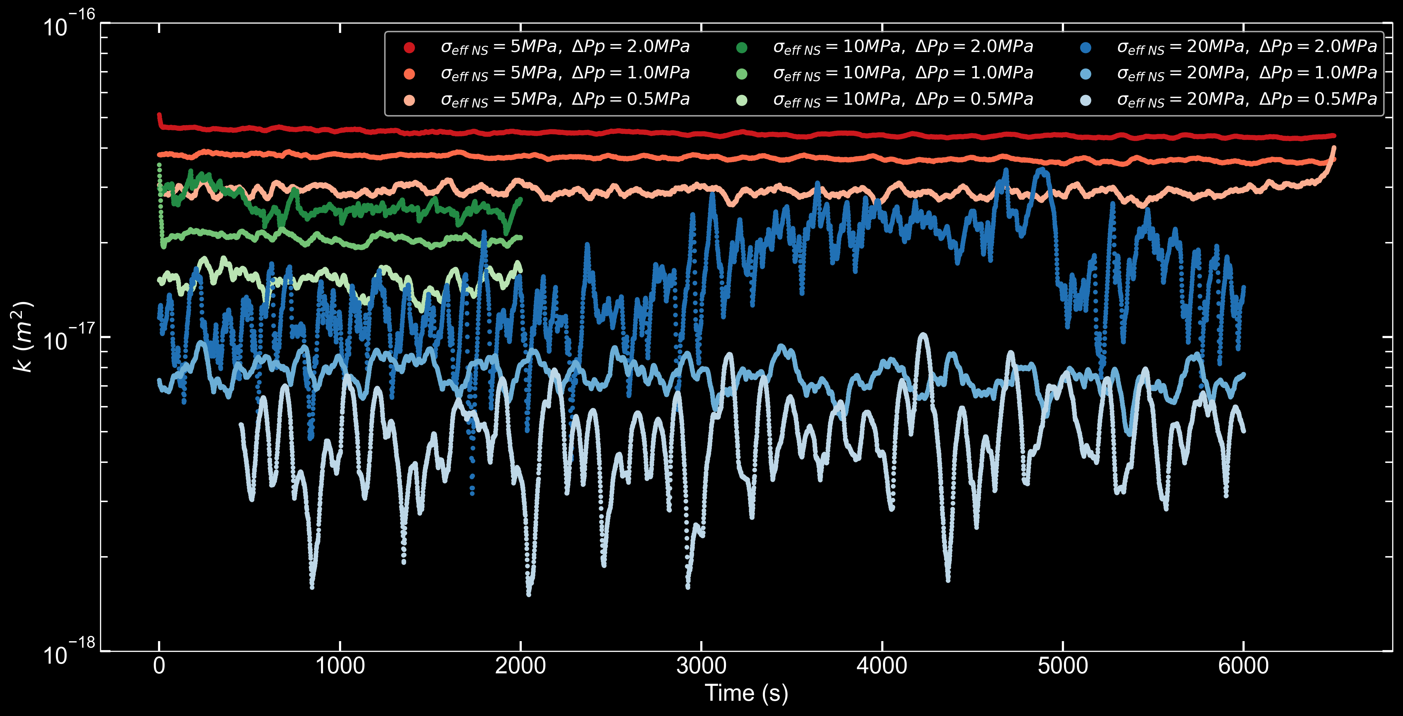
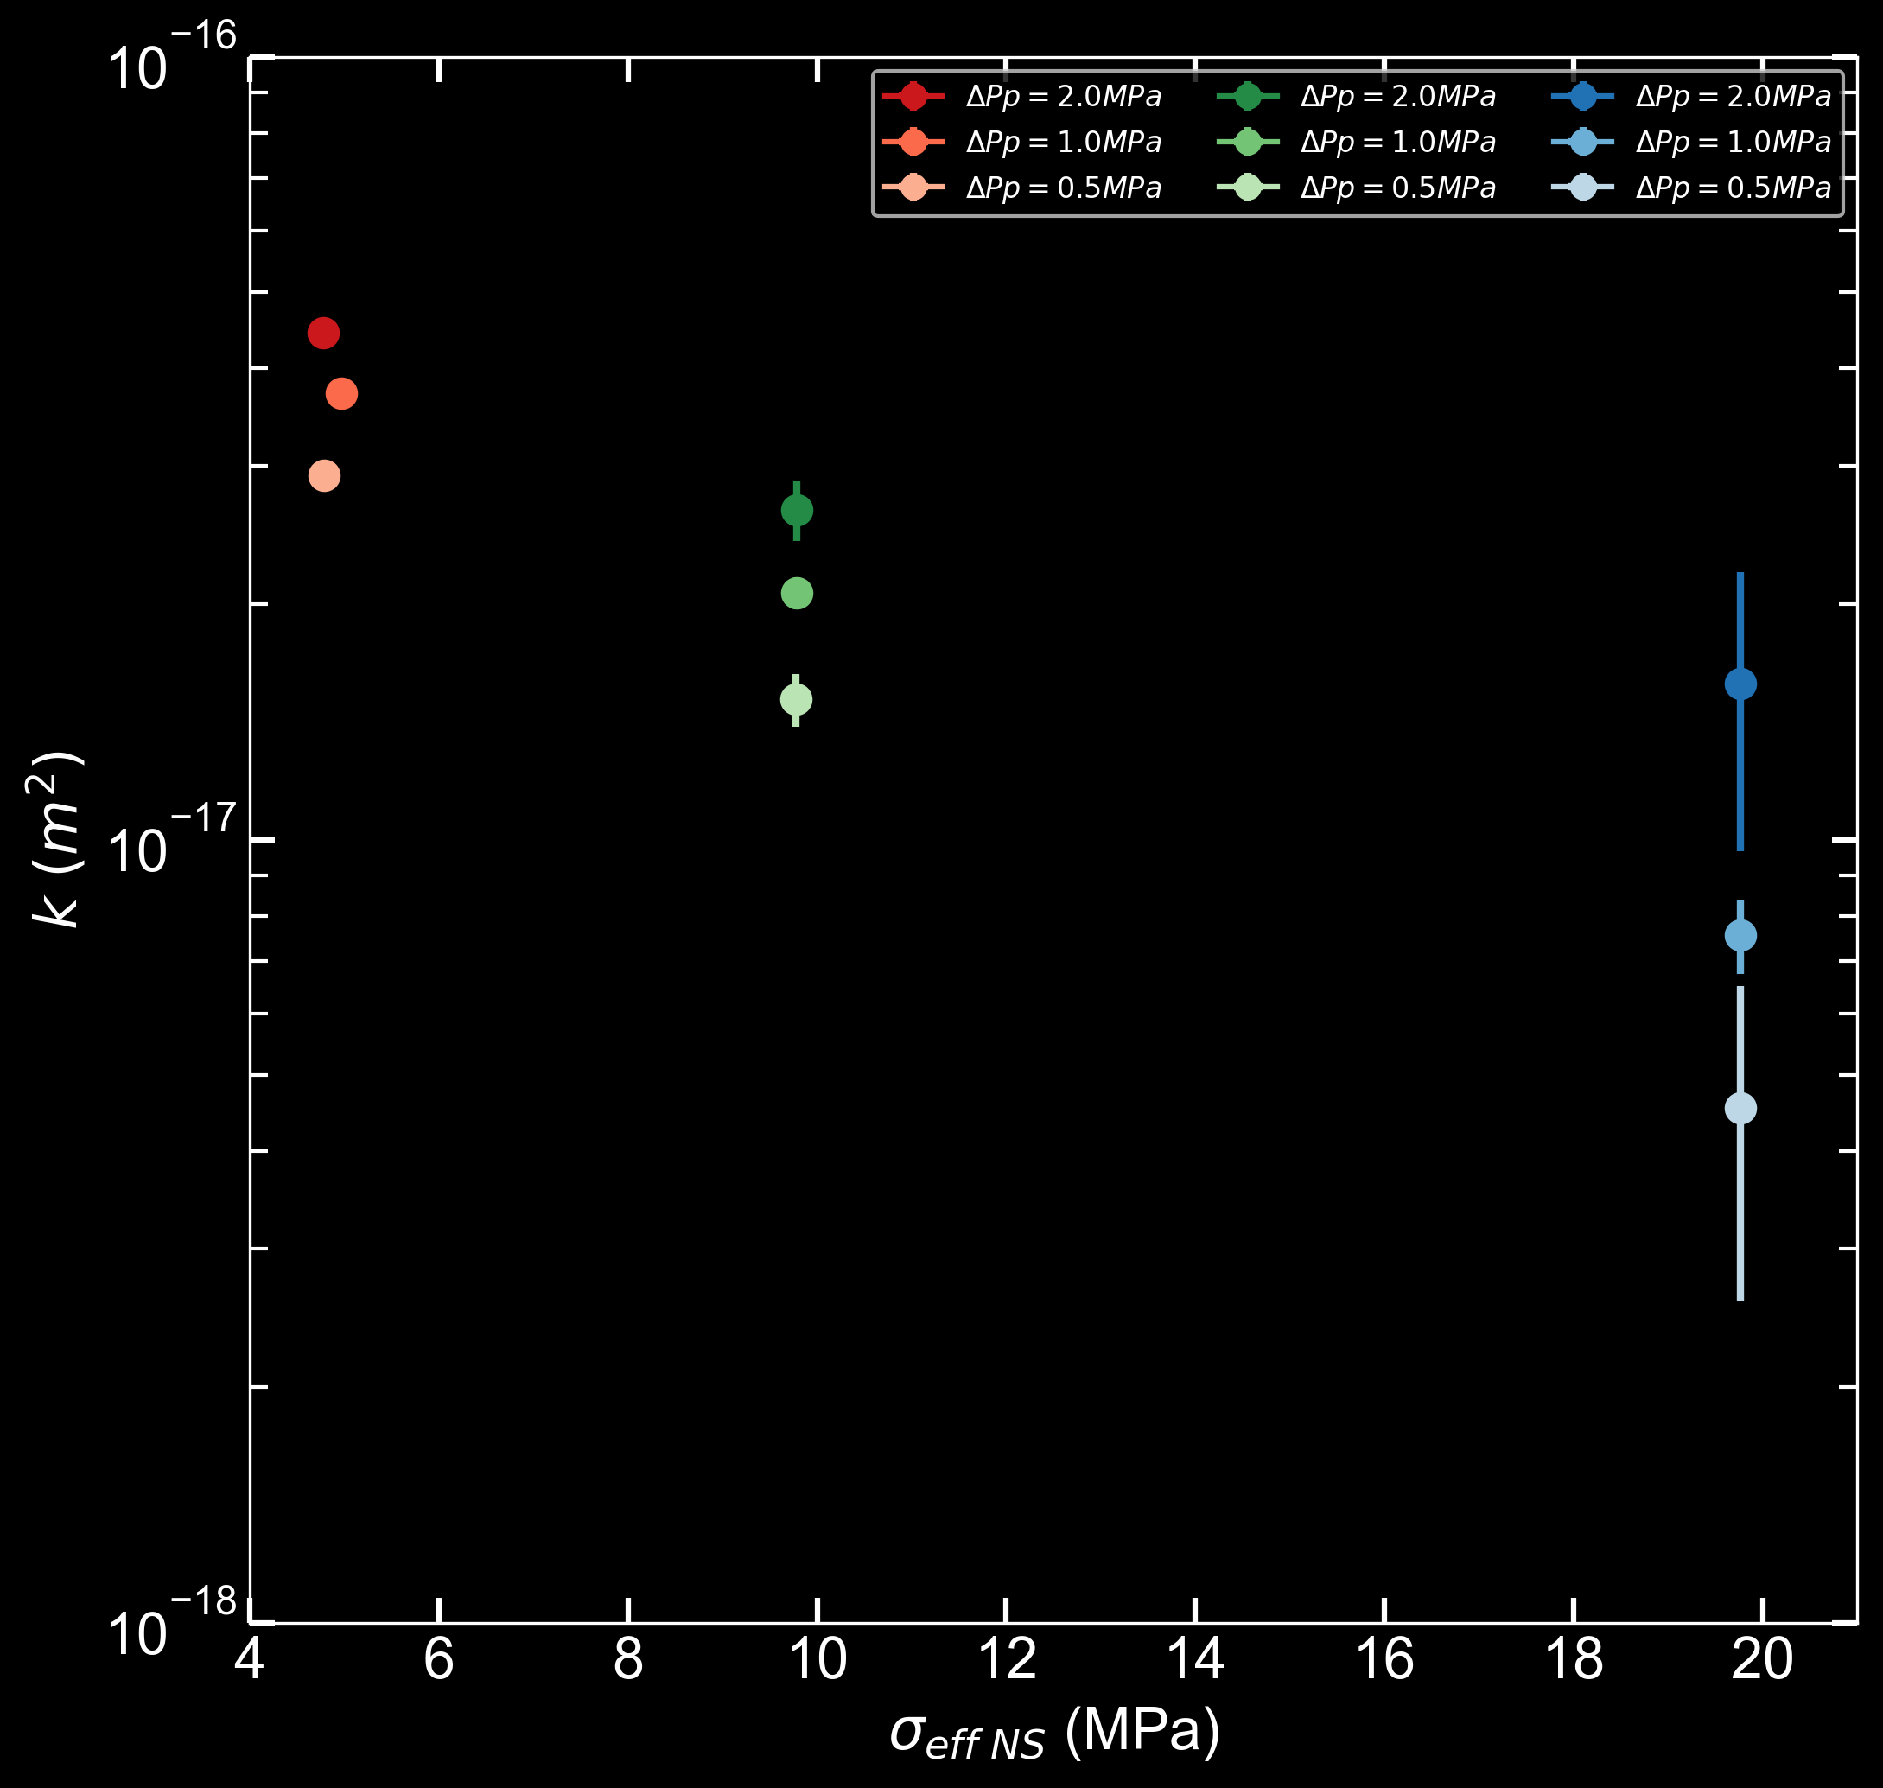
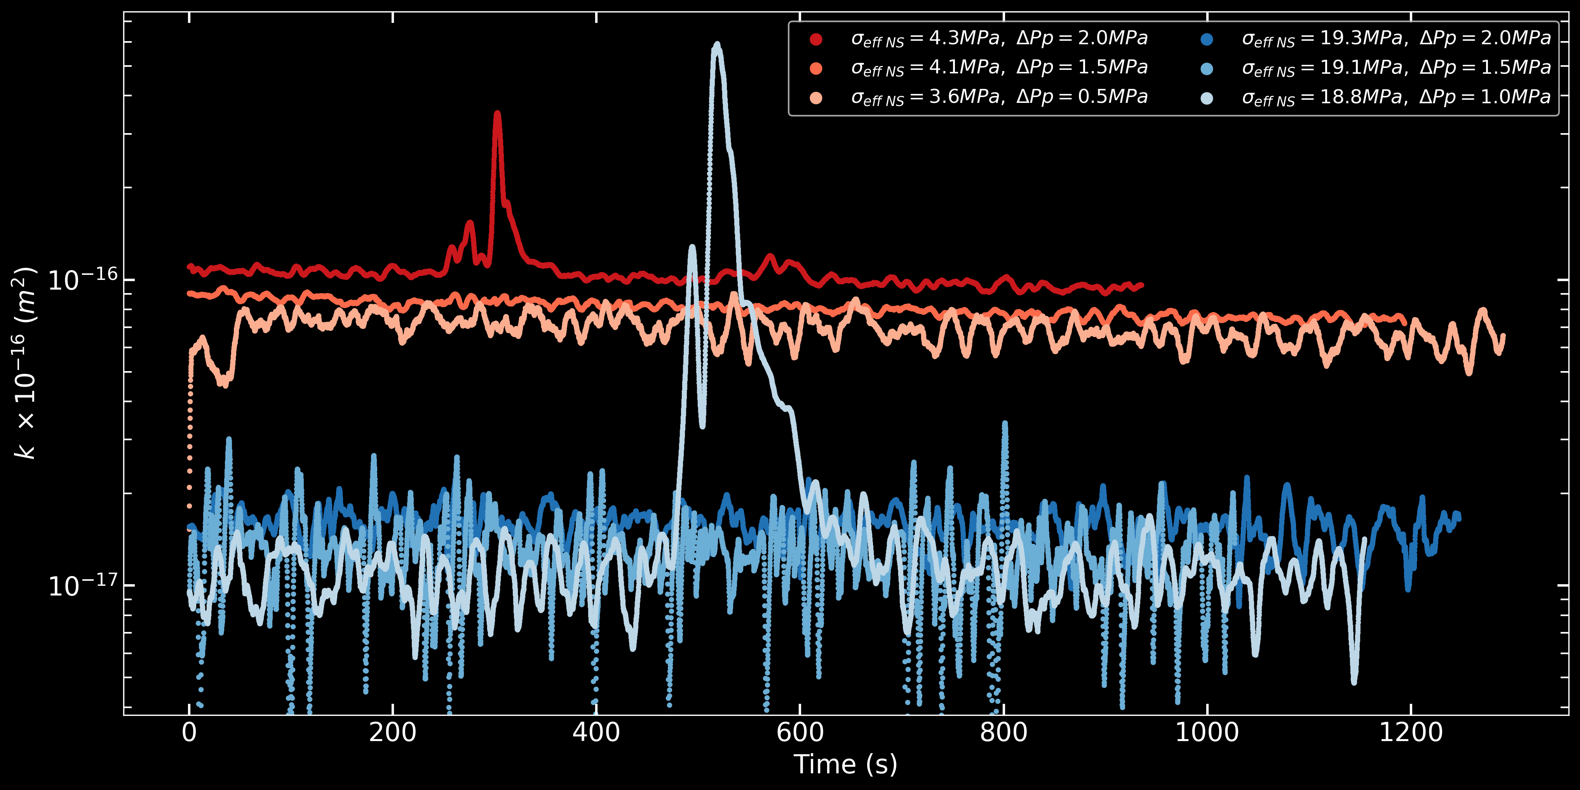
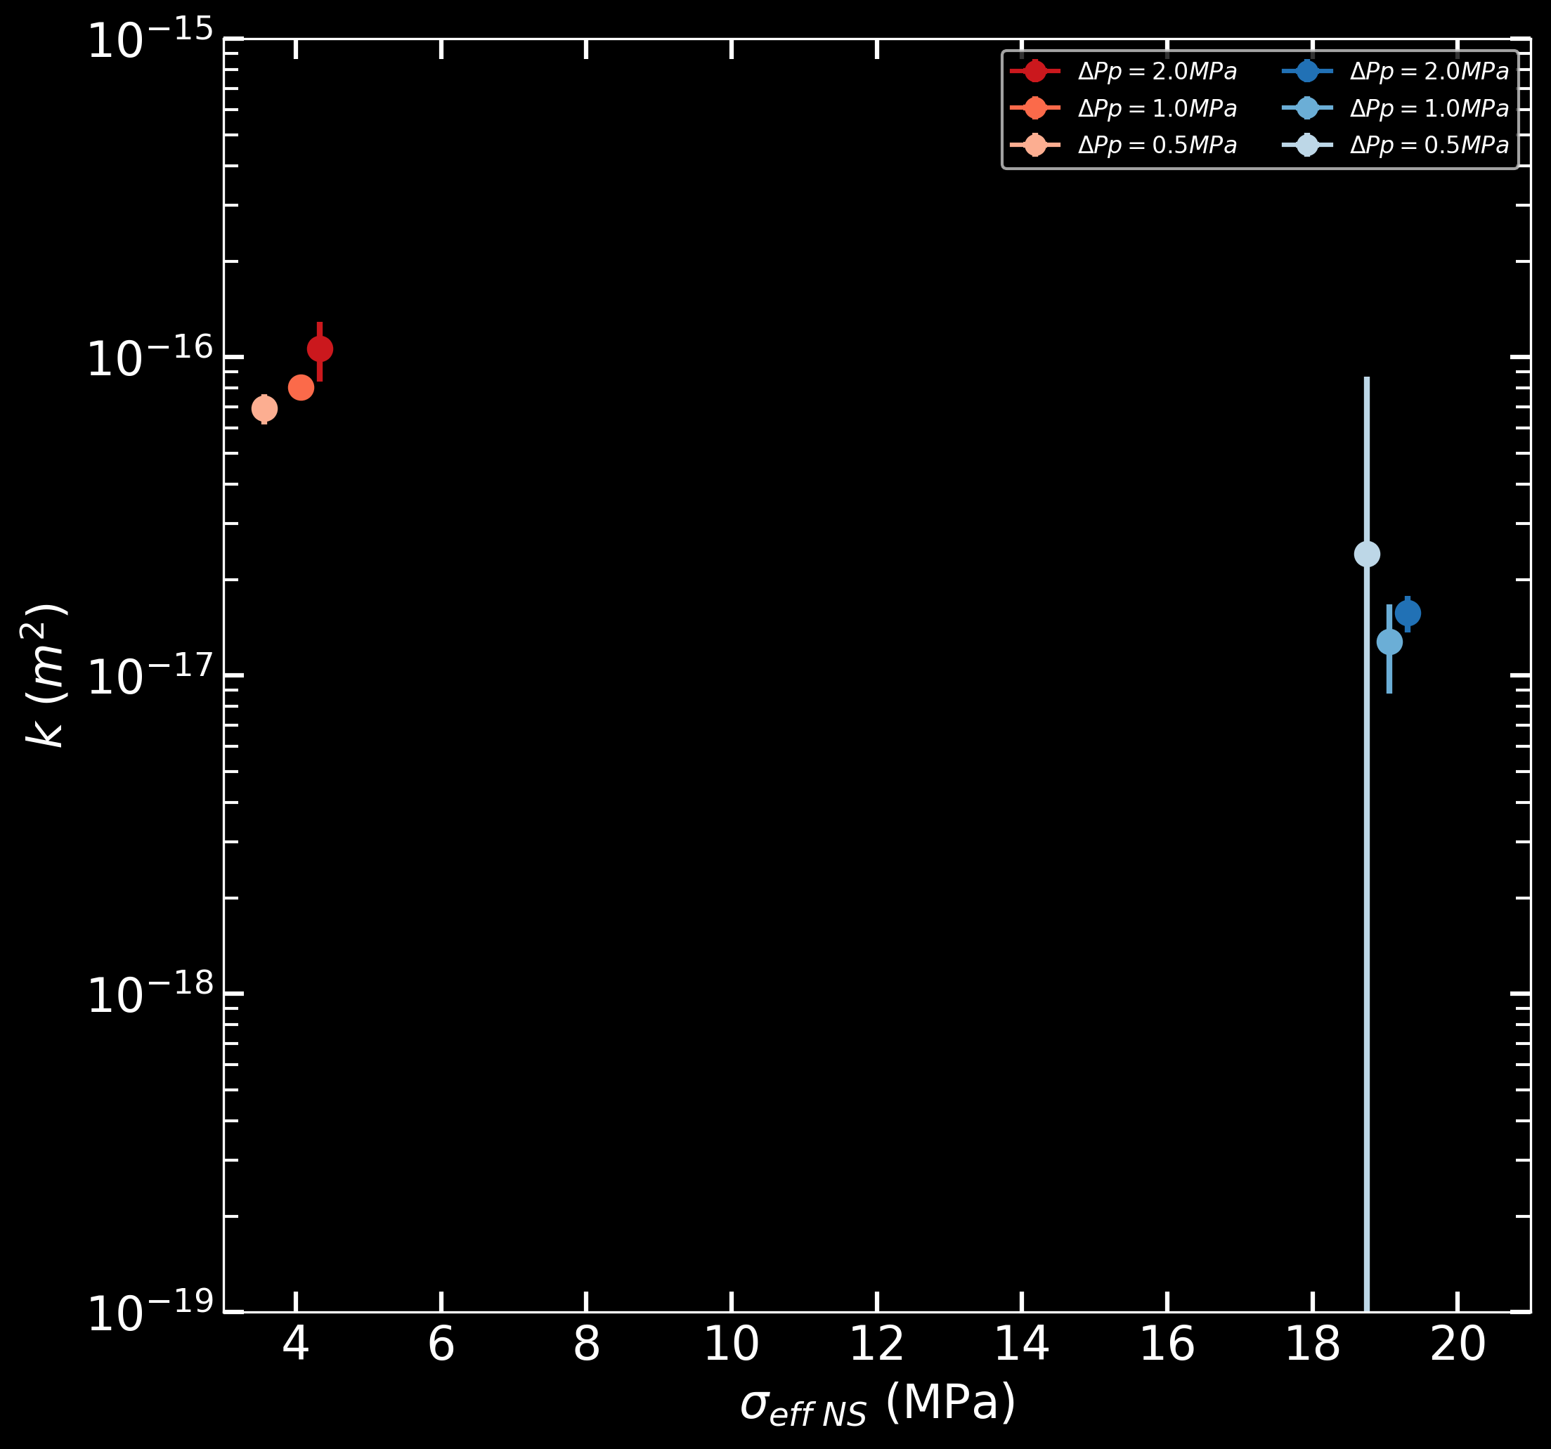
p5462
p5458

