Slide 1
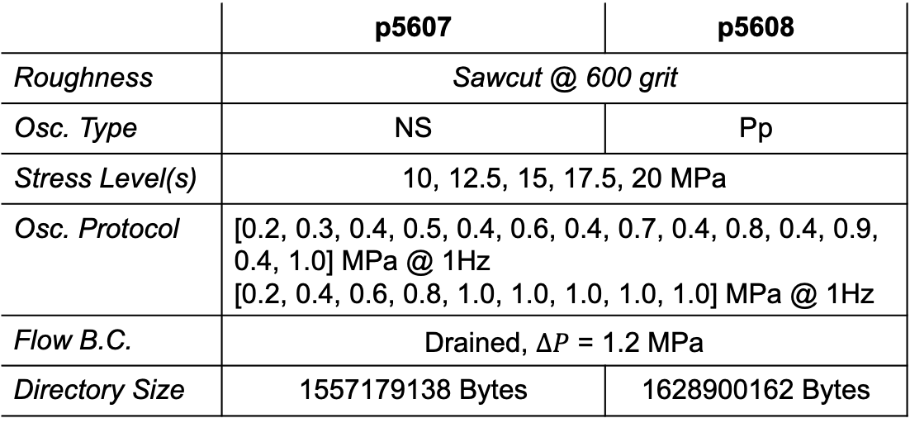
Experiments p5607 & p5608 – A quick look
Receivers
Transmitters
 | p5607 | p5608
Roughness | Sawcut @ 600 grit
Osc. Type | NS | Pp
Stress Level(s) | 10, 12.5, 15, 17.5, 20 MPa
Osc. Protocol | [0.2, 0.3, 0.4, 0.5, 0.4, 0.6, 0.4, 0.7, 0.4, 0.8, 0.4, 0.9, 0.4, 1.0] MPa @ 1Hz [0.2, 0.4, 0.6, 0.8, 1.0, 1.0, 1.0, 1.0, 1.0] MPa @ 1Hz
Flow B.C. | Drained, $∆P$ = 1.2 MPa
Directory Size | 1557179138 Bytes | 1628900162 Bytes
Excitation freq: 0.5 MHz
Time b/w pulses: 0.2 ms
Recording freq: 25 MHz

Slide 2
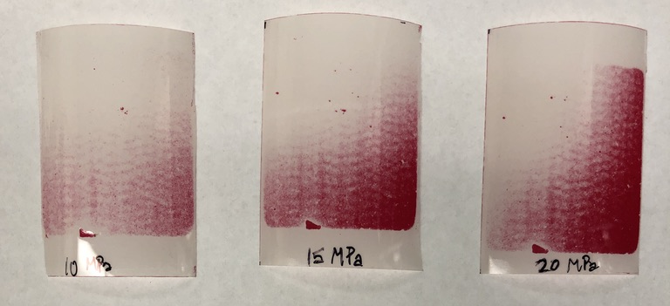
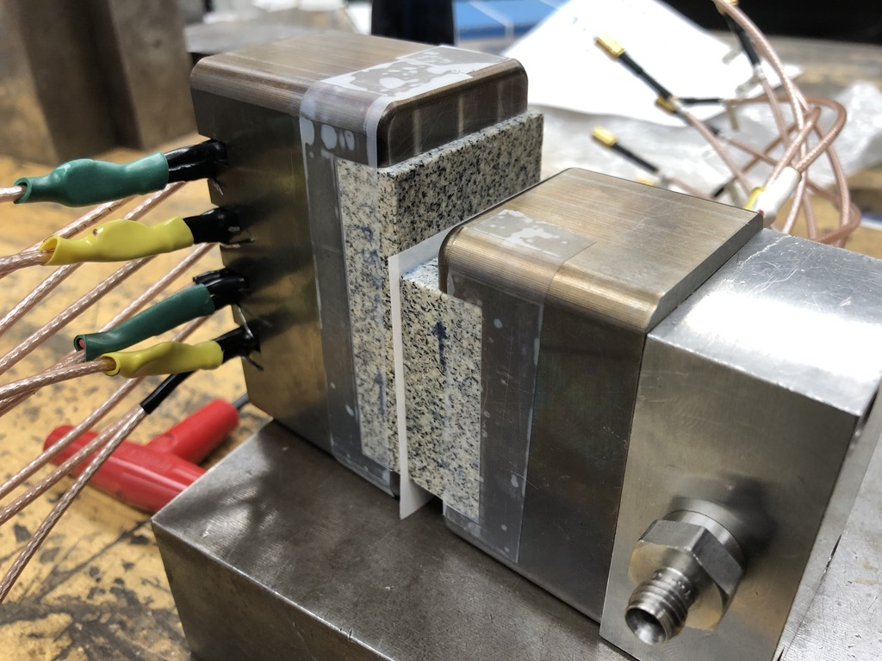
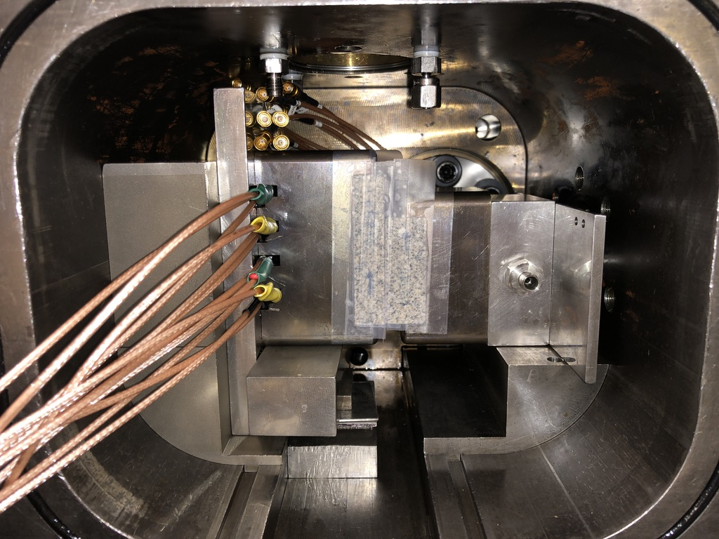
p5605 – pressure sensitive film
Follow-up with pressure films in vertical configuration outside vessel

Slide 3
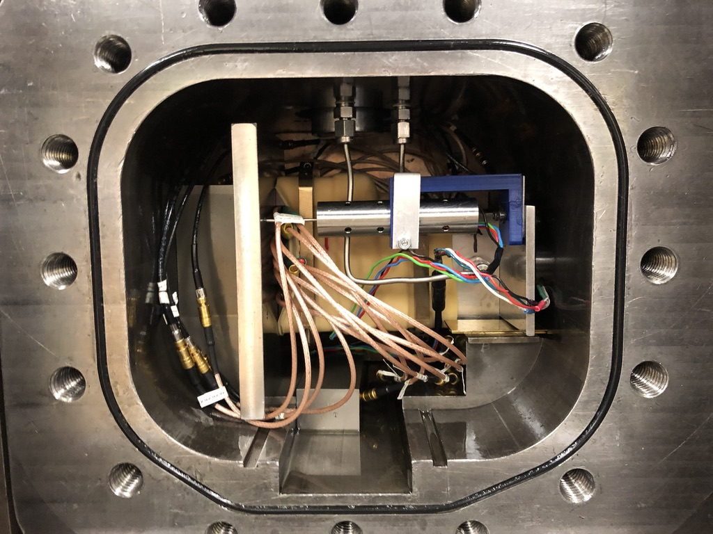
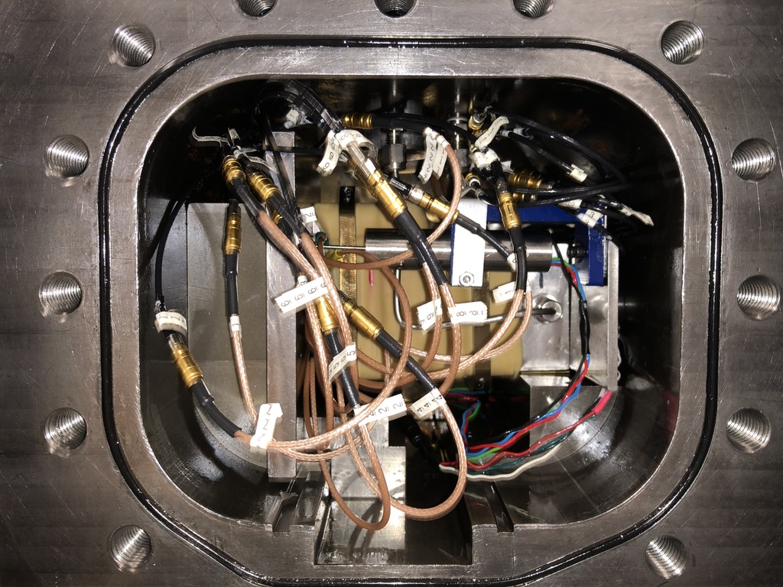
p5607/8 – sawcut fracture @ 600 grit

Slide 4
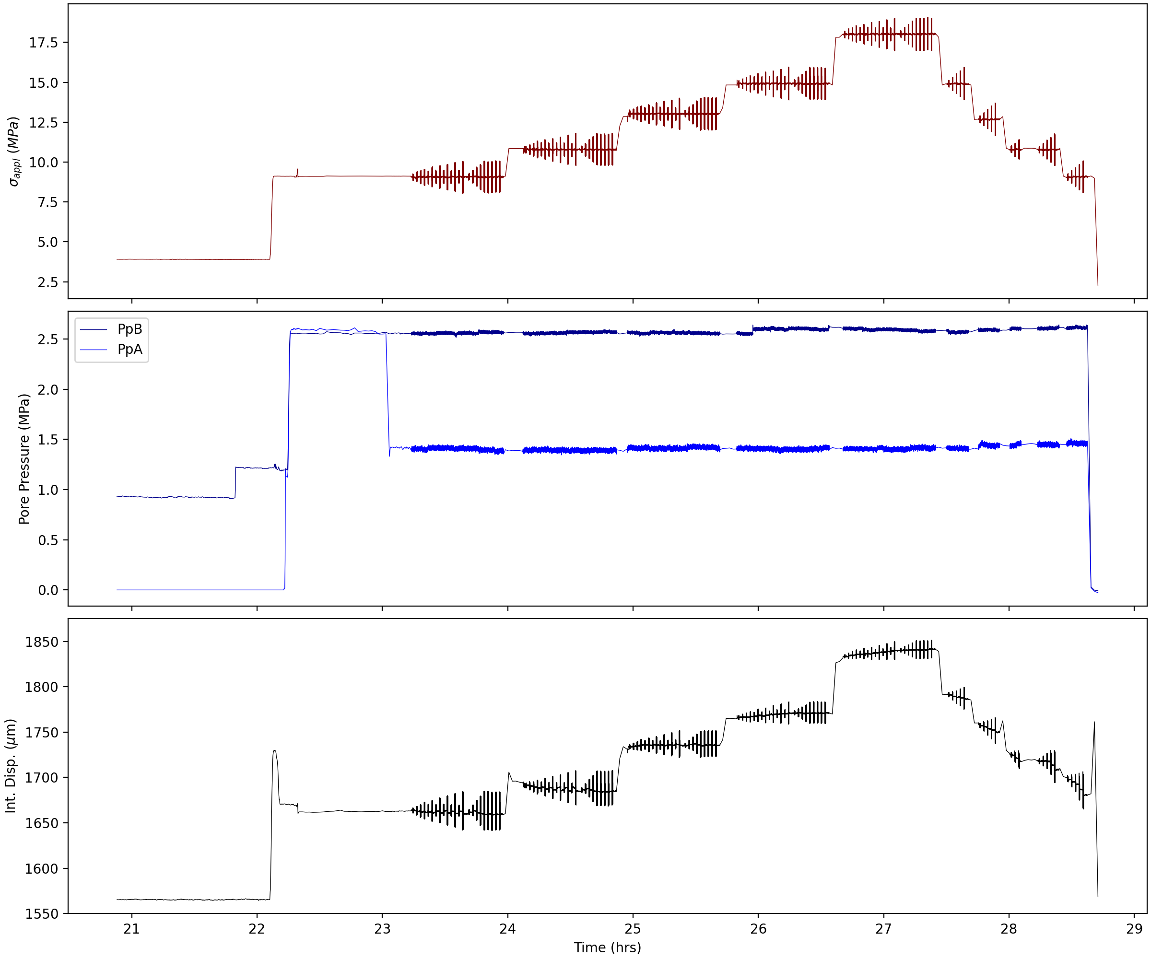
p5607

Slide 5
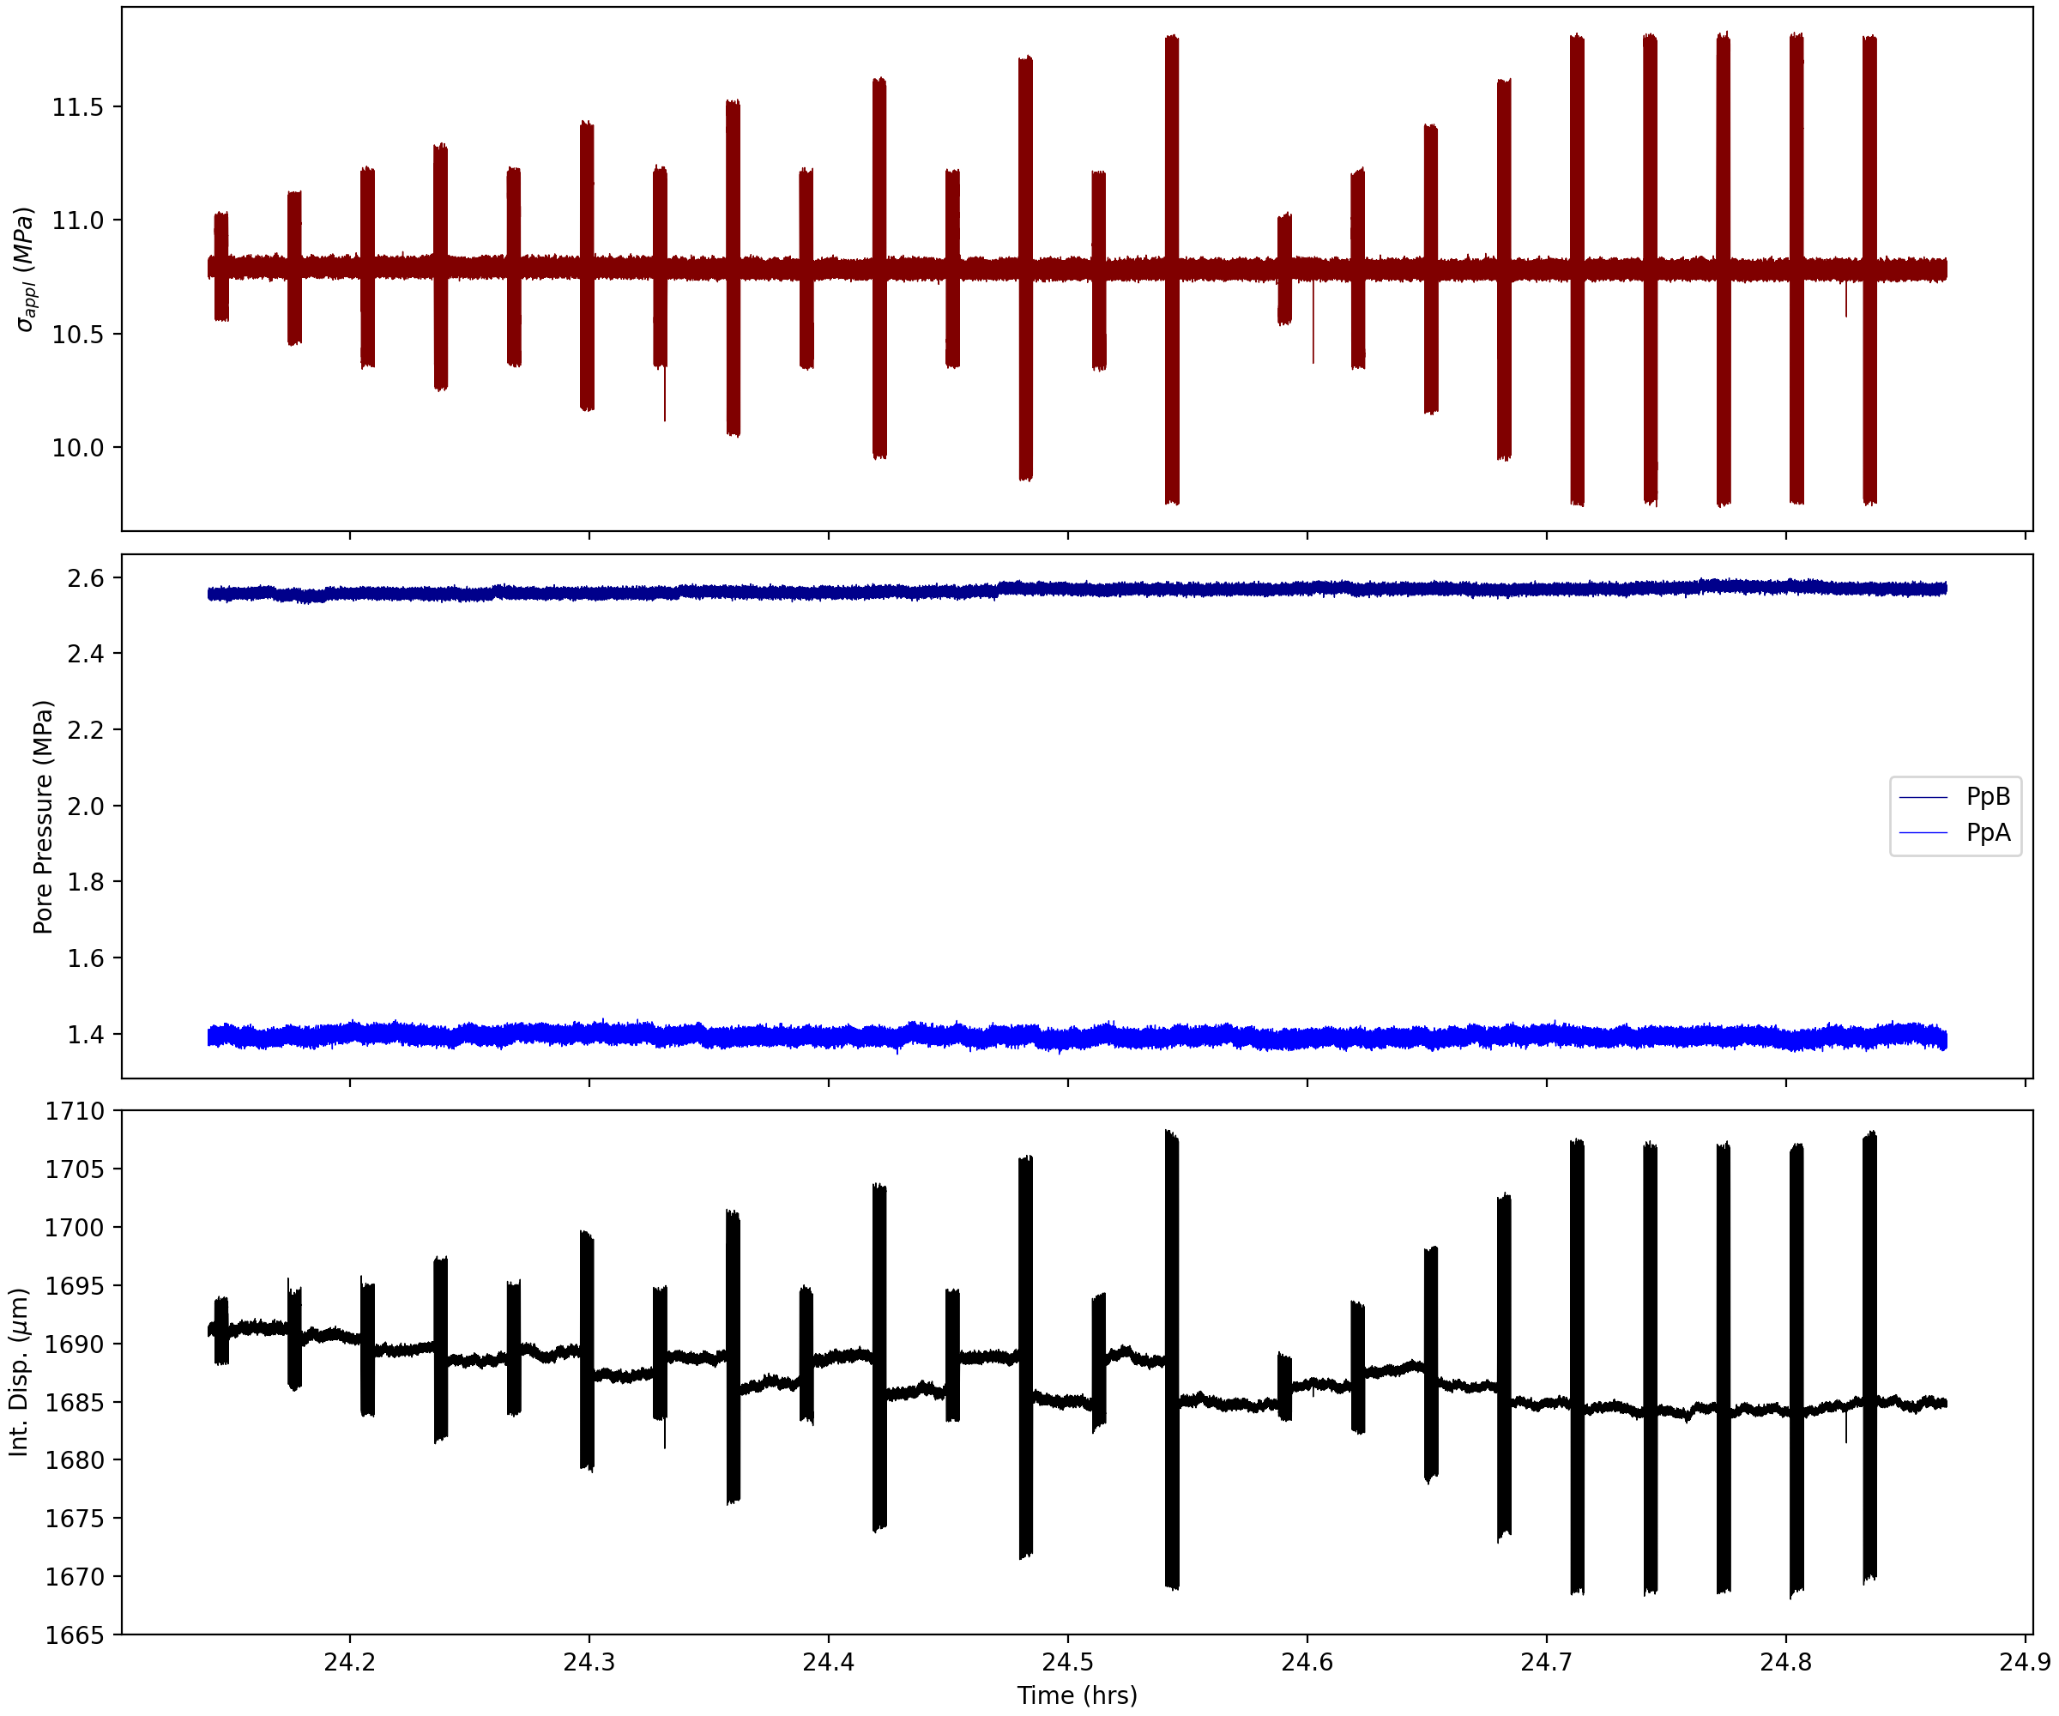
p5607

Slide 6
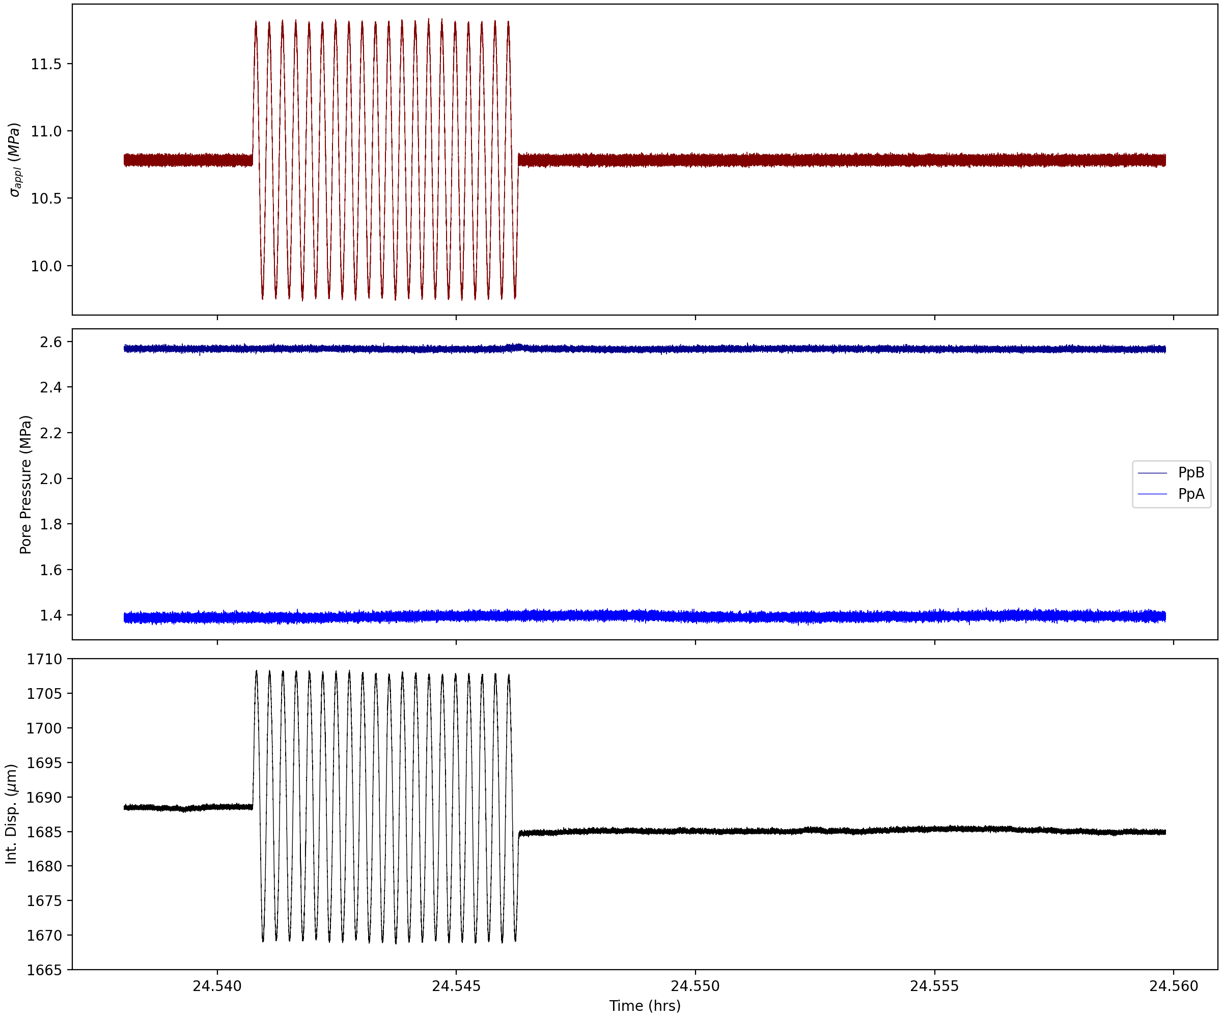
p5607

