Slide 1
SEP Modeling Challenge: Research to Operations SHINE 2019
Measurements for Challenge SEP Events
Organized by Kathryn Whitman and Ian Richardson
Kathryn.Whitman@nasa.gov
August 8, 2019

Slide 2
SEP Definitions for this Challenge
Two important thresholds
>10 MeV proton fluxes exceed 10 pfu (1/[cm² s sr])
>100 MeV proton fluxes exceed 1 pfu ← most important to SRAG
Will thresholds be exceeded in the 24 or 48 hours? Probabilistic, All Clear
When will these thresholds be crossed? Event start time
How strong will the event be? Peak flux, fluence
How quickly must astronauts act to mitigate radiation dose? Rise time
How long will the event last? End time, duration
Multiple model types would be very useful in an operational setting!

Slide 3
Approach to Calculating SEP Values for this Challenge
SEP measurements depend on:
The instruments with which they are taken
Choices made during post-processing
Values are reported here for multiple spacecraft and data sets
GOES-13 differential and integral channels
GOES-15 differential and integral channels
ESA’s SEPEM (RSDv2) calibrated data set extending from 1974 – 2015
Measurements display a range of values and model performance should be considered in the context of that range

Slide 4
For Modelers: Data Preparation Package for SHINE 2019
Kathryn Whitman developed a series of codes to help modelers calculate the values requested for the SHINE 2019 SEP Modeling Challenge session
All codes in repository: https://github.com/ktindiana/operational-sep
operational_SEP_SHINE_wrapper.py
Runs operational_sep_quantities.py for all SHINE events for all combinations of GOES-13, GOES-13, and SEPEM data types
Allows users to specify model info and runs operational_sep_quantities.py for model
Makes comparison plots with compare_data_model.py and saves to file
operational_sep_quantities.py
Calculates all values requested for shine session for GOES and SEPEM measurements (https://shinecon.org/shine2019/session2019.php#session19 )
Can calculate the same values for any model that outputs integral or differential flux time series
compare_data_model.py
Make comparison plots between measurements and model results

Slide 5
Schedule
SEPMOD (Luhmann, Lee)
AFRL (Kahler & Winter)
EPREM (Schwadron, Poduval)
STAT (Linker, PSI)
iPATH (Li)
SEPSTER (Richardson)
UMASEP (Nunez) and ESPERTA (Laurenza et al.) (email submissions)
Du Toit Strauss (Poster session)
Manolis Georgoulis (Georgia State University)

Slide 6
SHINE 2019 SEP Modeling Challenge Events
Please use the following as standard slides to report your results, if these quantities apply to your model.

Slide 7
March 7, 2012

Slide 8
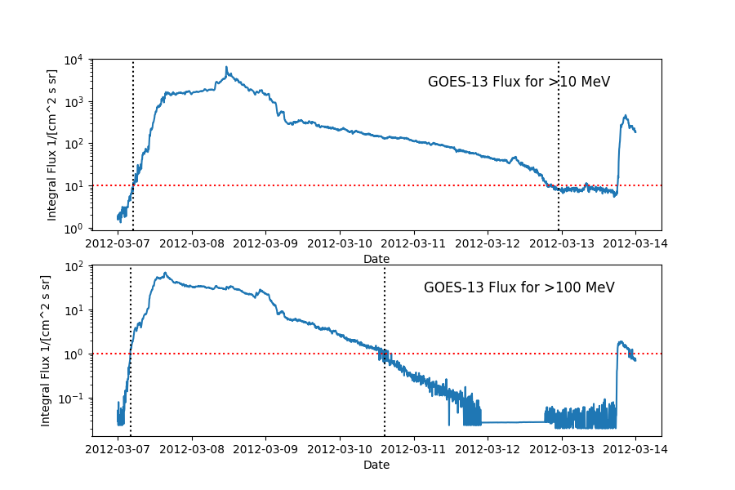
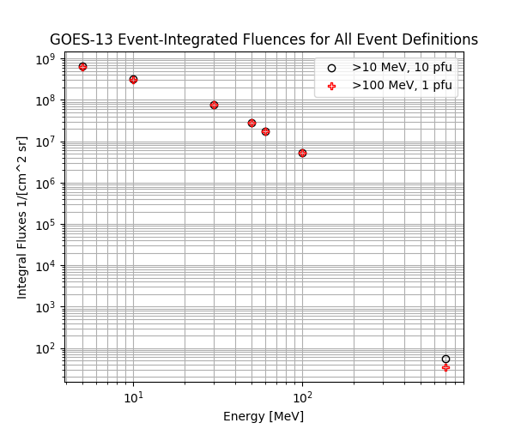
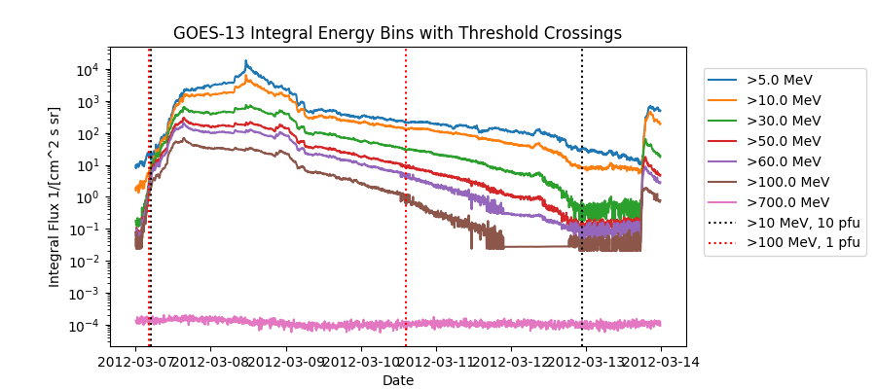
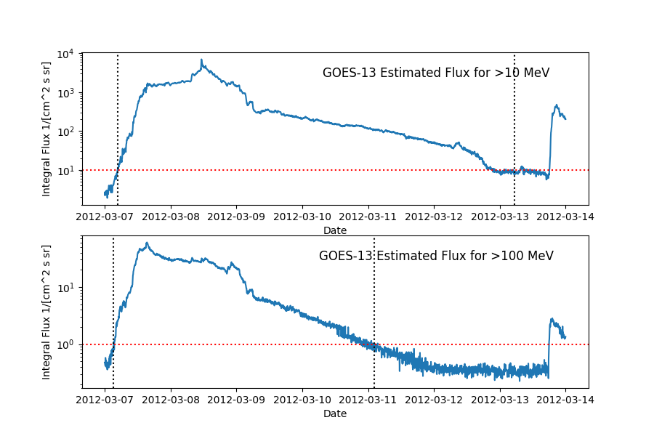
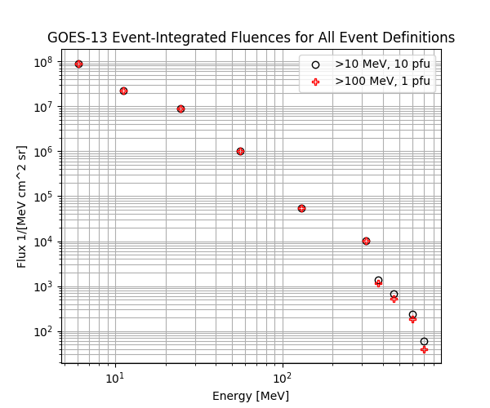
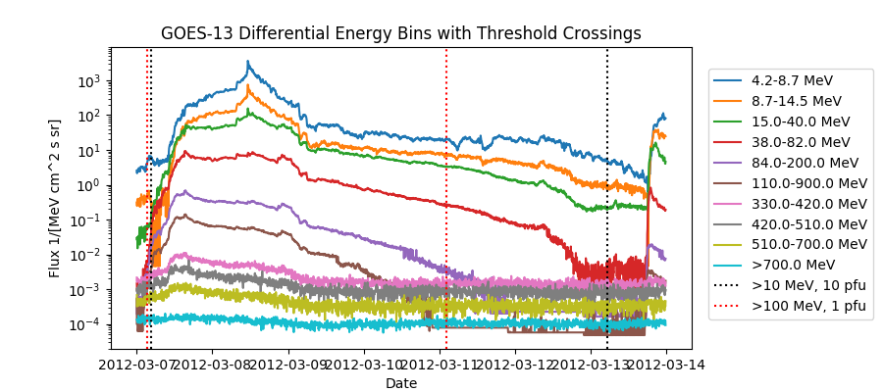
March 7, 2012 – Plots for GOES-13
GOES-13 Integral Channels
Event Definition
Fluence
Black fluence circles (right) defined by >10 MeV, 10 pfu threshold start and stop times, black vertical lines (above). Likewise for >100 MeV, 1 pfu (red).
GOES-13 Differential Channels
Event Definition
Fluence
Integral fluxes estimated from differential channels result in longer event times due to noise which takes longer to satisfy the end-of-event definition: 3 consecutive points below 0.85*threshold.

Slide 9
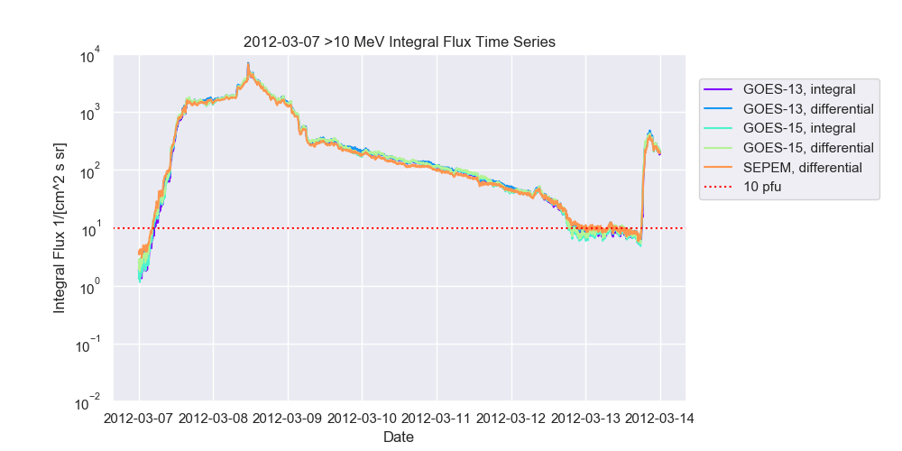
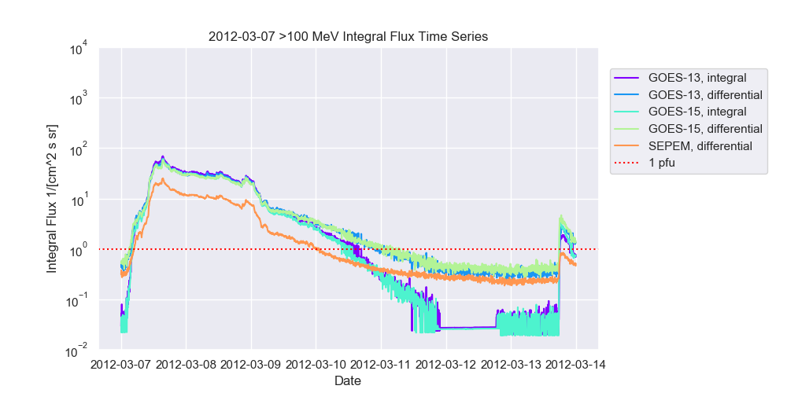
March 7, 2012 - >10 MeV and >100 MeV Flux Time Profiles
>10 MeV Profile – All Experiments
>100 MeV Profile – All Experiments

Slide 10
May 17, 2012

Slide 11
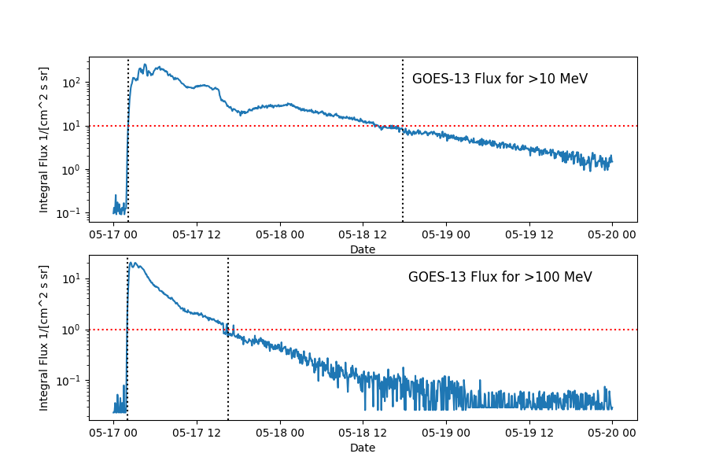
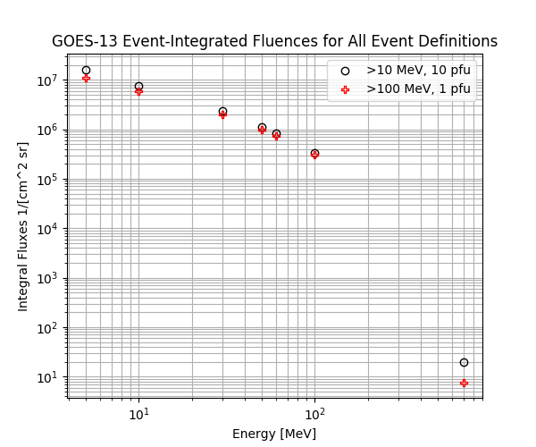
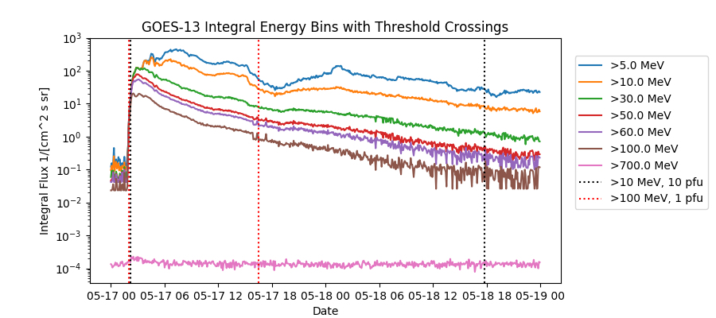
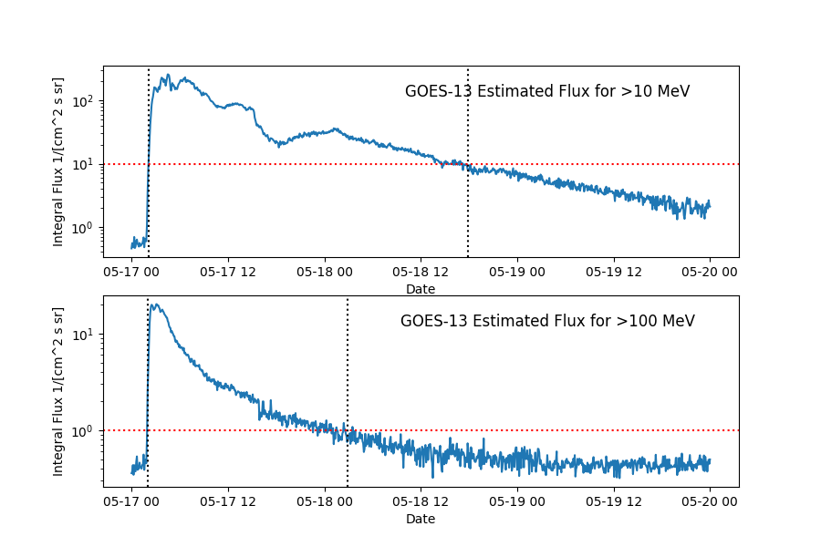
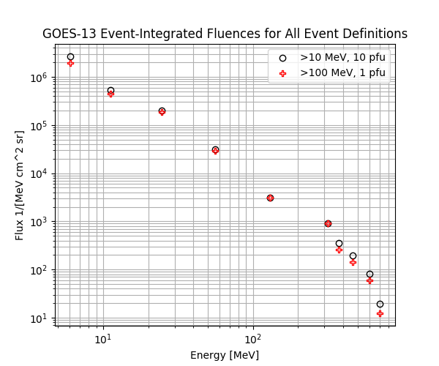
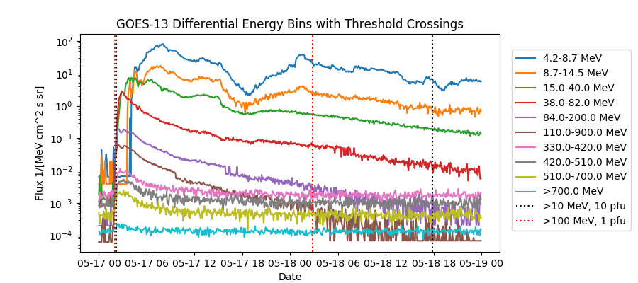
May 17, 2012 – Plots for GOES-13
GOES-13 Integral Channels
Event Definition
Fluence
Black fluence circles (right) defined by >10 MeV, 10 pfu threshold start and stop times, black vertical lines (above). Likewise for >100 MeV, 1 pfu (red).
GOES-13 Differential Channels
Event Definition
Fluence
Integral fluxes estimated from differential channels result in longer event times due to noise which takes longer to satisfy the end-of-event definition: 3 consecutive points below 0.85*threshold.

Slide 12
September 10, 2017

Slide 13
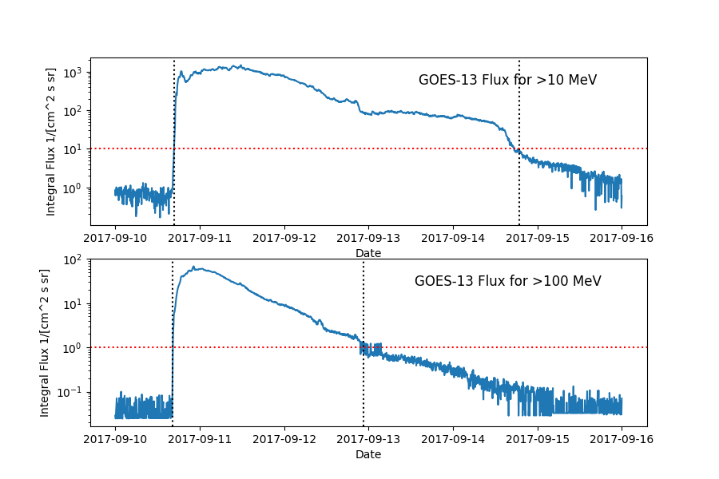
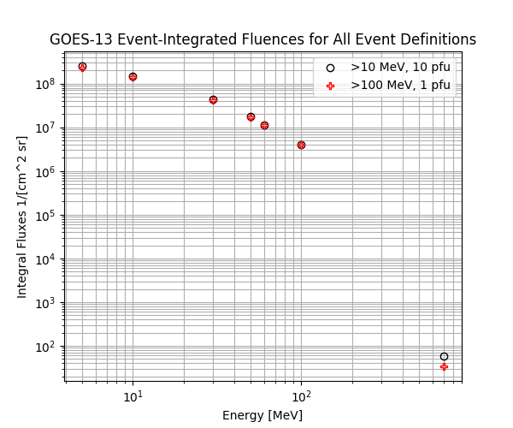
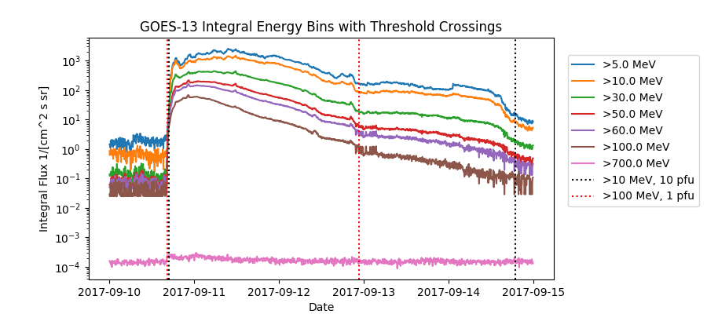
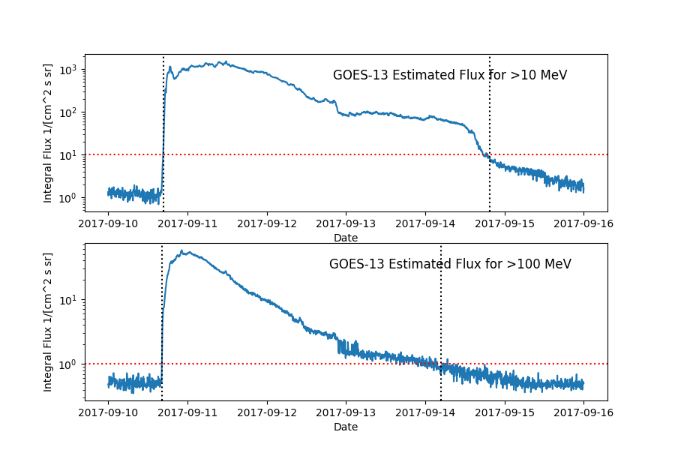
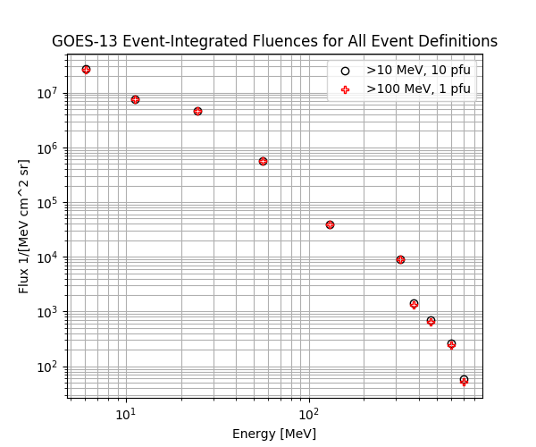
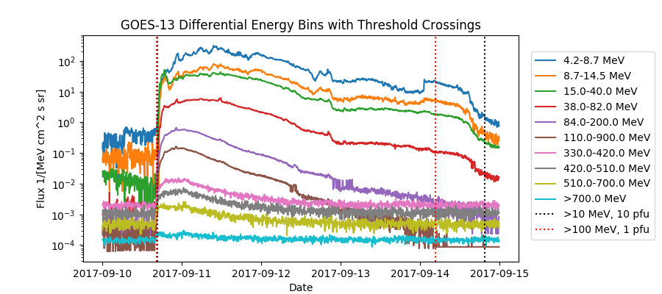
September 10, 2017 – Plots for GOES-13
GOES-13 Integral Channels
Event Definition
Fluence
Black fluence circles (right) defined by >10 MeV, 10 pfu threshold start and stop times, black vertical lines (above). Likewise for >100 MeV, 1 pfu (red).
GOES-13 Differential Channels
Event Definition
Fluence
Integral fluxes estimated from differential channels result in longer event times due to noise which takes longer to satisfy the end-of-event definition: 3 consecutive points below 0.85*threshold.

Slide 14
Some Talking Points
What methods should be used for model validation? Do we generate a set of standard inputs or events? How do we fairly validate different types of models?
What quantities should be used for model validation? What experiments and data sets should be used for comparison? Operational and Scientific…
Which observational data streams are important and will they be available into the future?
Are there any major barriers to providing information pertinent to forecasting and operations, particularly on operational timescales?
Models that predict flux time series rely heavily on solar wind/CME models that often have an inner boundary? Do we need improved modeling from the corona to tens of Rs?

