Slide 1
SEP Modeling Challenge: Research to Operations SHINE 2019
Measurements for Challenge SEP Events
Organized by Kathryn Whitman and Ian Richardson
Kathryn.Whitman@nasa.gov
July 2019

Slide 2
Approach to Calculating SEP Values for this Challenge
SEP measurements depend on:
The instruments with which they are taken
Choices made during post-processing
Values are reported here for multiple spacecraft and data sets:
GOES-15 corrected EPEAD fluxes from the west-facing detector
Differential channels
Integral channels
GOES-13 corrected EPEAD fluxes from the west-facing detector
Differential channels
Integral channels
ESA’s SEPEM (RSDv2) calibrated data set extending from 1974 – 2015
The SEPEM data set with a background-subtraction applied using a method developed at SRAG
Measurements display a range of values and model performance should be considered in the context of that range

Slide 3
SEP Definitions for this Challenge
SEP event definitions are selected to align with those used operationally by the Space Radiation Analysis Group (SRAG) when supporting the International Space Station (ISS) Mission Control
Threshold: >10 MeV proton flux exceeds 10 pfu (1/[cm² s sr])
Consequence: Awareness that proton levels are rising and provide support to Mission Control if an EVA is planned
Threshold: >100 MeV proton flux exceeds 1 pfu
Consequence: 24/7 support of Mission Control as proton levels can cause increased radiation dose behind shielding
SRAG currently monitors GOES-13 >10 MeV and > 100 MeV integral channels
Event end when 3 consecutive data points (15 minutes) fall below 0.85*threshold
Definition is somewhat arbitrary and was defined to keep the SRAG alarm code from retriggering as the proton flux decays slowly away around the threshold levels
>100 MeV fluxes below 1 pfu will not cause significant increase in dose behind shielding, so the part of the event above these levels is the most important to quantify

Slide 4
For Modelers: Data Preparation Package for SHINE 2019
Kathryn Whitman developed a series of codes to help modelers calculate the values requested for the SHINE 2019 SEP Modeling Challenge session
All codes in repository: https://github.com/ktindiana/operational-sep
operational_SEP_SHINE_wrapper.py
Runs operational_sep_quantities.py for all SHINE events for all combinations of GOES-13, GOES-13, and SEPEM data types
Allows users to specify model info and runs operational_sep_quantities.py for model
Makes comparison plots with compare_data_model.py and saves to file
operational_sep_quantities.py
Calculates all values requested for shine session for GOES and SEPEM measurements (https://shinecon.org/shine2019/session2019.php#session19 )
Can calculate the same values for any model that outputs integral or differential flux time series
compare_data_model.py
Make comparison plots between measurements and model results

Slide 5
operational_SEP_SHINE_wrapper.py

Slide 6
Analysis and Plots for All SHINE Events: operational_SEP_SHINE_wrapper.py
Runs operational_sep_quantities.py for all GOES and SEPEM experiments
All values in the tables in this powerpoint template are saved in output files
Runs operational_sep_quantities.py for your model
All values requested for SHINE are saved in output files
Makes plots of measurements and model for easy visualization of model performance by running compare_data_model.py

Slide 7
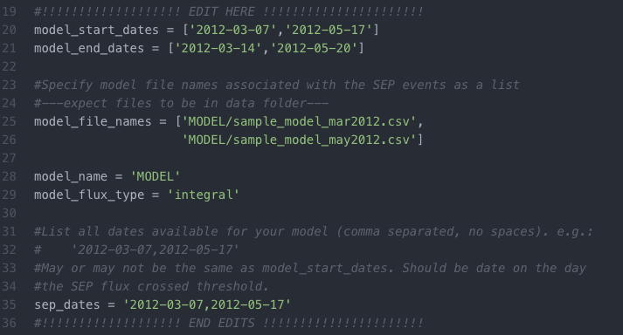
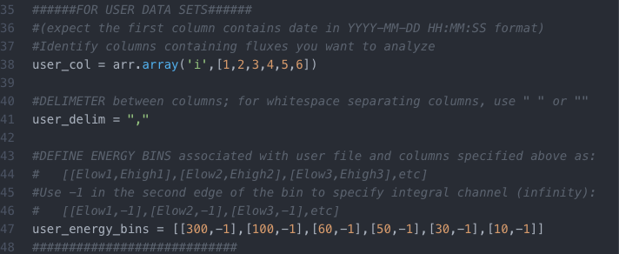
Modify operational_SEP_SHINE_wrapper.py and operational_sep_values.py for your Model
Values that should be changed in the operational_SEP_SHINE_wrapper.py for your model
Values that should be changed in operational_sep_quantities.py for your model

Slide 8
INSTRUCTIONS: To Run the Wrapper Code (Mac)
Do steps 1 – 3 the first time you run the code to ensure you have the correct libraries.
For Macs, I prefer using Homebrew. If you don’t have homebrew, you may install with:
/usr/bin/ruby -e "$(curl -fsSL https://raw.githubusercontent.com/Homebrew/install/master/install)”
Install python3.
If you use homebrew, you may use this command in the terminal: brew install python
Install additional libraries matplotlib, wget, scipy
pip3 install matplotlib pip3 install wget pip3 install scipy
If you try to run the code and get an error related to certificates, you may need to also run: pip3 install certifi
Run the code in terminal while inside the directory containing the code (try python if python3 doesn’t work): python3 operational_SEP_SHINE_wrapper.py

Slide 9
INSTRUCTIONS: To Run the Wrapper Code (Windows)
This is one way to run the code on Windows. Do steps 1 – 2 the first time you run the code to ensure you have the correct libraries.
Install python3.
Download anaconda navigator from https://www.anaconda.com/ (this downloads python3 plus a bunch of packages)
Install additional libraries matplotlib, wget, scipy
In Anaconda Prompt (which comes with anaconda navigator, NOT in command prompt) pip install matplotlib pip install wget pip install certify
If pip install doesn’t work, try: conda install matplotlib, etc
Run the code in Anaconda Prompt while inside the directory containing the code: py operational_SEP_SHINE_wrapper.py

Slide 10
operational_sep_quantities.py
PROVIDES:
Time to cross thresholds: >10 MeV exceeds 10 pfu; >100 MeV exceeds 1 pfu
Time to Peak Flux for >10 MeV, >100 MeV
Peak Flux for >10 MeV, >100 MeV
Duration >10 MeV, >100 MeV
Event fluence (total integrated event intensity) for >10 MeV, >100 MeV and energy spectrum

Slide 11
Code to Calculate SEP Values: operational_sep_quantities.py Also for use with your time profile model
A user-friendly python 3 code was developed by Kathryn Whitman (Kathryn.Whitman@nasa.gov) to calculate the values requested for the SHINE 2019 SEP Modeling Challenge.
This code is sent along with this presentation to all SEP modelers so that the exact choices and methodology for determining the SEP values is transparent to all.
If the code is run with GOES-13 integral channels, the output will exactly match that generated by the SRAG operational alarm code.
Additional intention of this code: For models that produce SEP time profiles, this code can be used to calculate exactly the same values in exactly the same way as data.
Users may input their own data set (e.g. model output or data with special post-processing, such as background subtraction)
Users may define their own threshold, e.g. >50 MeV, 10 pfu, to control event start and end
Note: The code is not smart enough to handle multiple SEP events in a row – please contact Katie if you want to use the code for a specific event and run into problems; Updates and modifications will be ongoing and made public

Slide 12
Description: Code to Calculate SEP Operational Quantities
The code, operational_sep_quantities.py, does the following for a single SEP event:
Creates “data” and ”output” directories
Automatically downloads GOES-8 to GOES-15 data for requested time periods into “data”
User must match spacecraft to requested time period
To use SEPEM data, the user must first manually download and unzip file (URL in code) into ”data” directory. The code will then break up the data set into yearly files for faster reading.
Searches for data gaps (e.g. -999, assumes any negative flux is a data gap) and fills in the missing data by applying a linear interpolation with time
Zero flux is treated as a valid value as model code may have real zero values
If user selects differential channels, code will estimate >10 and >100 MeV fluxes using power-law interpolation across the energy bins

Slide 13
Description: Code to Calculate SEP Operational Quantities
The code, operational_sep_quantities.py, does the following for a single SEP event:
Calculates threshold crossing times, peak flux, peak time, rise time (onset to peak), event end, and duration
Calculates all for >10 MeV, 10 pfu and >100 MeV, 1 pfu thresholds; will additionally calculate for a user-input threshold
An event ends when three consecutive data points fall below 0.85*threshold
Peak flux is the highest flux measured between event start and end times
Calculates event-integrated fluence of original channels (integral or differential) as well as event-integrated fluence corresponding to >10 MeV and >100 MeV fluxes (estimated if the original channels were differential)
Fluences and event values are saved to files in “output” directory
Shows useful plots with start and end times identified (close plots for program to continue)

Slide 14
INSTRUCTIONS: To Run the Code
RUN CODE FROM COMMAND LINE, e.g.:
python3 operational_sep_quantities.py --StartDate 2012-05-17 --EndDate '2012-05-19 12:00:00' --Experiment GOES-13 --FluxType integral --showplot
RUN CODE FROM COMMAND FOR USER DATA SET:
python3 operational_sep_quantities.py --StartDate 2012-05-17 --EndDate '2012-05-19 12:00:00' --Experiment user --ModelName MyModel --UserFile MyFluxes.txt --FluxType integral --showplot
RUN CODE IMPORTED INTO ANOTHER PYTHON PROGRAM, e.g.:
import operational_sep_quantities as sep
start_date = '2012-05-17'
end_date = '2012-05-19 12:00:00'
experiment = 'GOES-13'
flux_type = 'integral'
model_name = '' #if experiment is user, set model_name to describe data set
user_file = ''
showplot = True
detect_prev_event = True
threshold = '100,1' #default; modify to add a threshold to 10,10 and 100,1
sep.run_all(start_date, end_date, experiment, flux_type, model_name, user_file, showplot, detect_prev_event, threshold)

Slide 15
Example Run and Output – January 23, 2012
kwhitman$ python3 operational_sep_quantities.py --StartDate 2012-01-22 --EndDate 2012-01-29 --Experiment GOES-13 --FluxType differential --showplot
Checking that paths exist: data and output
Checking that the requested data is present on your computer.
Reading in data files for GOES-13.
Extracting fluxes for dates: 2012-01-22 00:00:00 to 2012-01-29 00:00:00
Checking for bad data values and filling with linear interpolation with time.
There is a data gap for time 2012-01-25 16:25:00 and energy 4.2 - 8.7 MeV. Filling in missing value with linear interpolation in time.
The first good value previous to gap is on 2012-01-25 16:20:00 with value 57.995
The first good value after to gap is on 2012-01-25 16:30:00 with value 58.943
Filling gap at time 2012-01-25 16:25:00 with interpolated flux 58.468999999999994
… (More output for corrections to other energy channels but left out to save space)
Finished checking for bad data.
Converting differential flux to integral flux for >10MeV.
Converting differential flux to integral flux for >100MeV.
Calculating threshold crossings and SEP event characteristics.
Flux Threshold Time Crossed Peak Flux Peak Time Rise Time End Time Duration
>10 MeV 10 pfu 2012-01-23 05:25:00 6740.972728430253 2012-01-24 15:30:00 1 day, 10:05:00 2012-01-27 15:15:00 4 days, 9:50:00
Calculating threshold crossings and SEP event characteristics.
Flux Threshold Time Crossed Peak Flux Peak Time Rise Time End Time Duration
>100 MeV 1 pfu 2012-01-23 04:35:00 4.2245477057861 2012-01-23 08:05:00 3:30:00 2012-01-24 18:40:00 1 day, 14:05:00
Extracting fluxes for dates: 2012-01-23 05:25:00 to 2012-01-27 15:15:00
=====Calculating event fluence for event defined by >10 MeV, for 2012-01-23 05:25:00 to 2012-01-27 15:15:00
Extracting fluxes for dates: 2012-01-23 05:25:00 to 2012-01-27 15:15:00
Event-integrated fluence for >10.0 MeV: 5028965340.697082 1/[cm^2]
Event-integrated fluence for >100.0 MeV: 4867346.341940369 1/[cm^2]
Extracting fluxes for dates: 2012-01-23 04:35:00 to 2012-01-24 18:40:00
=====Calculating event fluence for event defined by >100 MeV, for 2012-01-23 04:35:00 to 2012-01-24 18:40:00
Extracting fluxes for dates: 2012-01-23 04:35:00 to 2012-01-24 18:40:00
Event-integrated fluence for >10.0 MeV: 4254464976.467603 1/[cm^2]
Event-integrated fluence for >100.0 MeV: 3486739.9315438424 1/[cm^2]
Plotting estimated integral fluxes with threshold crossings.
Plotting fluxes in original energy bins. Any bad data points were interpolated. Lines indicate event start and stop for thresholds.
Plotting event-integrated fluence spectrum.

Slide 16
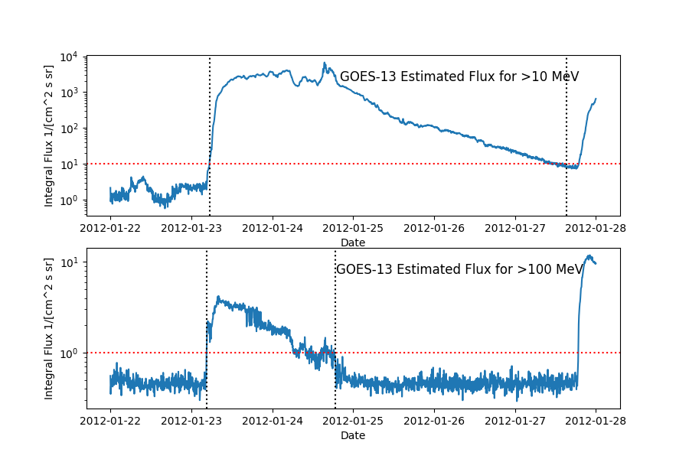
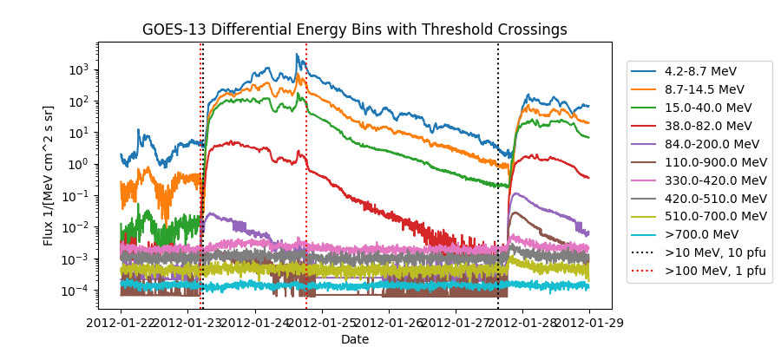
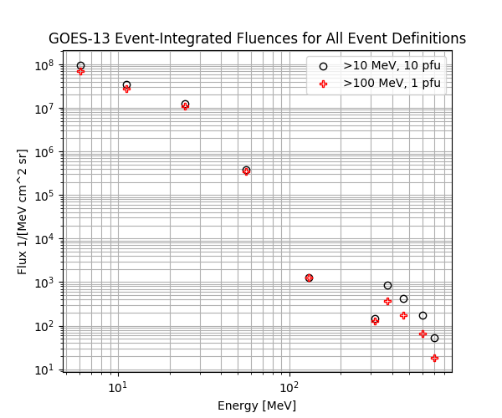
Example Run and Output – January 23, 2012
Integral fluxes estimated from the differential channels using power law interpolation across energy bins. Event start and end times for each threshold indicated by vertical black lines. Red line indicates 10 pfu threshold.
Plot of differential channels with the event start and end times for >100 MeV, 1 pfu threshold indicated by vertical black lines.
Event-integrated fluence of differential channels for the start and end times defined by >100 MeV, 1 pfu threshold. HEPAD channels could benefit from background-subtraction, especially when increase is small.

Slide 17
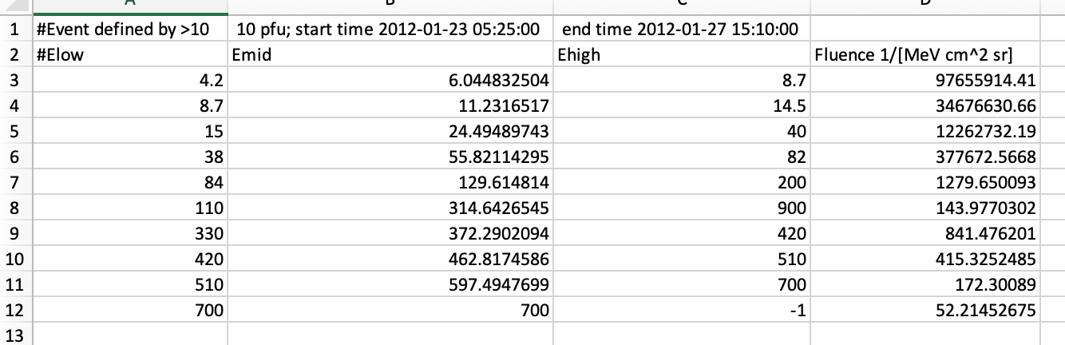
Output Files from Code – Fluence for Thresholds
Output files containing the event-integrated fluence for each of the integral or differential energy bins, as specified by user. There is a fluence file that corresponds to each threshold definition. For example, for GOES-13 spacecraft differential channels for Jan. 23, 2012 event:
>10 MeV, 10 pfu: fluence_GOES-13_differential_gt10_2012_1_23.csv
>100 MeV, 1 pfu: fluence_GOES-13_differential_gt100_2012_1_23.csv

Slide 18
Output Files from Code – All Other Values for Thresholds
Output files containing the event-integrated fluence for the integral or differential energy bins, as specified by user. There is a fluence file that corresponds to each threshold definition. For example, for GOES-13 spacecraft differential channels for Jan. 23, 2012 event:
sep_values_GOES-13_differential_2012_1_23.csv
Threshold definition
>10 MeV and >100 MeV event-integrated fluences integrated between the start and end times for the threshold definition in the row. Units [cm⁻²]
Time of first threshold crossing
Peak flux between start and end times
Time of Peak
Time from start to peak
End of event
End time – start time

Slide 19
compare_data_model.py
Makes plots of:
Integral flux time profile
Fluence spectrum
Bar charts for timing and intensity

Slide 20
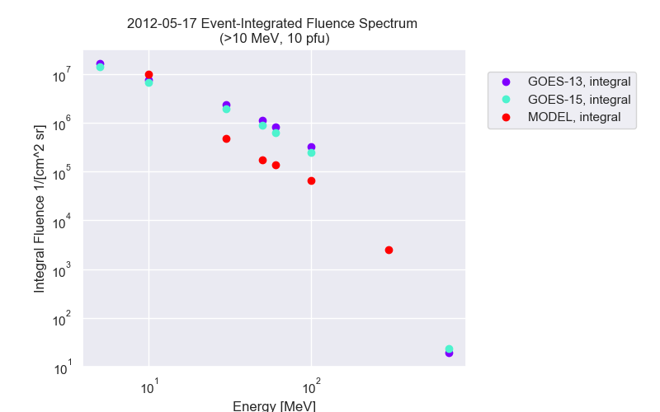
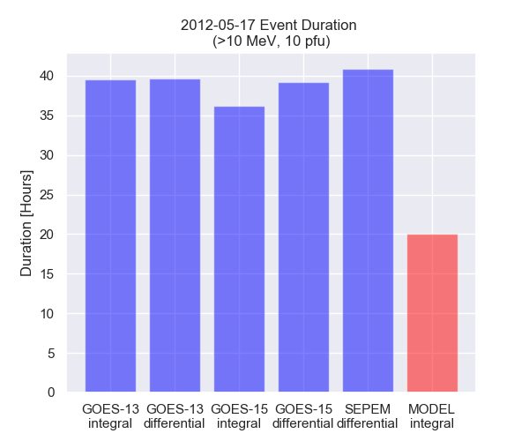
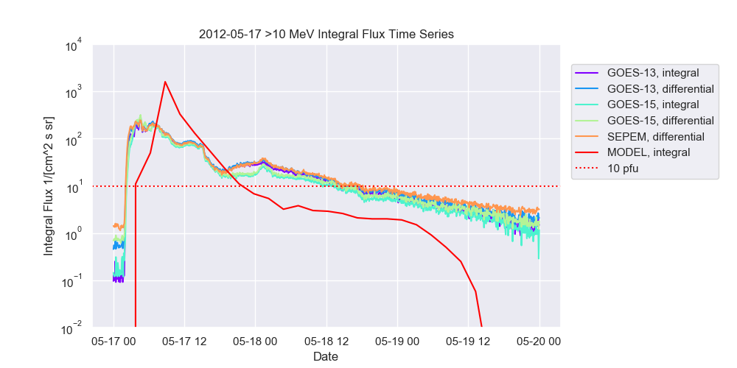
Plotting Code: compare_data_model.py
Read in output from operational_sep_quantities.py
Make useful visualizations to compare measurements with model results:
Time profile of >10 MeV and >100 MeV fluxes
Fluence spectrum
Bar charts – rise time, duration, peak flux, >10 MeV fluence, >100 MeV fluence

