Slide 1


Performance Analysis of 20 Large Cap US Assets with Pandas
Team 9: Clay, Tunde, Lucas, Irina

Slide 2

Objective & Scope
Objective: To analyze the performance of 20 large-cap US companies that are leaders in their respective industry sector over a period of 10 years (2010 to 2019) alongside the S&P 500.
Scope:
Determine relative performance of assets’ returns over the 10 years period
Determine relative volatility or riskiness of the assets
Determine correlation among the assets and the S&P 500
Forecast expected price/return of a low-risk asset and a high-risk asset
At the end of this presentation, our intention to use data analytics tools to deliver a crash course on “Stock Market 101”
All analysis was done in Jupyter notebook with Pandas

Slide 3

Assets Included in the Analysis
Industry | Asset 1 (Ticker Symbol) | Asset 2 (Ticker Symbol)
 | S&P500 (^GSPC)
Banks | Bank of America (BAC) | Wells Fargo (WFC)
Integrated Oil & Gas | ExxonMobil (XOM) | Chevron (CVX)
Telecommunications | AT&T (T) | T-Mobile (TMUS)
Entertainment | Disney (DIS) | Netflix (NFLX)
Restaurants | McDonald (MCD) | Starbucks (SBUX)
Household Products | Procter & Gamble (PG) | Colgate-Palmolive (PL)
Pharmaceuticals | Johnson & Johnson (JNJ) | Pfizer (PFE)
Airlines | American Airlines (AAL) | Delta Airlines (DAL)
Soft Drinks | Coca Cola (KO) | Pepsi (PEP)
Hypermarkets and Super Centers | Walmart (WMT) | Costco (COST)
Notes:
These stocks are in the large capitalization or “large cap” category, each with a market cap > $10 billion
Generally large cap stocks are less volatile to systemic risk/effect
Attractive to risk averse investors
All selected stocks are part of the S&P500 index
The S&P500 covers over 80% of America equity market by capitalization

Slide 4
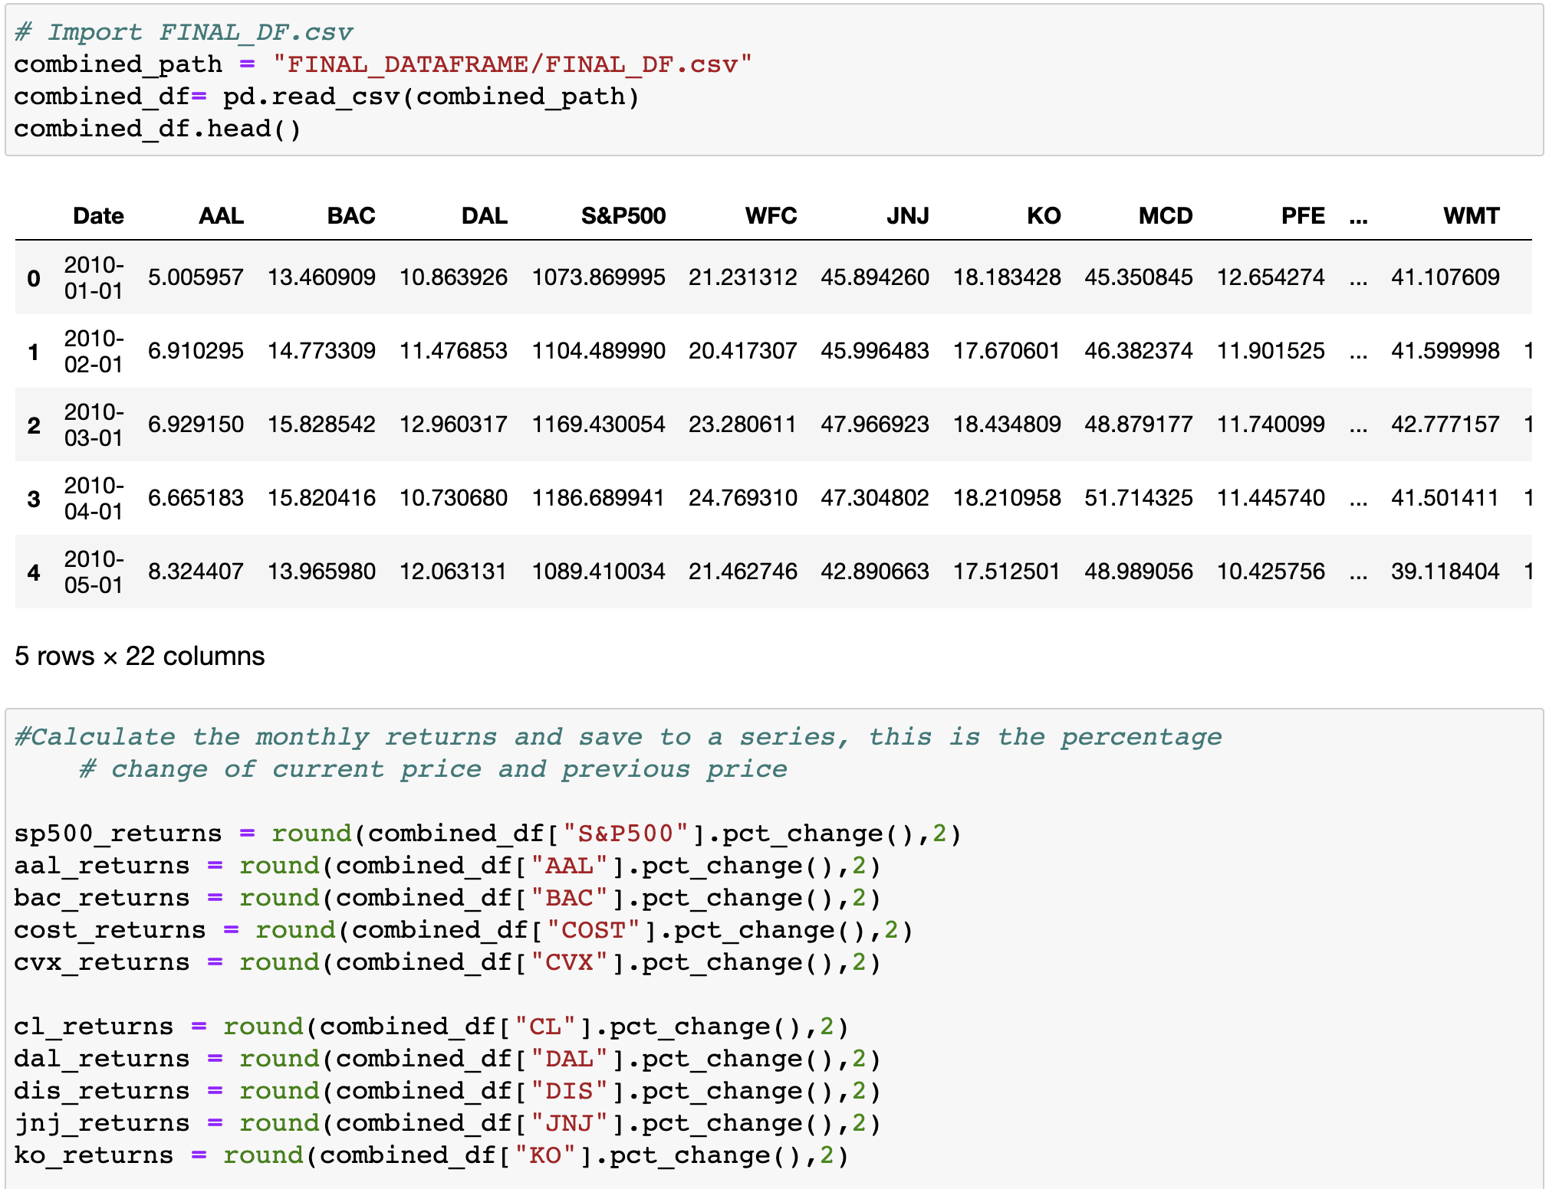
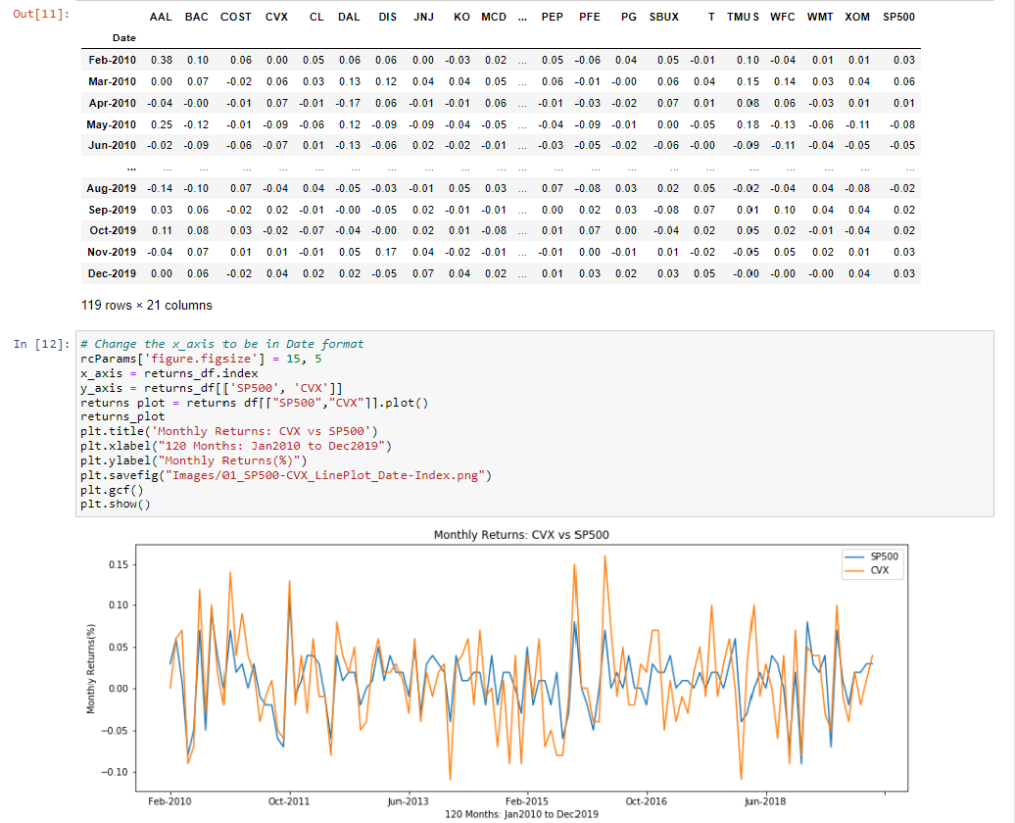
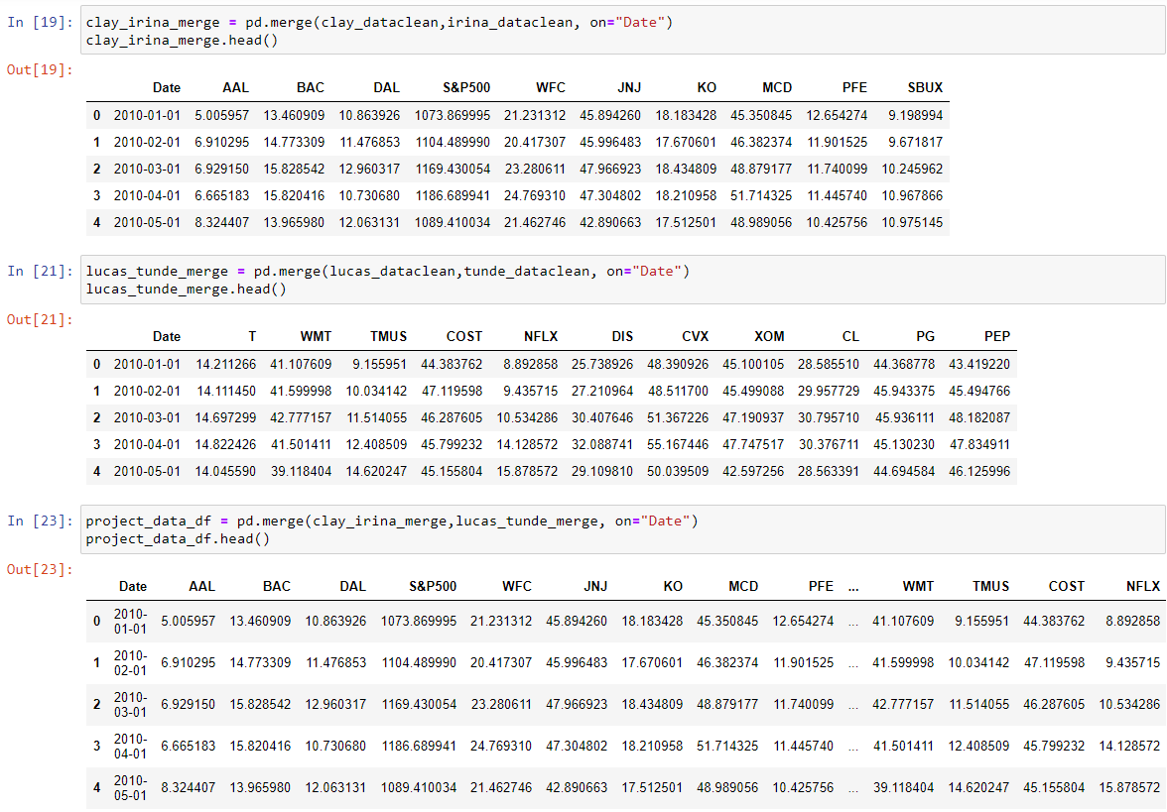
An extract from our work in Jupyter notebook

Slide 5
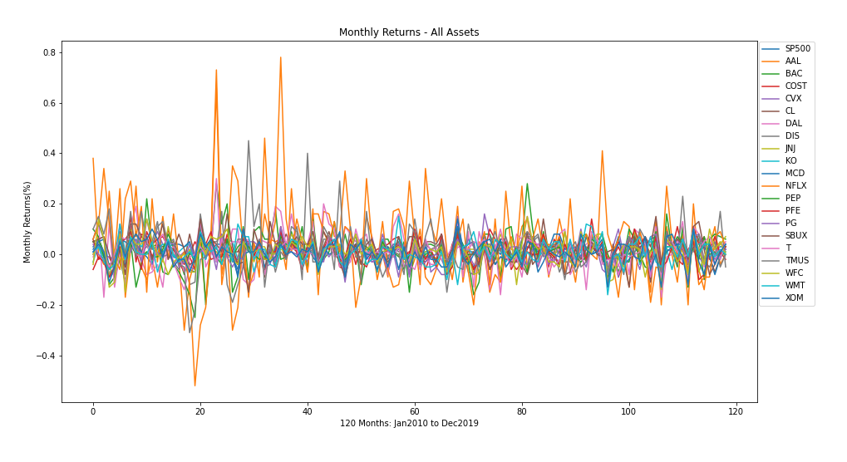
Plot of monthly returns of all assets
Notes:
To compute each stocks monthly returns, we used pandas “pct_change” function. Note that stock return is not the same as the price. Return is the % change of today’s closing price from yesterday’s closing price.
The line plot here shows the monthly returns of all stocks against time. Monthly Return is the dependent variable while time is the independent variable. The time period covered is 120 months from Jan 2010 to Dec 2019
As shown in the graph, returns are volatile, and they all swing on average +/- 2% on a monthly basis except for Netflix which we’ll talk about later in the presentation
In the next slide we will magnify on the returns of 2 assets in the same industry
Note: Long term investors are mostly interested in cumulative returns
Note: This only appeals to a day trader
The highest peaks are not from SP500 – it is actually from Netflix.
”Cut the wire / Cut the cord” – that’s when Netflix started going off the trend.
Note: Netflix in January 2012 starts its expansion in Europe, launching in the UK and Ireland. By September it has expanded to Scandinavian countries

Slide 6
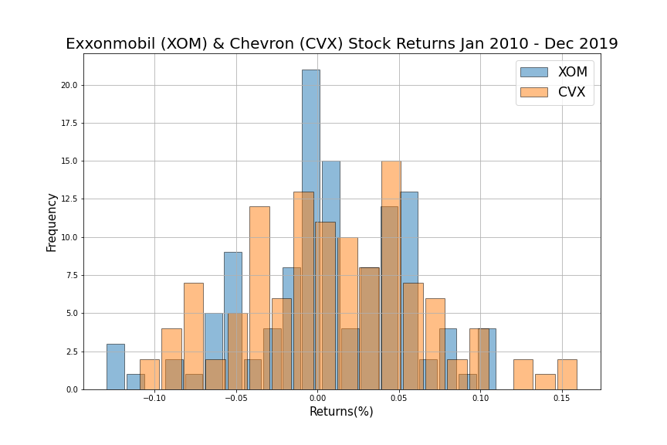
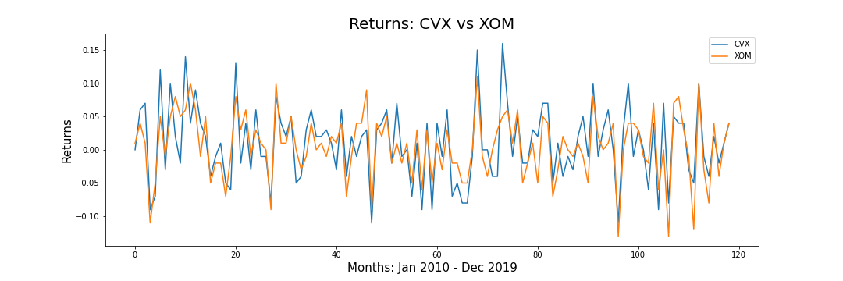
Monthly Return of 2 Oil & Gas Assets
Can clearly see that both assets have similar positive and negative returns
Notes:
Same plot as previous slide, but with only 2 stocks
This is the monthly returns of the 2 US oil & gas giants.
As shown in the line plot and the histogram distribution ---their returns have similar spread of +ve and -ve returns except for a few instances when CVX posted >10% returns which appeared to be outliers.

Slide 7
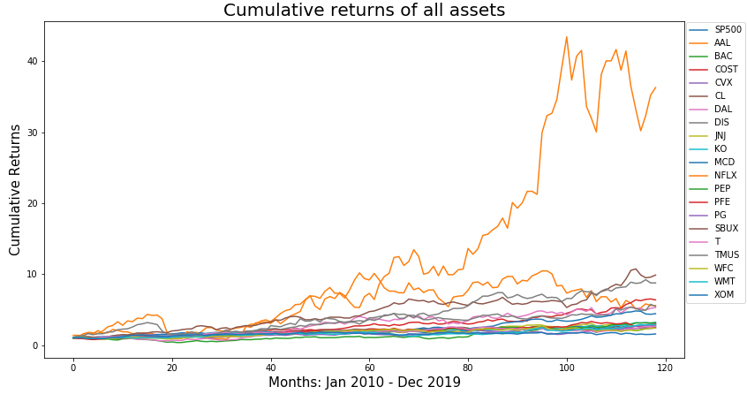
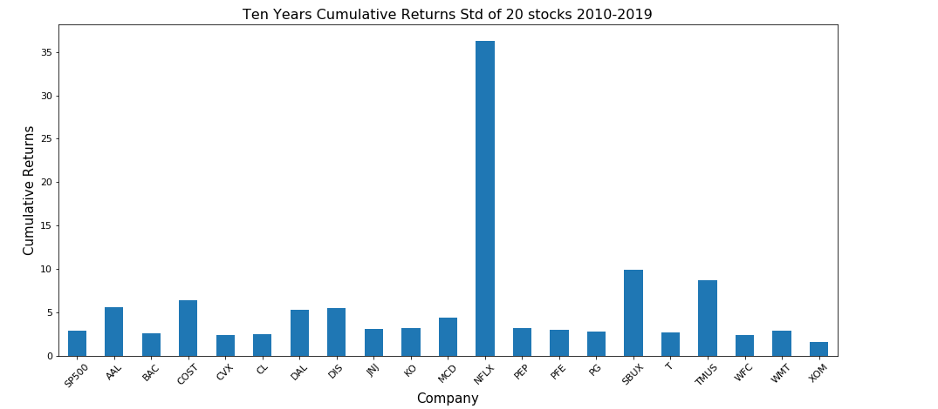
Cumulative Returns of all Assets over 10 years
Notes:
On top is a line plot of cumulative returns of all assets against time. For this plot we use the pandas “cumprod” function to calculate individual stocks cumulative returns.
As a non-sophisticated investor your interest should be the growth of your investment- “What will my investment be worth after x-years?”
Cumulative returns is the measure of the growth of investment after x years
Again, as you can see in the plot, NFLX completely broke out from the lot. Netflix has seen unprecedented growth since 2009, and has pushed some notable companies out of the industry, such as Blockbuster, and continue to be a threat to established companies like Fox or CBS.
A $1000 investment in NFLX in Jan 2010 would be worth $36,300 by the end of 2019, but a note of caution because it’s not all rosy. Netflix lost almost 50% of its value in Oct 2011, as seen in the plot, when they announced the split of a DVD and streaming business called Qwisker.
For now, let’s consider the Netflix phenomenon as an outlier and we’ll decouple it from the group in the next slide

Slide 8
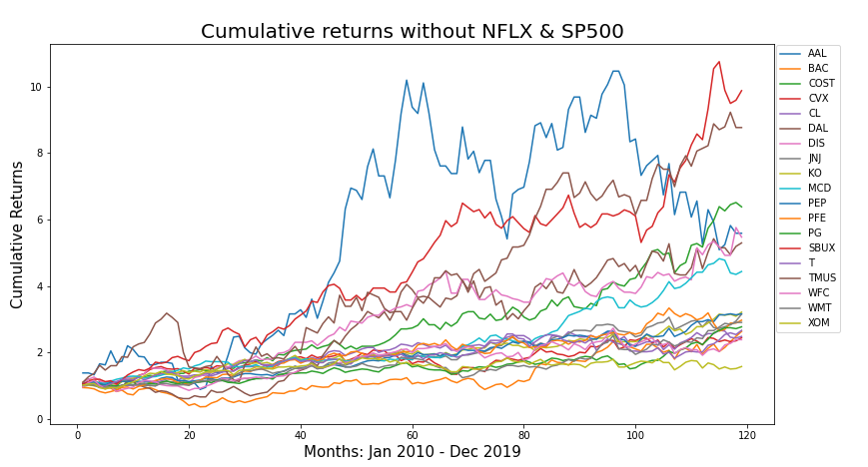
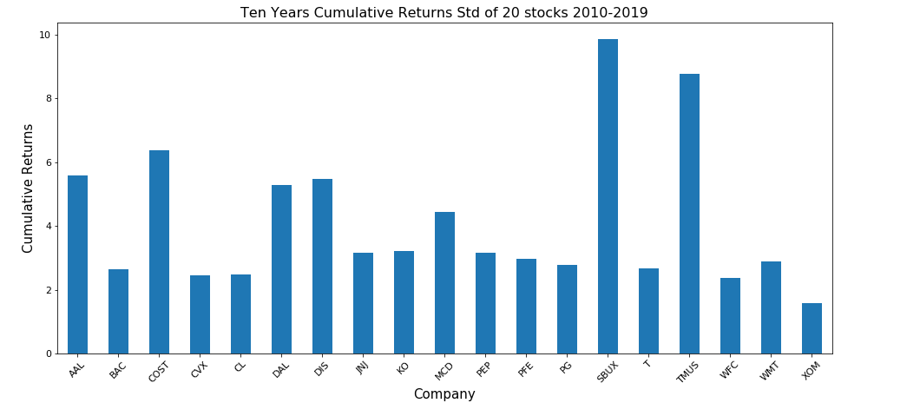
Cumulative Returns without NFLX & SP500
Notes:
As you can see here, all companies maintained a healthy growth over the ten years period.
An investment of $1000 in the least performing asset listed (XOM) in Jan 2010 will be worth $1,573.30 at the end of Dec 2019
While an investment of $1000 in the best performing asset listed (SBUX) in Jan 2010 will be worth $9,873.90 at the end of Dec 2019
With large cap companies, your strategy to grow your investment should be long term holding or “Buy and Hold”

Slide 9

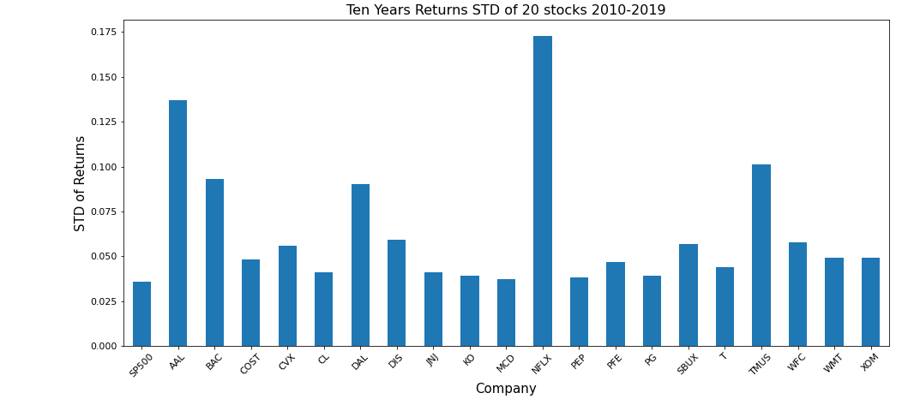
Relative Standard Deviation or Volatility
Speculators and day traders love risky assets while long term investors favor more stable assets
The STD of most stocks we have analyzed fall between 3.5% to 5.5%
Notes:
Here we used panda’s standard deviation function to calculate the STD of our stock’s monthly returns over 10 years.
Essentially, this is a measure of the volatility of the return. A more volatile stock will have a higher risk/reward.
Young, aggressive investors may be more inclined to invest in more volatile stocks because they have time to recoup their potential losses.
Speculators and day traders also love risky assets, while long term investors favor more stable assets.
It should be noted that there is always some risk in every undertaking, and even greater risk when you put your money into a company in which operations you are less knowledgeable of.
The STD of returns of most stocks we have analyzed fall between 3.5% to 5.5%, a range that is very typical of large-cap S&P 500 stocks.
Netflix stands out with a STD of returns of ~17% over the last 10 years and has been one of the most successful growth stories of the past decade.
-Note that a low STD isn’t necessarily the holy grail of investments. Young and aggressive investors typically go for above average std assets
-Also note that std are very susceptible to outliers.
-Remember in this context, STD is the dispersion of each stocks return relative to its mean value (variance). A higher STD indicates more datapoints are further away from the mean within the data set and a large return range.

Slide 10
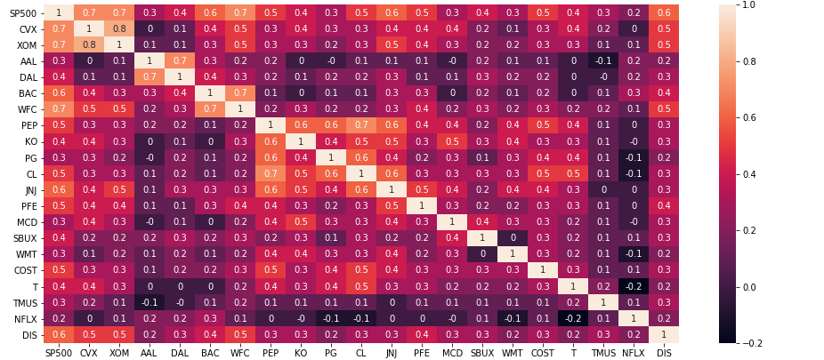
Correlation Matrix of All Assets
Bank of America (BAC) | Wells Fargo (WFC)
ExxonMobil (XOM) | Chevron (CVX)
AT&T (T) | T-Mobile (TMUS)
Disney (DIS) | Netflix (NFLX)
McDonald (MCD) | Starbucks (SBUX)
Procter & Gamble (PG) | Colgate-Palmolive (CL)
Johnson & Johnson (JNJ) | Pfizer (PFE)
American Airlines (AAL) | Delta Airlines (DAL
Coca Cola (KO) | Pepsi (PEP)
Walmart (WMT) | Costco (COST)
- Displays a higher correlation in the table with other assets compared to the assets it’s own category excluding SP500
Correlation between assets in the same category
-1 or 1 (perfect correlation)
>= +/- 0.7 (strong correlation)
>= +/- 0.5 (moderate)
<= +/- 0.3 (weak)
0 (no linear relationship)
Notice the level of correlation among assets within the same industry
Notes:
Here we created a correlation matrix of all assets returns using pandas CORR function
The objective of this is to study the degree of linear relationships between pairs of stocks and to use analytical tools to create a more diverse portfolio.
As an investor, you don’t want to put all of your eggs in one basket and risk taking a major hit.
Take a look at assets within same industry such as Chevron/Exxon ; American/Delta; BofA/WFC; and note that they have strong correlation of returns.
However, some assets have a stronger relationship with companies outside of their industry than they do within. A few examples of this is Walmart having a higher correlation with Pepsi that it does Costco, and Disney has a higher correlation with Wells Fargo than it does Netflix.
Information is always powerful to an investor, and the key take away here is to have a mix of lowly correlated assets in your portfolio.
Next we will focus on 2 assets and make an attempt to predict their future stock price with regression model ….the assets are CVX with the strongest correlation with the market and NFLX with the lowest correlation with the market …also NFLX returns have the highest volatility while CVX have a much lower volatility relative to NFLX

Slide 11
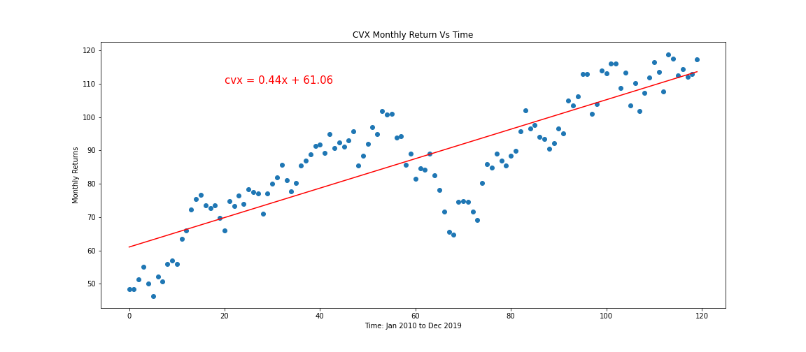
Making price predictions based on regression model: CVX (Low STD) and NFLX (High STD)
Forecasted closing price based on regression model:
Jan 2020: 114.30
Feb 2020: 114.74
The actual closing price for CVX:
Jan 2020: 104.37
Feb 2020: 90.93
The STD of CVX price is 18.1.
The Jan forecasted price is within +/- CVX STD, while Feb is outside the STD.
This can be attributed to the price war between Russia and Saudi Arabia that sent crude oil prices tumbling into the negative.

Slide 12
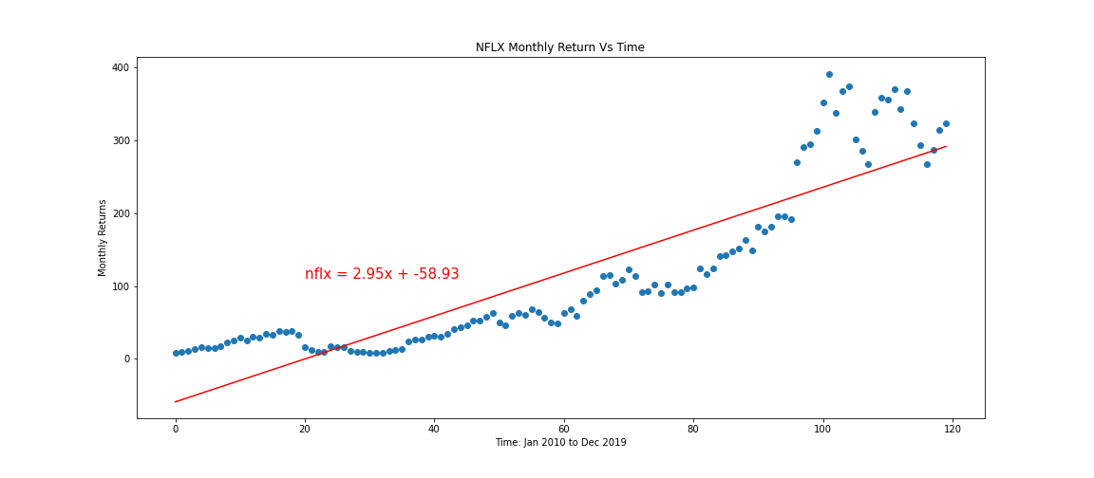
Making price predictions based on regression model: CVX (Low STD) and NFLX (High STD)
Forecasted closing price based on regression model:
Jan 2020: 298.02
Feb 2020: 300.97
The actual closing price for NFLX:
Jan 2020: 345.09
Feb 2020: 369.03
The STD of NFLX price is 115.71.
The Jan and Feb forecasted prices are within +/- NFLX STD.
Notes:
What could be responsible for the high spread within the NFLX price distribution and non-conformity with the model?
All the price breakout above $200 happened in 2019
90% of NFLX prices in 2019 (month 100 and above) are above the line equation and could be outliers if regression was limited to Q1 of 2019.
NFLX members-base more than doubled at the end of Q3 of 2019 with massive international expansion resulting in more than 60% of its subscribers being international.

Slide 13
Multiple Regression with SkLearn.Linear_Model
Added “US Unemployment rate” for 2010 to 2019 as the second dependent variable alongside “Time”
Price = intercept + coefficient1*time + coefficient2*unemp_rate
CVX Model:-9.567894331153013 [0.86705591 7.28598621]
cvx_jan2020 = -9.568 + (0.867*121) + (7.286*0.036) = 95.60
cvx_feb2020 = -9.568 + (0.867*122) + (7.286*0.035) = 96.46
Both forecasted prices within CVX actual price and std of +/-18.1
NFLX Model: -945.0750550498519 [ 8.28553905 91.42047607]
nflx_jan2020 = -945.075 + (8.286*121) + (91.42*0.036) = 60.82
nflx_feb2020 = -945.075 + (8.286*122) + (91.42*0.035) = 69.02
Both forecasted prices out of range with NFLX actual price and std of +/- 115.71
Notes:
We also consider the possibility of a more conservative predictor for price with multiple regression by introducing another dependent variable. We added the US unemployment rate for 10 years coinciding with the years included in our analysis
For this purpose we imported the LinearRegression module from sklearn.linear_model
For CVX: The introduction of an additional variable resulted in a more conservative or better fitting prediction of CVX’s Jan and Feb prices within the STD.
For NFLX: The model didn’t provide a better prediction further alluding to its non-conformity with others in the pack.

Slide 14
Conclusions
Our analysis has shown Python/Panda as an effective tool in financial data analytics
Stock prices are time series with predictable trends especially during period of economic stability
Day trading is speculative and highly risky. You should stay away from it If you are risk-averse and your strategy is to grow your investment
Daily/Monthly volatility only appeals to experts, day traders, and those with insider information which is illegal.
Monthly or daily returns should not be a factor when you are making investment decisions, though they are a good indicator of periodic volatility of an asset
Cumulative returns should be your primary focus when thinking about growing your capital with stocks
Make your portfolio selection with a mix of lowly correlated assets . Also include assets that have low correlation with the market to provide some balance against systemic risk
To use multiple regressions for price prediction there is no one variable fit all to use alongside Time. Each stock unique situation and industry knowledge will provide an insight into variables that impact their price movement.
Notes:
Old slide information is here:
Stock prices are Time Series
Day trading is speculative and risky
The sure way to make good returns on your investment is long term holding “buy and hold”
Make your portfolio selections with a mix of lowly correlated assets
Regression analysis may be able to tell the future trend of an asset price because prices are time series …however, there are other variables other than time that determines the future price of an asset.

Slide 15
Thank you

Slide 16
Backup Slides

Slide 17
Data Integrity of the 2 Assets
The box plot lends some credence to the Jan 2020 price of NFLX with all prices >120 as outliers
50% of your data is in the box.
Orange line represents the median.
The narrower the box the closer the majority of data is to the median.
Notes:
How good is the data? To answer the question around the credibility of the assets data we created box plots of their monthly price to give us a quick visual understanding of the distribution and skewness/dispersion/variability.
CVX appears to have normal distribution. A shorter box indicates a less dispersed distribution which aligns with our earlier calculation of CVX’s STD.
However, NFLX has a positive skew and the longer box show greater degree of spread. This also aligns with our previous observations.

