Slide 1
Predictive Analysis of 20 Large Cap US Assets
Proj1- Team#09

Slide 2
Objective & Scope
Objective: To analyze the performance of 20 large-cap US companies that are leaders in their respective industry sector over a period of 10 years (2010 to 2019) alongside the S&P 500.
Scope:
Determine relative performance of assets’ returns over the 10 years period
Determine relative volatility or riskiness of the assets
Determine correlation among the assets and the S&P 500
Forecast expected price/return of a low risk asset and a high risk asset

Slide 3
Assets Included in the Analysis: S&P500 (^GSPC)
Industry | Asset 1 (Ticker Symbol) | Asset 2 (Ticker Symbol)
Banks | Bank of America (BAC) | Wells Fargo (WFC)
Integrated Oil & Gas | ExxonMobil (XOM) | Chevron (CVX)
Telecommunications | AT&T (T) | T-Mobile (TMUS)
Entertainment | Disney (DIS) | Netflix (NFLX)
Restaurants | McDonald (MCD) | Starbucks (SBUX)
Household Products | Procter & Gamble (PG) | Colgate-Palmolive (PL)
Pharmaceuticals | Johnson & Johnson (JNJ) | Pfizer (PFE)
Airlines | American Airlines (AAL) | Delta Airlines (DAL
Soft Drinks | Coca Cola (KO) | Pepsi (PEP)
Hypermarkets and Super Centers | Walmart (WMT) | Costco (COST)

Slide 4
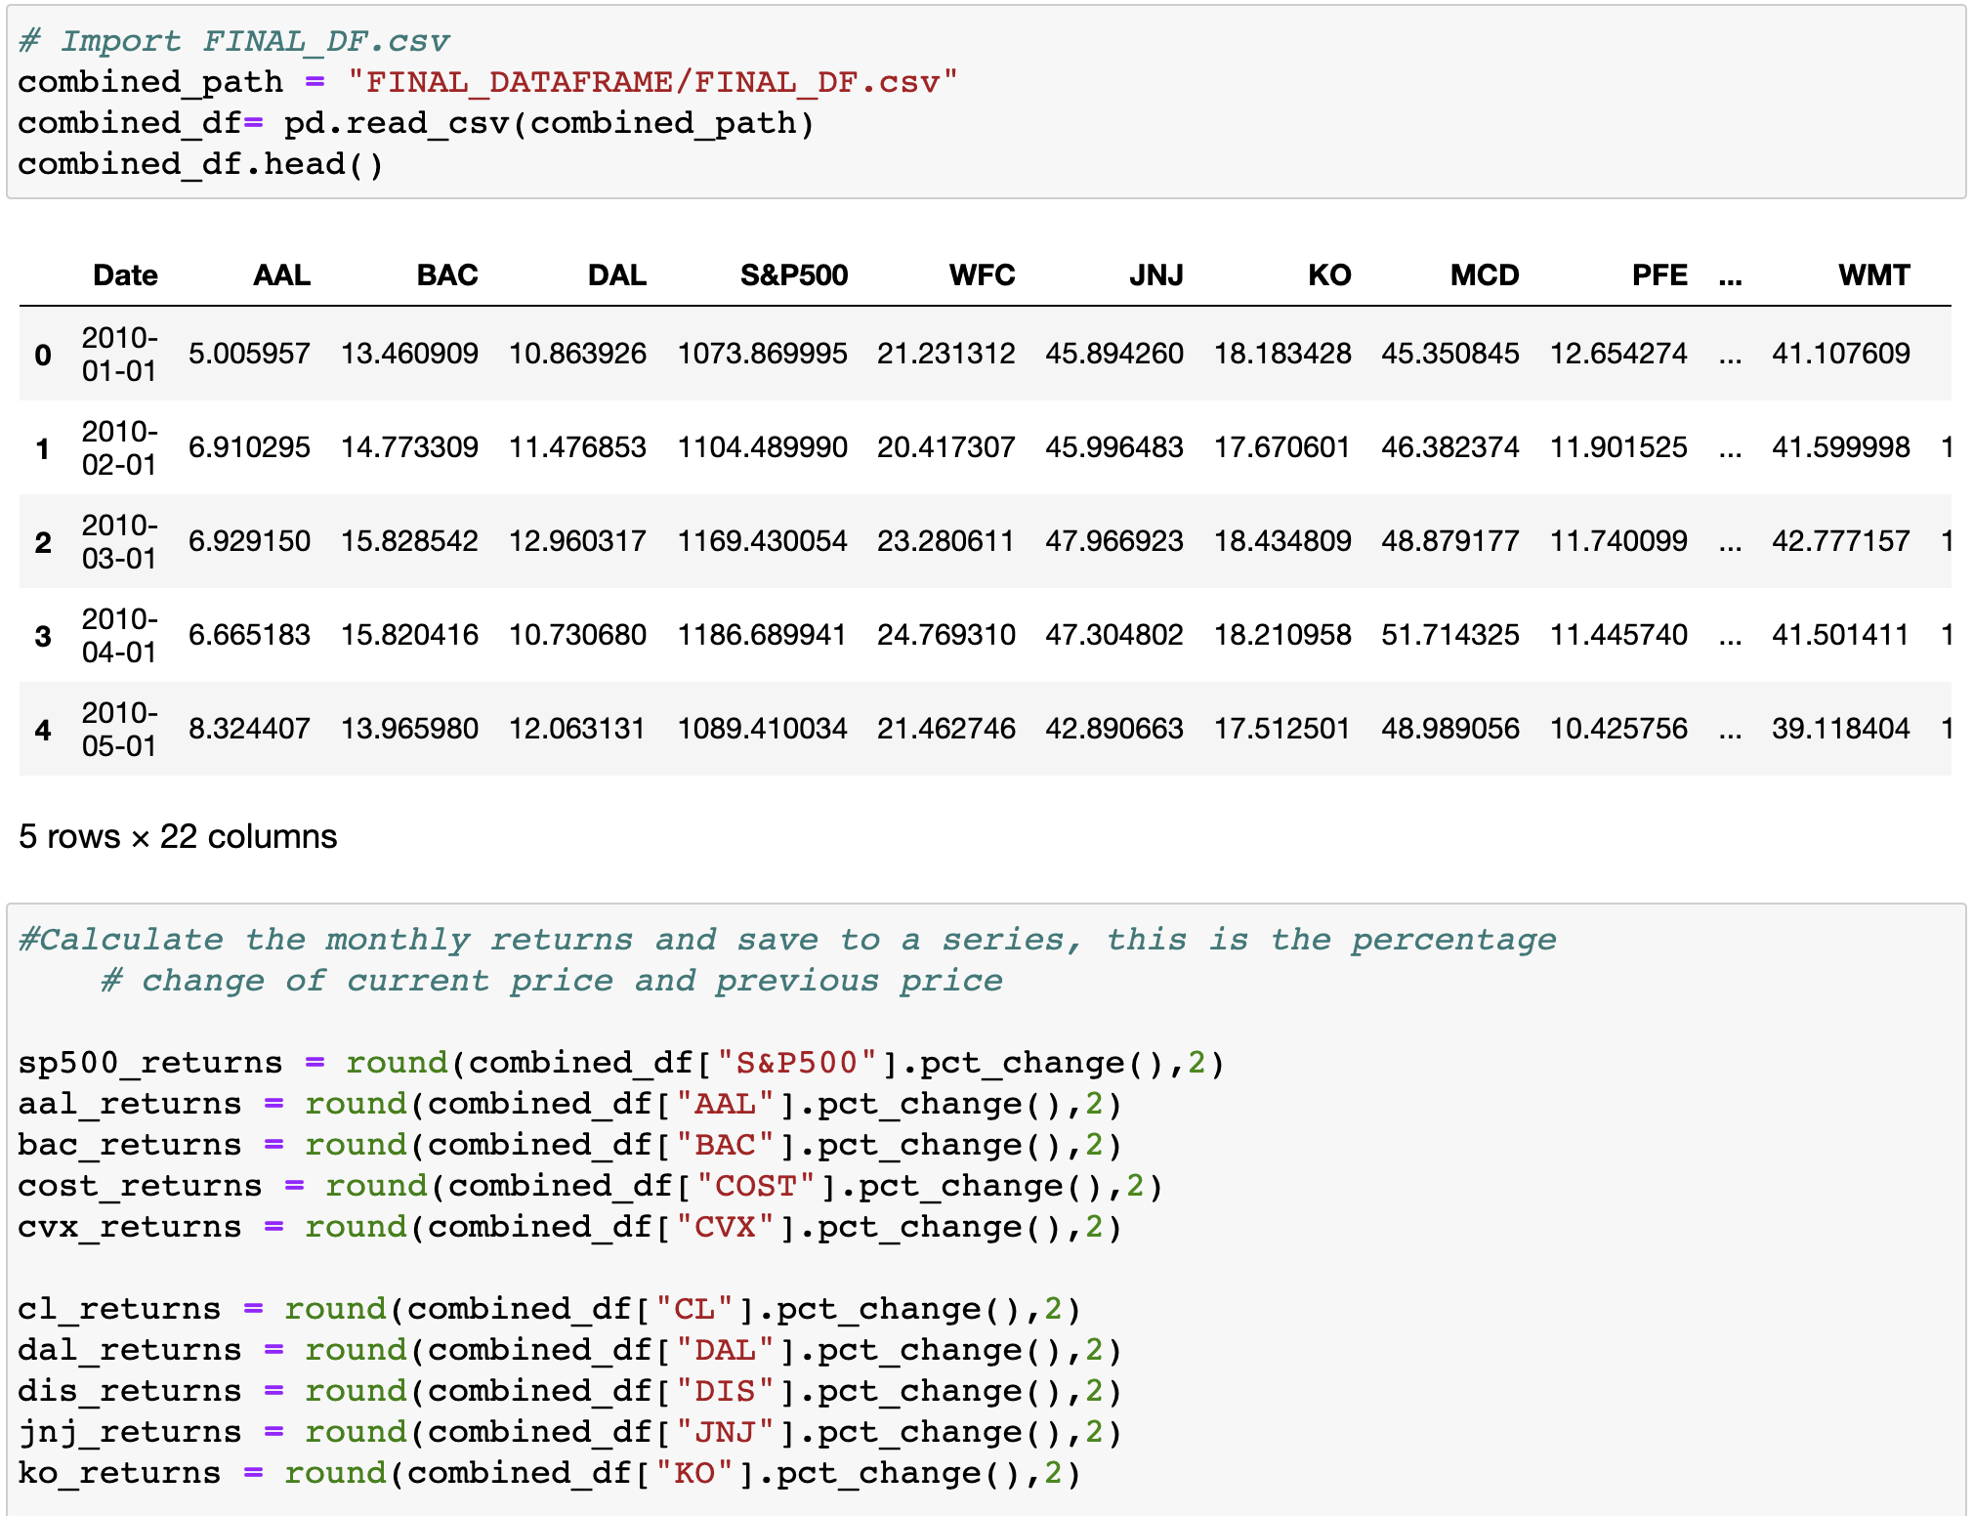
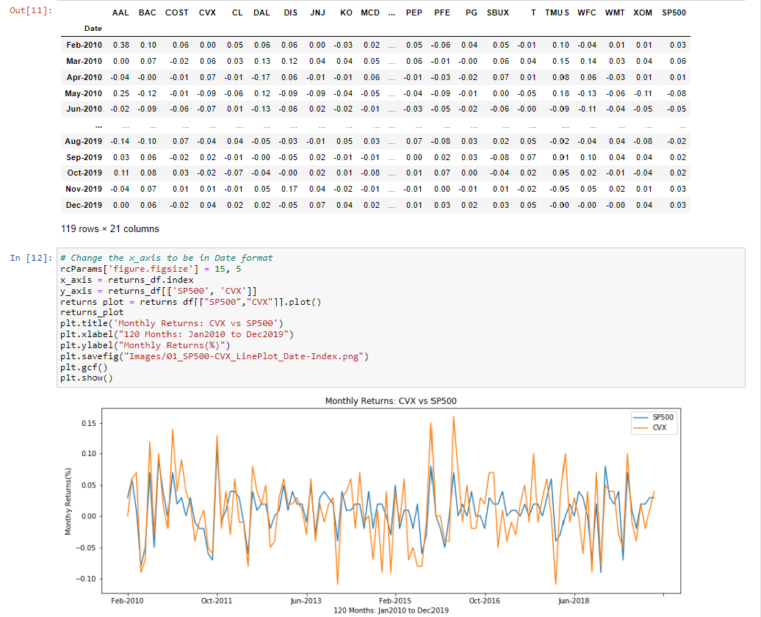
An extract from our work in Jupyter notebook

Slide 5
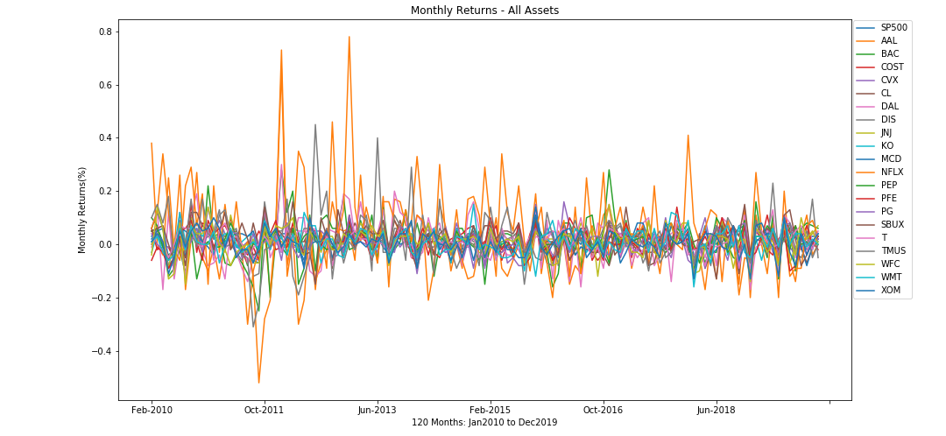
Plot of monthly returns of all assets
Cannot really use this view, as too much noise. Note: might need to take out the SP500.
Note: change the x_axis to convert to mm-YYYY. (in 2012, Netflix …)
No change I believe we should keep This because it shows the large difference between Netflix and the Others
Data is too noisy – cannot conclude decisively.
All assets appear volatile and swing
Note: This only appeals to a day trader
Note: Long term investors are mostly interested in cumulative returns
Note: Netflix in January 2012 starts its expansion in Europe, launching in the UK and Ireland. By September it has expanded to Scandinavian countries
Notes:
The highest peaks are not from SP500 – it is actually from Netflix.
”Cut the wire / Cut the cord” – that’s when Netflix started going off the trend.

Slide 6
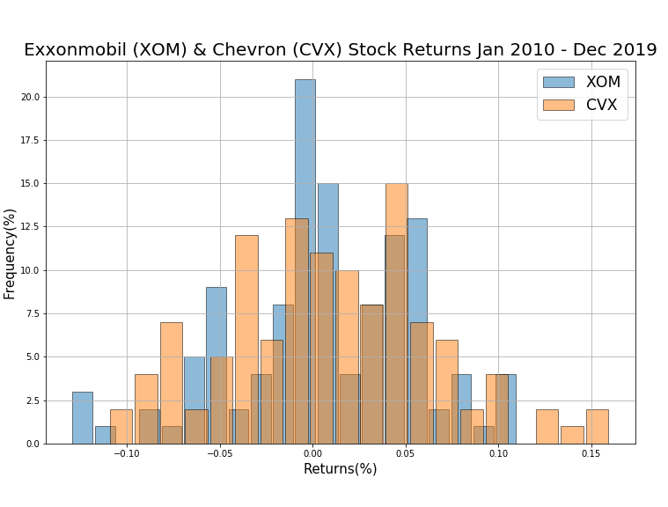
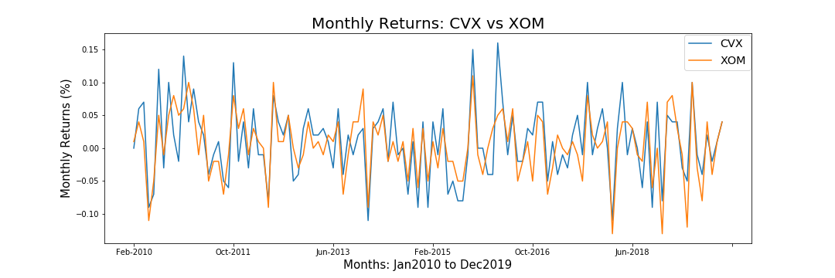
Monthly Return of 2 Oil & Gas Assets
Note: can clearly see that both assets have similar positive and negative returns
The intention is to use a different representation to avoid noisy data as in the previous graph.
Import updated graphs.
Notes:
This is a continuation of the previous slide. Now, when we look closer at two companies within the same industry, we can observe this behavior from the presented histogram plot.

Slide 7
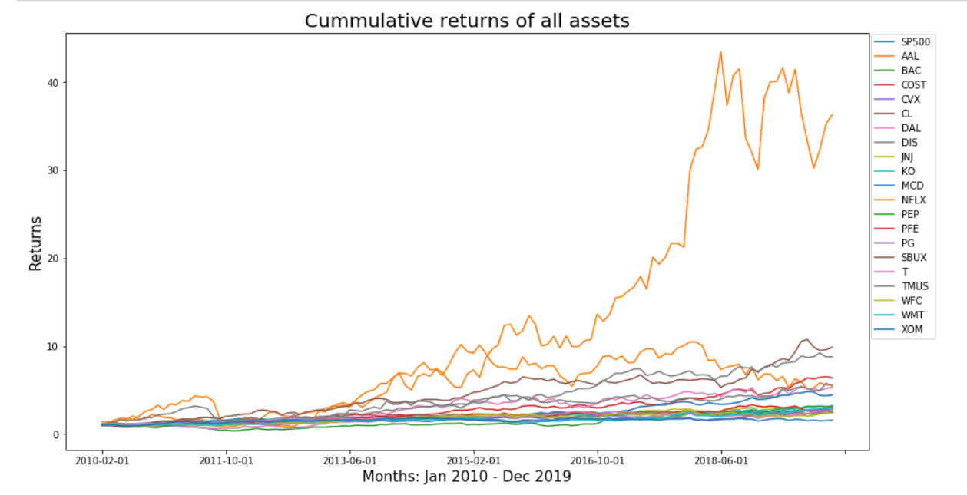
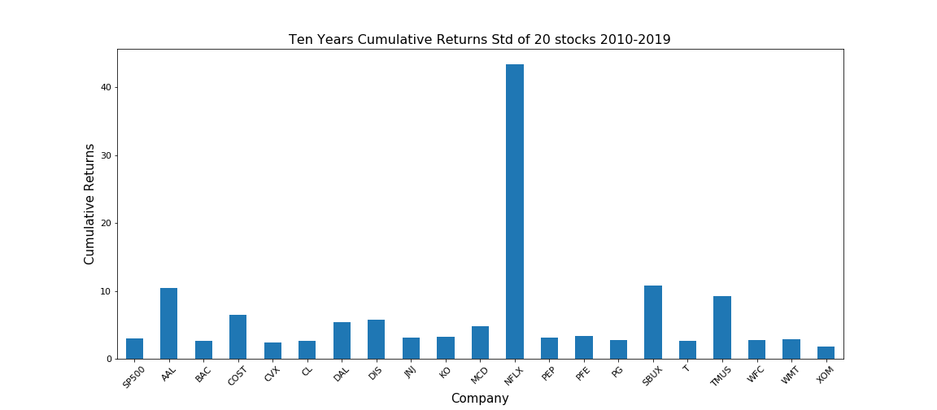
Plot of Cumulative Returns of all Assets
As shown on the line plot Netflix has the highest Cumulative returns out of all the Assets
Due to an extreme amount of noise on the rest of the assets a Bar chart was made
Bar chart shows clearer difference in the Cumulative Returns of Netflix compared to all the other Assets
A slide for the cumulative returns. I put this cause it showed the greatest display with the most graph images for comparison in the notebook and project in whole for all 20 assets.

Slide 8
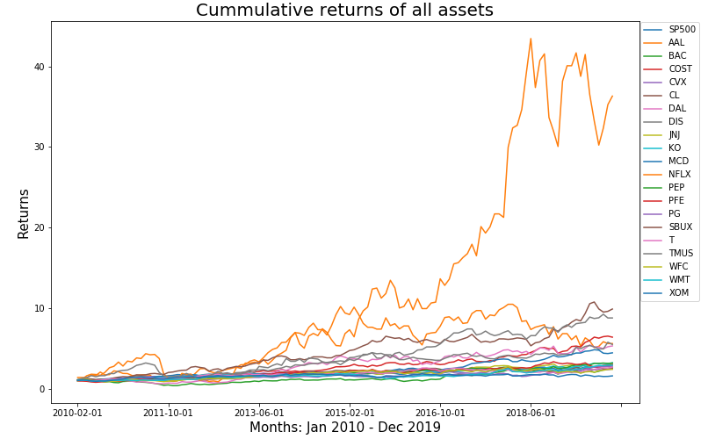
Cumulative Return of all assets for the 10 years
All assets have >100% return within 10 years
The best performing asset return >300%
The least performing asset return ~150%
Add all assets.
Import separate legend from previous graph.
Note: y_axis renamed to Returns (no %)
No change in this slide cause if we keep the slide I made, it adds a more depth explanation on the images
 | SP500 | AAL | BAC | COST | CVX | CL | DAL | DIS | JNJ | KO | MCD | NFLX | PEP | PFE | PG | SBUX | T | TMUS | WFC | WMT | XOM
count | 119 | 119 | 119 | 119 | 119 | 119 | 119 | 119 | 119 | 119 | 119 | 119 | 119 | 119 | 119 | 119 | 119 | 119 | 119 | 119 | 119
mean | 1.83104765 | 5.53372755 | 1.26526476 | 2.84832641 | 1.80156984 | 1.95091572 | 2.8624747 | 3.05537718 | 1.90291562 | 1.97400452 | 2.3410098 | 13.0043989 | 1.89488274 | 1.98016985 | 1.53533459 | 4.58845047 | 1.8584931 | 4.31434975 | 1.74249642 | 1.62959201 | 1.53656463
std | 0.53047462 | 3.00531932 | 0.57620666 | 1.41337537 | 0.37542312 | 0.51630954 | 1.5809339 | 1.27774506 | 0.6720489 | 0.52503617 | 1.02257909 | 12.9635067 | 0.6034693 | 0.6619695 | 0.41835587 | 2.38018104 | 0.42382978 | 2.35749814 | 0.50846301 | 0.48798236 | 0.21729116
min | 0.96377553 | 0.88595174 | 0.36156827 | 0.95704021 | 0.95987346 | 0.96568292 | 0.60883842 | 1.06 | 0.91783 | 0.93958825 | 1.02 | 0.85408017 | 1.02606134 | 0.78036859 | 0.98843231 | 1.05 | 0.9879012 | 1.1 | 0.82458208 | 0.91060372 | 0.89699433
max | 2.93820531 | 10.4623426 | 2.6299749 | 6.50902856 | 2.44543175 | 2.66587586 | 5.41850951 | 5.75583508 | 3.14842513 | 3.20936811 | 4.81955 | 43.4501631 | 3.15983786 | 3.3337903 | 2.76782565 | 10.7465934 | 2.6625178 | 9.22560132 | 2.72763518 | 2.90068771 | 1.83651027
ave_max = | 6.32446235
 | SP500 | AAL | BAC | COST | CVX | CL | DAL | DIS | JNJ | KO | MCD | PEP | PFE | PG | SBUX | T | TMUS | WFC | WMT | XOM
count | 119 | 119 | 119 | 119 | 119 | 119 | 119 | 119 | 119 | 119 | 119 | 119 | 119 | 119 | 119 | 119 | 119 | 119 | 119 | 119
mean | 1.83104765 | 5.53372755 | 1.26526476 | 2.84832641 | 1.80156984 | 1.95091572 | 2.8624747 | 3.05537718 | 1.90291562 | 1.97400452 | 2.3410098 | 1.89488274 | 1.98016985 | 1.53533459 | 4.58845047 | 1.8584931 | 4.31434975 | 1.74249642 | 1.62959201 | 1.53656463
std | 0.53047462 | 3.00531932 | 0.57620666 | 1.41337537 | 0.37542312 | 0.51630954 | 1.5809339 | 1.27774506 | 0.6720489 | 0.52503617 | 1.02257909 | 0.6034693 | 0.6619695 | 0.41835587 | 2.38018104 | 0.42382978 | 2.35749814 | 0.50846301 | 0.48798236 | 0.21729116
min | 0.96377553 | 0.88595174 | 0.36156827 | 0.95704021 | 0.95987346 | 0.96568292 | 0.60883842 | 1.06 | 0.91783 | 0.93958825 | 1.02 | 1.02606134 | 0.78036859 | 0.98843231 | 1.05 | 0.9879012 | 1.1 | 0.82458208 | 0.91060372 | 0.89699433
max | 2.93820531 | 10.4623426 | 2.6299749 | 6.50902856 | 2.44543175 | 2.66587586 | 5.41850951 | 5.75583508 | 3.14842513 | 3.20936811 | 4.81955 | 3.15983786 | 3.3337903 | 2.76782565 | 10.7465934 | 2.6625178 | 9.22560132 | 2.72763518 | 2.90068771 | 1.83651027
ave_max = | 4.46817731
Notes:
Note: focus on accumulative returns. Where investors make or lose money. Long-term investors see 1.5 – 3.0 times the return over 10 years period.
Speculators capture gains on the volatility of short-term market movements.

Slide 9
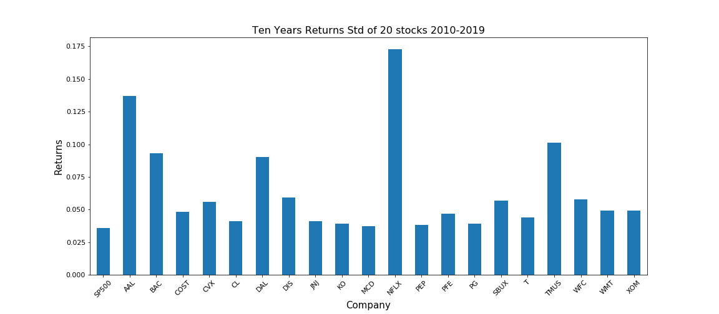
Relative Standard Deviation or Volatility
Only leave one plot.
Make the graph as big as possible.
Collect all figures in a separate folder.
All within 3.5 to 5.5% with the 2 oil & gas assets having the highest risk
Speculators and day traders love risky assets while long term favor more stable assets
No change
Notes:
This chart

Slide 10
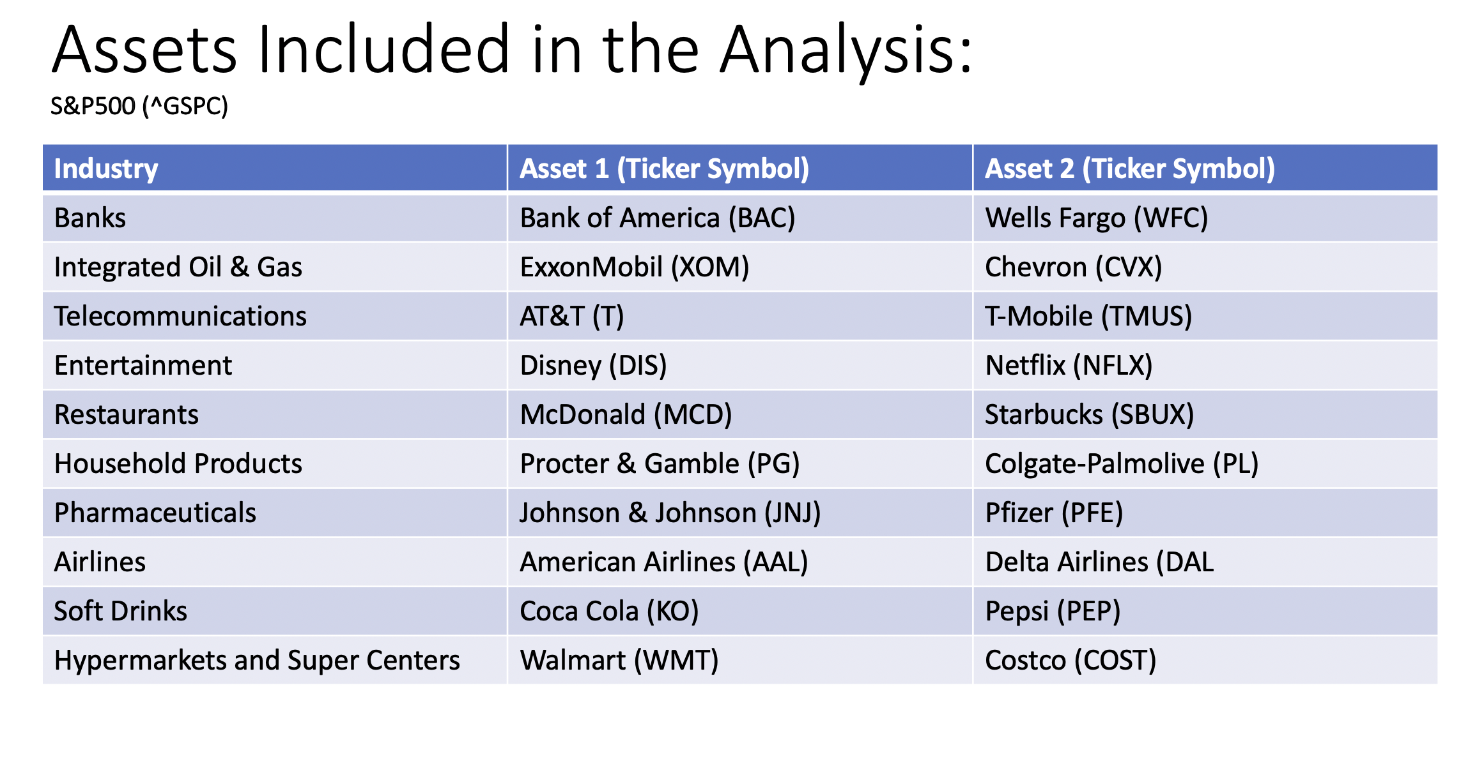
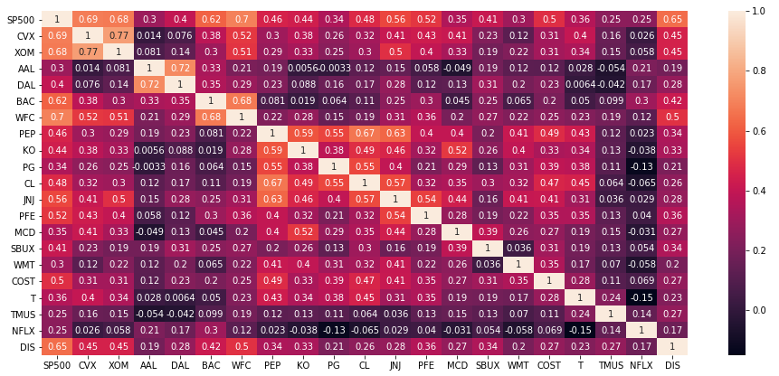
Correlation Matrix of All Assets
Highlight the correlating assets with better marking ☺. Re-arrange the assets to have assets from the same industries in pairs.
Added highlights and went through to find higher correlation in the general matrix
- Displays a higher correlation in the table with other assets compared to the assets it’s own category excluding SP500
A measure of linear relationship between 2 assets…what is the impact of a change on one asset on the other asset?
Notice the level of correlation among assets within the same industry
- Correlation between assets in the same category

Slide 11
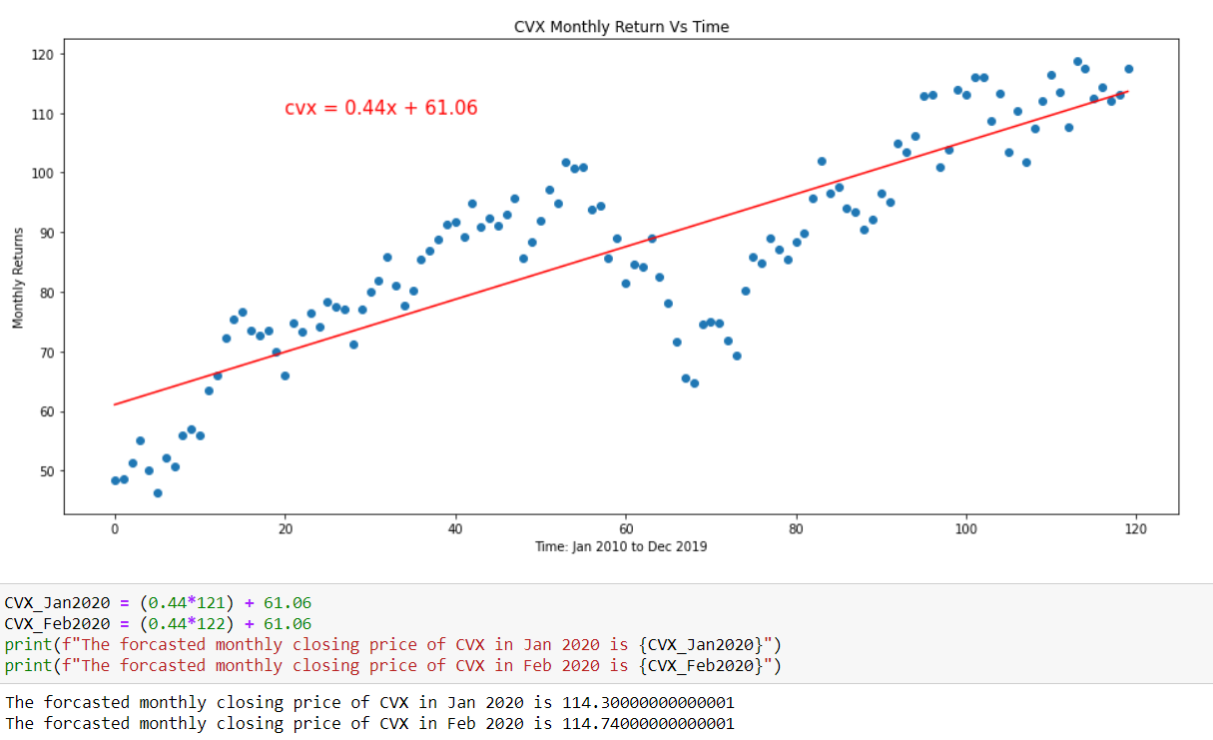
Predict the future Price of 2 assets with relative high and low STD – CVX and NFLX
Updated the Image
The actual closing price for CVX at the end of Jan 2020 is 104.37, while Feb is 90.93
The STD of CVX price is 18.1 the Jan forecasted price is within +/- CVX std, while Feb is outside the std. This can be attributed to the price war between Russia and Saudi Arabia that send crude price tumbling to the negative.
Keep the CVX but replace with an updated plot.
Note: open to change, if more interesting companies observed.
Notes:
Open

Slide 12
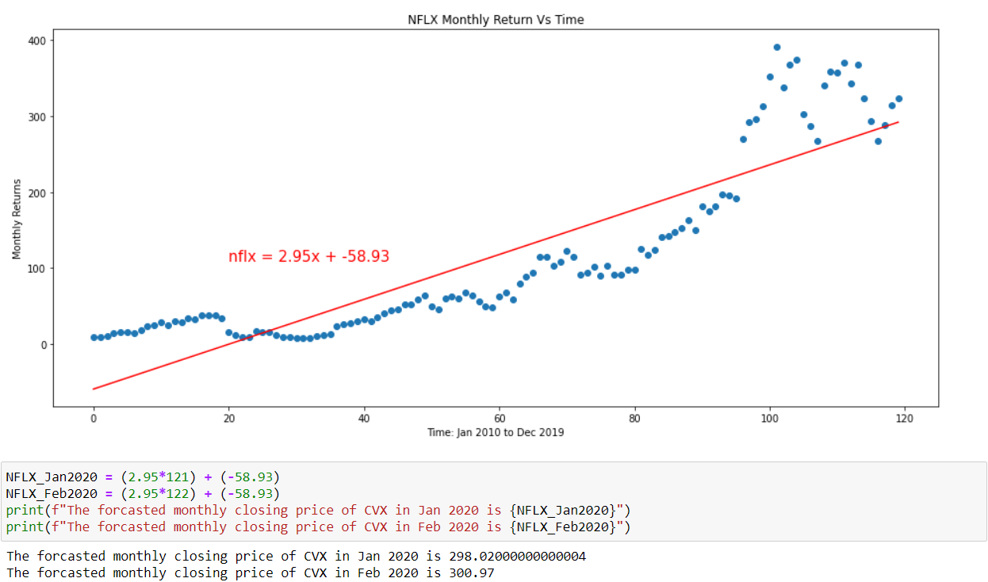
Predict the future Price of 2 assets with relative high and low STD – CVX and NFLX
Updated the Image. Not sure about the text below. Same with the slide above
The actual closing price for NFLX at the end of Jan 2020 is 123.06, while Feb is 112.48
The STD of NFLX price is 18.83…the Jan forecasted price is outside +/- PG std, while Feb is within the std. This can be attributed to the “Jan effect” when companies announce their annual returns.
Keep the PG but replace with an updated plot.
Note: open to change, if more interesting companies observed.

Slide 13
Integrity of Data of the 2 Assets
The box plot lend some credence to the Jan 2020 price of NFLX with all prices >120 as outliers
Keep the CVX but replace with an updated plot.
Note: open to change, if more interesting companies observed.
Notes:
50% of your data is in the box.
Orange line is the median.
The narrower the box the more data is closer to the median.
Outlierss

Slide 14
Conclusions ---WIP
Stock prices are Time Series
Day trading is speculative and risky
The sure way to make good returns on your investment is long term holding “buy and hold”
Make your portfolio selections with a mix of lowly correlated assets
Regression analysis may be able to tell the future trend of an asset price because prices are time series …however, there are other variables other than time that determines the future price of an asset.

