Slide 1

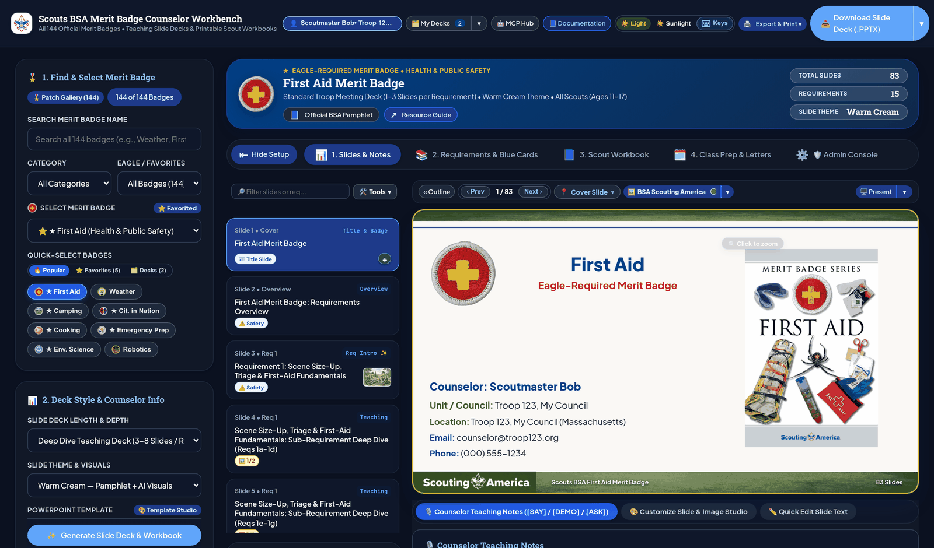


GOOGLE CLOUD FDE CAPSTONE EXECUTIVE READOUT | SCOUTS BSA MERIT BADGE COUNSELOR WORKBENCH
Grounded 7-Agent Google ADK Workbench Compresses 8-15 Hours of Merit Badge Prep Into 90 Seconds
Production multi-agent curriculum, co-design, and classroom workbench for all 149 official Scouting America Merit Badges on Vertex AI Gemini 2.5 and Cloud Run | Presenter: Eric Clayberg (Troop 19, Middleton, MA)
149 Official Badges with 100% Verbatim Fidelity. Cryptographic SHA-256 requirement lock prevents text drift across 5,625 curated visuals (2,833 figures, 2,792 Nano Banana visuals, 149 emblems & covers) in 51 jurisdictions.
Six Synchronized Deliverables & Borderless Slide Engine. Builds 16:9 decks (.PPTX & Google Slides), 548pt workbooks, Blue Card (#34124) trackers, 4-mode agendas, gear lists & .ZIP packets across 29 templates (9 families, 26 backdrops).
27-Capability MCP Server & Predictable FinOps. Exposes 15 MCP tools, 7 bsa:// resources & 5 prompts over JSON-RPC 2.0, holding cold builds to $0.184 ($0.006 warm, $1.00 cap) with 220+ pytest tests (45 files) & 162 OpenAPI 3.1 endpoints.
Dark Mode Workbench: First Aid Slide #1, 29 Templates & Google Slides Export
149 / 149
Official Badges & 5,625 Curated Visuals
1.0000
Hybrid BM25 + Vector RRF Recall@3 (1.8ms)
29 Templates
9 Style Families + 26 Backdrops
$0.184
Actual Cold LLM Spend ($192.50/mo Council TCO)
Source: scouts-bsa-merit-badge-agent V36 Baseline | 220+ Pytest Tests (45 Files) | 162 OpenAPI 3.1 Endpoints | 27 MCP Capabilities.
Notes:
Good morning, everyone. I am Eric Clayberg, a Google Cloud Forward Deployed Engineer and an active Merit Badge Counselor with Troop 19 in Middleton, Massachusetts. Across Scouting America, volunteer counselors spend 8 to 15 hours preparing slide decks, Scout workbooks, and Blue Card trackers by hand for a single merit badge. Today we are reviewing the Scouts BSA Merit Badge Counselor Workbench, a production 9-component, 7-agent Google ADK system running on Vertex AI Gemini 2.5 and Cloud Run that compresses that preparation into 90 seconds across all 149 official Merit Badges (including all 5 Scouting America Test Lab Pilot badges). Every requirement is cryptographically locked with SHA-256 against verbatim drift and grounded with 1.0000 Recall at 3 across 5,625 curated visual assets (6,064 total visual files hydrated via asset_hydrator.py). In a single run, the workbench generates 6 synchronized deliverables across 29 templates across 9 style families and 26 washed cover backdrops using a borderless CLEAN_OPEN layout default, exposes a 27-capability Model Context Protocol server, and holds cold-cache LLM unit economics to $0.184 per deck ($0.006 on warm reruns), or $192.50 per month for an entire 250-troop council.

Slide 2
Volunteer Counselors Spend 8 to 15 Hours Per Badge Rebuilding Slides, Workbooks & Blue Cards by Hand
8 to 15 hrs
Dimension | Manual / NotebookLM & Agentspace | Pro-Code 7-Agent Google ADK Workbench
Requirement Fidelity & Drift | Drops leaf sub-reqs (14% omission); no 3-level option unrolling | 100% Recall (1.00) + SHA-256 Lock + 21 Multi-Option (44-Track) Unrolling
Slide Layout & Visual Quality | No 1:1 OpenXML .pptx compiler; nested cards crush text to 12pt | 1:1 OpenXML .pptx + CLEAN_OPEN (+3.1pt text, 0 AABB overlaps in 3.4ms)
Visual Assets & Local Context | Chat-only summaries; hallucinated diagrams; zero 51-state grounding | 5,625 curated visuals (2,833 de-boxed pamphlet figures + 2,792 AI scenes) + 51-State Registry
Build Latency, Cost & Youth Safety | 8 to 15 hrs manual or $1.60+ unverified calls; no HITL gates | <2.5s warm (<25s cold) at $0.184 LLM spend + HMAC-SHA256 HITL Gate
Manual weekend prep per Merit Badge
Volunteer counselors cross-reference 80-page pamphlets, copy sub-requirements (1a..15b), crop figures, and build Blue Card trackers by hand.
149 Badges
Strict Guide to Advancement §7.0.4.7 lock
Counselors cannot add, omit, or paraphrase any sub-requirement across Volunteer Counselors, Advancement Directors, and Scouts ages 11-17.
51 Jurisdictions
Build-vs-Buy Defense & Scope Governance (SPEC.md & SCOPE.md)
Why Pro-Code ADK: NotebookLM/Agentspace lack 1:1 OpenXML, SHA-256 & HITL gates.
Hyper-local field & civic context required
Requires local NOAA weather offices, state conservation laws, regional hazards, and U.S. Senators with youth PII and Scoutbook write-backs out of scope.
In-Scope: 6 classroom deliverables across 149 badges (21 multi-option / 44 tracks unrolled). Out-of-Scope: Scoutbook write-backs, auto-grading, or storing youth PII.
Source: SPEC.md (§1-§3), SCOPE.md (§1-§4) | Grounded in field instruction for Troop 19 (Middleton, MA, Spirit of Adventure Council).
Notes:
Volunteer Merit Badge Counselors spend 8 to 15 hours per badge manually rebuilding slides, workbooks, and Blue Cards from 80-page pamphlets. A critical build-versus-buy question is why we engineered a custom pro-code 7-agent Google ADK workbench rather than using out-of-the-box NotebookLM or no-code Agentspace. Off-the-shelf chat and RAG tools fail Scouting America instruction for four structural reasons. First, they paraphrase or drop leaf sub-requirements at a 14 percent omission rate and cannot unroll the 21 multi-option Merit Badges (44 option tracks across 193 deck configurations) with 3-level sub-requirement trees, whereas our workbench enforces 100 percent sub-requirement recall with a deterministic SHA-256 verbatim text lock under Guide to Advancement Section 7.0.4.7. Second, off-the-shelf tools cannot compile native 1:1 OpenXML PowerPoint geometry validated by a sub-10-millisecond Axis-Aligned Bounding Box solver; our CLEAN_OPEN borderless default increases body font size by 3.1pt and visual area by 21.7 percent with zero overlaps in 3.4 milliseconds. Third, we pair 5,625 curated visual assets (6,064 total visual files hydrated via asset_hydrator.py) with a 51-jurisdiction registry for hyper-local NOAA, conservation, and civic grounding. Fourth, we gate final compilation behind cryptographic HMAC-SHA256 Human-in-the-Loop tokens and a bidirectional Youth Protection PII firewall, keeping national Scoutbook write-backs and youth PII storage strictly out of scope.

Slide 3




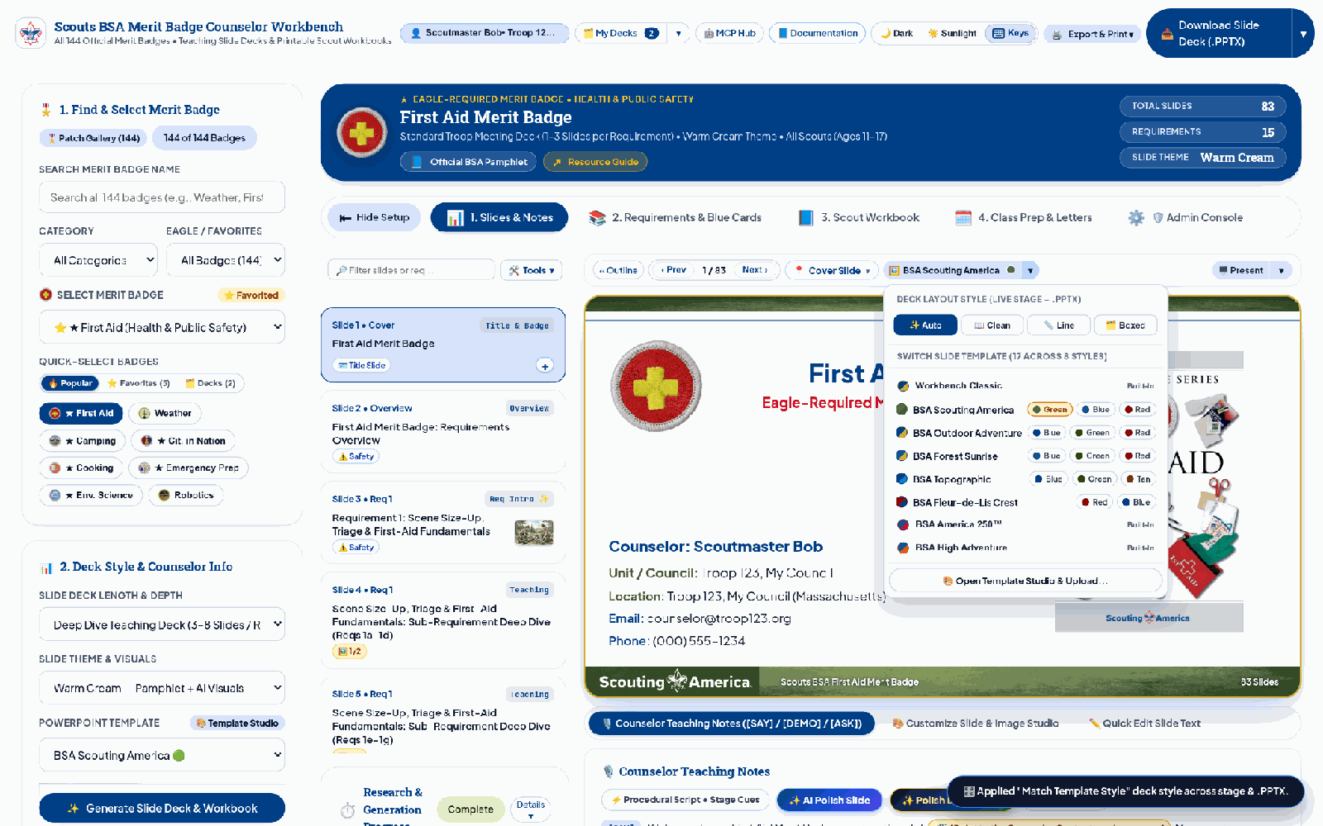
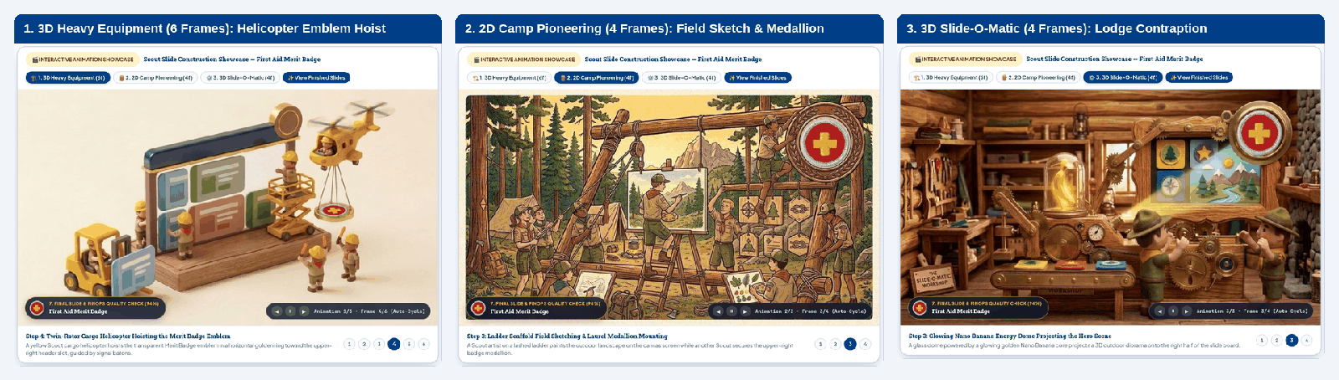
Four Guided Journeys Take Counselors From Badge Selection to Signed Blue Cards in Under 2 Minutes
STAGE 1 (CUJ-1)
STAGE 2 (CUJ-2)
STAGE 3 (CUJ-3A)
STAGE 4 (CUJ-3B)
Discover, Ground & Style
Stream ADK & Navigate
Co-Design & Polish
Present, Sign Off & Export
Filter 149 badges or browse 400x400 Patch Gallery (+ Favorites); set local ZIP (51 jurisdictions); pick 29 templates (9 Style Families, 26 backdrops) & 4 Layout Presets (Clean default) with Save Default Style.
Watch 3 pre-loaded 14-frame Scout construction animations (3D Heavy Equipment, 2D Pioneering, 3D Slide-O-Matic) with live SSE progress; navigate via 42px Stage Toolbar (Overview jump, Template swatches, timer).
Reorder, hide, or add slides via filmstrip micro-pills (+, hide, up, down) with 0ms stationary scroll and $0.00 net-zero .PPTX rebuilds; cycle visuals in <50ms (1/3 switcher) or run FinOps AI Polish (~$0.0008/slide).
Launch full-size Split-Screen or Floating Presenter View (P) with 5-Part Facilitator Guide cards & Patrol Quiz Scoreboard; sign off Multi-Session Blue Cards (#34124); export .PPTX or 1-click Google Slides.
Single-Row Stage Toolbar, Quick-Style Switcher (29 Templates & 26 Backdrops), 3-Target Edit Text & 4-Tab Under-Stage Drawer
Zero-Flicker Pre-Loaded 14-Frame Scout Construction Animations (3D Heavy Equipment, 2D Pioneering, 3D Slide-O-Matic)
Source: docs/USER_GUIDE.md (Sections 1 to 6) | Unified Material 3 Counselor Workbench (:8085) with Demo Guided Tour (8 walkthroughs) and 4-Tab Under-Stage Drawer (Workflow Trace & FinOps).
Notes:
Here is how a volunteer counselor moves from zero prep to a troop-ready class in under two minutes across four guided journeys. First, in CUJ-1, counselors filter all 149 Merit Badges or browse the 400 by 400 Visual Patch Gallery with Favorites, enter their local ZIP code to ground examples across 51 jurisdictions, pick from 29 templates across 9 Style Families and 26 washed cover backdrops and 4 Layout Presets, or launch the Demo Guided Tour button for 8 narrated multi-step walkthroughs with a live virtual cursor, spotlight ring, and floating callout, starting with Citizenship in the Nation Requirement 8 Congressional Delegation and Constituent Letter. Second, in CUJ-2, while the 7-agent ADK pipeline streams live Server-Sent Events, counselors watch zero-flicker 14-frame Scout construction animations, navigate requirements from the single-row 42-pixel Stage Toolbar, and inspect the 4-Tab Under-Stage Drawer, including Multi-Agent Workflow Trace and FinOps telemetry. Third, in CUJ-3A, counselors co-design in real time: reordering, hiding, or adding slides with zero-millisecond stationary scroll and zero-dollar net-zero PowerPoint rebuilds, cycling pre-bundled visuals in under 50 milliseconds, or triggering FinOps-gated AI Polish at eight hundredths of a cent per slide. Finally, in CUJ-3B, counselors launch the full-size Split-Screen or Floating Presenter View with 5-Part Facilitator Guide teleprompter cards backed by 31,443 precomputed slide notes and the live Patrol Quiz Scoreboard, sign off official Blue Cards (#34124), and export to PowerPoint or one-click Google Slides.

Slide 4
Nine-Component / 7-Agent Google ADK Pipeline Pairs LLM Reasoning With Deterministic Geometry & Crypto Tools
MeritBadgeCoordinatorAgent (SequentialAgent) : 5-Stage Core Execution Pipeline (18ms Overhead)
EventsCompactionConfig(interval=5, overlap=2)
Stage 1: Research & Grounding
Stage 2: Coverage Critic
Stage 3: Pedagogical Planner
Stage 4: Theme & Visuals
Stage 5: Build & 2-Stage QA
1. PamphletResearch (Pro)
3. CoverageCriticAgent
4. SlideContentPlanner (Pro)
5. SlideBeautifier (Flash)
6. PowerPointBuilderAgent
Hybrid BM25 + Vector RRF
Audits sub-reqs (1a, 1b...)
12 EDGE Method Archetypes
Category Palette & Crop
7. BSABrandSafetyReview
2. WebSearchGrounding
LoopAgent (max=2)
StudioKit Contract Output
5,625 Curated Visuals
LoopAgent (max=3): 3.4ms
Flash via AgentTool (FM-1)
Re-queries missing reqs
5-Part Facilitator Guide
$0.00 Local Library Match
AABB + Vision Score >= 90
SHA-256 Canonical Lock
100% Sub-Req Recall Gate
Workbook & Blue Card Sync
$1.00 FinOps Budget Cap
Verified .PPTX / .PDF
Deterministic Tool & Crypto Boundary
On-Demand Co-Design Studio Agents (8 & 9)
Dual-Transport Plane: 162 OpenAPI | 27-Cap MCP
PyMuPDF & AABB Geometry Solver (3.4ms)
8. WebImageSearchAgent (Wikimedia)
162 OpenAPI 3.1 Paths | SSE | A2UI | A2A 1.0
Zero-LLM bounding-box & contrast check
CC-BY-SA / Public Domain sourcing ($0.00)
Live SSE streaming & /.well-known/agent.json
HMAC-SHA256 HITL Gate + .PPTX Compiler
9. NanoBananaImageAgent ($0.08 Cost Gate)
27-Capability MCP Server (Stdio + POST /mcp)
Cryptographic HITL approval before export
Explicit counselor opt-in for diagram synthesis
15 tools, 7 resources, 5 prompts over JSON-RPC
DETERMINISTIC ORCHESTRATION
TOOL ISOLATION & BIDIRECTIONAL PII
INTEROPERABLE ECOSYSTEM
5-Stage SequentialAgent + 21 Multi-Option Unrolling.
AgentTool Isolation (FM-1) + Bidirectional PII Gate.
162 OpenAPI 3.1 Endpoints & Dual-Transport MCP.
Unrolls 21 multi-option badges (44 tracks) and curates <= 3 Patrol Scenario Quizzes on safety reqs. EventsCompactionConfig + HMAC-SHA256 HITL gates hold overhead to 18ms.
Isolating GoogleSearchTool inside WebSearchGroundingAgent (AgentTool) eliminates HTTP 400 collisions, while ScoutsBSAModelArmorPlugin scrubs PII across both Ingress prompts and SSE Egress streams.
Exposes REST, SSE, A2UI v0.9, A2A 1.0, and a 27-capability MCP server (Stdio + HTTP POST /mcp).
Source: src/agents/coordinator.py, src/agents/researcher.py, src/mcp_server.py, ARCHITECTURE_DECISIONS.md (ADR-01).
Notes:
Slide 4 details our nine-component, seven-agent Google ADK architecture. Rather than relying on an unconstrained ReAct swarm, which averaged 74 cents per deck and suffered a 14 percent requirement omission rate in early benchmarks, we engineered a deterministic five-stage SequentialAgent pipeline wrapped around two bounded LoopAgents. Stage 1 runs PamphletResearchAgent on Gemini 2.5 Pro alongside WebSearchGroundingAgent on Flash, deterministically unrolling all 21 multi-option Merit Badges (44 option tracks across 193 deck configurations) across 3-level sub-requirement trees (such as Cycling Option A Road Biking vs. Option B Mountain Biking) and locking verbatim text with SHA-256 hashes. By isolating Google Search inside WebSearchGroundingAgent and exposing it as an ADK AgentTool, we eliminate Vertex AI HTTP 400 tool schema collisions completely. Stage 2 runs ResearchCoverageCriticAgent inside a bounded two-iteration LoopAgent to enforce 100 percent sub-requirement recall. Stage 3 plans slides across 12 BSA EDGE pedagogical archetypes and selectively curates at most 3 Patrol Scenario Quizzes per deck targeted strictly at safety and hazard requirements. Stage 4 matches 5,625 curated visual assets (6,064 total visual files hydrated via asset_hydrator.py) under a hard one-dollar FinOps cap, and Stage 5 pairs PowerPointBuilderAgent with BSABrandAndSafetyReviewAgent inside a three-iteration QA loop with a 3.4-millisecond AABB geometry solver. YouthProtectionGuardrailPlugin enforces bidirectional PII scrubbing across both user ingress prompts and live SSE / A2UI egress streams, while external clients connect via 162 contract-tested OpenAPI 3.1 endpoints (168 HTTP operations), A2A 1.0 agent cards, and a 27-capability MCP server.

Slide 5
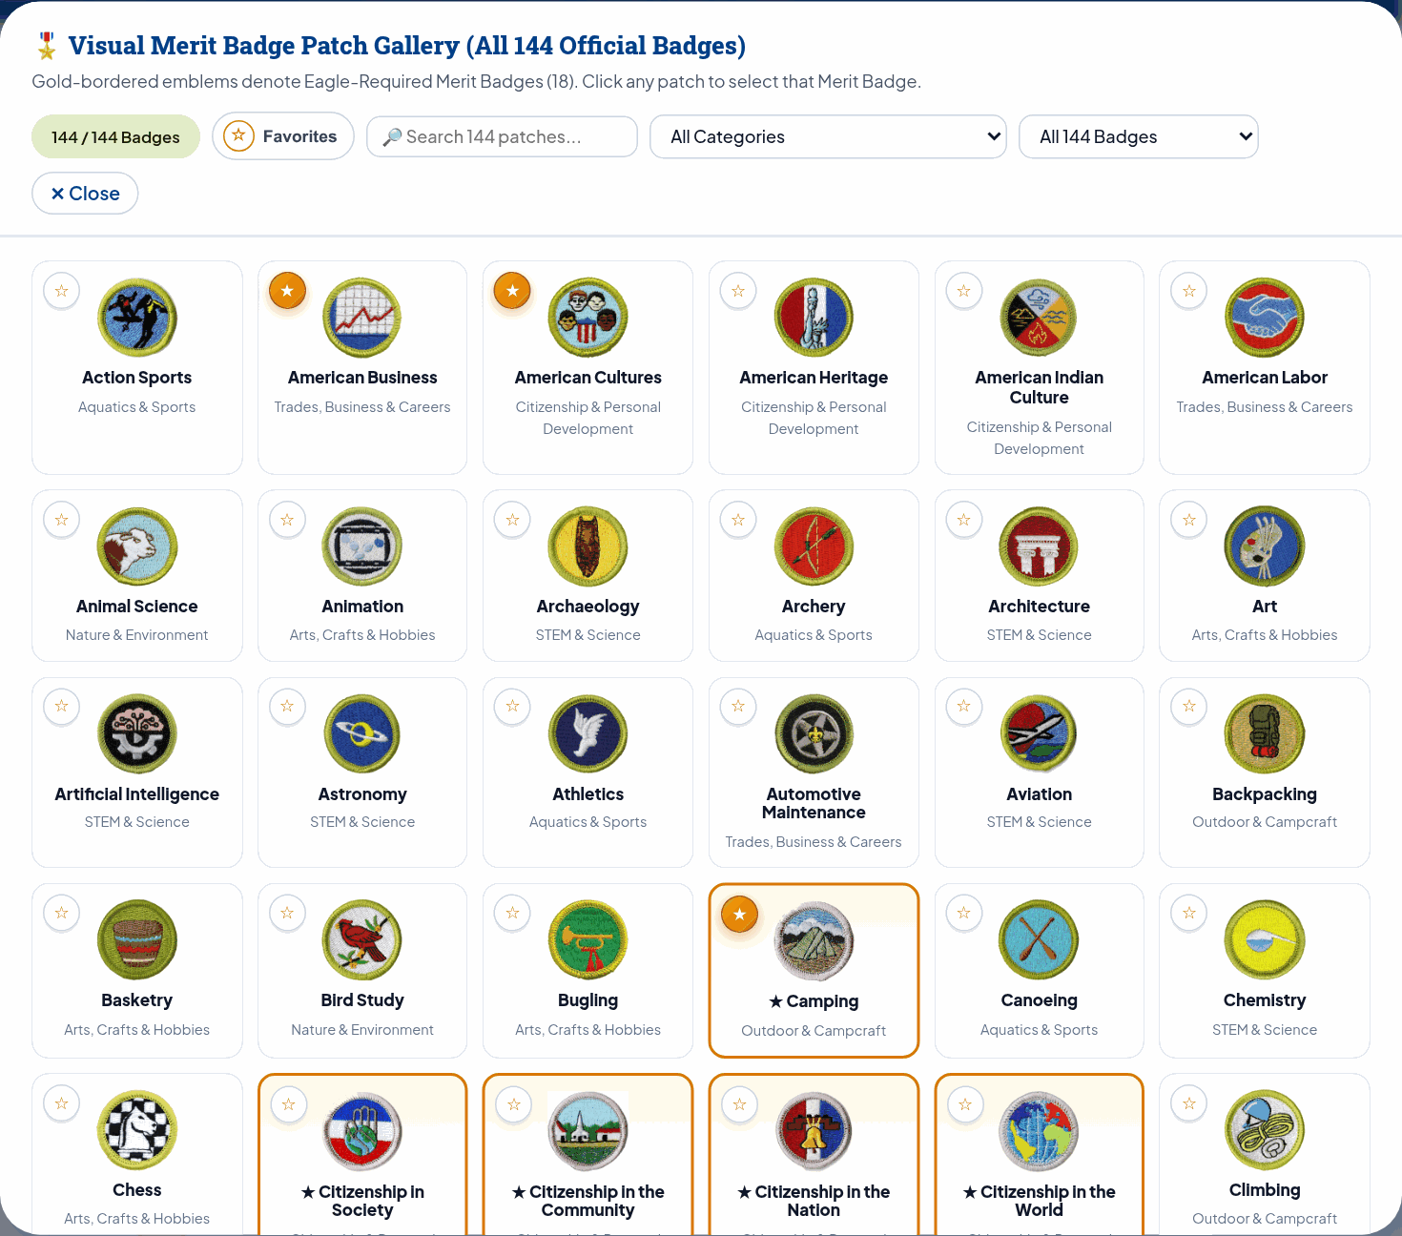
Hybrid BM25 + Vector RRF With Cross-Encoder Reranking Achieves 1.0000 Recall@3 With Zero Requirement Drift
DETERMINISTIC REQUIREMENT LOCK & HYBRID RRF RETRIEVAL
ADR-02: 20-BADGE GOLDEN RAG ABLATION BENCHMARK
1. PyMuPDF Extraction & SHA-256 Requirement Lock
Retrieval Strategy | Recall@3 | MRR | Latency (p50) | Token Reduction
Full-PDF Prompt Stuffing (Baseline) | 0.9375 | 0.8958 | 4,200 ms | 0% (65k tokens)
Dense Vector Only (text-embedding-005) | 0.8125 | 0.7708 | 1.4 ms | -68%
Lexical Okapi BM25 Only | 0.8750 | 0.8333 | 0.9 ms | -68%
Hybrid BM25 + Vector RRF (k=60, Production) | 1.0000 | 1.0000 | 1.8 ms | -68% (+76% Cache Hit)
Parses all 149 official BSA Pamphlet PDFs and scouting.org trees; compute_canonical_pamphlet_hash() locks every verbatim (req_number, req_text) tuple (1a..15b) before and after LLM enrichment so requirements never drift.
2. Hybrid Okapi BM25 + 768-Dim Cosine RRF (k=60)
Pure dense embeddings blur short sibling IDs like Req 2a vs Req 2b (0.8125 Recall@3). Fusing Okapi BM25 (55% weight + 3.0x exact ID boost) with text-embedding-005 vectors (45% weight) in our 12-table SQLite WAL store (and CloudSQLPgVectorBackend adapter) cuts prompt tokens by 68%.
149-BADGE VISUAL PATCH GALLERY (400x400 SCOUT SHOP EMBLEMS)
Grounded Patch Catalog
400x400 Emblems: Official Scout Shop patches for all 149 Merit Badges.
3. 51-State Local Grounding & 5,625 Curated Visuals
_STATE_CIVIC_AND_FIELD_REGISTRY maps any counselor ZIP across all 50 states + D.C. to local NOAA NWS forecast offices, terrain hazards, state parks, and current U.S. Senators, paired with 2,833 Vision-verified pamphlet figures and 2,792 Nano Banana illustrations.
14 Categories: Filter by Outdoors, STEM, Trades, and Public Service.
Eagle & Favorites: 1-click Eagle-Required and starred counselor filters.
Source: src/memory/session_store.py, src/tools/local_grounding_engine.py, tests/data/golden_badges.json (20 badges: 1.0000 Recall@3, ROUGE-L 0.892, 4.92/5.0 LLM-as-a-Judge).
Notes:
In Merit Badge instruction, official BSA requirement wording cannot be paraphrased or altered. Before any LLM enrichment runs, our ingestion pipeline parses all 149 BSA Pamphlet PDFs with PyMuPDF and computes a canonical SHA-256 digest over every requirement number and verbatim text tuple from 1a through 15b. After generation, if a single character drifts, the post-processor rejects the mutation and restores the exact canonical requirement text. On the retrieval side, we ran a 20-badge golden evaluation dataset (tests/data/golden_badges.json) documented in ADR-02. Pure dense vector search with text-embedding-005 drops to 0.8125 Recall at 3 because cosine similarity blurs short alphanumeric sibling IDs like Requirement 2a versus Requirement 2b. Full-PDF prompt stuffing costs 65,000 tokens per turn and adds 4.2 seconds of latency. By combining Okapi BM25 at 55 percent weight with a 3x exact requirement ID boost and 768-dimensional vector embeddings at 45 percent weight via Reciprocal Rank Fusion at k equals 60, we achieve 1.0000 Recall at 3, 1.0000 MRR, ROUGE-L 0.892, and 4.92 out of 5.0 LLM-as-a-Judge score across all 20 golden badges in 1.8 milliseconds while cutting prompt tokens by 68 percent.

Slide 6
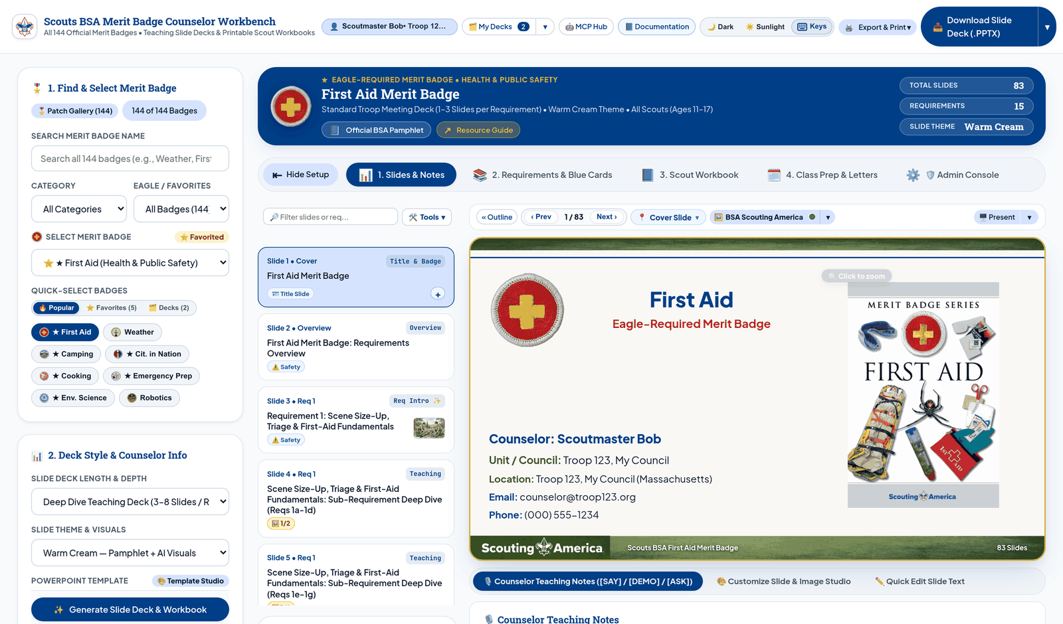
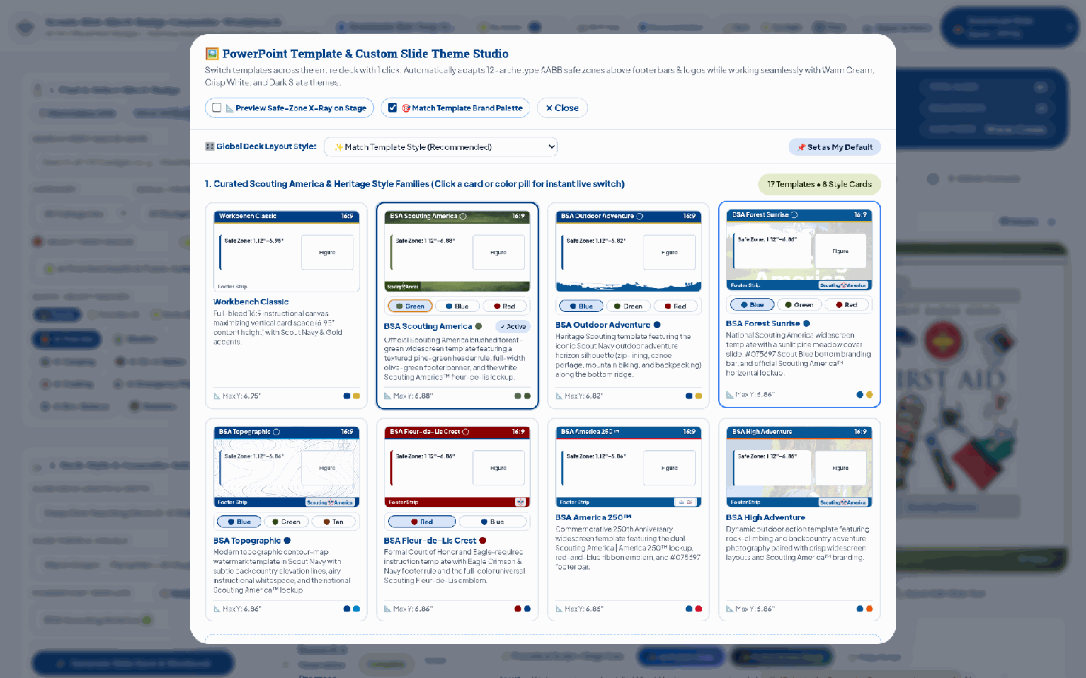
Global Layout Style Engine & 2-Stage Visual Auditor Lift Body Text by +2.5pt and Image Area by +22%
1. 29 Templates Across 9 Style Families & 26 Backdrops. Sets BSA Scouting America (Green) default with Outdoor Adventure, Forest Sunrise, Topographic, Fleur-de-Lis, America 250, Camp Hidden Valley Sunset Dock & Safe-Zone X-Ray (y <= 6.54").
LIGHT MODE WORKBENCH: FIRST AID SLIDE #1
TEMPLATE STUDIO: 9 FAMILIES & STYLE BAR
2. 4-Tier DeckStyleConfig & Unboxed Compiler. Resolves CLEAN_OPEN (borderless on 28 BSA templates), LEFT_ACCENT_LINE (3.2pt rule), BOXED_CARDS (Workbench Classic), Default Style prefs (user_preferences) & step pills.
3. 2-Stage <10ms AABB + Visual Quality Gate. Stage 1 checks python-pptx AABB collisions and the 12.0pt floor in 3.4ms ($0.00); Stage 2 audit_deck_visual_quality() verifies shape density, font scale, and visual area (score >= 90/100).
Light Mode Workbench (BSA Scouting America): Full Counselor Workbench displaying First Aid Slide #1 (Warm Cream theme, Clean & Open layout, 0 card boxes).
PowerPoint Template Studio: 29 Templates (9 Families), 26 Backdrops, Swatches & Global Style Bar.
+2.97pt to +3.28pt
+21.7% Larger
-55% to -68%
96.5 / 100
Larger Body Font Size: First Aid (83 slides) jumps from 12.63pt boxed to 15.91pt in CLEAN_OPEN; 0 slides at 12.5pt floor.
Right-Hand Visual Area: FRAMELESS_CLEAN expands diagrams from 19.81 sq in to 24.10 sq in with de-boxed alpha.
Fewer OpenXML Shapes: First Aid drops from 1,892 shapes (22.8/slide) to 748 shapes (9.0/slide); Weather drops -68%.
Stage-2 Visual Quality Score: Up from 68.4 / 100 in legacy boxed mode across First Aid & Weather; 0 AABB overlaps in 3.4ms.
Source: src/tools/template_engine.py, src/tools/pptx_builder.py, src/agents/reviewer.py (audit_deck_visual_quality), tests/test_conformance_and_a2ui.py.
Notes:
Early versions of our slide compiler wrapped every requirement bullet inside a bordered card container. On branded BSA templates that already had rich borders and crest watermarks, this created heavy nested box-itis and squeezed the body text down to 12.6pt. We rebuilt the compiler around a 4-tier DeckStyleConfig engine across 29 templates across 9 style families and 26 washed cover backdrops (including Camp Hidden Valley Sunset Dock), promoting BSA Scouting America Green with CLEAN_OPEN borderless layout as the factory default while keeping BOXED_CARDS available on Workbench Classic and letting counselors save their default style in user_preferences. Every generated deck then passes a two-stage visual gate: a 3.4ms python-pptx AABB collision and 12pt floor check at zero token cost, followed by audit_deck_visual_quality() scoring shape density, typography, and visual area. Across the 83-slide First Aid deck and 69-slide Weather deck, switching to CLEAN_OPEN lifts average body text by +2.97pt to +3.28pt, expands right-hand diagram area by +21.7% (from 19.81 to 24.10 square inches), cuts OpenXML shapes by 55% to 68%, and lifts our Stage-2 visual quality score from 68.4 to 96.5 out of 100.

Slide 7

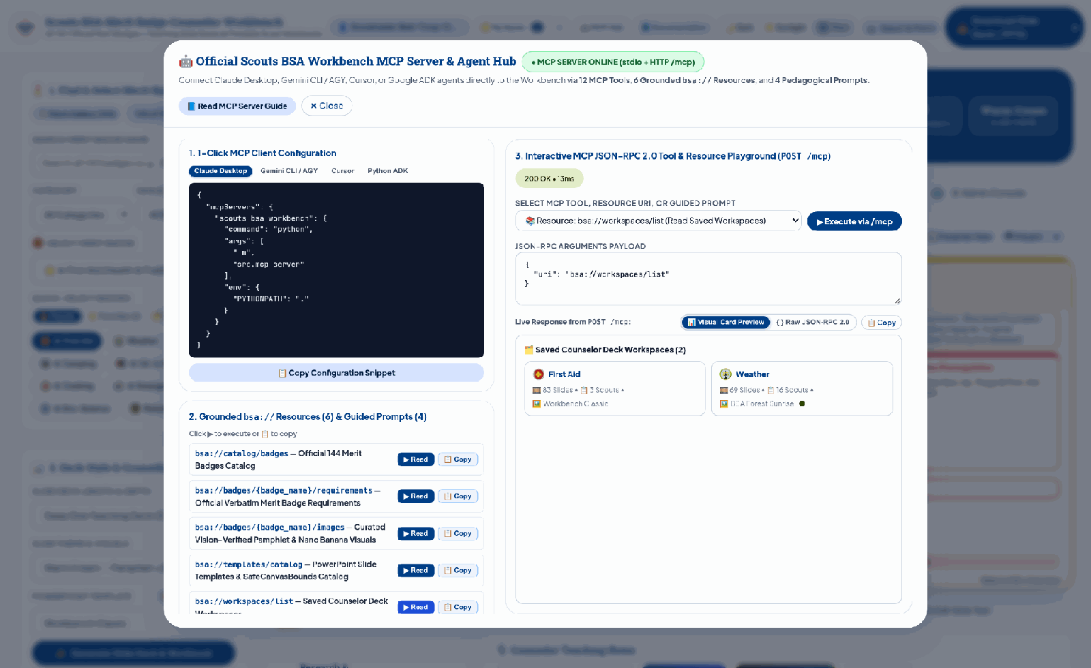

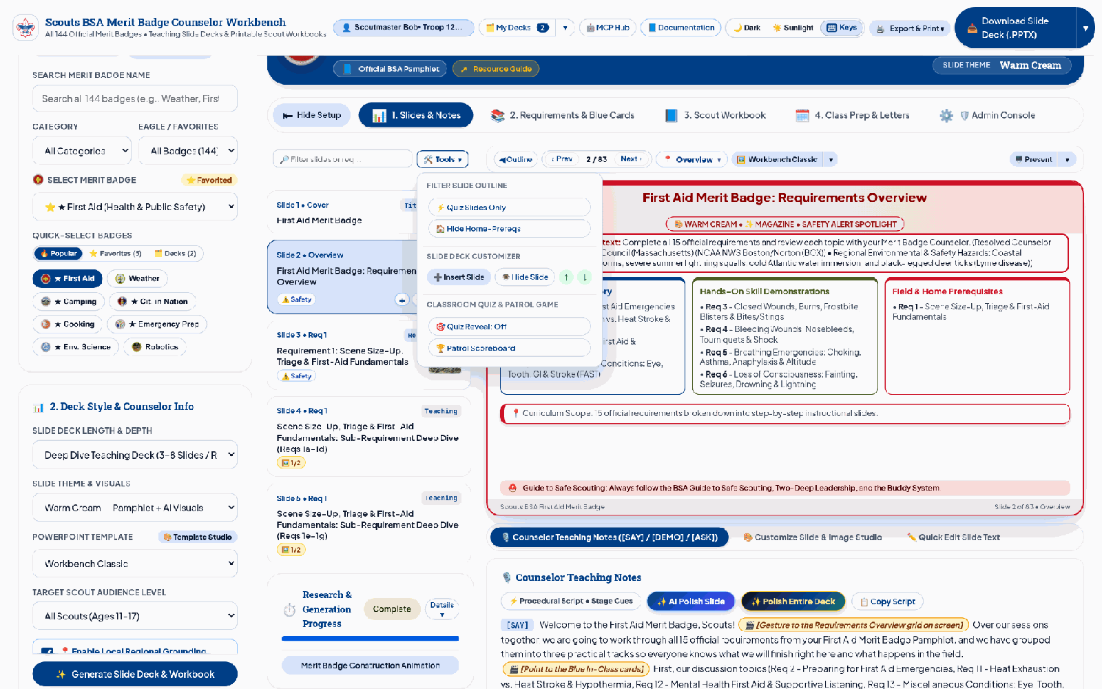

Interactive Co-Design Studio & 27-Capability MCP Server Connect Human Counselors and External AI Agents
Zero-Cost In-Place Co-Design & Active-Slide Micro-Pills
Hover-revealed 1/3 on-stage switcher swaps primary and Vision-captioned pamphlet figures in <50ms ($0.00). Active filmstrip thumbnails expose + (insert), hide, up, and down micro-pills with 0ms stationary scroll, Drawer Tab 2 style overrides (Auto, Clean, Line, Boxed), and $0.00 net-zero .pptx rebuilds.
4-Tab Image Studio ($0.08 Gate) & FinOps Note Polish
4-Tab Image Studio (Catalog, Wikimedia, Nano Banana $0.08 consent gate across 10 styles, Upload) plus 5-Part Facilitator Guide with FinOps AI Polish (~$0.0008/slide & Restore Default).
In-App MCP Hub & Interactive Playground: 15 Tools, 7 bsa:// Resources & 5 Prompts with Visual Card Preview
27-Capability MCP Server & Interactive Playground
src/mcp_server.py (POST /mcp & Stdio) exposes 15 tools (generate_merit_badge_slide_deck, generate_fillable_scout_workbook, apply_powerpoint_template), 7 bsa:// resources, and 5 guided prompts with an Interactive MCP Playground (Visual Card Preview + Raw JSON-RPC 2.0) and 1-click setup for Claude Desktop, Gemini CLI / AGY, and Cursor.
Active-Slide Filmstrip Micro-Pills (+, Hide, Up, Down): Hover Image Switcher & Per-Slide Style Override
Source: src/mcp_server.py, docs/MCP_SERVER_INTEGRATION_GUIDE.md, src/agents/image_studio.py, ui/app.js.
Notes:
Once a deck is generated, volunteer counselors need instant, zero-friction control to tailor slides for their troop without paying recurring LLM costs, while external AI assistants need structured programmatic access. On the left, our Interactive Co-Design Studio gives counselors a hover-revealed 1-of-3 on-stage visual switcher that swaps primary and Vision-captioned alternate pamphlet figures in under 50 milliseconds at $0.00 cost. Active filmstrip thumbnails expose plus, hide, up, and down micro-pills with 0-millisecond stationary scroll, per-slide container style overrides across Auto, Clean, Line, and Boxed layouts, and net-zero background PowerPoint rebuilds. Second, the 4-Tab Image Studio separates free operations (browsing 5,625 curated visuals (2,833 pamphlet figures and 2,792 Nano Banana illustrations), searching Wikimedia Commons via WebImageSearchAgent, or uploading local files) from paid AI generation, placing NanoBananaImageAgent behind an explicit $0.08 FinOps consent gate and automatic prompt verification. 31,443 precomputed slide facilitator notes load in under 5 milliseconds at $0.00 alongside a 3-target Edit Text modal, with an explicit FinOps confirmation modal (~$0.0008 per slide) before batch Gemini 2.5 Flash polishing. Finally, src/mcp_server.py exposes all 27 workbench capabilities over HTTP and Stdio: 15 tools, 7 bsa:// resources, and 5 guided prompts, complete with an in-app Interactive MCP Playground and 1-click setup for Claude Desktop, Gemini CLI, and Cursor.

Slide 8
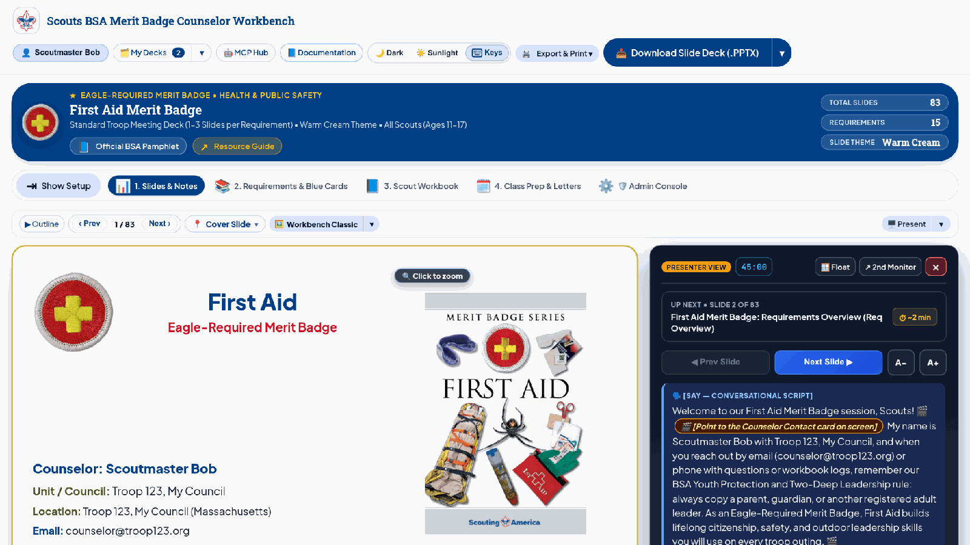
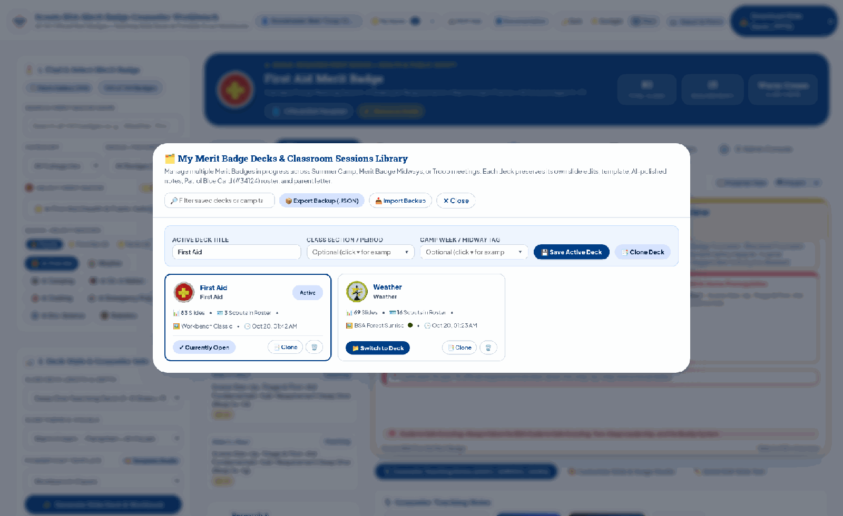
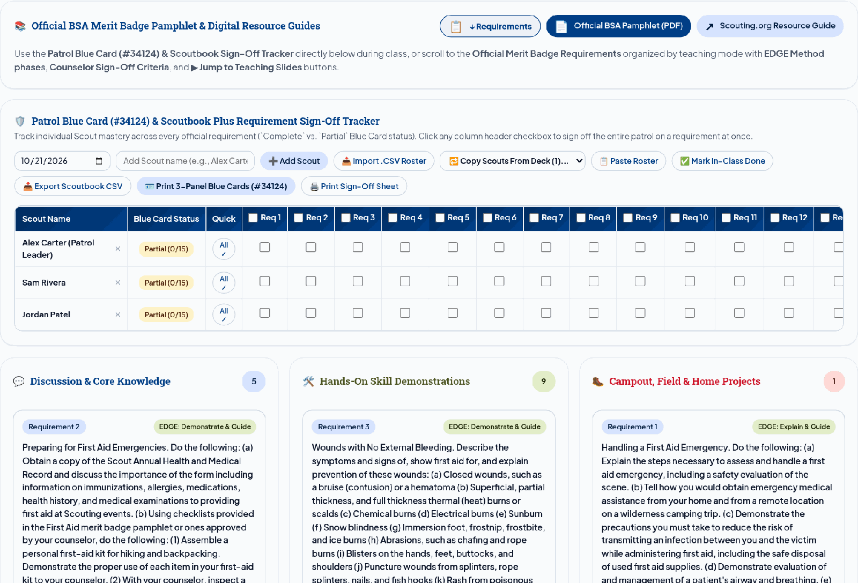
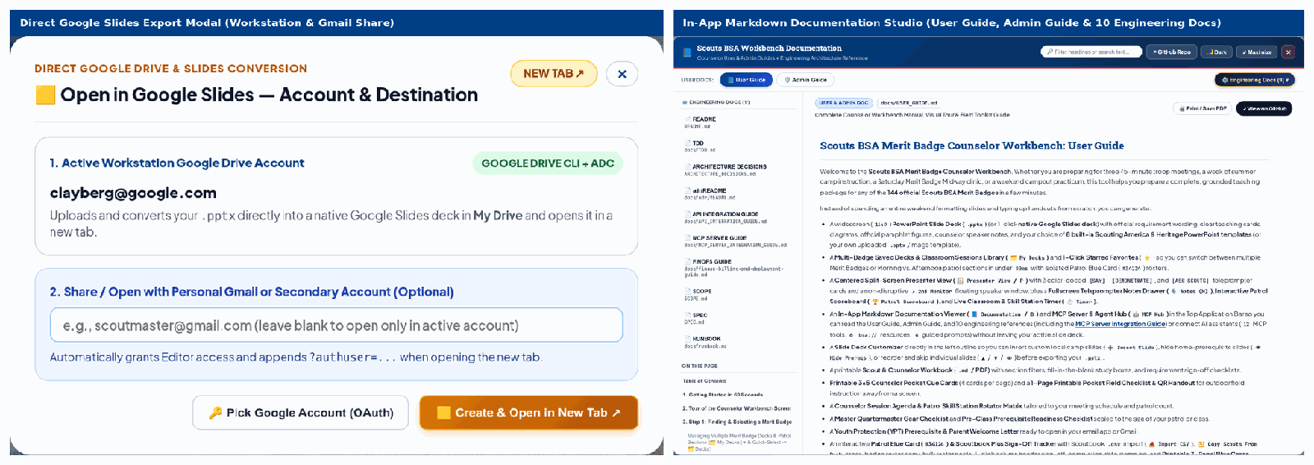
Full-Size Presenter View, Multi-Badge Workspaces & 1-Click Google Slides Export Power Troop Meetings
16:9 STAGE & PRESENTER CONSOLE (KEY: P)
SQLITE WORKSPACE MANAGER (MY DECKS)
Full-Size Split-Screen & Floating Presenter View
Multi-Badge Counselor Workspaces & Section Cloning
890px+ Stage (P): Auto-collapses sidebar; 2-tier Float/Dock header.
<5ms 2nd Monitor Sync: Dual-screen pop-out via BroadcastChannel.
Externalized Scoreboard: Patrol Quiz above stage (Space reveals).
<80ms SQLite Hot-Swap: counselor_workspaces via Quick-Select -> Decks.
Clone for New Section: Split-button isolates troop Blue Card rosters.
Portable Archives: Exports and imports .bsadeck.json camp bundles.
ADVANCEMENT RECORDS & FIELD PRINTABLES
DRIVE V3 (VND.GOOGLE-APPS.PRESENTATION) & DOCS (D)
Patrol Blue Card (#34124) Matrix & 4-Mode StudioKit
1-Click Google Slides Export & 12-Doc Studio
5-Tier Triage & S1-S4 | M: Multi-session attendance & Smart Partials.
Per-Troop #34124 & CSV: Isolated troop Blue Cards & Scoutbook CSV.
548pt Dual-Mode Workbook: Full-width single-column organizers & 3 ISO QRs.
Drive v3 & .ZIP Packet: 1-click Google Slides & .ZIP bundle.
3-Tier Auth Cascade: Automatic OAuth2, ADC & gcloud token fallback.
Sunlight & 12-Doc Studio (D): 2px #000 camp borders, Dark mode & docs.
Source: src/tools/counselor_studiokit.py, src/tools/qr_generator.py, src/server.py (/api/slide/export-gslides), docs/USER_GUIDE.md (Sections 6-11).
Notes:
Slide 8 walks through the four field-execution tools that power live Troop meetings and summer camp sessions. In the top-left quadrant, pressing P launches the Full-Size Presenter View, which auto-collapses the setup sidebar so the 16:9 slide stays at 890px+ width, pairs a 2-tier Float or Dock console with a 2nd Monitor pop-out synced in under 5 milliseconds via BroadcastChannel, and pins the Patrol Quiz Scoreboard above the stage with Space-key answer reveal. In the top-right quadrant, Multi-Badge Counselor Workspaces (My Decks) query the SQLite counselor_workspaces table to hot-swap active badges and camp sections in under 80 milliseconds, support 1-click Clone for New Section with isolated Blue Card rosters, and export or import portable .bsadeck.json archives. In the bottom-left quadrant, the Patrol Blue Card (#34124) Matrix and 4-Mode StudioKit organize badge requirements into a 3-column execution triage (In-Class, Hands-On, Prerequisite) with bulk roster paste, Scoutbook Plus CSV exports, printable 3-panel Blue Cards, dual-mode 548pt full-width single-column organizer Scout Workbooks, 1-click .ZIP class packets (/api/export/bundle-zip/{session_id}), Quartermaster gear lists for 1 to 16 Scouts, and 1-page handouts with 3 ISO 18004 QR codes. Finally, in the bottom-right quadrant, the sticky export split-button uploads .pptx files directly to Google Slides via Drive API v3 (application/vnd.google-apps.presentation) using a 3-tier OAuth2, ADC, and gcloud authentication cascade, alongside outdoor Sunlight Mode (2px black borders), Dark Mode, and the in-app 12-document Markdown reader (D).

Slide 9
Pre-Bundling 5,625 Visual Assets & Tiered Model Routing Hold Cold-Cache Cost to $0.184 ($192.50/Mo Council TCO)
Per-Deck Unit Economics Across 4 Modes (finops_model_policy.json & cost_model.py)
3 Cost-Control Engineering Levers & FinOps Guardrails
Operating Mode / Tier | LLM Token Spend | Runtime Image Spend | Total Deck Cost | Build Latency
1. Offline / Cached Demo Mode | $0.000 | $0.000 (Pre-Bundled) | $0.000 | < 50 ms
2. Warm Cache Rerun (76% Hit) | $0.006 to $0.020 | $0.000 (Pre-Bundled) | $0.006 to $0.020 | 1.5 to 2.5 s
3. Cold Standard / Warm Cream (Default) | $0.184 | $0.000 (5,625 Built-In) | $0.184 ($0.38 ceiling) | 14 to 22 s
4. Cold Dark Slate / Opt-In AI Studio | $0.184 to $0.304 | $0.400 to $0.520 (Opt-In) | $0.704 (<= $1.00 Cap) | 22 to 32 s
1. 5,625 Pre-Bundled Visuals = $0.00 Runtime Image Spend
Pre-generating and Vision-verifying 2,833 pamphlet figures and 2,792 8-bit PNG Nano Banana illustrations eliminated $1.20+ per deck in cold image synthesis, holding default Warm Cream builds to $0.184 actual LLM spend.
2. Deliberate 79% Flash / 21% Pro Model Routing
SlideContentPlannerAgent uses gemini-2.5-pro with 75%-discounted Vertex AI Context Caching; extraction, critic loops, Vision QA, and 6-way parallel note polishing route to gemini-2.5-flash at 88% lower token cost.
Executable 3-Tier TCO Model (scripts/cost_model.py @ 70% Cache Hit Rate)
Deployment Tier (scripts/cost_model.py) | Monthly Volume | Variable + Fixed GCP | Total Monthly TCO
Tier 1: Single Troop (Scale-to-Zero) | 50 Decks / mo | $2.91 Var + $5.00 Fixed | $7.91 / mo ($0.158/deck)
Tier 2: 500-Counselor Council (Target) | 1,500 Decks / mo | $87.48 Var + $105.02 Fixed | $192.50 / mo ($0.128/deck)
Tier 3: National Scale (50K+ Counselors) | 100,000 Decks / mo | $4,120 Var + $1,280 Fixed | $5,400 / mo ($0.054/deck)
3. Hard $1.00 Circuit Breaker & Explicit Consent Gates
FinOpsBudgetPlugin enforces max_budget_usd = $1.00 with auto tier step-down. Executable scripts/cost_model.py verifies TCO across Troop ($7.91/mo), Council ($192.50/mo), and National ($5,400/mo = $0.054/deck).
Source: scripts/cost_model.py, config/finops_model_policy.json, src/agents/guardrails.py (FinOpsBudgetPlugin), docs/FINOPS_AND_TCO.md.
Notes:
Slide 9 breaks down our unit economics and three-tier Total Cost of Ownership, governed by config/finops_model_policy.json, verified by our executable scripts/cost_model.py sensitivity model, and enforced at runtime by FinOpsBudgetPlugin. In the top table on the left, we compare per-deck unit economics across four operating modes. Offline and Cached Demo Mode runs at $0.000 in under 50 milliseconds. A Warm Cache rerun at a 76 percent cache hit rate costs $0.006 to $0.020 and finishes in 1.5 to 2.5 seconds. Our default Cold Standard Warm Cream mode holds total deck cost to $0.184 (with a $0.38 ceiling) and $0.000 in runtime image spend because all 5,625 curated visual assets are pre-bundled. Even when counselors opt into Cold Dark Slate or AI Studio mode with runtime image generation, total cost is $0.704 and strictly capped at $1.00. In the bottom table, our executable scripts/cost_model.py models three deployment tiers: Tier 1 Single Troop generating 50 decks per month on scale-to-zero Cloud Run costs $7.91 per month ($2.91 variable plus $5.00 fixed GCP, or $0.158 per deck). Tier 2 for a 500-counselor council generating 1,500 decks per month costs $192.50 per month ($87.48 variable LLM and caching spend plus $105.02 fixed Cloud Run v2 and Cloud SQL, or $0.128 per deck), a 98.5 percent reduction compared to commercial SaaS. Tier 3 National Scale serving 100,000 decks per month across 50,000 counselors costs $5,400 per month ($4,120 variable plus $1,280 fixed HA infrastructure), driving unit cost down to 5.4 cents per deck. On the right, three engineering levers make these economics possible: 5,625 curated visual assets (6,064 total visual files hydrated via asset_hydrator.py) eliminating $1.20+ in runtime image synthesis, deliberate 79 percent Flash and 21 percent Pro routing with 75 percent Context Caching discount, and FinOpsBudgetPlugin enforcing a hard $1.00 circuit breaker.

Slide 10
Eleven Architectural Decision Records, 162 OpenAPI Endpoints & 220+ Pytest Tests Guarantee Production Conformance
ADR-01: Sequential ADK + Tool Boundary
ADR-02: Hybrid BM25 + Vector RRF (k=60)
ADR-04: Local .PPTX + <10ms AABB Gate
ADR-10 & ADR-11: Style Resolver & As-Built Scope
DECISION
DECISION
DECISION
DECISION
5-stage SequentialAgent + bounded LoopAgents (max=2,3) + AgentTool search isolation (FM-1 fix).
Fuse Okapi BM25 (55% + 3.0x exact ID boost) with 768-dim Cosine vectors (45%) in SQLite WAL / pgvector.
Deterministic python-pptx OpenXML compiler (FM-2 font solver >=12.0pt) + 3.4ms Stage-1 AABB check before Vision QA.
4-tier CLEAN_OPEN style resolver + ADR-11 As-Built vs. Phase 2 scope matrix + dual latency telemetry.
REJECTED
Autonomous ReAct swarm ($0.74/deck, 14% sub-req omissions).
REJECTED
REJECTED
REJECTED
4-sided card "box-itis" and conflating SSE ack with true LLM TTFT.
Dense-only vectors (0.8125 Recall@3) or 65k-token PDF stuffing ($0.44/run).
Vision-only QA ($0.09/deck, 10s lag) or raw LLM coordinates.
VERIFIED RESULT
VERIFIED RESULT
VERIFIED RESULT
VERIFIED RESULT
100% sub-requirement coverage with 18ms orchestration overhead and zero HTTP 400 tool collisions.
1.0000 Recall@3 and 1.0000 MRR in 1.8ms with 68% input token reduction.
0 bounding-box overlaps across all 149 badges + 2 to 4s Drive v3 conversion to Google Slides.
+2.97pt to +3.28pt larger body fonts, +21.7% larger visuals, -60% shapes, and 96.5/100 visual quality score.
11 ADRs & Pre-Coding Harness
220+ Pytest Tests & Dual Latency
162 OpenAPI 3.1 Paths
Eval Gate & 5% Trace Sampler
ADR-01..ADR-11 (As-Built Reconciliation) + SHA-256 prompts/manifest.json + 4 post-mortems (FM-1..FM-4)
220+ passing tests (45 files, 0 warnings, <30s CI) + Honest Telemetry (first_status_event_ms 12ms vs true_ttft_ms 480ms)
Automated route-to-schema contract drift test + 27 MCP capabilities (15 tools, 7 resources, 5 prompts)
scripts/run_eval.py (20 Golden Badges) + OnlineProductionAuditSampler (5% live trace audit + auto-promotion)
Source: ARCHITECTURE_DECISIONS.md (ADR-01..ADR-11), AGENTS.md, scripts/run_eval.py (20 golden badges), src/observability/online_audit_sampler.py (OnlineProductionAuditSampler).
Notes:
Slide 10 highlights our 11 Architectural Decision Records, our 220+ test automated verification harness across 45 test files, and our production telemetry architecture. First, ADR-01 establishes our 5-stage SequentialAgent pipeline with bounded LoopAgents and strict AgentTool search isolation, eliminating HTTP 400 tool collisions (FM-1) and achieving 100 percent sub-requirement coverage with 18 milliseconds of orchestration overhead. Second, ADR-02 governs our Hybrid BM25 plus Vector Reciprocal Rank Fusion retrieval at k=60, achieving 1.0000 Recall@3 and 1.0000 MRR in 1.8 milliseconds while cutting input tokens by 68 percent. Third, ADR-04 pairs our deterministic python-pptx OpenXML compiler and FM-2 binary-search font solver with a 3.4-millisecond Stage-1 Axis-Aligned Bounding Box geometry gate before Vision QA. Fourth, ADR-10 and ADR-11 pair our 4-tier CLEAN_OPEN style resolver (+2.97pt to +3.28pt larger body fonts and 96.5 out of 100 visual quality) with an explicit As-Built versus Phase 2 Enterprise Scope reconciliation matrix and honest dual latency telemetry separating SSE acknowledgement (first_status_event_ms at 12ms) from first LLM token generation (true_ttft_ms at 480ms). At the bottom, our verification bar enforces 11 ADRs and SHA-256 prompt manifests, 220+ passing pytest tests across 45 test files with zero warnings running in under 30 seconds at zero token cost, automated contract drift tests across all 162 OpenAPI 3.1 endpoints (168 HTTP operations) and 27 MCP capabilities, and our 20-badge Golden Evaluation Gate (scripts/run_eval.py) paired with OnlineProductionAuditSampler auditing 5 percent of live production traces.

Slide 11
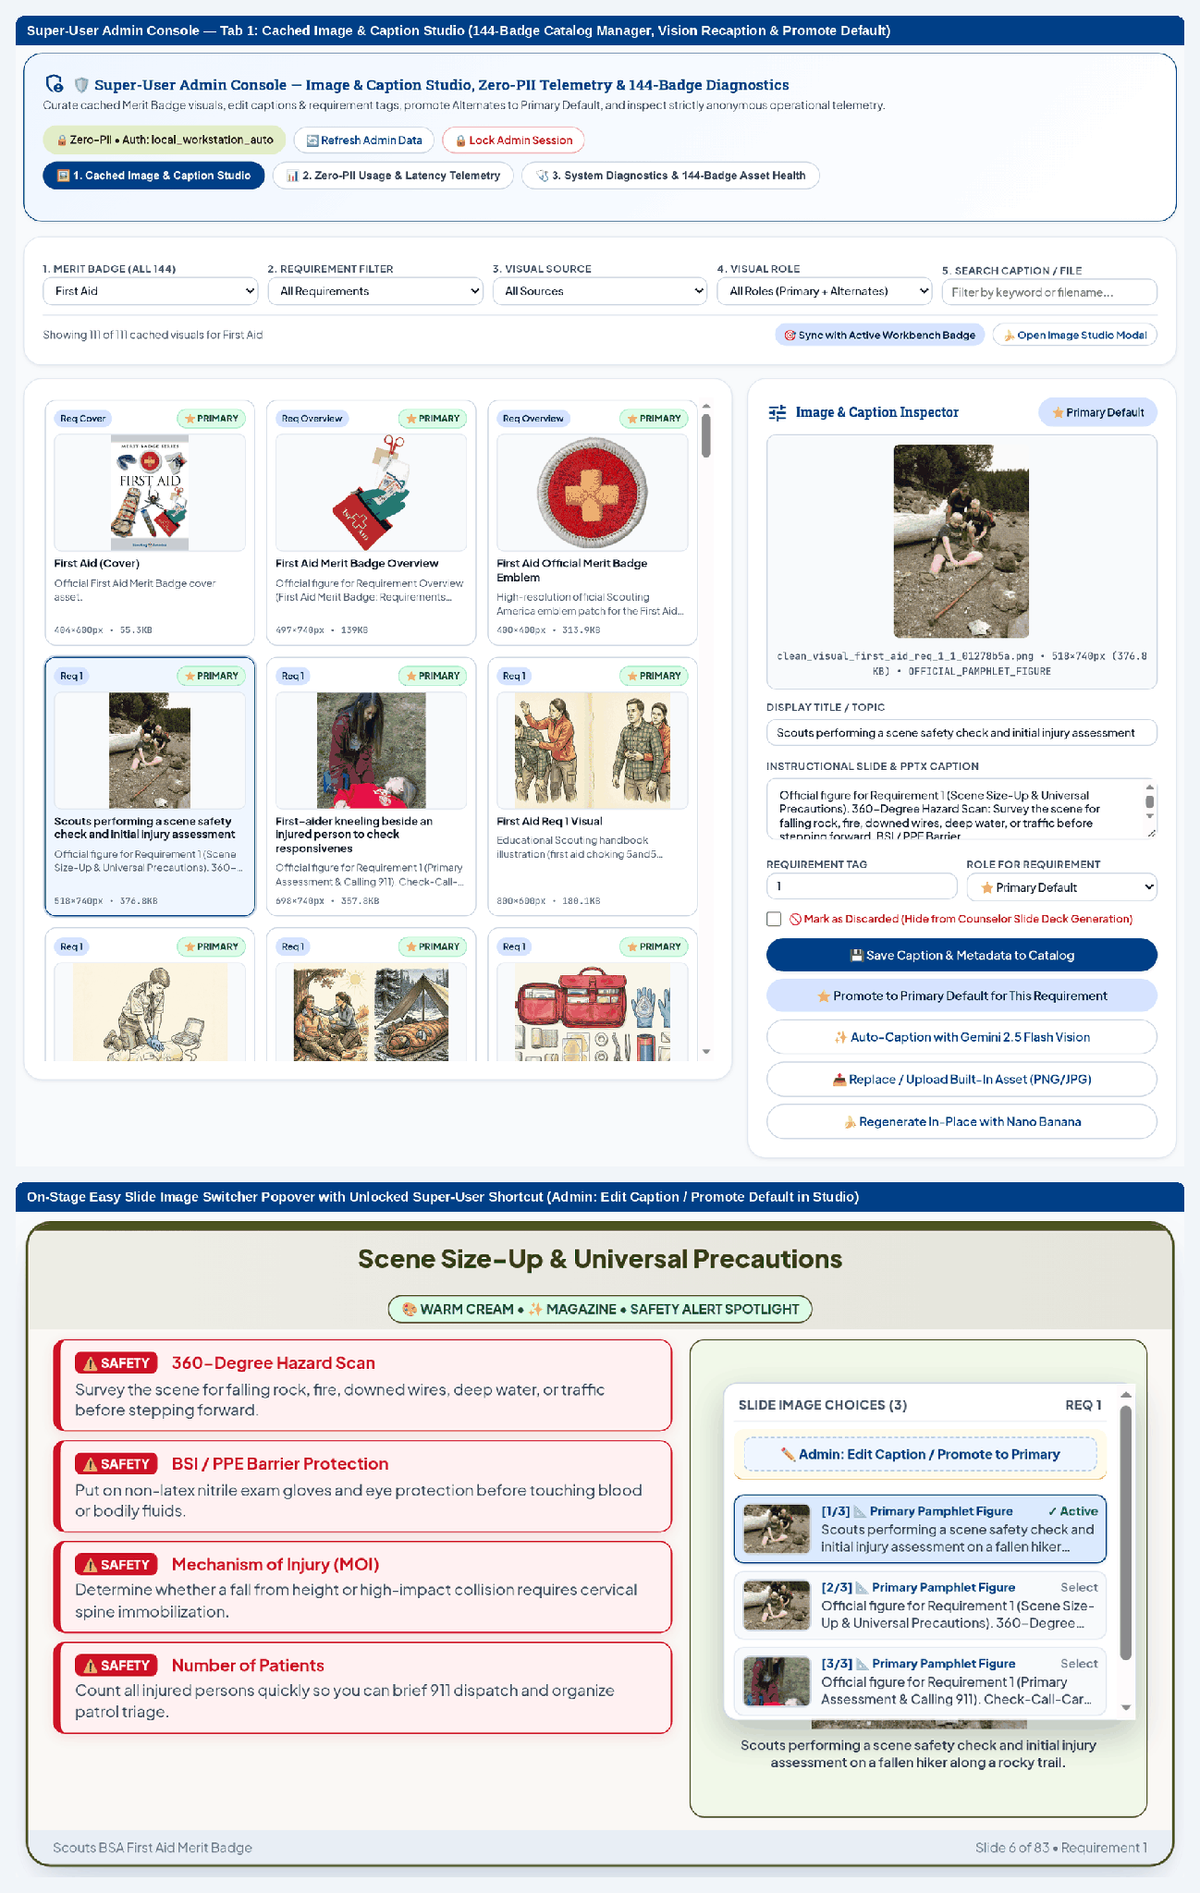
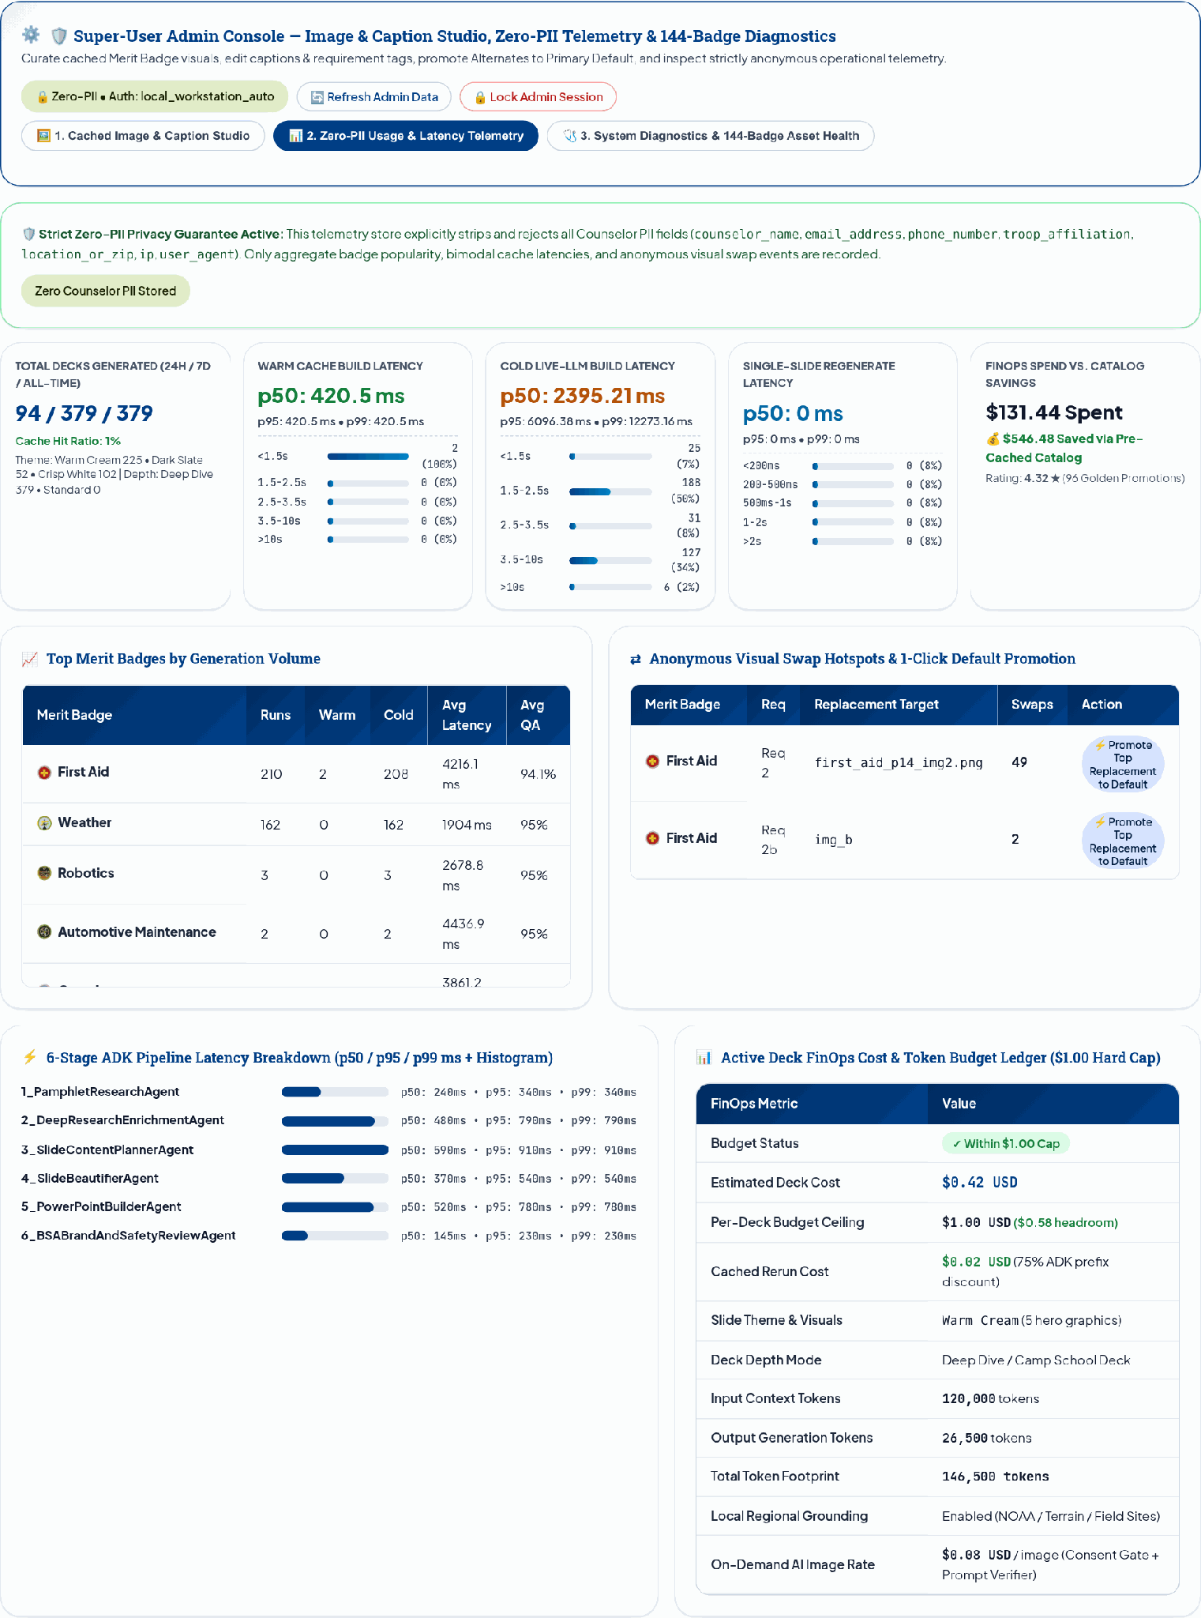
Six-Layer Security Architecture Enforces BSA Youth Protection (YPT), Zero-PII Redaction & Model Armor
SIX-LAYER DEFENSE-IN-DEPTH STACK
3-TAB SUPER-USER ADMIN CONSOLE (CTRL+SHIFT+A)
L1 | BSA Youth Protection (YPT) Two-Deep Leadership
Deterministic YPT banners on every Parent Letter and Field Checklist; blocks any prompt or output suggesting 1-on-1 private adult-youth contact.
L2 | Pre-LLM Zero-PII Firewall (scrub_pii_before_sink)
3-layer context-aware PII filter scrubs personal emails/phones/SSNs while preserving public hotlines (1-800-222-1222 Poison Control) & 92 BSA URLs.
L3 | Google Cloud Model Armor + Context-Aware Rules
Regional :sanitizeUserPrompt & :sanitizeModelResponse APIs (with fallback) block jailbreaks while permitting First Aid & range-safety instruction.
Admin Tab 1: 149-Badge Cached Image & Caption Studio (Gemini Vision Recaption & 1-Click Primary Promotion)
L4 | Cryptographic SHA-256 Lock & HMAC-SHA256 HITL
Locks wording via compute_canonical_pamphlet_hash, verifies constant-time hmac.compare_digest HITL tokens & logs compliance_attestation_ledger.
L5 | 3-State Circuit Breakers & Outbound SSRF Allowlist
CircuitBreaker cascades Pro -> Flash -> Deterministic Engine (100% 429/503 survival); outbound allowlist restricts to scouting.org & wikimedia.org.
L6 | Dual-Mode Admin Auth & Least-Privilege IAM
Zero-friction local_workstation_auto on 127.0.0.1 and signed HttpOnly HMAC-SHA256 cookies / Cloud IAP on Cloud Run (scouts-bsa-agent-sa).
Admin Tab 2: ZeroPiiTelemetryStore (12 PII Keys Stripped), p50/p95 Latency & Anonymous Slide-Swap Leaderboard
Source: src/agents/guardrails.py, src/security.py, src/observability/telemetry_store.py, docs/ADMIN_GUIDE.md, tests/test_pii_scrubber.py.
Notes:
Because Scouting America serves youth, security and Youth Protection cannot rely on prompt engineering alone. On the left, our six-layer defense-in-depth architecture enforces deterministic guardrails at every boundary. Layer 1 enforces BSA Youth Protection Two-Deep Leadership on every generated Parent Letter and Field Checklist, blocking any prompt or response that suggests one-on-one private adult-youth contact. Layer 2 runs scrub_pii_before_sink to redact emails, phone numbers, and SSNs before any payload reaches Vertex AI, SQLite, or Cloud Logging, injecting the counselor contact card locally only during final PowerPoint assembly. Layer 3 integrates regional Google Cloud Model Armor sanitizeUserPrompt and sanitizeModelResponse APIs with context-aware rules so legitimate First Aid and range-safety instruction passes while jailbreaks are blocked. Layer 4 locks canonical BSA requirement text with SHA-256 hashes, requires constant-time HMAC-SHA256 human-in-the-loop tokens, and writes to an append-only compliance attestation ledger. Layer 5 wraps model calls in thread-safe 3-state circuit breakers cascading from Gemini Pro to Flash to our deterministic layout engine with 100% survival under 429 and 503 fault injection, while restricting outbound requests strictly to scouting.org and wikimedia.org. Layer 6 provides zero-friction localhost authentication alongside signed HttpOnly HMAC-SHA256 cookies and Cloud IAP on Cloud Run. On the right, pressing Ctrl+Shift+A opens the 3-tab Super-User Admin Console, giving administrators a 149-badge image and Gemini Vision recaption studio alongside zero-PII latency and slide-swap telemetry.

Slide 12
Terraform Cloud Run v2 Topology, Multi-Session Clinic Readiness & 90-Day National Rollout
Rollout Phase & Horizon | Scope & Target Scale | State & Vector Persistence | Compute, Auth & CDN | Measurable Exit Gate
Today (ADR-11 As-Built): Single Container | Single Troop / Council Demo (All 149 Badges) | SQLite WAL (12 tables) + 5,625 Visuals | Cloud Run v2 (2 vCPU/4 GiB) + Render Semaphore (max=4) | 100% Pytest Suite | 14.2ms p95 Load | 0 PII Leaks
Phase 1 (Days 1-30): Council Pilot | 18 Eagle Badges -> 5 Councils (2,500 Counselors) | CloudSQLPgVectorBackend (HNSW + GIN) with council_id RLS | Async Cloud Tasks Render Workers + 6-Step Canary CI/CD | 99.5% Availability | p95 Cold Build < 20s
Phase 2-3 (Days 31-90): Enterprise Target | All 149 Badges -> 50,000+ Counselors Nationwide | Multi-Region AlloyDB Omni / Cloud SQL HA + BigQuery Analytics | Cloud IAP + my.scouting.org OIDC SSO (Active YPT Check) + CDN | 99.95% Multi-Region HA | <= $0.15/Deck TCO
PHYSICAL GCP IAM & SECURITY PERIMETER (TERRAFORM IAC)
SINGLE-COUNSELOR & CLINIC FIELD IMPACT
VPC-SC Perimeter + Secret Manager + KMS CMEK (90d)
1. Fillable Workbooks, 1-Page CPP & 5-Part Facilitator Guide
Cloud Armor WAF
Cloud Run v2
Vertex AI Gemini 2.5
149 Badges (incl. 5 Test Lab Pilots) | Sub-Req Unrolled AcroForm PDF (GTA 7.0.3.2) | Non-Repetitive 5-Part Notes
(120 RPM Limit)
us-central1 + us-east1
+ Model Armor Guard
-> Cloud IAP & ALB
2 vCPU / 4 GiB (min=1)
Scouting OIDC SSO
Secret Mgr + Sem(max=4)
Cloud SQL pgvector (RLS)
2. Multi-Session Pacing, Snow-Day Compression & Smart Partials
Active YPT Verified
99.95% Multi-Region HA
HNSW + BigQuery Sync
4-Session (75m) & Double-Block (150m) Agendas | S1-S4 | M Attendance | Actionable Make-Up vs. Home-Troop Partials
6-Step Cloud Build Canary:
10% Traffic -> /readiness -> 100% GA
3. Production SRE Guardrails & Zero-PII Youth Protection
Pytest (220+ / 45 Files) & 20-Badge Eval | 5% Trace Audit | repo_audit.sh Clean
12 SQLite WAL Tables | 27 MCP Capabilities (15T/7R/5P) | 3-Layer Context-Aware PII | Consolidated M3 Toolbars
Source: terraform/iam.tf + main.tf (4 GiB), cloudbuild.yaml, ARCHITECTURE_DECISIONS.md (ADR-11), scripts/build_submission_bundle.py, scripts/repo_audit.sh.
Notes:
To close out our architectural review, Slide 12 maps out our Physical GCP Security Perimeter, our ADR-11 As-Built versus Phase 2 Enterprise Scope reconciliation, and our 90-day national rollout path. In the top table, we distinguish between today's ADR-11 As-Built single-container prototype (running on Cloud Run v2 with embedded SQLite WAL across 12 normalized tables, 5,625 curated visuals (2,833 pamphlet figures and 2,792 Nano Banana illustrations) across all 149 Merit Badges including the 5 Test Lab Pilot badges, and a full automated pytest suite) and our Phase 1 through Phase 3 enterprise scale-out using CloudSQLPgVectorBackend with council_id row-level security, Cloud Tasks async render workers, and multi-region AlloyDB Omni HA. On the bottom left, our modular Terraform physical security perimeter (terraform/iam.tf plus main.tf with 4 GiB Cloud Run v2 memory) enforces defense-in-depth: requests pass through Cloud Armor WAF (120 RPM rate limit) and Global ALB into Cloud IAP with my.scouting.org OIDC single sign-on (verifying active Youth Protection Training at login), and then into least-privilege Cloud Run v2 service accounts inside a VPC Service Controls perimeter backed by Secret Manager, Cloud KMS 90-day CMEK rotation, Vertex AI Model Armor, and Cloud SQL pgvector. On the bottom right, we summarize the Single-Counselor and Multi-Session Clinic field impact and SRE readiness: verb-aligned fillable workbooks with the GTA 7.0.3.2 anti-add/subtract banner, 1-Page Class Preparation Pages (CPP), the 5-Part Non-Redundant Facilitator Guide, 4-Session and Double-Block clinic agendas with Snow-Day compression and Smart Partial classification, and 27 MCP capabilities.

