Slide 1
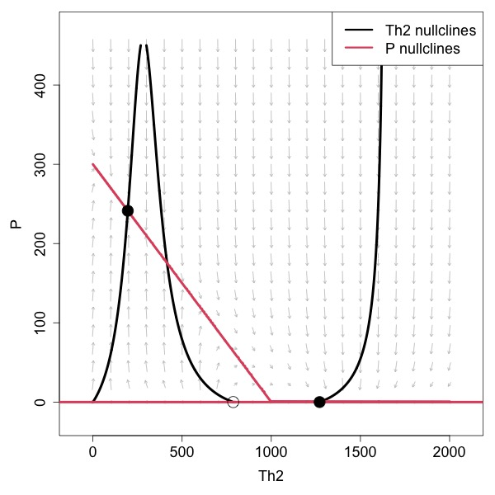
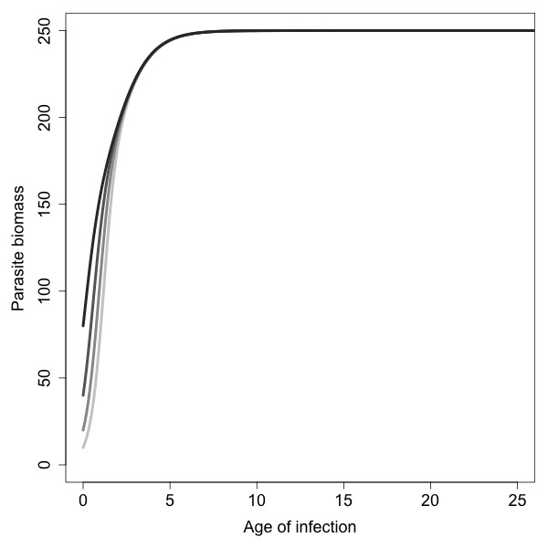
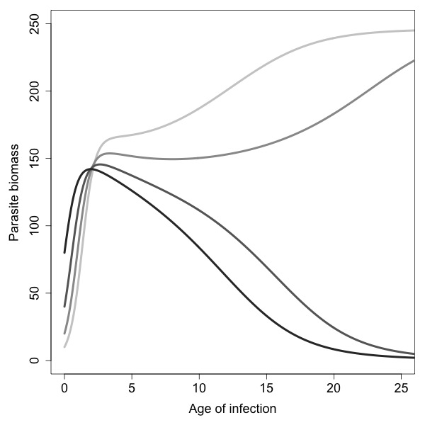
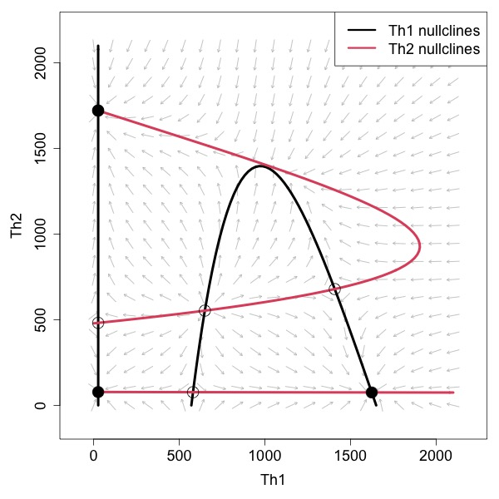
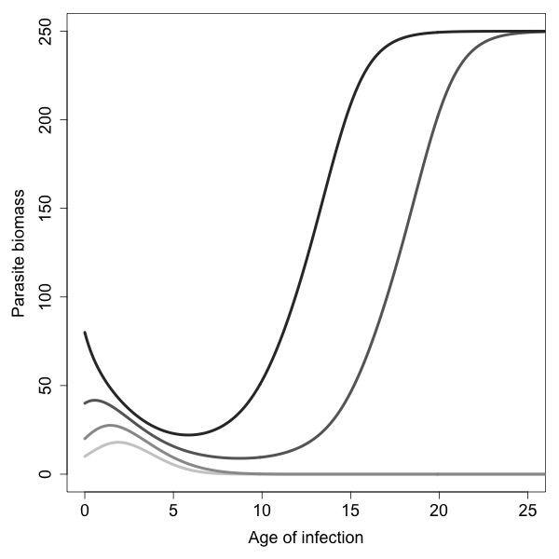
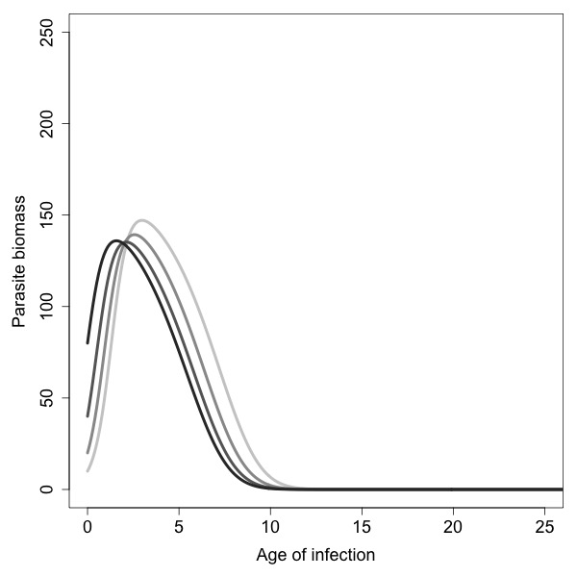
Dynamical Profile of
Immune-Parasite Interaction
Chronicity-Promoting Feedback >
Clearance-Promoting Feedback
Clearance-Promoting Feedback >
Chronicity-Promoting Feedback
A
C1
C2
Initial Th1 Bias
B
D1
D2
Initial Th2 Bias

