Slide 1
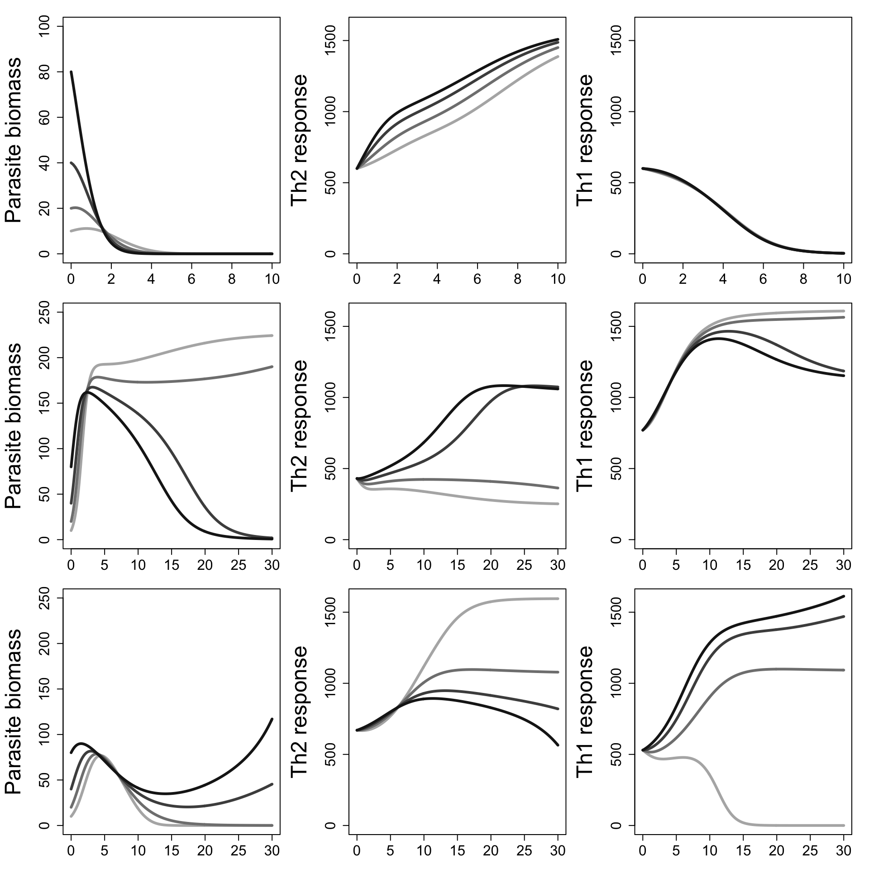
A
+
B
C
D
+
Th1
Strong Negative Feedbacks
-
-
P
+
-
Th2
+
+
E
F
G
+
Th1
Strong Clearance-Promoting Feedbacks
-
-
P
+
-
Th2
+
+
H
I
J
+
Th1
Strong Chronicity-Promoting Feedbacks
-
-
P
+
-
Th2
+

