Slide 1
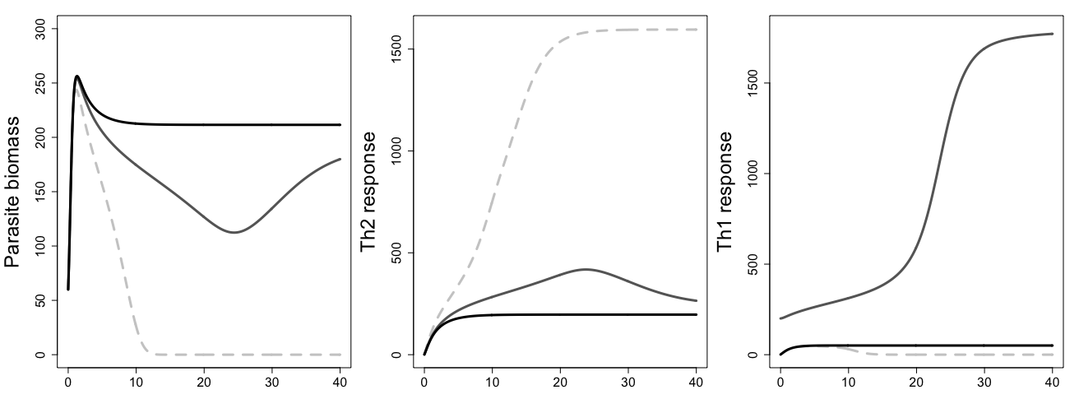
A
B
C
Clearance-promoting parameter set
Increase initial Th1ness thru higher baseline Th1 stimulation
Weaken strength of clearance-promoting feedbacks

