Slide 1
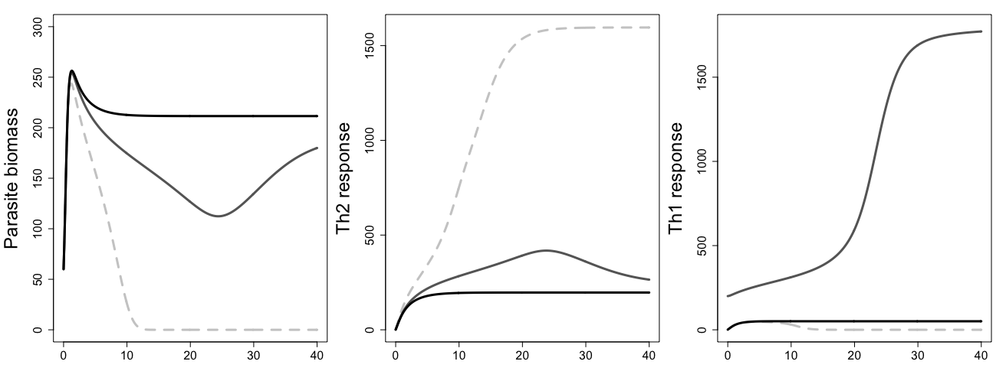
a
Baseline parameter set
b
c
Increase initial Th1ness
Weaken clearance-
promoting feedbacks
Age of infection
Days post-infection

