Slide 1
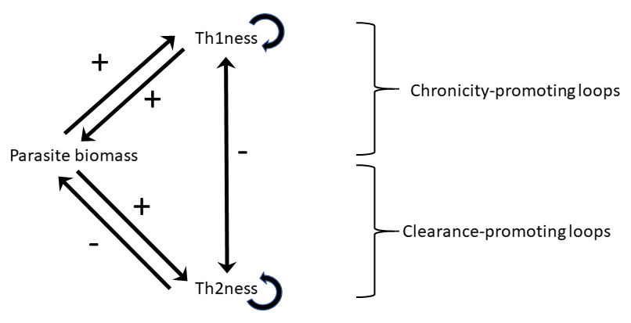
(A)
(B)
Negative feedbacks dominate
(C)
Positive feedbacks dominate
High dose
Long
infection
Long
infection
High dose
Initial Dose/
Infection Duration
Initial Dose/
Infection Duration
Low dose
Low dose
Short infection
Short infection
Host Environment
Host Environment

