Slide 1
UAS Alert

Slide 2
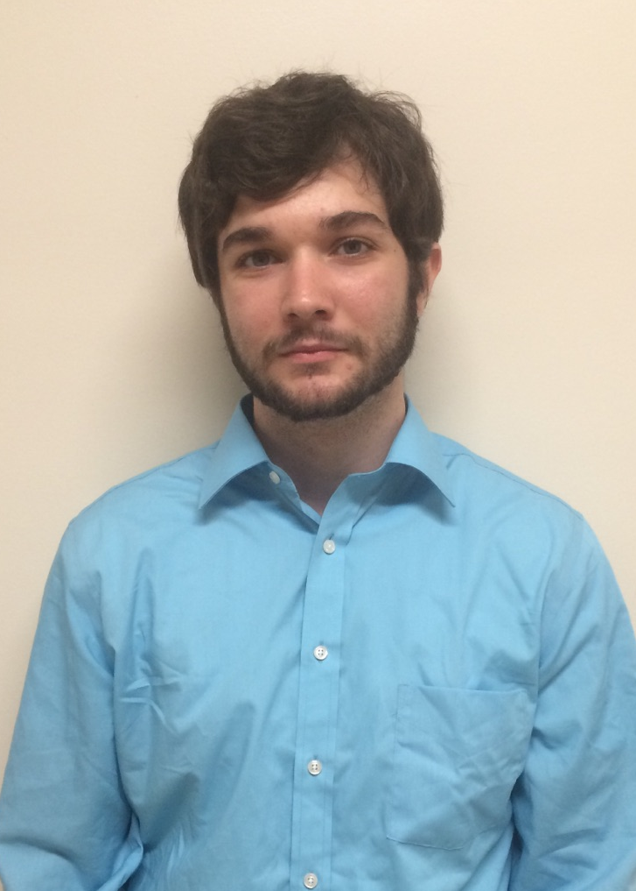

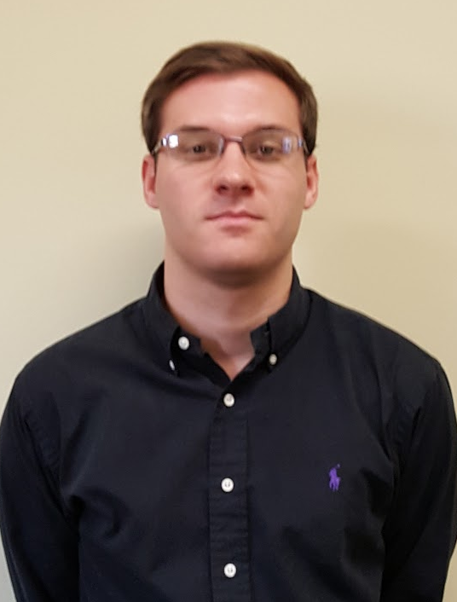


Team Members
Brian Joyner
Carter Long
Clayton Hudspeth
Brady Wade
Chase Abercrombie
Computer Engineering
Electrical Engineering
Electrical Engineering
Electrical Engineering
Electrical Engineering

Slide 3

Advisor
Dr. J.W. Bruce
Associate Professor
Mississippi State University
Ph.D., Electrical Engineering, University of Nevada Las Vegas, 2000
M.S., Electrical Engineering, Georgia Institute of Technology, 1993
B.S., Electrical Engineering, The University of Alabama in Huntsville, 1991

Slide 4
Problem Statement
During a nine month period, November 2014 to August 2015, the FAA reported 764 UAV sightings where the UAV compromised the safety of the aircraft [1].
UAS operators do not have to go through any safety training or certification before being allowed to operate a UAV.
Recent FAA rules allow for a UAV to fly above 400 ft. through a waiver application.

Slide 5
Solution
Provide UAVs the ability to map and track nearby air traffic.
Create a device that can be easily attached to any UAV.
Give alerts to help mitigate the chance of mid air collisions.

Slide 6
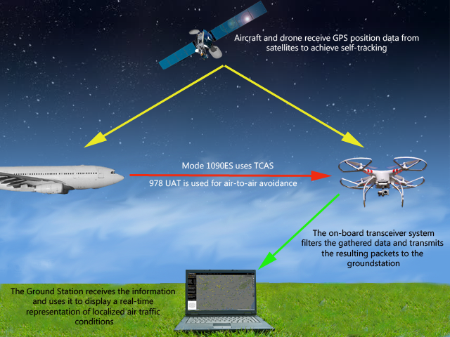
What is UAS Alert?

Slide 7
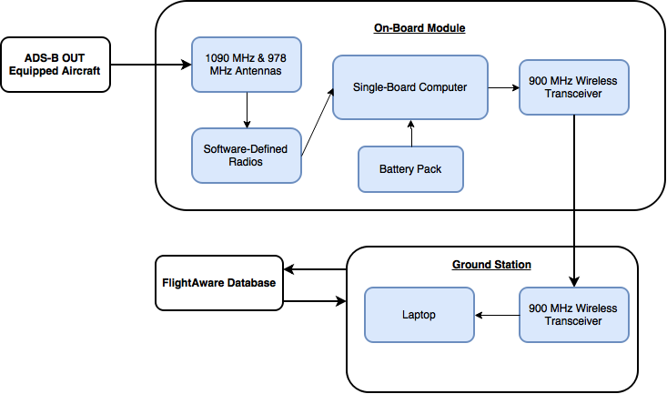
System Overview

Slide 8
Constraints
Technical
Transmission
Device Weight
Battery Life
Compact Design
Response time
Practical
Safety
Political
Notes:
Here we have our 5 technical and 2 practical constraints.

Slide 9
Technical Constraints
Transmission
Line-of-sight range
Transceiver range > UAV controller range
900MHz. Not 2.4GHz or 5.8GHz
Device Weight
Device weight < 300 grams
Notes:
First off when communicating with our device we will need a line-of-sight range and need to have a range larger than the UAVs controller range. We used 900MHz so that we do not crowd the commonly used frequencies for UAVs.
Our second constraint is the weight. We need to keep our device weight under the average payload of a UAV which is 300 grams.

Slide 10
Technical Constraints
Battery Life
Battery Life > 1 hour (avg. UAV flight time)
Compact Design
Device does not interfere with flight
Dimensions - 150x150x100 mm (LxWxH)
Response Time
Response time < 1 minute
Notes:
Since our device must protect airplanes throughout the duration of the UAVs flight time we need our battery to power our device for more than an hour which is the average flight time of a UAV.
Our design must also not interfere with the UAVs standard operations. To do this our device needs to have the dimensions here which is the available space on average size UAVs.
Our response time must also be fast enough to give accurate alerts and notifications for the operator.

Slide 11
Practical Constraints
Safety
Real time mapping
Accurate Results
Alerts to keep pilots safe
Political
Can only use ADS-B IN
Cannot broadcast on unauthorized frequencies
Notes:
Now for our Practical constraints. Safety is a key component of our project. We are using real time air traffic mapping to keep pilots safe.
Political is our other main constraint because we are not legally able to broadcast on certain frequencies. Therefore we are just using ADS-B IN to listen certified broadcasting.

Slide 12
Approach

Slide 13
Hardware
Batteries
Antennas
Transceivers
Software-defined Radios
Notes:
The Hardware we are using is Batteries, Antennas, Tranceivers, and Software-defined Radios.

Slide 14
Power
 | Current Draw | Voltage | Power Draw
SDR (x2) | 290 mA-hr each | 5 V | 2.9 W-hr
Raspberry Pi | 400 mA-hr | 5 V | 2 W-hr
Transceiver | 215 mA-hr | 2.1-3.6 V | 0.46-.774 W-hr
Needed | 1.195 A-hr | 5 V | 5.975 W-hr
Notes:
Here we have the table that breaks down the power usage of our on board device. We will be powering 2 SDRs, a Raspberry Pi, and a Transceiver. The overall Current usage and power draw are shown in te Needed row.

Slide 15
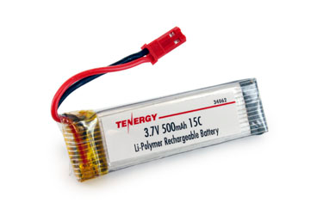
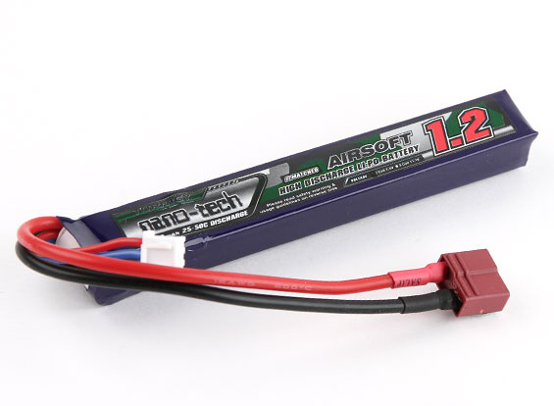
Battery Comparison
Tenergy | Turnigy
3.7 V 500 mAh 57x18.5x7.8 mm 17 Grams | 7.4 V 1200 mAh 116x17x13 mm 55 Grams
✔
Notes:
These are the 2 batteries we have looked at, the Tenergy and the Turnigy. We decided on the Turnigy battery because it met our voltage and Amperage requirements to meet our flight time constraints.

Slide 16
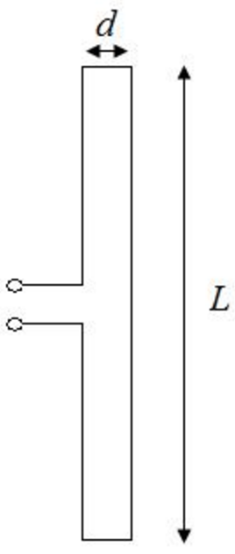
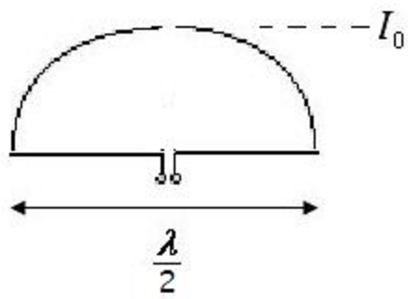
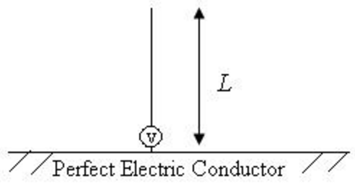
Antennas
Designs Considered:
Monopole
Dipole
Folded Dipole

Slide 17
Antennas
Advantages for Application Constraints:
Much higher dBi over folded dipole design increasing range.
Does not require a ground plane that allows for interference from circuit board signal paths due to compact design.
Dipole

Slide 18
Antennas
Designs Considered:
✔
Monopole
Dipole
Folded Dipole

Slide 19
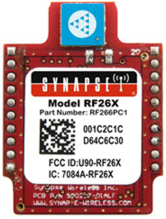
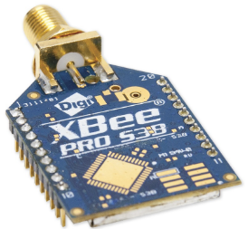
Transceivers
Synapse RF266PC1 |  |  | XBee 900HP
 | Operating Frequency Band | ISM 2.4GHz |  | Operating Frequency Band | ISM 902 to 928MHz
 | Encryption | AES 128-bit |  | Encryption | AES 128-bit
 | Line-Of-Sight Range | Up to 4,000 feet at 250Kbps |  | Line-Of-Sight Range | Up to 1,000 feet at 200Kbps; Up to 4 miles at 200Kbps (w/2.1dBi dipole)
 | Antenna Options | Chip Antenna |  | Antenna Options | Wire; Optional 2.1dBi dipole
 | Receiver Sensitivity | -103dBm |  | Receiver Sensitivity | -101dBm

Slide 20
Transceivers
Advantages for Application Constraints:
XBee 900HP
Operates on the 902 MHz to 928MHz scale which reduces signal interference from smaller objects within LOS range.
Longer range when standard wire antenna is replaced with 2dbi high gain antenna.

Slide 21
Transceivers
✔
Synapse RF266PC1 |  |  | XBee 900HP
 | Operating Frequency Band | ISM 2.4GHz |  | Operating Frequency Band | ISM 902 to 928MHz
 | Encryption | AES 128-bit |  | Encryption | AES 128-bit
 | Line-Of-Sight Range | Up to 4,000 feet at 250Kbps |  | Line-Of-Sight Range | Up to 1,000 feet at 200Kbps; Up to 4 miles at 200Kbps (w/2.1dBi dipole)
 | Antenna Options | Chip Antenna |  | Antenna Options | Wire; Optional 2.1dBi dipole
 | Receiver Sensitivity | -103dBm |  | Receiver Sensitivity | -101dBm

Slide 22
Software-Defined Radios (SDR)
Software-defined radios are radios where typical radio components such as demodulators are implemented in software
RTL-SDR is Digital Video Broadcasting USB dongle used as an SDR
The RTL2832U is a high-performance DVB-T demodulator IC that supports a USB 2.0 interface [2].
Uses Rafael Micro R820T2 tuner IC tunes to desired frequency

Slide 23
Software-Defined Radios
SDR | Frequency Range | Frequency Stability | Weight | Price | Choice
NooElec NESDR Nano 2+ | 25-1750 MHz | 0.5PPM | 17 grams | $22.95 | ✓
NooElec NESDR SMArt | 25-1750 MHz | 0.5PPM | 28 grams | $21.95
RTL-SDR.com | 0.5-1700 MHz | 1PPM | 31 grams | $24.95

Slide 24
Software-Defined Radios
SDR | Frequency Range | Frequency Stability | Weight | Price | Choice
NooElec NESDR Nano 2+ | 25-1750 MHz | 0.5PPM | 17 grams | $22.95 | ✓
NooElec NESDR SMArt | 25-1750 MHz | 0.5PPM | 28 grams | $21.95
RTL-SDR.com | 0.5-1700 MHz | 1PPM | 31 grams | $24.95

Slide 25
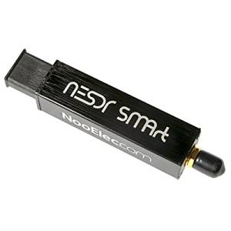
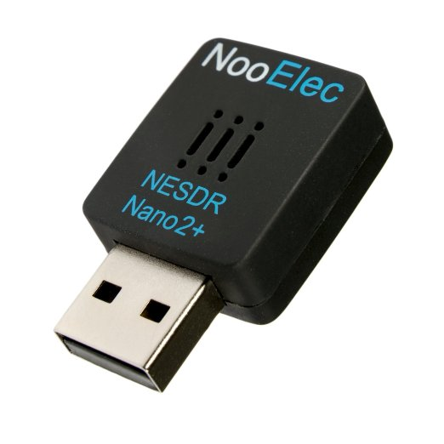
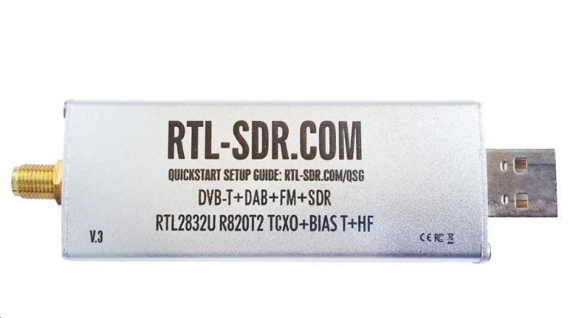
Software-defined Radios
NooElec NESDR SMArt
NooElec NESDR Nano2+
RTL-SDR.com SDR

Slide 26
Software
Linux-based Operating System
Ground Station
Demodulation Software
Display and Alerts
Code will be written in Python and C/C++

Slide 27
Operating System
Demodulation software used is designed to run on a linux-based system
PiAware runs on linux-based machines (Ubuntu, Raspbian)

Slide 28
Ground Station
Makes use of services from FlightAware
Multilateration (MLAT)
Interpretation of messages
Decides whether or not to upload to FlightAware

Slide 29
Demodulation Software
Dump1090/Dump978
Software on-board will simply demodulate, parse (remove unneeded data), and repeat to ground station
Decodes a variety of message formats including DF17 (ADS-B)
Features 24-bit Cyclic Redundancy Check (CRC) for error correction (Very important to have correct data)

Slide 30
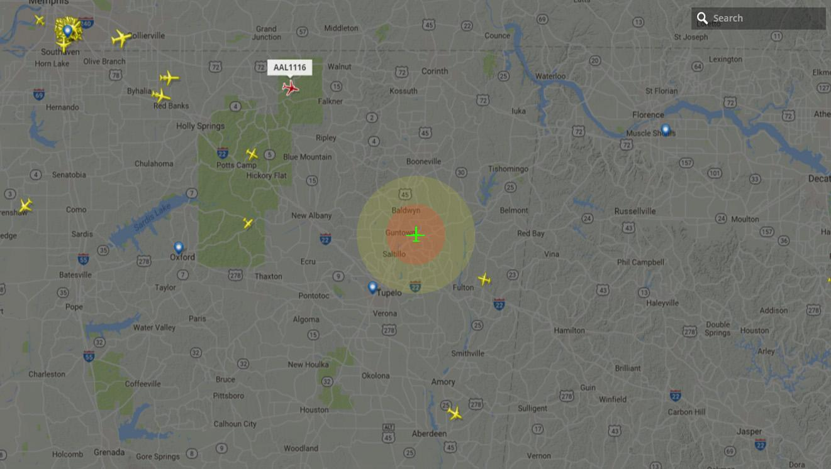
Display and Alerts (User Interface)

Slide 31
Design Plan
Test everything through Transmission Control Protocol (TCP) sockets
Use simulation software to test possible flight conditions before implementation
Simulation data will feed to “on-board module” which will feed to the ground station.
Modular testing
Weekly goals

Slide 32
Testing Diagram

Slide 33
Timeline
 | August | September | October | November | December
Research
Prototyping and Software
Testing and Debugging
Final Design Changes

Slide 34
Progress
Ordered parts
Able to receive signals on 1090 and 978, and send raw data packets through a TCP connection simulating the air-to-ground datalink. (From RPi to Laptop)
Mostly researching, it’s a broad field.

Slide 35
References
[1]"A320 collision heightens UAV safety concerns", Flightglobal.com, 2016. [Online]. Available: https://www.flightglobal.com/news/articles/a320-collision-heightens-uav-safety-concerns-424419/. [Accessed: 30- Aug- 2016].
[2]"Realtek", Realtek.com.tw, 2016. [Online]. Available: http://www.realtek.com.tw/products/productsView.aspx?Langid=1&PFid=35&Level=4&Conn=3&ProdID=257. [Accessed: 06- Oct- 2016].

Slide 36
Questions?

