Slide 1
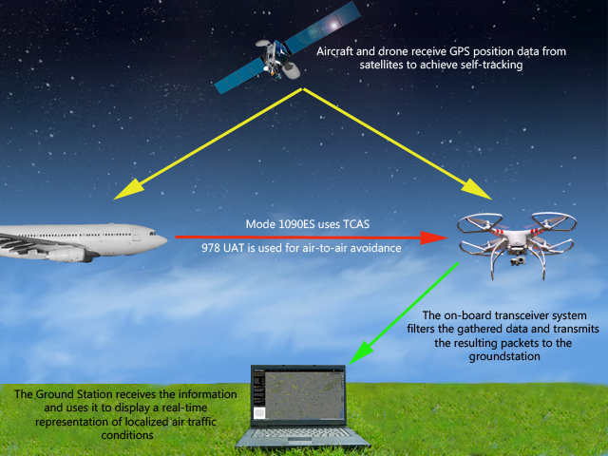
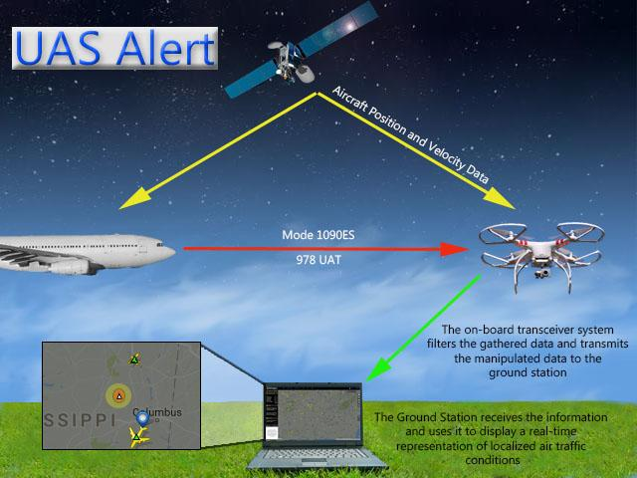

Application:
Alerts the user when nearby aircraft are detected
Helps operators fly safely
Features:
Helps keep other aircraft safe
Fits on a variety of UAVs
Small & lightweight
Easy-to-use display
Specifications:
Receives ADS-B from aircraft
Range of 4 miles from ground station
Lightweight design
Battery life > 1hr
Wireless communication from flight frame to ground station (902-928MHz)
UAS Alert

