Slide 1
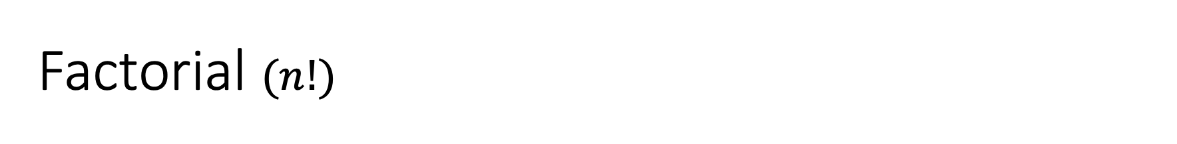
Factorial $(n!)$
n | n! | Expanded form
0 | 0! = 1 | Base case
1 | 1! = 1 | Base case
2 | 2! = 2 | 2 x 1
3 | 3! = 6 | 3 x 2 x 1
4 | 4! = 24 | 4 x 3 x 2 x 1
5 | 5! = 120 | 5 x 4 x 3 x 2 x 1
6 | 6! = 720 | 6 x 5 x 4 x 3 x 2 x 1
7 | 7! = | 7 x 5 x 4 x 3 x 2 x 1
8 | 8! = | 8 x 7 x 6 x 5 x 4 x 3 x 2 x 1
Etc.

Slide 2
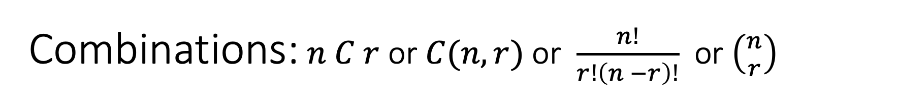
Combinations: $n C r$ or $C(n,r)$ or $\frac{n!}{r!\left(n −r\right)!}$ or $\left({n \atop r}\right)$
n / r | 1 | 2 | 3 | 4 | 5 | 6 | 7 | 8 | 9 | 10
1 | 1 | - | - | - | - | - | - | - | - | -
2 | 2 | 1 | - | - | - | - | - | - | - | -
3 | 3 | 3 | 1 | - | - | - | - | - | - | -
4 | 4 | 6 | 4 | 1 | - | - | - | - | - | -
5 | 5 | 10 | 10 | 5 | 1 | - | - | - | - | -
6 | 6 | 15 | 20 | 15 | 6 | 1 | - | - | - | -
7 | 7 | 21 | 35 | 35 | 15 | 7 | 1 | - | - | -
8 | 8 | 28 | 56 | 70 | 56 | 28 | 8 | 1 | - | -
9 | 9 | 36 | 84 | 126 | 126 | 84 | 36 | 9 | 1 | -
10 | 10 | 45 | 120 | 210 | 252 | 210 | 120 | 45 | 10 | 1

Slide 3
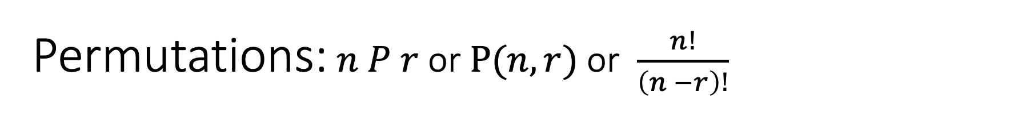
Permutations:$n P r$ or $P(n,r)$ or $\frac{n!}{\left(n −r\right)!}$
n / r | 1 | 2 | 3 | 4 | 5 | 6 | 7 | 8 | 9 | 10
1 | 1 | - | - | - | - | - | - | - | - | -
2 | 2 | 2 | - | - | - | - | - | - | - | -
3 | 3 | 6 | 6 | - | - | - | - | - | - | -
4 | 4 | 12 | 24 | 24 | - | - | - | - | - | -
5 | 5 | 20 | 60 | 120 | 120 | - | - | - | - | -
6 | 6 | 30 | 120 | 360 | 720 | 720 | - | - | - | -
7 | 7 | 42 | 210 | 840 | 2520 | 5040 |  | - | - | -
8 | 8 | 56 | 336 | 1680 | 6720 | 20160 | 40320 | 40320 | - | -
9 | 9 | 72 | 504 | 3024 | 15120 | 60480 | 181440 | 362880 | 362880 | -
10 | 10 | 90 | 720 | 5040 | 30240 | 151200 | 1814400 | 3628800 | 3628800

Slide 4
Set partitions
A set partition is a grouping of its elements into non-empty subsets, in such a way that every element is included in exactly one subset.
Example: The set {1, 2, 5} can be partitioned into
{1}, {2}, {5}
{1, 2}, {5}
{1, 5}, {2}
{2, 5}, {1}
{1, 2, 5}
A set of 3 elements thus has 5 possible partitions.

Slide 5

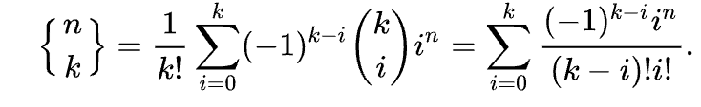
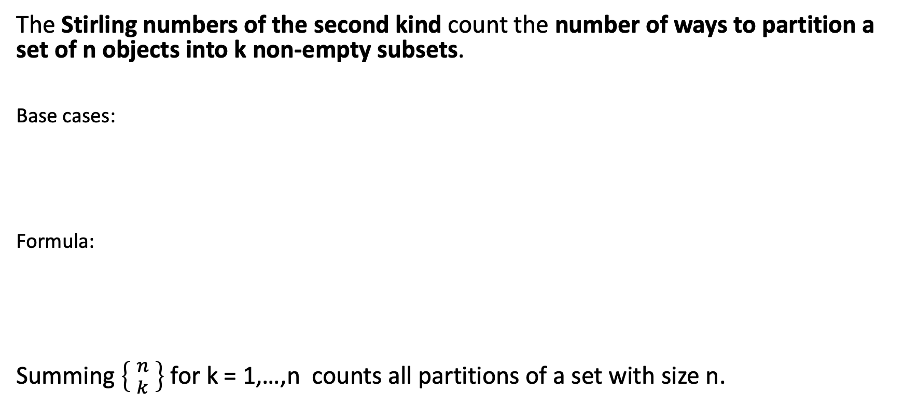
Counting set partitions
The Stirling numbers of the second kind count the number of ways to partition a set of n objects into k non-empty subsets.
Base cases:
Formula:
Summing $\left\{ {n \atop k} \right\}$for k = 1,…,n counts all partitions of a set with size n.

Slide 6
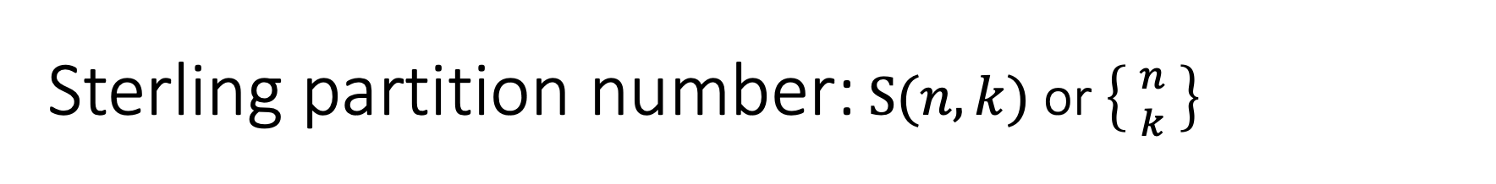
Sterling partition number:$S(n,k)$ or $\left\{ {n \atop k} \right\}$
n / k | 0 | 1 | 2 | 3 | 4 | 5 | 6 | 7 | 8 | 9 | 10
0 | 1 | - | - | - | - | - | - | - | - | - | -
1 | 0 | 1 | - | - | - | - | - | - | - | - | -
2 | 0 | 1 | 1 | - | - | - | - | - | - | - | -
3 | 0 | 1 | 3 | 1 | - | - | - | - | - | - | -
4 | 0 | 1 | 7 | 6 | 1 | - | - | - | - | - | -
5 | 0 | 1 | 15 | 25 | 10 | 1 | - | - | - | - | -
6 | 0 | 1 | 31 | 90 | 65 | 15 | 1 | - | - | - | -
7 | 0 | 1 | 63 | 301 | 350 | 140 | 21 | 1 | - | - | -
8 | 0 | 1 | 127 | 966 | 1701 | 1050 | 266 | 28 | 1 | - | -
9 | 0 | 1 | 255 | 3025 | 7770 | 6951 | 2646 | 462 | 36 | 1 | -
10 | 0 | 1 | 511 | 9330 | 34105 | 42525 | 22827 | 5580 | 750 | 45 | 1

Slide 7
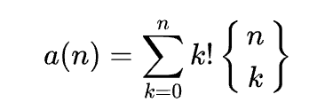
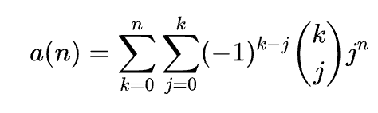
Ordered Bell numbers / Fubini numbers
count the number of weak orderings on a set of n elements
computed via a summation formula involving binomial coefficients, or by using a recurrence relation
or
T(n) | 0 | 1 | 2 | 3 | 4 | 5 | 6 | 7
Fubini(n) | 1 | 1 | 3 | 13 | 75 | 541 | 4683 | 47293

Slide 8
Ranked interpretations of a set
A set of ranked interpretations means that each interpretation is preferred or equal relative to the other interpretations in the set.
A set of ranked interpretations corresponds to a partition of interpretations.
The number of differently ordered partitions is called the set of possible worlds.

Slide 9
Counting possible worlds
Given a set S of all interpretations with size n, the number of all possible worlds is given by Fubini(n).
Example: a propositional belief set with 2 atoms, has 4 interpretations with Fubini(4) = 75 possible worlds.
For large numbers of atoms, enumerating the set of all possible worlds becomes intractable.

Slide 10
Enumeration of possible worlds
Given a set S of all interpretations with size n, print all combinations of all partitions of S

