Slide 1
Abstraction, Inheritance, and Polymorphism in Java

Slide 2
“Object Orientation involving encapsulation, inheritance, polymorphism, and abstraction, is an important approach in programming and program design. It is widely accepted and used in industry and is growing in popularity in the first and second college-level programming courses.”

Slide 3
Some other reasons to move on to Java:
Platform-independent software
Relatively easy graphics and GUI programming
Lots of library packages
Free compiler and IDEs

Slide 4
Some other reasons to move on to Java:
Colleges are teaching it
Companies are using it
Students want it
(Teachers welcome it... ;)
(Programmers drink it... :)

Slide 5
What are OOP’s claims to fame?
Better suited for team development
Facilitates utilizing and creating reusable software components
Easier GUI programming
Easier program maintenance

Slide 6
OOP in a Nutshell:
A program models a world of interacting objects
Objects create other objects and “send messages” to each other (in Java, call each other’s methods)
Each object belongs to a class; a class defines properties of its objects
A class implements an ADT; the data type of an object is its class
Programmers write classes (and reuse existing classes)

Slide 7
OOP
Encapsulation
Abstraction
Inheritance
Polymorphism

Slide 8
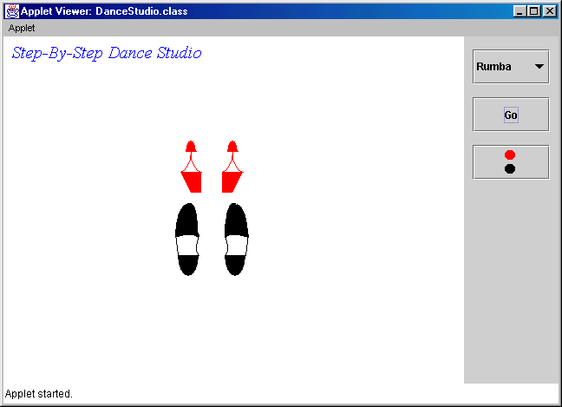
Case Study: Dance Studio

Slide 9
Quiz:
How many classes we wrote
for this applet?
A. 1
B. 2
C. 5
D. 10
E. 17

Slide 10
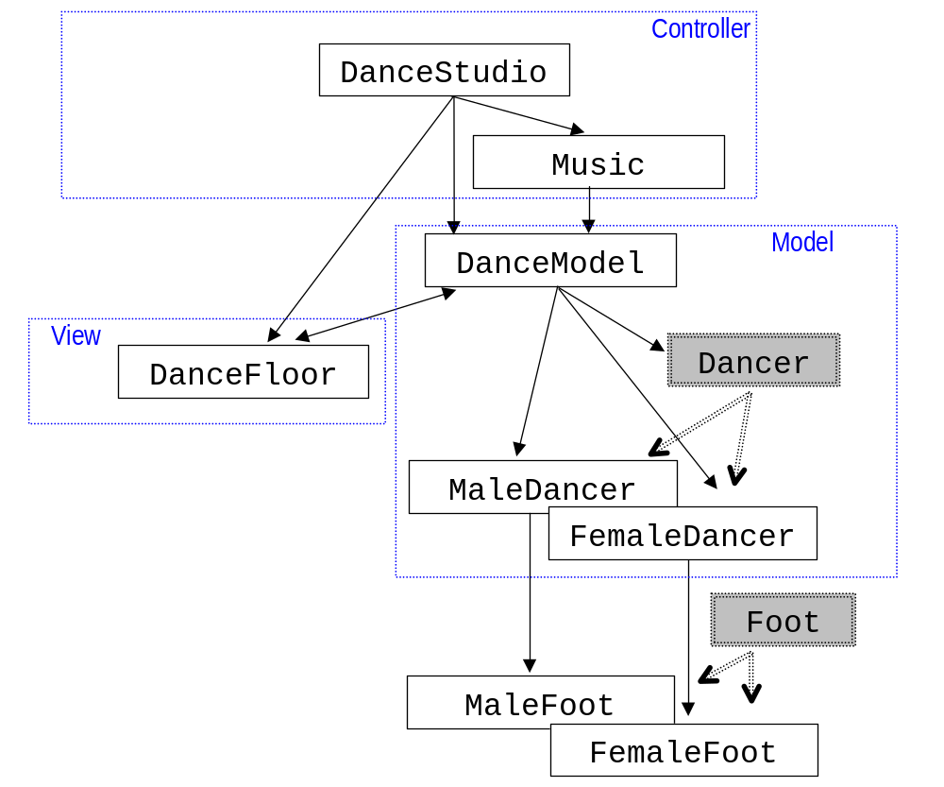

Slide 11

Good news:
The classes are fairly short
In OOP, the number of classes is not considered a problem

Slide 12
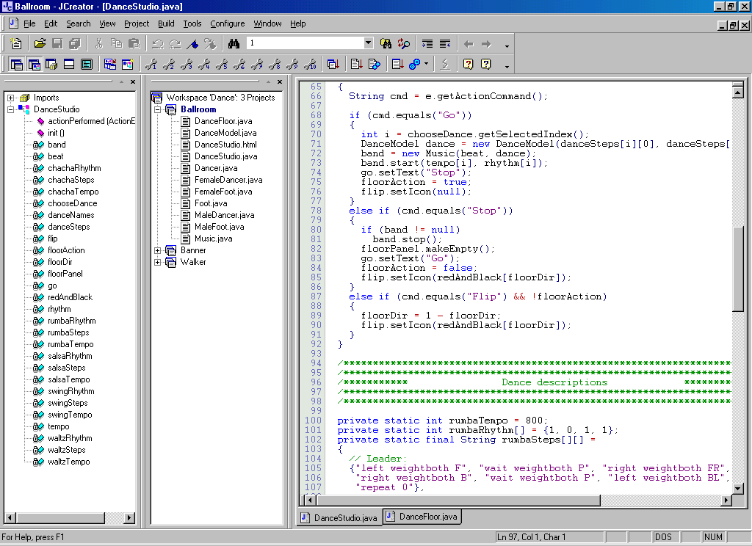
In a project with 10 classes we need an IDE...

Slide 13

Abstraction
Abstraction
Encapsulation
Inheritance
Polymorphism
Abstraction means ignoring irrelevant features, properties, or functions and emphasizing the relevant ones...
“Relevant” to what?
... relevant to the given project (with an eye to future reuse in similar projects).

Slide 14
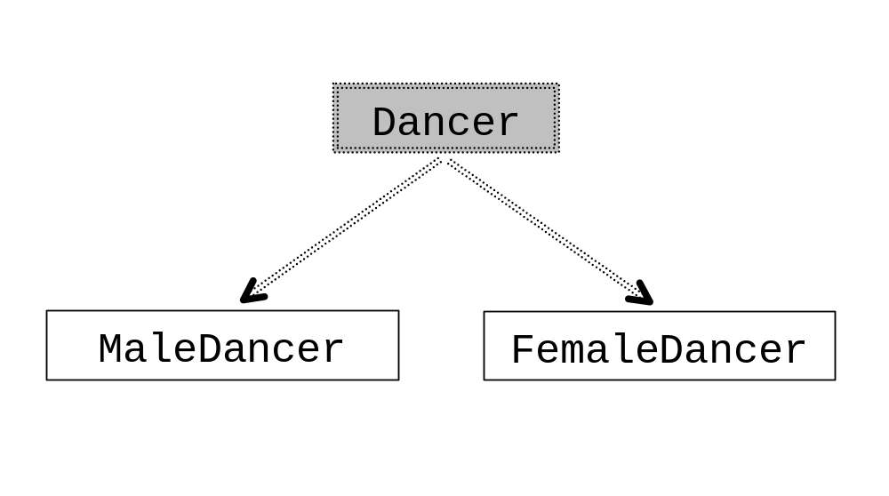
Abstraction

Slide 15
Encapsulation
Abstraction
Encapsulation
Inheritance
Polymorphism
Encapsulation means that all data members (fields) of a class are declared private. Some methods may be private, too.
The class interacts with other classes (called the clients of this class) only through the class’s constructors and public methods. Constructors and public methods of a class serve as the interface to class’s clients.

Slide 16
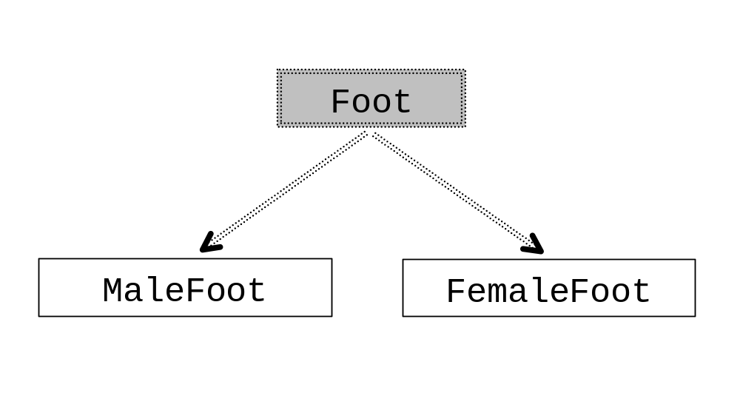
Encapsulation

Slide 17
public abstract class Foot
{
private static final int footWidth = 24;
private boolean amLeft;
private int myX, myY;
private int myDir;
private boolean myWeight;
// Constructor:
protected Foot(String side, int x, int y, int dir)
{
amLeft = side.equals("left");
myX = x;
myY = y;
myDir = dir;
myWeight = true;
}
Continued 
All fields are private

Slide 18
Encapsulation ensures that structural changes remain local
Changes in the code create software maintenance problems
Usually, the structure of a class (as defined by its fields) changes more often than the class’s constructors and methods
Encapsulation ensures that when fields change, no changes are needed in other classes (a principle known as “locality”)

Slide 19
True or False? Abstraction and encapsulation are helpful for the following:
◻ Team development ________
◻ Reusable software ________
◻ GUI programming ________
◻ Easier program maintenance ________

Slide 20
Answer:
☑ Team development ________
☑ Reusable software ________
◻ GUI programming ________
☑ Easier program maintenance ________
T
T
F
(True if you are working on system packages, such as Swing)
T

Slide 21
Inheritance
Abstraction
Encapsulation
Inheritance
Polymorphism
A class can extend another class, inheriting all its data members and methods while redefining some of them and/or adding its own.
Inheritance represents the is a relationship between data types. For example: a FemaleDancer is a Dancer.

Slide 22
Inheritance Terminology:
subclass
or
derived class
superclass
or
base class
extends
public class FemaleDancer extends Dancer
{
...
}

Slide 23
Inheritance (cont’d)
Example:

Slide 24
Inheritance (cont’d)
Constructors are not inherited. The FemaleDancer class only adds a constructor:
public class FemaleDancer extends Dancer
{
public FemaleDancer(String steps[],
int x, int y, int dir)
{
leftFoot = new FemaleFoot("left", x, y, dir);
rightFoot = new FemaleFoot("right", x, y, dir);
leftFoot.move(-Foot.getWidth() / 2, 0);
rightFoot.move(Foot.getWidth() / 2, 0);
}
}

Slide 25
Inheritance (cont’d)
Example:

Slide 26
public class FemaleFoot extends Foot
{
public FemaleFoot(String side, int x, int y, int dir)
{
super(side, x, y, dir); // calls Foot's constructor
}
//
public void drawLeft(Graphics g)
{
...
}
public void drawRight(Graphics g)
{
...
}
}
Supplies methods that are abstract in Foot:

Slide 27
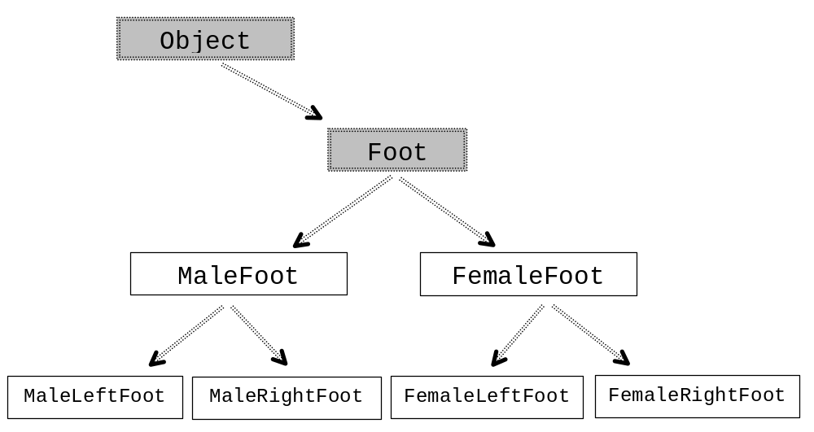
Inheritance may be used to define a hierarchy of classes in an application:

Slide 28
All methods of the base library class are available in your derived class
You don’t need to have the source code of a class to extend it

Slide 29
True or False? Inheritance is helpful for the following:
◻ Team development ________
◻ Reusable software ________
◻ GUI programming ________
◻ Easier program maintenance ________

Slide 30
Answer:
◻ Team development ________
☑ Reusable software ________
☑ GUI programming ________
☑ Easier program maintenance ________
F
T
T
???

Slide 31
Polymorphism
Abstraction
Encapsulation
Inheritance
Polymorphism
Polymorphism ensures that the appropriate method is called for an object of a specific type when the object is disguised as a more general type.
Good news: polymorphism is already supported in Java — all you have to do is use it properly.

Slide 32
Polymorphism (cont’d)
Situation 1:
A collection (array, list, etc.) contains objects of different but related types, all derived from the same common base class.

Slide 33
Polymorphism replaces old-fashioned use of explicit object attributes and if-else (or switch) statements, as in:
public abstract class Foot
{
...
public void draw(Graphics g)
{
...
if (isLeft())
drawLeft(g);
else
drawRight(g);
...
}
}

Slide 34
These slides and the Dance Studio code are posted at:
http://www.skylit.com/oop/

