Slide 1



PyPSA-GB Data Exploration
Ir. Claysius D. Widjaja, M.Sc
Senior Power Systems Engineer
06/03/2025
Workstream #5 – Interconnector and Offshore Wind Design

Slide 2
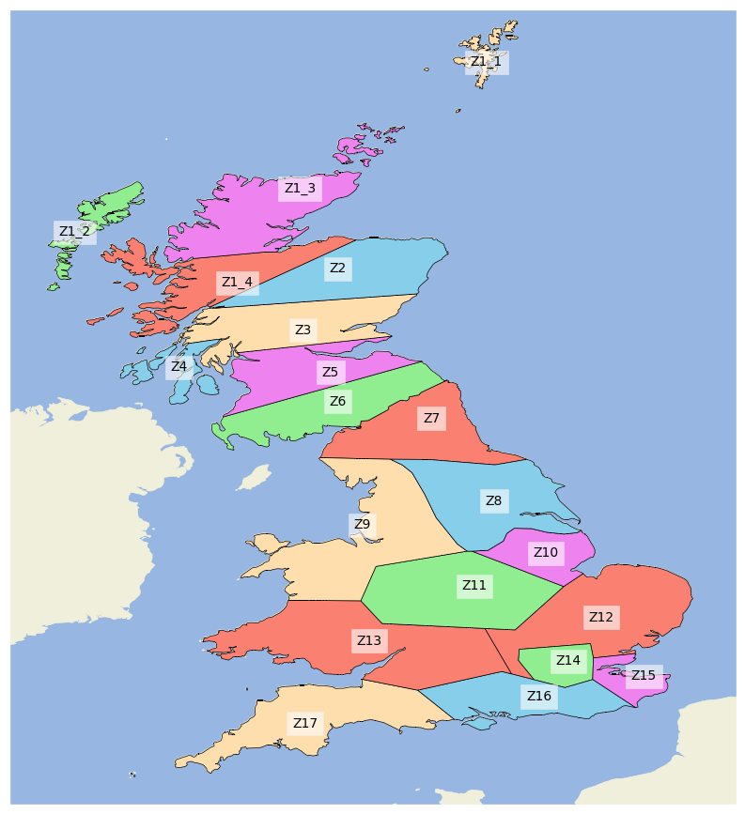
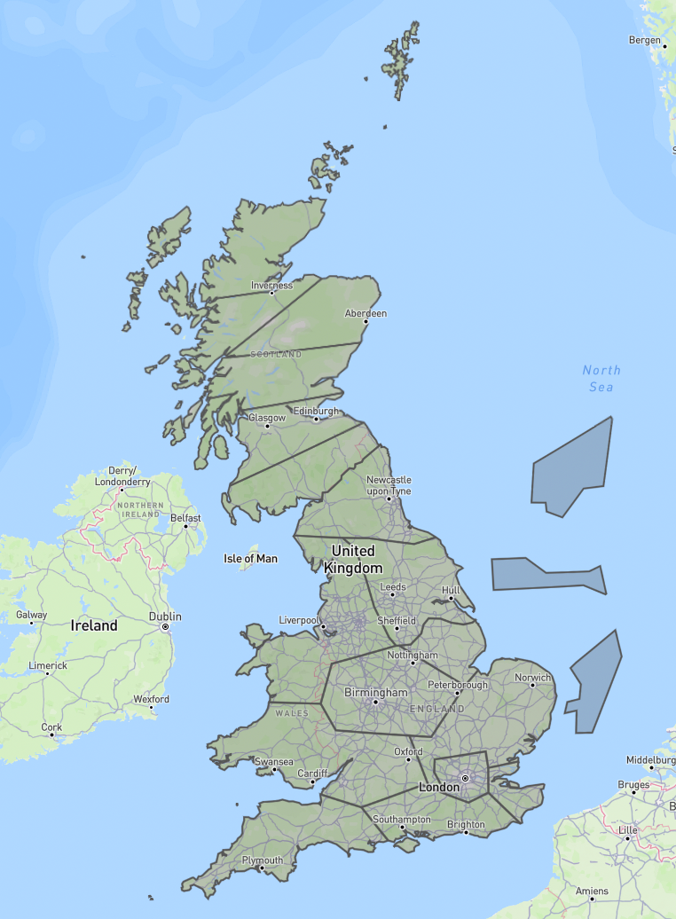
Zonal Network Model
GB Network divided into 20 zones
E&W are from Z7 to Z17 (11 zones in total)
The way the zone was classified is from the old ETYS, there are similarities with old boundaries classification from previous ETYS
We can modify the .geojson file to divide the zone to follow current ETYS boundary classification (use geojson.io)

Slide 3
Zone Lines
name | bus0 | bus1 | carrier | p_nom | marginal_cost | p_min_pu | p_max_pu
Z10,Z8 | Z10 | Z8 | AC | 5000 | 0 | -1 | 1
Z11,Z10 | Z11 | Z10 | AC | 3684 | 0 | -1 | 1
Z11,Z9 | Z11 | Z9 | AC | 3367 | 0 | -1 | 1
Z12,Z10 | Z12 | Z10 | AC | 4621 | 0 | -1 | 1
Z12,Z11 | Z12 | Z11 | AC | 3238 | 0 | -1 | 1
Z13,Z11 | Z13 | Z11 | AC | 896 | 0 | -1 | 1
Z13,Z12 | Z13 | Z12 | AC | 844 | 0 | -1 | 1
Z14,Z12 | Z14 | Z12 | AC | 5000 | 0 | -1 | 1
Z15,Z12 | Z15 | Z12 | AC | 1453 | 0 | -1 | 1
Z15,Z14 | Z15 | Z14 | AC | 5000 | 0 | -1 | 1
Z16,Z13 | Z16 | Z13 | AC | 2559 | 0 | -1 | 1
Z16,Z14 | Z16 | Z14 | AC | 5000 | 0 | -1 | 1
Z16,Z15 | Z16 | Z15 | AC | 1467 | 0 | -1 | 1
Z17,Z13 | Z17 | Z13 | AC | 590 | 0 | -1 | 1
Z17,Z16 | Z17 | Z16 | AC | 302 | 0 | -1 | 1
Z1_3,Z1_1 | Z1_3 | Z1_1 | DC | 257 | 0 | -1 | 1
Z1_3,Z1_2 | Z1_3 | Z1_2 | DC | 450 | 0 | -1 | 1
Z1_4,Z1_1 | Z1_4 | Z1_1 | AC | 0 | 0 | -1 | 1
Z1_4,Z1_2 | Z1_4 | Z1_2 | AC | 19 | 0 | -1 | 1
Z1_4,Z1_3 | Z1_4 | Z1_3 | AC | 117 | 0 | -1 | 1
Z2,Z1_3 | Z2 | Z1_3 | DC | 1200 | 0 | -1 | 1
Z2,Z1_4 | Z2 | Z1_4 | AC | 755 | 0 | -1 | 1
Z3,Z2 | Z3 | Z2 | AC | 1342 | 0 | -1 | 1
Z4,Z3 | Z4 | Z3 | AC | 5000 | 0 | -1 | 1
Z5,Z3 | Z5 | Z3 | AC | 1752 | 0 | -1 | 1
Z6,Z5 | Z6 | Z5 | AC | 3343 | 0 | -1 | 1
Z7,Z2 | Z7 | Z2 | DC | 2000 | 0 | -1 | 1
Z7,Z6 | Z7 | Z6 | AC | 3313 | 0 | -1 | 1
Z8,Z7 | Z8 | Z7 | AC | 1112 | 0 | -1 | 1
Z9,Z3 | Z9 | Z3 | DC | 2200 | 0 | -1 | 1
Z9,Z7 | Z9 | Z7 | AC | 1226 | 0 | -1 | 1
Z9,Z8 | Z9 | Z8 | AC | 1275 | 0 | -1 | 1
Clear need to update the lines!!!
Need to have clear marginal cost assumption for TL too (might use NREL studies assumption for easiest way out)
Should add bootstrap links here too

Slide 4
Current and Future Interconnectors
name | bus0 | bus1 | carrier | p_nom | installed date | marginal_cost
BritNed | Netherlands | Z15 | DC | 1000 | 01/01/2020 | 20
EastWest | Ireland | Z9 | DC | 600 | 01/01/2020 | 7
Moyle | N. Ireland | Z5 | DC | 600 | 01/01/2020 | 7
Nemo | Belgium | Z15 | DC | 1000 | 01/01/2020 | 20
IFA | France1 | Z15 | DC | 2000 | 01/01/2020 | 15
IFA2 | France2 | Z16 | DC | 1000 | 01/01/2020 | 15
NSL | Norway | Z7 | DC | 1400 | 01/01/2021 | 1
ElecLink | France1 | Z15 | DC | 1000 | 01/01/2022 | 15
Viking Link | Denmark | Z12 | DC | 1400 | 01/01/2023 | 7
Greenlink | Ireland2 | Z13 | DC | 500 | 01/01/2023 | 7
GridLink | France1 | Z15 | DC | 1400 | 01/01/2024 | 15
NeuConnect | Germany | Z15 | DC | 1400 | 01/01/2024 | 20
NorthConnect | Norway | Z2 | DC | 1400 | 01/01/2025 | 1
FAB Link | France2 | Z17 | DC | 1400 | 01/01/2025 | 15
Clear need to update all the interconnectors!
Need to have clear marginal cost assumption for these interconnectors too (again, might use NREL studies assumption for easiest way out)

Slide 5
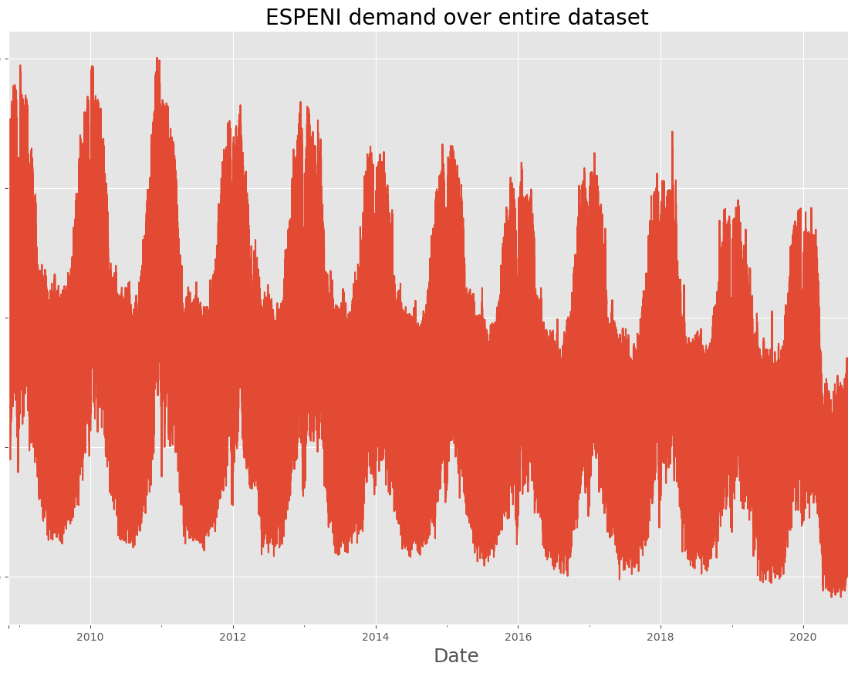
Historical Demand Data – ESPENI
PyPSA-GB uses ESPENI (Elexon Sum Plus Embedded Net Imports) dataset (last updated 19 August 2024, v 8.0.10)
This is used to develop historical half hourly electricity profiles to represent the total system demand of the GB. Data is available from 2008-11-06 up to 2024-08-18 (PyPSA-GB use up to 2021-06-06)
Do we need to use the most updated dataset? (I haven’t explored in detail if there are any different features from the old dataset compared to the new dataset)

Slide 6
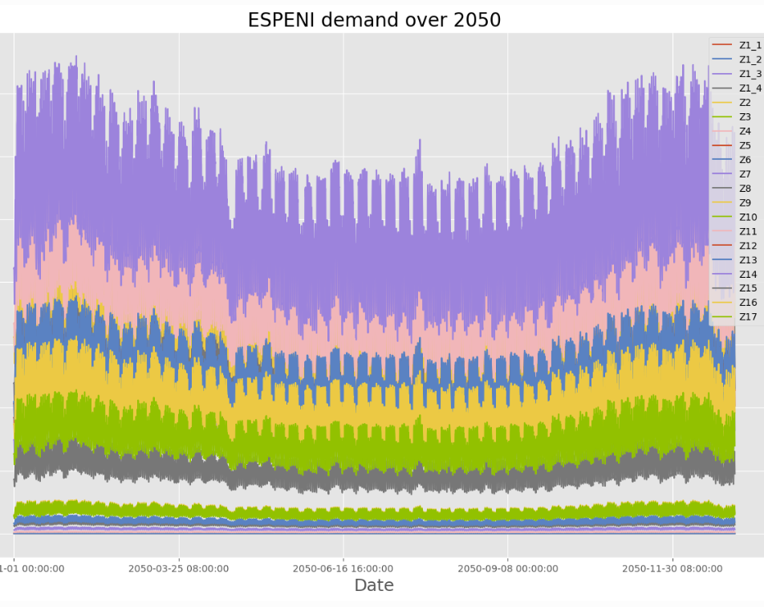
Future Demand Data – FES2021
Future demand profiles are generated by scaling historical demand profiles to match the projected annual load from FES21 dataset
Demand distributions across buses are also obtained from FES21 where data is available for distributions for the years 2020-2050 with all four scenarios

Slide 7
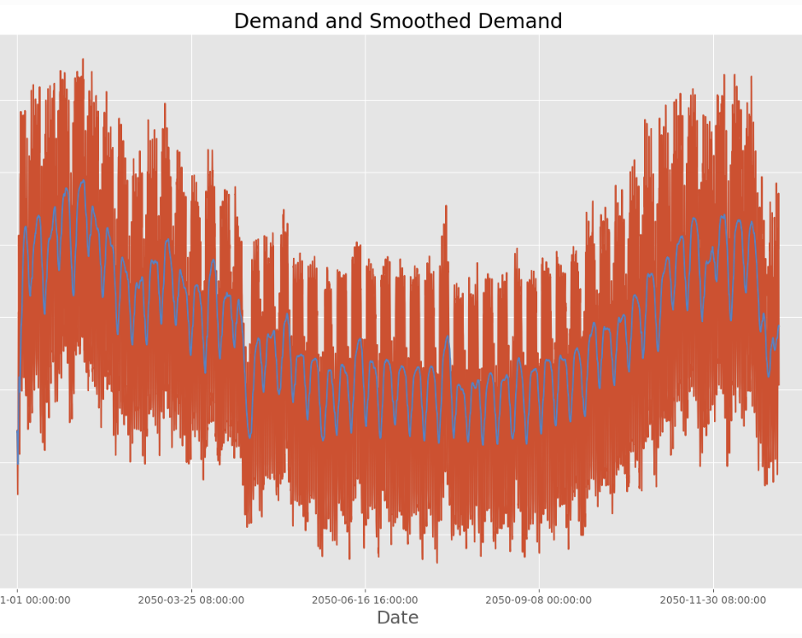
Future Demand Scaling
Simply scaling the load profile according to the annual energy demand to generate future load profiles results in overestimation of peak demand -> Moving average technique to reduce the peak demand
Example: 2050 ACS Leading the Way Peak Demand: 94.7GW. Scaled loads: 115.8GW
With moving average: 99.2GW
No smoothing algorithm involved in the datasets

Slide 8
Renewables and Storage
For historical years, data on PV, onshore+offshore wind is sourced from Renewable Energy Planning Database (REPD)
Geocoordinates, technology type, and installed capacity are extracted. Power timeseries are generated using Atlite
Need to update the renewables available (especially offshore wind, I think we can use the onshore wind and PV as it is)
Spatial distribution of PV and Onshore wind from 2020 is used as baseline -> projected from FES2021-2022 workbooks to get projected capacities
Spatial distribution of Offshore Wind was taken directly from REPD + SMP for up to 2030 due to large expansion
From 2030-2050, spatial distribution is assumed static for every renewables
 | carrier | type | p_nom | bus | Turbine Capacity (MW) | marginal_cost | ramp_limit_up | ramp_limit_down | p_max_pu
West Burton | Coal | Conventional steam | 0 | Keadby |  |  | 1 | 1 | 1
Sutton Bridge CCS Gas | CCS Gas | CCS Gas | 116.67140197753906 | Walpole |  | 100 | 1 | 1 | 1
Baglan Bay CCS Gas | CCS Gas | CCS Gas | 74.07707977294922 | Melksham |  | 100 | 1 | 1 | 1
Severn Power CCS Gas | CCS Gas | CCS Gas | 121.08753967285156 | Melksham |  | 100 | 1 | 1 | 1
Blackburn CCS Gas | CCS Gas | CCS Gas | 8.547355651855469 | Penwortham |  | 100 | 1 | 1 | 1
Damhead Creek CCS Gas | CCS Gas | CCS Gas | 114.67701721191406 | Kemsley |  | 100 | 1 | 1 | 1
Rye House CCS Gas | CCS Gas | CCS Gas | 101.85598754882812 | Pelham |  | 100 | 1 | 1 | 1
Shoreham CCS Gas | CCS Gas | CCS Gas | 59.83148956298828 | Lovedean |  | 100 | 1 | 1 | 1
Castleford CCS Gas | CCS Gas | CCS Gas | 7.977531909942627 | Thornton/Drax/Eggborough |  | 100 | 1 | 1 | 1

Slide 9
How did I prepare my career and tips from an expat

