Slide 1
Data Imbalance and Few-Shot Learning With BERT and Multiclass Classification
Clayton Cohn

Slide 2
Overview
Dataset, data imbalance, and multiclass classification
Base case
Reducing class number
Reducing size of prevalent class
Bootstrap Aggregating (Bagging)
Few-shot learning
Comparison across models
Future work

Slide 3
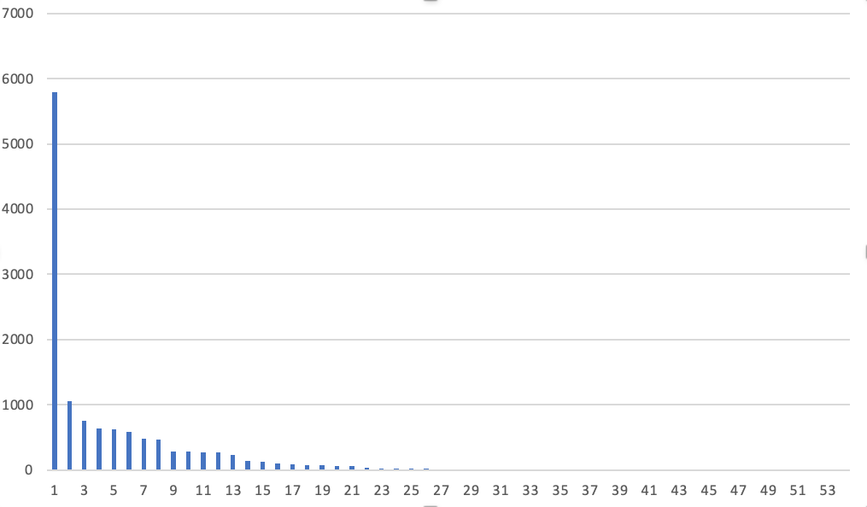
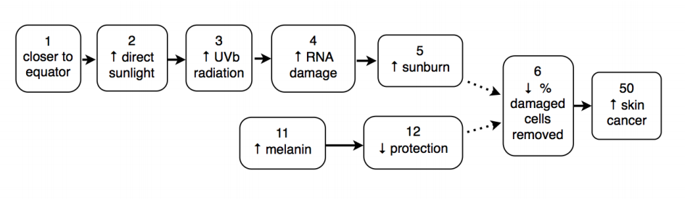
Dataset, Data Imbalance, and Multiclass Classification
Dataset (and why we care)
Causal relations
Multiclass classification
Data imbalance (Zipfian distribution)

Slide 4
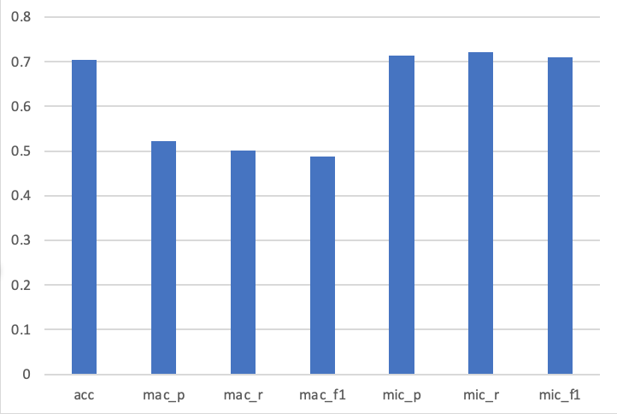
Base Case
Higher accuracy and micro metrics
Lower macro metrics
No relation class:
5,791 / 12,639
No relation class F1 = 92.59
Effect of data imbalance

Slide 5
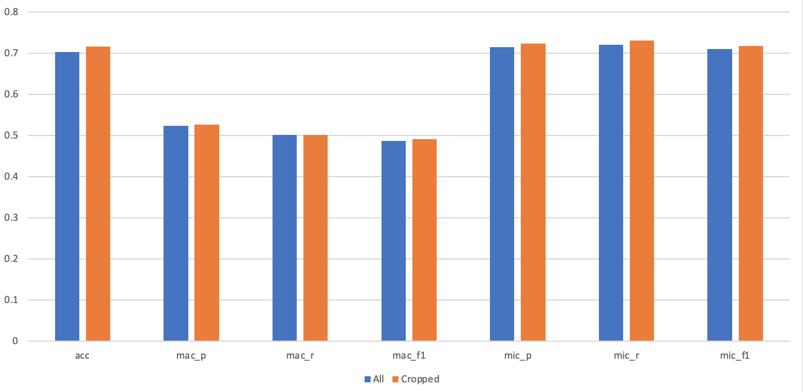
Reducing Class Number
15+ instances
54 to 28 (26 classes)
Common method
Slight improvement
Surprisingly similar

Slide 6
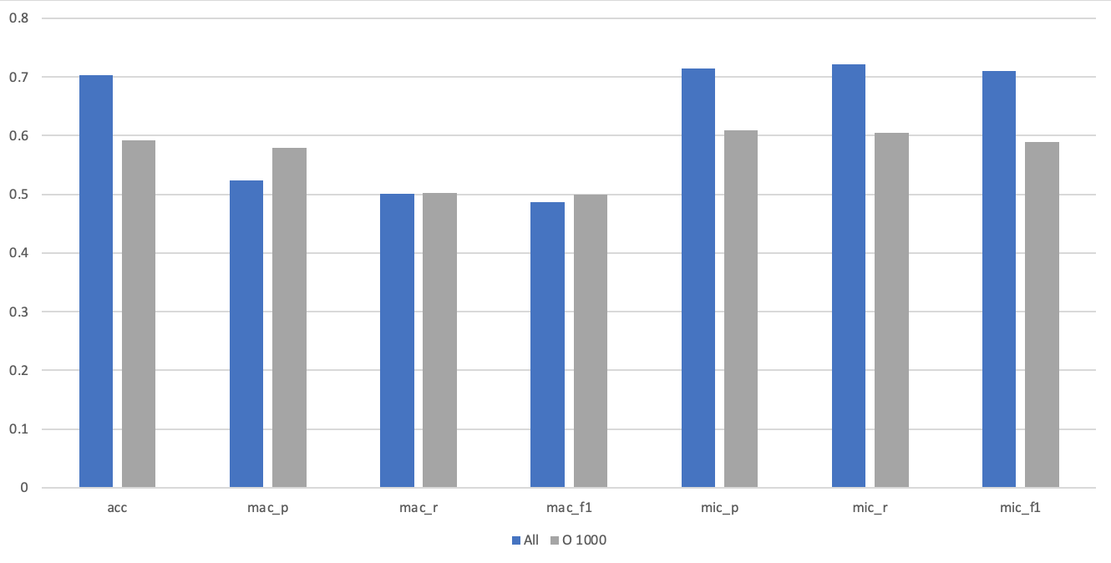
Reducing Size of Prevalent Class
“O” 1000
Remove weighting of prevalent class
Slight macro improvement but not significant
Reduction in micro metrics (expected)

Slide 7
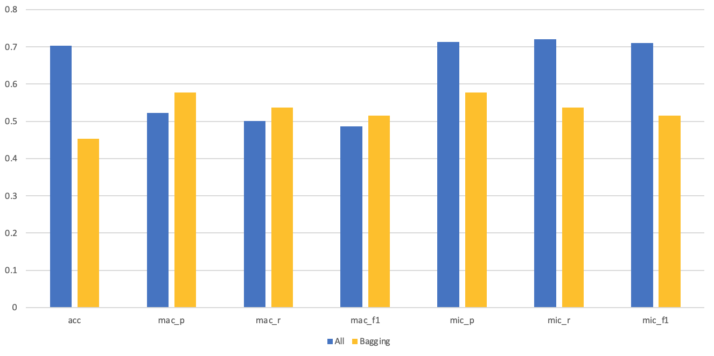
Bagging
Ensembles (Random Forests)
1000 instances per class
Poorer micro performance
3.97% average increase in macro performance
p = 0.0002

Slide 8
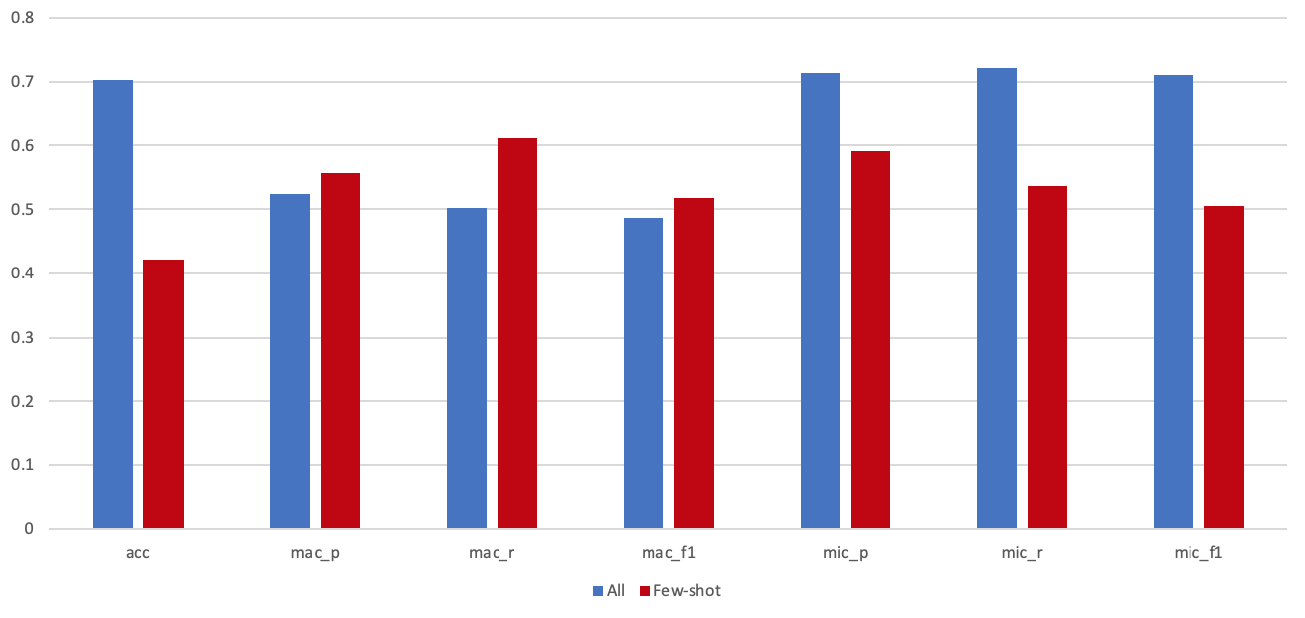
Few-Shot Learning
15 instances per class
Poorer micro performance
5.85% increase in macro performance
p = 0.0038
10.94% increase in macro recall
p = 0.0494
Epochs

Slide 9
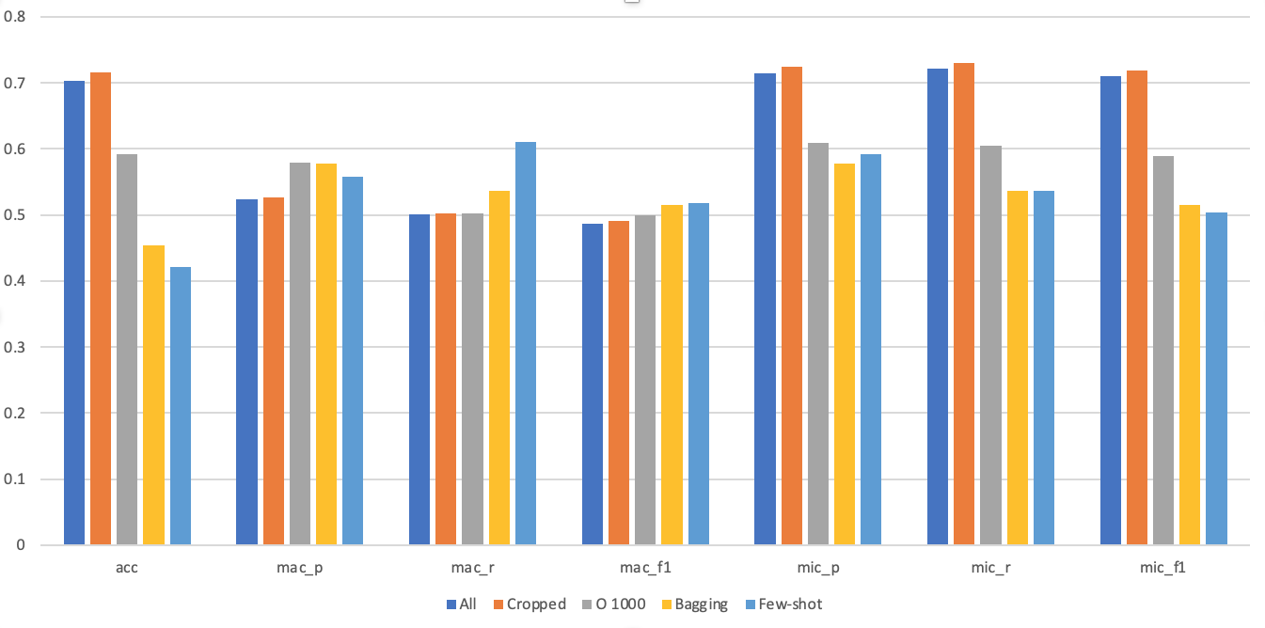
Comparison of Methods Across Metrics

Slide 10
Future Work
Cost-sensitivity
Generative data augmentation
CG-BERT
Back Translation
Synonym Replacement
Random Insert/Swap
Metrics by class

