Slide 1
BERT
By Clayton Cohn

Slide 2

Components
Byte Pair Encoding (BPE)
Attention (and Self-Attention)
Transformer

Slide 3
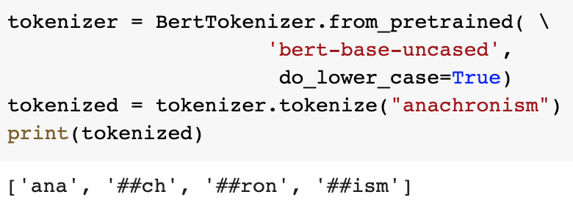
BPE
Data compression
Out-of-vocabulary (OOV)
Subword tokenization

Slide 4
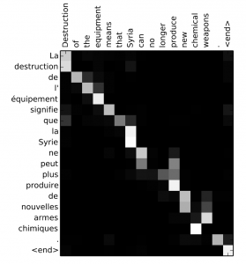
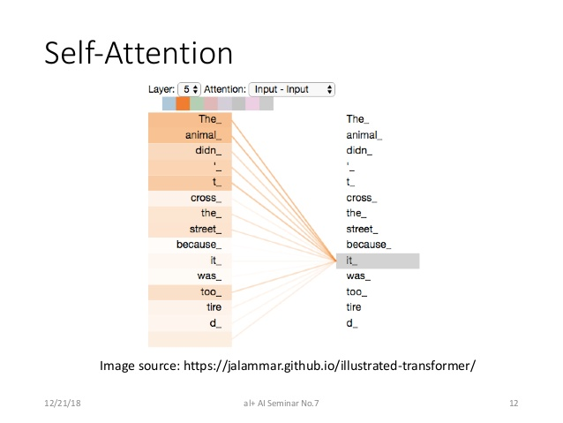
Attention
Encoder-decoder ”forgets”
Selective focus
Self-attention

Slide 5
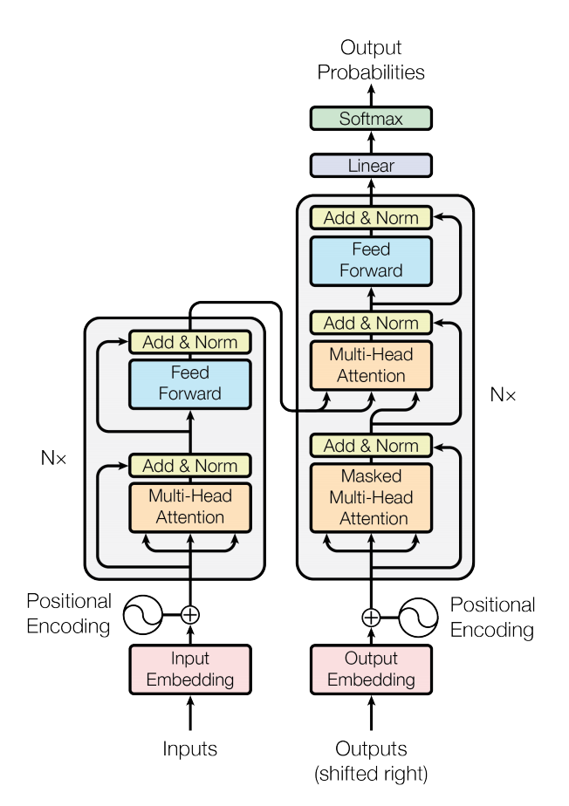
Transformer
Attention is all you need!
No time-steps
Parallelization-friendly
Large corpora

Slide 6
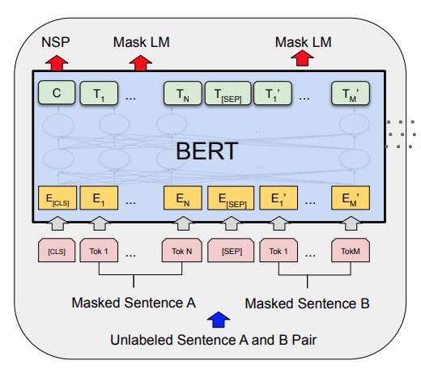
BERT
12 transformer layers, 768 hidden nodes, 12 attention heads, 110M parameters
Wikipedia and BookCorpus
Masked Language Model (MLM)
Next Sentence Prediction (NSP)
30,000 WordPiece vocabulary
450MB disk, 12GB ram
4 days to train on 4 TPUs

Slide 7
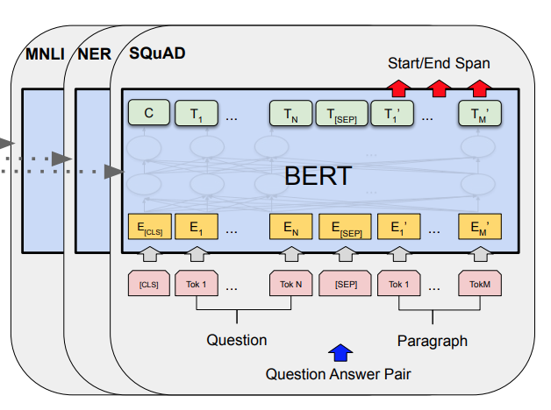
Transfer Learning
Fine-tuning
Tasks
Additional pretraining
BioBERT and SciBERT

Slide 8

Achievements
11 SOTA benchmarks
ImageNet moment
Google

Slide 9
The Future
ArtBERT?
LegalBERT?
CodeBERT?

