Slide 1
Assignment 4
Clayton Cohn

Slide 2
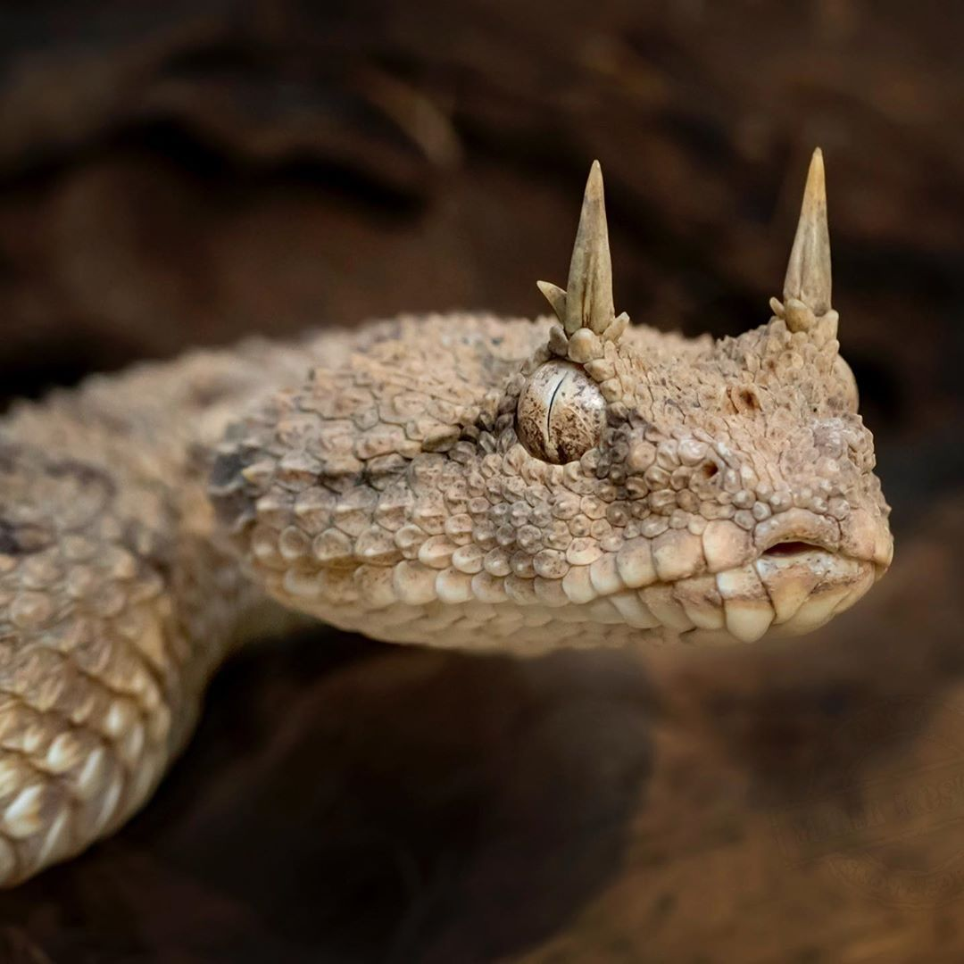


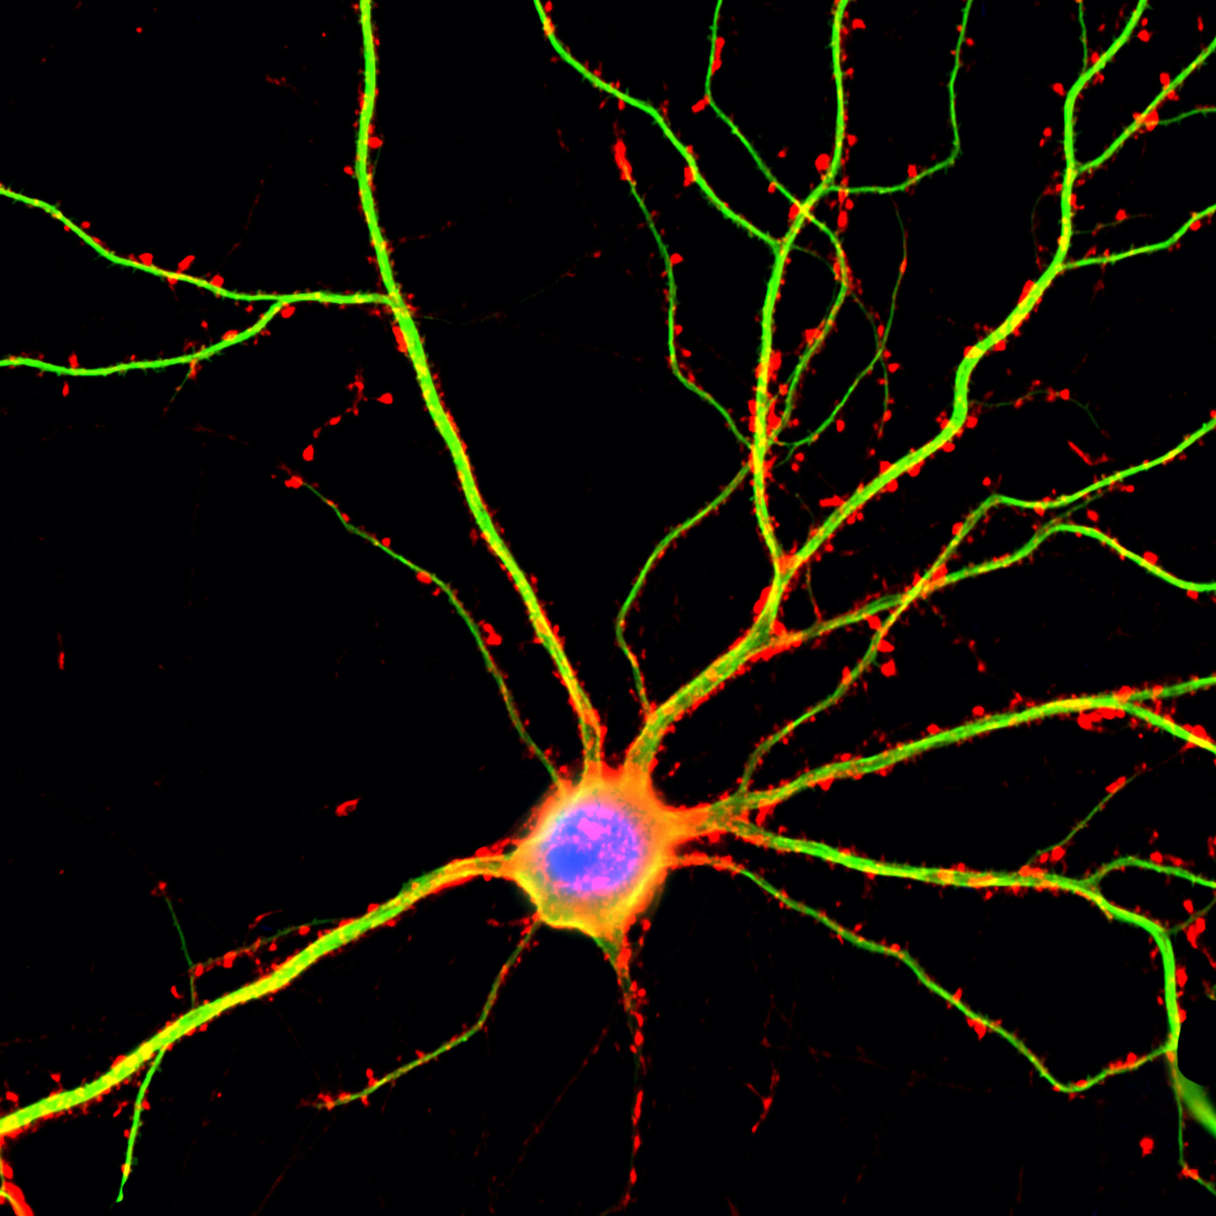
Images
EASY
HARD
horned_viper
military_uniform
?
?

Slide 3
MODELS
Lime
Integrated Gradients
'viper’: 'horned_viper', 0.941, 'sidewinder', 0.0438
'marines': ‘mil_uniform', 0.999, ‘bulletproof_vest', 0.00022
‘phil': 'golf_ball', 0.399, 'ping-pong_ball', 0.0670
'neuron’: 'jellyfish', 0.934, 'sea_anemone', 0.0143
‘viper': 'horned_viper', 11.299, 'sidewinder', 8.23
'marines': 'mil_uniform', 17.522, 'bulletproof_vest', 9.135
'phil': 'golf_ball', 7.419, 'ping-pong_ball', 5.635
'neuron’: 'jellyfish', 10.593, 'sea_anemone', 6.417
Inception V3
VGG16
ResNet50
'viper’: 'horned_viper', 0.923, 'sidewinder', 0.0764
'marines’: 'mil_uniform', 0.938, 'bulletproof_vest', 0.025
‘phil': 'parachute', 0.484, ‘ballplayer', 0.146
'neuron’: 'jellyfish', 0.431, 'oscilloscope', 0.333
'viper’: 'horned_viper', 26.00, 'sidewinder', 23.51
'marines’: 'mil_uniform', 12.724, 'bulletproof_vest', 9.096
'phil': 'parachute', 10.22, 'ballplayer', 9.02
'neuron’: 'jellyfish', 12.155, 'oscilloscope', 11.897
'viper’: 'horned_viper', 0.9470, 'sidewinder', 0.0530
'marines’: 'mil_uniform', 0.9982), 'assault_rifle', 0.00048
‘phil': 'ballplayer', 0.515, ‘golf_ball', 0.126
'neuron’: 'spider_web', 0.881, 'oscilloscope', 0.045
'viper’: 'horned_viper', 28.177, 'sidewinder', 25.293
'marines’: 'mil_uniform', 17.491, 'assault_rifle', 9.853
'phil’: 'ballplayer', 12.828, 'golf_ball', 11.422
'neuron’: 'spider_web', 12.852, 'oscilloscope', 9.88

Slide 4
Resnet50
Image | LIME | Integrated Gradients
Horned Viper | 94.70 : horned_viper 4.30 : sidewinder | 28.18 : horned_viper 25.29 : sidewinder
Marines’ Bootcamp | 99.82 : military_uniform 0.05 : assault_rifle | 17.49 : military_uniform 9.85 : assault_rifle
Phil Mickelson | 51.46 : ballplayer 12.63 : golf_ball | 12.83 : ballplayer 11.42 : golf_ball
Neuron | 88.06 : spider_web 4.52 : oscilloscope | 12.85 : spider_web 9.88 : oscilloscope

Slide 5
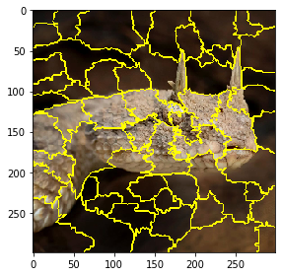
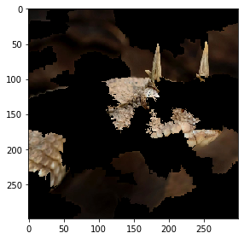
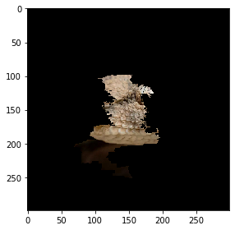
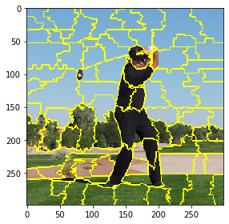
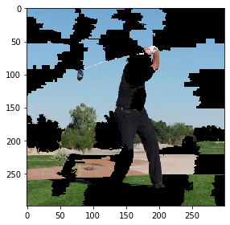
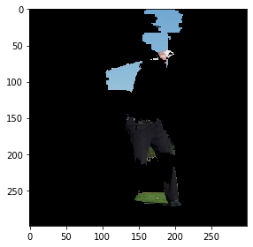
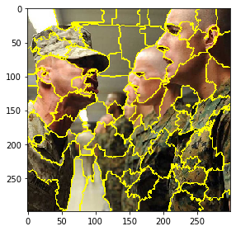
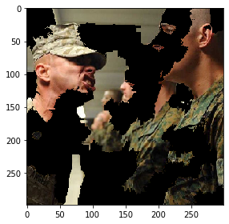
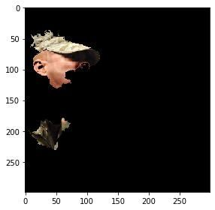
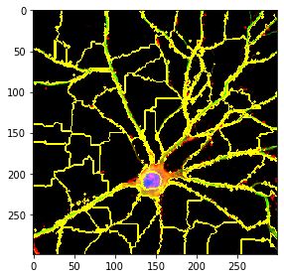
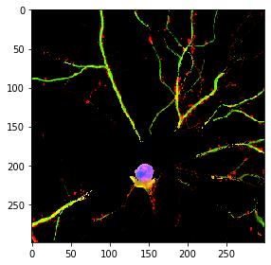
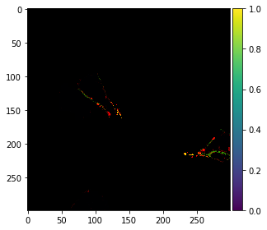
Lime

Slide 6
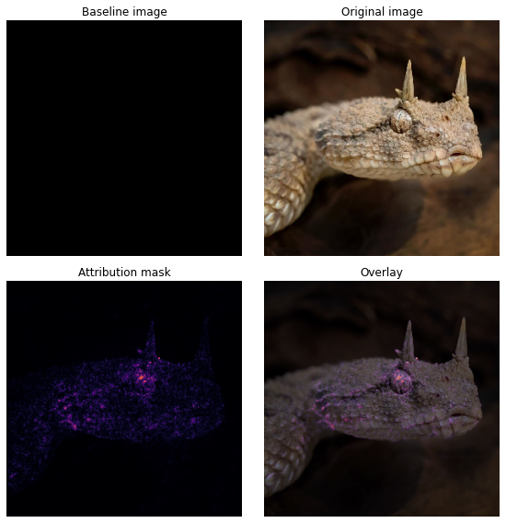
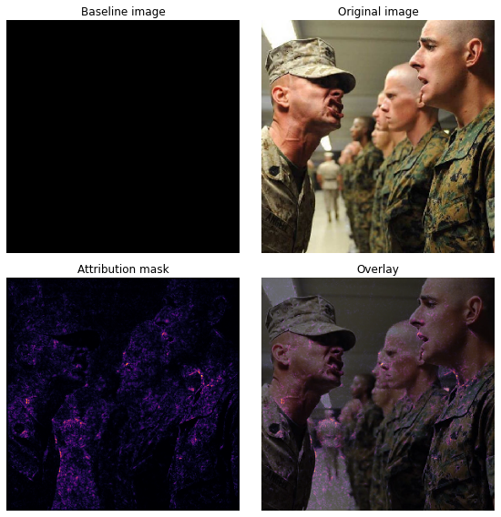
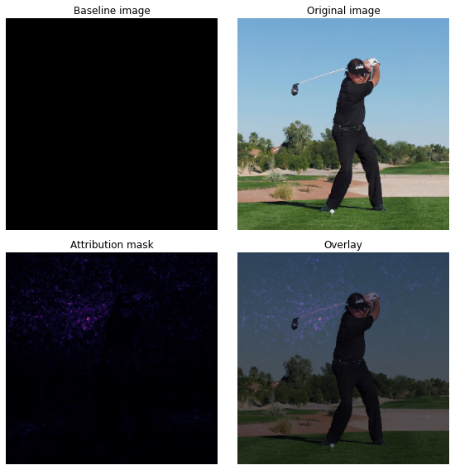
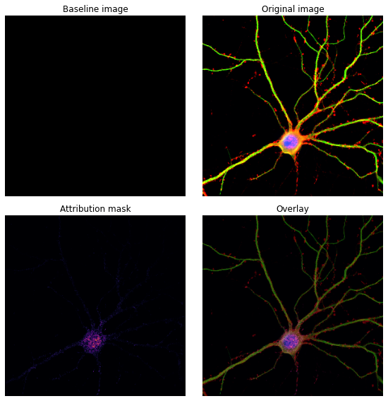
Integrated gradientS

Slide 7
Discussion
LIME
Integrated Gradients
Image selection
Multilabel classification?

