Slide 1
Examining Multimodal Methods for Analyzing Learning and Training Environments: A Systematic Literature Review
Gautam Biswas, Clayton Cohn, Eduardo Davalos, Joyce Horn Fonteles, Meiyi Ma, Hanchen (David) Wang, Caleb Vatral

Slide 2
Today’s topics
Framework
Scope (RQs)
Analysis Methods

Slide 3
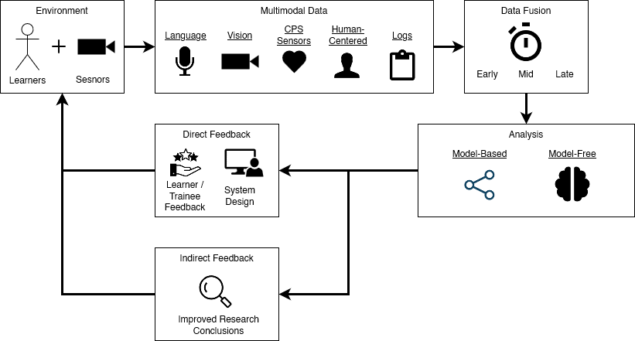
Framework

Slide 4
Scope (RQs)
Research Gaps.
E.g., the need for mid-fusion
Current SOTA and Challenges.
Overall
Within subdomains
Environments.
Learning/Training
Physical/virtual/blended
Domain/subject of training/learning
Participant structure
Didactic nature
Level of instruction
Data and Approach.
Data collection mediums
Modalities
Analysis methods
Fusion types
Model-based v. model-free
Results.
Analysis of results achieved
Advantage of multimodal v. unimodal

Slide 5
Analysis methods
Descriptive Statistics.
Identify, analyze, and discuss trends regarding individual features
Clustering (quantitative).
Identify, analyze, and discuss specific groups of multimodal research regarding several features
Subdomain Analysis (qualitative).
Natural Language
Vision
CPS/Sensors
Human-Centered
Logs

Slide 6
notes

