Slide 1
Examining Multimodal Methods for Analyzing Learning and Training Environments: A Systematic Literature Review
Gautam Biswas, Clayton Cohn, Eduardo Davalos, Joyce Horn Fonteles, Meiyi Ma, Hanchen (David) Wang, Caleb Vatral

Slide 2
Today’s topics
Framework
Scope (RQs)
Analysis Methods

Slide 3
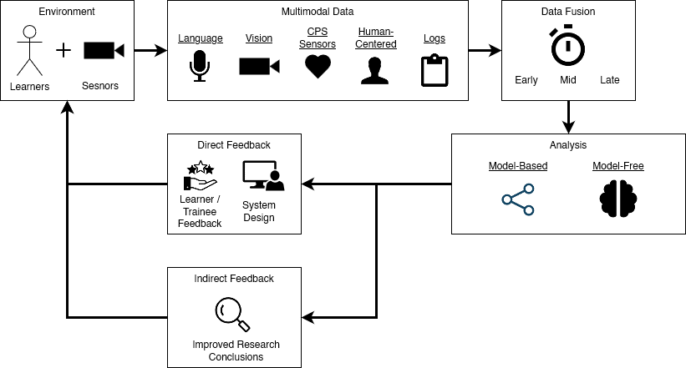
Framework

Slide 4
Scope (RQs)
Research Gaps.
E.g., the need for mid-fusion
Current SOTA and Challenges.
Overall
Within subdomains
Environments.
Learning/Training
Physical/virtual/blended
Domain/subject of training/learning
Participant structure
Didactic nature
Level of instruction
Data and Approach.
Data collection mediums
Modalities
Analysis methods
Fusion types
Model-based v. model-free
Results.
Analysis of results achieved
Advantage of multimodal v. unimodal

Slide 5
Analysis methods
Descriptive Statistics.
Clustering (quantitative).
Subdomain Analysis (qualitative).
Natural Language
Vision
CPS/Sensors
Human-Centered
Logs

