Slide 1
Identifying Educational Emotions via Speech Transformers
Clayton Cohn
Vanderbilt University
OELE Lab

Slide 2
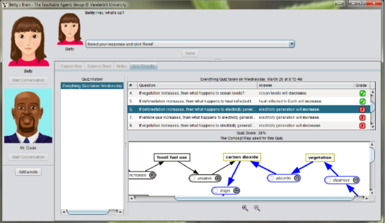
Overview
I apply NLP methods to learning environments
Both speech and text
Speech is richer than text
Goal is to detect “educational” emotions from speech
Confusion, frustration, success (eureka).

Slide 3

Problem
Emotion detection typically only covers “core” emotions
Noise (both literally and figuratively)
Different representations
Limited data
Few available models (3 on Hub, 2 don’t work)
Meme c/o http://www.quickmeme.com/meme/3qxjem

Slide 4


Solution?
Audeering for Speech Emotion Recognition
Fine-tuned Wav2Vec2-Large-Robust on MSP-Podcast
Vectorizes audio clips across three dimensions
Arousal
Dominance
Valence
Can we apply traditional ML methods to these vectors to identify emotions?

Slide 5
Approach
Created toy dataset w/ 5 instances of neutral, confusion, frustration, and eureka.
Feed through Audeering (Wav2Vec2) to get vectors (arousal, dominance, valence)
Apply traditional ML methods (KNN, Naïve Bayes, Decision Tree, and SVM) via LOOCV

Slide 6
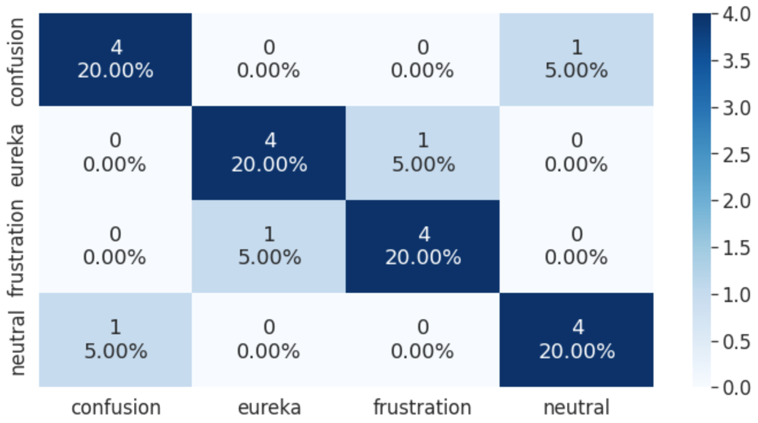
Results
KNN w/ K=3 was the best model!

Slide 7
Critical analysis
What are the limitations?
What is the next step?
What did the results tell us?

