Slide 1
Getting Unstuck
Aleksandr Logunov

Slide 2
Objectives
Get your code to work!

Slide 3
How to find a bug?
Common ways:
looking at the code
testing and debugging
thinking about idea correctness
…

Slide 4

How to find a bug?
Common ways:
looking at the code
testing and debugging
thinking about idea correctness
…
What if none of this helps?

Slide 5
Debugging small programs
Revisit the task from the lesson “Structuring Code”

Slide 6
Debugging small programs
person a[n];
int employed, sumAges;
initData();
readData();
countEmployed();
countSumAges();
writeAnswers();

Slide 7
Debugging small programs
person a[n];
int employed, sumAges;
initData();
readData();
countEmployed();
countSumAges();
writeAnswers();
Say, the sum of all ages has been calculated incorrectly

Slide 8
Debugging small programs
person a[n];
int employed, sumAges;
initData();
readData();
countEmployed();
countSumAges();
writeAnswers();
Conclusion: most likely the bug is in countSumAges() function

Slide 9
Debugging small programs
person a[n];
int employed, sumAges;
initData();
readData();
countEmployed();
countSumAges();
writeAnswers();
You can analyze only one function instead of all code if your code is structured

Slide 10
Debugging small programs
How to debug a function F?

Slide 11
Debugging small programs
How to debug a function F?
You can just insert a breakpoint near it, start the debugger and watch what happens

Slide 12
Debugging small programs
But there can be functions before F:
person a[n];
int employed, sumAges;
initData();
readData();
countEmployed();
countSumAges();
writeAnswers();

Slide 13
Debugging small programs
But there can be functions before F:
person a[n];
int employed, sumAges;
initData();
readData();
countEmployed();
countSumAges();
writeAnswers();

Slide 14

Debugging small programs
If:
at least one function G before function F is buggy
G affects data which F uses
the result of F can be unexpected even if F is absolutely correct!
G
F

Slide 15
Debugging small programs
Solution: localize F
You can write and call a special function for debugging.

Slide 16
Debugging small programs
Return to our example:
void debugSumAges() {
setTestData();
countSumAges();
printAnswer();
}
…
debugSumAges();

Slide 17

Simplifying
Sometimes at first it is better to think about simplifying the existing code

Slide 18
Simplifying
Consider an example:
int i = 0;
while (true) {
if (i >= 10)
break;
if (i < 5)
continue;
doSomething();
i++;
}

Slide 19
Simplifying
Consider an example:
int i = 0;
while (true) {
if (i >= 10)
break;
if (i < 5)
continue;
doSomething();
i++;
}

Slide 20
Simplifying
Consider an example:
int i = 0;
while (true) {
if (i >= 10)
break;
if (i < 5)
continue;
doSomething();
i++;
}

Slide 21
Simplifying
Consider an example:
int i = 0;
while (true) {
if (i >= 10)
break;
if (i < 5)
continue;
doSomething();
i++;
}

Slide 22
Simplifying
The code on the previous slide is equivalent to:
for (int i = 5; i < 10; i++) {
doSomething();
}

Slide 23
Simplifying
Both codes do the same, but the second version is easier to understand
The more understanding you have, the greater the probability of finding the bug is

Slide 24
Simplifying
It is also a good idea to rewrite buggy functions completely in order to make them clearer for you
Competitive programmers sometimes rewrite the whole solution during a contest because it is faster than finding all bugs

Slide 25
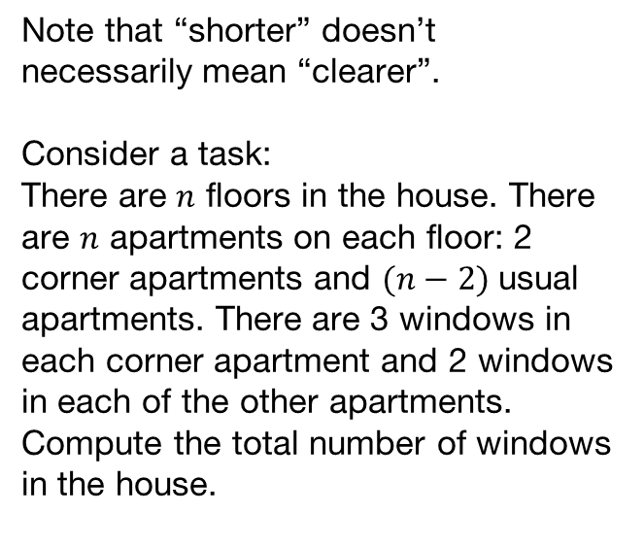
Simplifying
Note that “shorter” doesn’t necessarily mean “clearer”.
Consider a task:
There are $n$ floors in the house. There are $n$ apartments on each floor: 2 corner apartments and $(n−2)$usual apartments. There are 3 windows in each corner apartment and 2 windows in each of the other apartments.
Compute the total number of windows in the house.

Slide 26

Simplifying
Possible formula:
$$n∙(\left(n−2\right)∙2+2∙3)$$

Slide 27

Simplifying
Possible formula:
$$n∙(\left(n−2\right)∙2+2∙3)$$
It can be easily simplified:
$$2{∙n}^{2}+ 2∙n$$

Slide 28
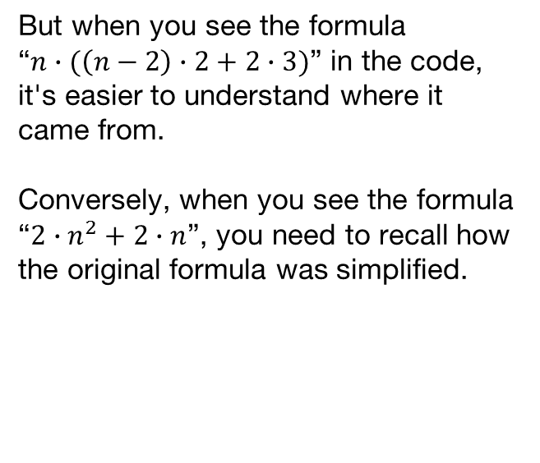
Simplifying
But when you see the formula “$n∙(\left(n−2\right)∙2+2∙3)$” in the code, it's easier to understand where it came from.
Conversely, when you see the formula “$2{∙n}^{2}+ 2∙n$”, you need to recall how the original formula was simplified.

Slide 29
Simplifying: another approach
You can often solve the same problem in many ways
Some of your algorithms can be faster than others; some of them can be slower, but simpler

Slide 30

Simplifying: another approach
Consider the following situation:
You solve a complex task, and you realize that you need to sort an array of size $n$ at some moment

Slide 31
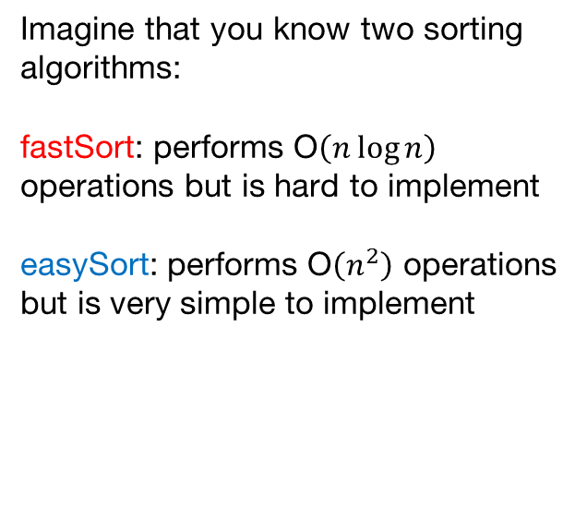
Simplifying: another approach
Imagine that you know two sorting algorithms:
fastSort: performs O$\left(n\log{n}\right)$ operations but is hard to implement
easySort: performs O$\left(n^{2}\right)$ operations but is very simple to implement

Slide 32
Simplifying: another approach
Imagine that you have used fastSort in your code, and your code isn’t working
What is wrong: hard sorting algorithm or something other?

Slide 33
Simplifying: another approach
Imagine that you have used fastSort in your code, and your code isn’t working
What is wrong: hard sorting algorithm or something other?
Idea: to find out an answer, you can replace fastSort with easySort

Slide 34
Simplifying: another approach
If your code:
still doesn’t work → you have bugs in another part of code
started working → most likely replaced code is buggy

Slide 35
Simplifying: another approach
But you should implement easySort very carefully
If you made a bug in easySort, you can make wrong conclusions after replacing
In this case time of debugging can even increase!

Slide 36
Simplifying: another approach
Related topics:
stress-testing
brute force solutions

Slide 37
Double-checking
We always check our code by ourselves
Let’s learn how to force the computer to check our code, too!

Slide 38
Invariants
Invariant is a correct statement about data you are working with
Invariants always arise naturally;
they are usually associated with specific places in the code

Slide 39
Invariants
Example 1
int a[n], sum = 0;
for (int i = 0; i < n; i++) {
if (a[i] < 0)
a[i] = -a[i];
sum = sum + a[i];
}
write(sum);

Slide 40
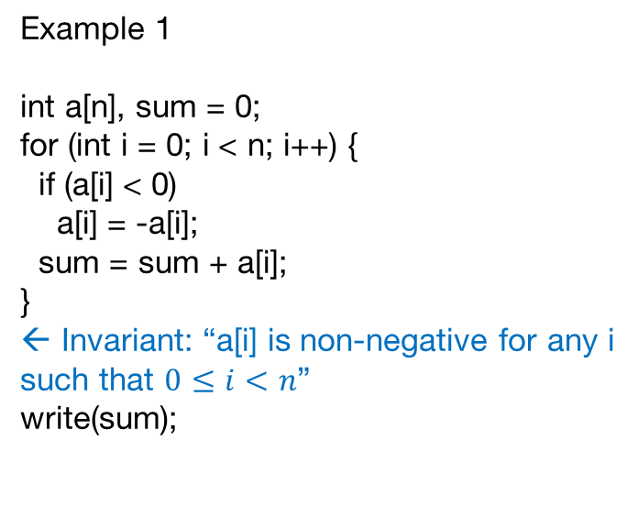
Invariants
Example 1
int a[n], sum = 0;
for (int i = 0; i < n; i++) {
if (a[i] < 0)
a[i] = -a[i];
sum = sum + a[i];
}
← Invariant: “a[i] is non-negative for any i such that $0≤i<n$”
write(sum);

Slide 41
Invariants
Example 2
Again about sorting:
int a[n];
readArray();
sortArray();
printArray();

Slide 42
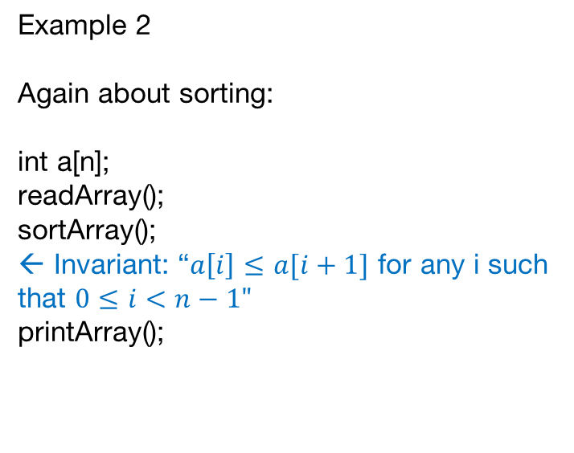
Invariants
Example 2
Again about sorting:
int a[n];
readArray();
sortArray();
← Invariant: “$a\left[i\right]≤a[i+1]$ for any i such that $0≤i<n−1"$
printArray();

Slide 43
Invariants
If you are sure that all invariants are held, it becomes easier to locate mistakes
But how can you be sure in it?

Slide 44
Invariants
If you are sure that all invariants are held, it becomes easier to locate mistakes
But how can you be sure in it?
Idea: Let your computer check all invariants!

Slide 45
Double-checking
assert: a function that takes an expression, computes it and throws an error if the result is false

Slide 46
Double-checking
assert: a function that takes an expression, computes it and throws an error if the result is false
Examples:
assert(2 < 3); //does nothing
assert(2 + 2 == 5); //runtime error

Slide 47
Double-checking
Assert is a simple and efficient tool
With asserts your code is checked twice: 1) by testing
2) by checking invariants

Slide 48
Double-checking on Java
Actually
assert(…)
is a shortcut version of
if not (…) throw an exception

Slide 49
Double-checking on Java
It is more convenient to use a shorter version, but in Java asserts are checked only with the compilation key -ea (a.k.a. -enableassertions)
That's why in Java people usually write
if (! ...)
throw new RuntimeException();
instead of assert statement

Slide 50
Double-checking
Usage in Example 1:
int a[n], sum = 0;
for (int i = 0; i < n; i++) {
if (a[i] < 0)
a[i] = -a[i];
sum = sum + a[i];
}
for (int i = 0; i < n; i++)
assert(a[i] >= 0);
write(sum);

Slide 51
Double-checking
Usage in Example 2:
int a[n];
readArray();
sortArray();
for (int i = 0; i < n – 1; i++)
assert(a[i] <= a[i + 1]);
printArray();

Slide 52
Double-checking
What if you haven’t got a test on which your program works incorrectly?

Slide 53
Double-checking
What if you haven’t got a test on which your program works incorrectly?
Just add asserts to your code and send it to the testing system!

Slide 54
Double-checking
If you receive a verdict “Runtime Error”, this can mean that some of your assertions have failed (but not always!)
After that, you can easily find failing assert by "deactivating" asserts one by one.

Slide 55
Upsolving
Upsolving is a frequent word in competitive programming communities.
It means “solving tasks after the end of the contest”.

Slide 56

Upsolving
After the contest some tasks usually remain unsolved

Slide 57
Upsolving
Reasons not to get OK:
you didn’t read the statement

Slide 58
Upsolving
Reasons not to get OK:
you didn’t read the statement
you couldn’t understand the statement

Slide 59
Upsolving
Reasons not to get OK:
you didn’t read the statement
you couldn’t understand the statement
you didn’t come up with the solution

Slide 60
Upsolving
Reasons not to get OK:
you didn’t read the statement
you couldn’t understand the statement
you didn’t come up with the solution
you wrote the code but it didn’t pass all tests

Slide 61
Upsolving
Consider a situation in which you came up with a solution, but didn’t implement it correctly during the contest.
It could seem that it is useless to finish your solution: it will not affect the result of the contest.

Slide 62

Upsolving
Actually, after the contest, you can write code more calmly, paying attention to absolutely all details.

Slide 63
Upsolving
You can:
think what prevented you from writing the code correctly;
understand this;
finish your code.
And if you see the same idea next time, you will implement it faster and simpler!

Slide 64
Upsolving
What if you don’t know the solution?
Contest authors almost always post the editorial of their contest. There you can find out how the tasks were meant to be solved.

Slide 65
Upsolving
What if you don’t know the solution?
Contest authors almost always post the editorial of their contest. There you can find out how the tasks were meant to be solved.
But why do you need it if the contest has already ended?

Slide 66

Upsolving
Anyway all ideas and algorithms are repeated. It is rare to find something completely new.
When reading the editorial, you can learn ideas which you have not known before, and which can be useful to you in the future.

Slide 67
Upsolving
You can also find out which algorithms are most often encountered in contests.
Good knowledge of these algorithms will improve your results.

Slide 68
Upsolving
There are many different tasks, but they are usually divided into groups of the following topics:
strings
geometry
bruteforce
graphs
greedy algorithms
data structures
…

Slide 69
Upsolving
After participating in a series of contests and reading their editorials you can observe your strengths and weaknesses.
It is cool to know what tasks are you good at, but it is also useful to work on your weak points

Slide 70
Upsolving
Consider the following point of view:
You could solve a task during a contest → it was simple for you, so it isn’t actually valuable for you
You couldn’t solve a task during a contest → it is hard for you, so it is very valuable to try to solve it

Slide 71
Upsolving
For example, if you rarely solve tasks that involve strings, you can search for more such tasks and solve them, and after a while you will see that you have fewer problems with them.
And remember the rule: If you have drawbacks, they always find them out at interviews.

Slide 72

Upsolving

Slide 73
Summary
What to do if we are stuck on a task?
break our code apart and investigate each part;
simplify our code;
put as much as possible asserts
And when the task is solved, it is worth to look for tasks of the same type and solve them, too.

