Slide 1
Design with an HDL
A Verilog Review
[Some slides adapted from A. Sprintson, M. Irwin, D. Paterson and others]

Slide 2
Verilog Overview
A Hardware Description Language (HDL) for describing & testing logic circuits.
  text based way to talk about designs
  easier to simulate before silicon
  translate into silicon directly
    Logic synthesis - automatic generation of lower-level logic circuit designs from high-level specifications

Slide 3
Why Verilog?
Verilog: Similar to C, with some changes to account for time
Widely used in industry
VHDL is alternative; similar and can pick it up easily.
  Verilog is simpler to learn!
We will study only a simple subset of Verilog.

Slide 4
HDL to Gates
Simulation
  Input values are applied to the circuit
  Outputs checked for correctness
  Millions of dollars saved by debugging in simulation instead of hardware
Synthesis
  Transforms HDL code into a netlist describing the hardware (i.e., a list of gates and the wires connecting them)
IMPORTANT:
When describing circuits using an HDL, it is critical to think of the hardware the code should produce.

Slide 5
Verilog Overview
Verilog is a hardware description language
  Although it looks like a general purpose language
Describing circuits is not equivalent to programming
Need to figure out the circuit first and then how to use Verilog to describe it.

Slide 6

Verilog Overview
Verilog description composed of modules:
module Name ( port list ) ;
Declarations and Statements;
endmodule
Modules can have instantiations of other modules or use primitives supplied by language

Slide 7
Verilog Overview
Verilog has 2 basic modes
1. Structural composition: describes the structure of the hardware components, including how ports of modules are connected together
  module contents are builtin gates (and, or, xor, not, nand, nor, xnor, buf) or other modules previously declared
2. Behavoral: describes what should be done in a module
  module contents are C-like assignment statements, loops

Slide 8

Basic gates: Inverter
Truth Table
A | Y
0 | 1
1 | 0
A
Y
Symbol
Verilog – structural description
Input
Output
Notes:
credential:
bring a computer
die photo
wafer
:
This can be an hidden slide· I just want to use this to do my own planning·
I have rearranged Culler’s lecture slides slightly and add more slides· This covers everything he covers in his first lecture (and more) but may
We will save the fun part, “ Levels of Organization,” at the end (so student can stay awake): I will show the internal stricture of the SS10/20·
Notes to Patterson: You may want to edit the slides in your section or add extra slides to taylor your needs·

Slide 9
Basic gates: Inverter
Truth Table
A | Y
0 | 1
1 | 0
A
Y
Symbol
Verilog – structural description
Input
Output
module gate (Y, A);
input A;
output Y;
not inst1(Y,A);
endmodule
Notes:
credential:
bring a computer
die photo
wafer
:
This can be an hidden slide· I just want to use this to do my own planning·
I have rearranged Culler’s lecture slides slightly and add more slides· This covers everything he covers in his first lecture (and more) but may
We will save the fun part, “ Levels of Organization,” at the end (so student can stay awake): I will show the internal stricture of the SS10/20·
Notes to Patterson: You may want to edit the slides in your section or add extra slides to taylor your needs·

Slide 10

The AND Gate
A
Y
B

Slide 11
The AND Gate
A
Y
B
module gate (Y, A,B);
input A, B;
output Y;
and inst1(Y,A,B);
endmodule

Slide 12
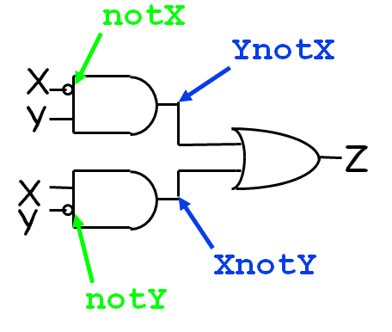
Example: Structural XOR (xor built-in,but..)
module xor(X, Y, Z);
input X, Y;
output Z;
wire notX, notY,
XnotY, YnotX;
not n0(notX, X);
not n1(notY, Y);
and a0(YnotX, notX, Y);
and a1(XnotY, X, notY);
or o0(Z, YnotX, XnotY);
endmodule
which “ports” input, output
Default is 1 bit wide data
“ports” connect components
Note: order of gates doesn’t matter,
since structure determines relationship

Slide 13
Adders in Verilog
Half Adder
  Add two single bit inputs
  Output of a sum and a carry
Full Adder
  Add two single bit inputs with a carry in
  Output of a sum and a carry out
Larger Adders can be built from these single bit components (more on this to come)

Slide 14
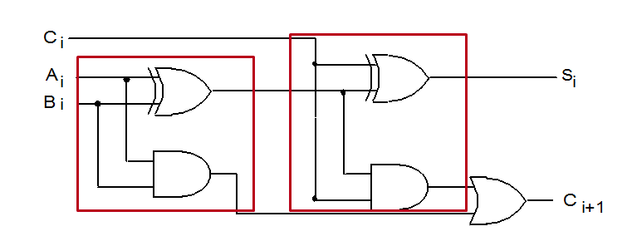
Full – Adder in Verilog

Slide 15
Full – Adder in Verilog
module half_add (S, C, X, Y);
output S, C ;
input X, Y ;
xor x0(S, X, Y) ;
and a0(C, X, Y) ;
endmodule

Slide 16
Full – Adder in Verilog
module full_add (S, CO, A, B, CI) ;
output S, CO ;
input A, B, CI ;
wire N1, N2, N3;
half_add HA1 (N1, N2, A, B);
half_add HA2 (S, N3, N1, CI);
or P1 (CO, N3, N2);
endmodule
module half_add (S, C, X, Y);
output S, C ;
input X, Y ;
xor x0(S, X, Y) ;
and a0(C, X, Y) ;
endmodule

Slide 17
The AND Gate – behavioral Verilog
A
Y
B
module gate (Y, A,B);
input A, B;
output Y;
assign Y=A & B;
endmodule

Slide 18
Behavioral Verilog Example
Verilog:
module example(input a, b, c,
output y);
assign y = ~a & ~b & ~c | a & ~b & ~c | a & ~b & c;
endmodule
Synthesis: ?

Slide 19
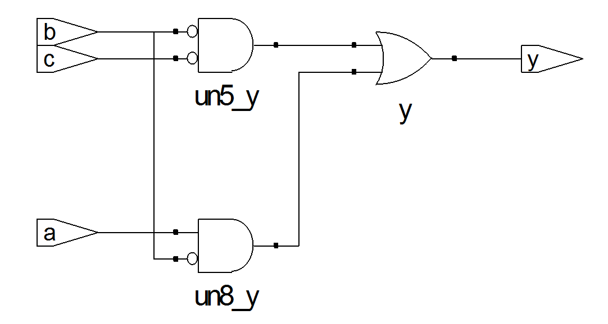
Behavioral Verilog Example
Verilog:
module example(input a, b, c,
output y);
assign y = ~a & ~b & ~c | a & ~b & ~c | a & ~b & c;
endmodule
Synthesis:

Slide 20
Full – adder - behavior model
module fa_rtl (S, CO, A, B, CI) ;
output S, CO ;
input A, B, CI ;
assign S = A ^ B ^ CI; //continuous assignment
assign CO = A & B | A & CI | B & CI; //continuous assignment
endmodule

Slide 21
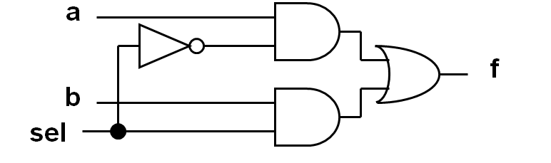
Multiplexor – behavior model
A reg behaves like memory: holds its value until imperatively assigned otherwise
module mux(f, a, b, sel);
output f;
input a, b, sel;
reg f;
always @(a or b or sel)
if (sel) f = b;
else f = a;
endmodule
Sensitivity list contains signals whose change triggers the execution of the block
Notes:
credential:
bring a computer
die photo
wafer
:
This can be an hidden slide. I just want to use this to do my own planning.
I have rearranged Culler’s lecture slides slightly and add more slides. This covers everything he covers in his first lecture (and more) but may
We will save the fun part, “ Levels of Organization,” at the end (so student can stay awake): I will show the internal stricture of the SS10/20.
Notes to Patterson: You may want to edit the slides in your section or add extra slides to taylor your needs.

Slide 22
Full – adder - Alternative behavior model
Sensitivity list contains signals whose change triggers the execution of the block
module fa_bhv (S, CO, A, B, CI) ;
output S, CO ;
input A, B, CI ;
reg S, CO; // required to “hold” values between events.
always@(A or B or CI) //;
begin
S = A ^ B ^ CI; // procedural assignment
CO = A & B | A & CI | B & CI; // procedural assignment
end
endmodule

Slide 23
Example
// Behavioral model of 4-bit Register:
// positive edge-triggered,
// synchronous active-high reset.
module reg4 (CLK,Q,D,RST);
input [3:0] D;
input CLK, RST;
output [3:0] Q;
reg [3:0] Q;
always @ (posedge CLK)
if (RST) Q <= 0; else Q <= D;
endmodule // reg4
On positive clock edge, either reset, or load with new value from D

Slide 24
Example
initial
begin
CLK = 1'b0;
forever
#5 CLK = ~CLK;
end
...
No built in clock in Verilog, so we need to specify one
Clock CLK above alternates forever in 10 ns period:
5 ns at 0, 5 ns at 1,
5 ns at 0, 5 ns at 1, …
(Note: we assume a `timescale of 1ns/10ps here)

Slide 25
Example
module add4 (S,A,B);
a combinational logic block that forms the sum (S) of the two 4-bit binary numbers (A and B)
Write the Verilog for this module in a behavioral style now
  Assume this addition takes 4 ns

Slide 26
Example
module add4 (S,A,B);
input [3:0] A, B;
output [3:0] S;
reg S;
always @(A or B)
#4 S = A + B;
endmodule
a combinational logic block that forms the sum of the two 4-bit binary numbers, taking 4 ns
Above is behavioral Verilog

Slide 27
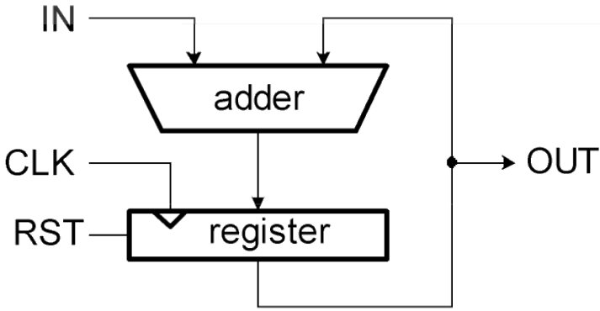
Example
// Accumulator
module acc (CLK,RST,IN,OUT);
input CLK,RST;
input [3:0] IN;
output [3:0] OUT;
wire [3:0] W0;
add4 myAdd (.S(W0), .A(IN), .B(OUT));
reg4 myReg (.CLK(CLK), .Q(OUT), .D(W0), .RST(RST));
endmodule // acc
This module uses prior modules, using wire to connect output of adder to input of register

Slide 28
Verilog Syntax
Case sensitive
  Example: reset and Reset are not the same signal.
No names that start with numbers
  Example: 2mux is an invalid name.
Whitespace ignored
Comments:
  // single line comment
  /* multiline
comment */

Slide 29
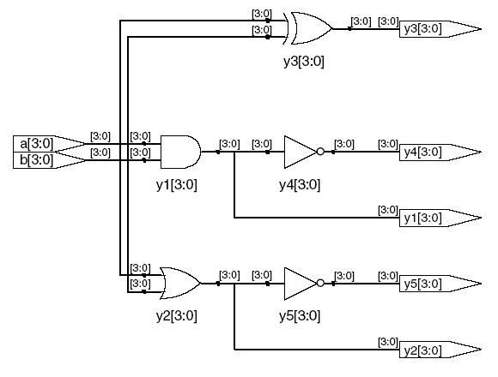
Bitwise Operators
module gates(input [3:0] a, b,
output [3:0] y1, y2, y3, y4, y5);
/* Five different two-input logic
gates acting on 4 bit busses */
assign y1 = a & b; // AND
assign y2 = a | b; // OR
assign y3 = a ^ b; // XOR
assign y4 = ~(a & b); // NAND
assign y5 = ~(a | b); // NOR
endmodule
// single line comment
/*…*/ multiline comment

Slide 30
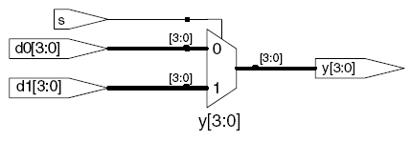
Conditional Assignment
module mux2(input [3:0] d0, d1,
input s,
output [3:0] y);
assign y = s ? d1 : d0;
endmodule
? : is also called a ternary operator because it
operates on 3 inputs: s, d1, and d0.

Slide 31
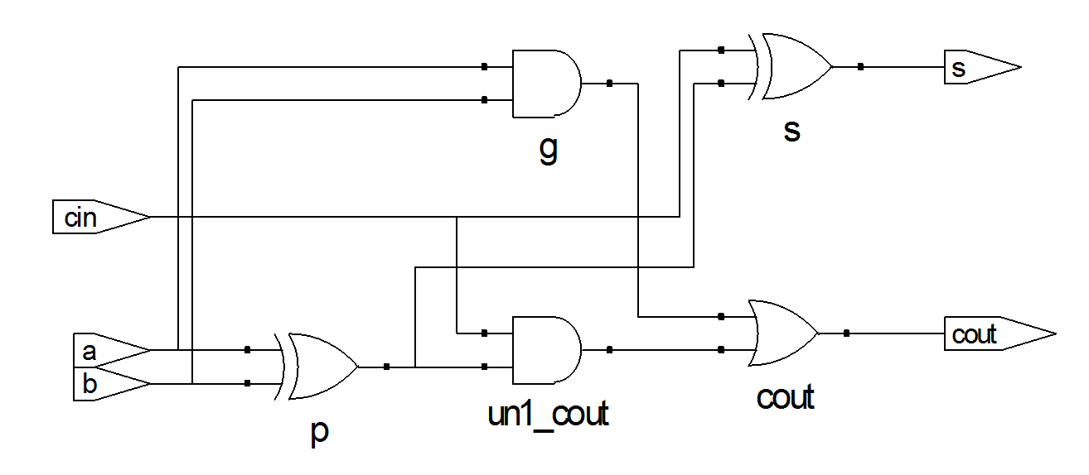
Internal Variables (wires)
module fulladder(input a, b, cin, output s, cout);
wire p, g; // internal nodes
assign p = a ^ b;
assign g = a & b;
assign s = p ^ cin;
assign cout = g | (p & cin);
endmodule

Slide 32
Numbers
Format: N'Bvalue
N = number of bits, B = base
N'B is optional but recommended (default is decimal)
Number | # Bits | Base | Decimal Equivalent | Stored
3’b101 | 3 | binary | 5 | 101
‘b11 | unsized | binary | 3 | 00…0011
8’b11 | 8 | binary | 3 | 00000011
8’b1010_1011 | 8 | binary | 171 | 10101011
3’d6 | 3 | decimal | 6 | 110
6’o42 | 6 | octal | 34 | 100010
8’hAB | 8 | hexadecimal | 171 | 10101011
42 | Unsized | decimal | 42 | 00…0101010

Slide 33
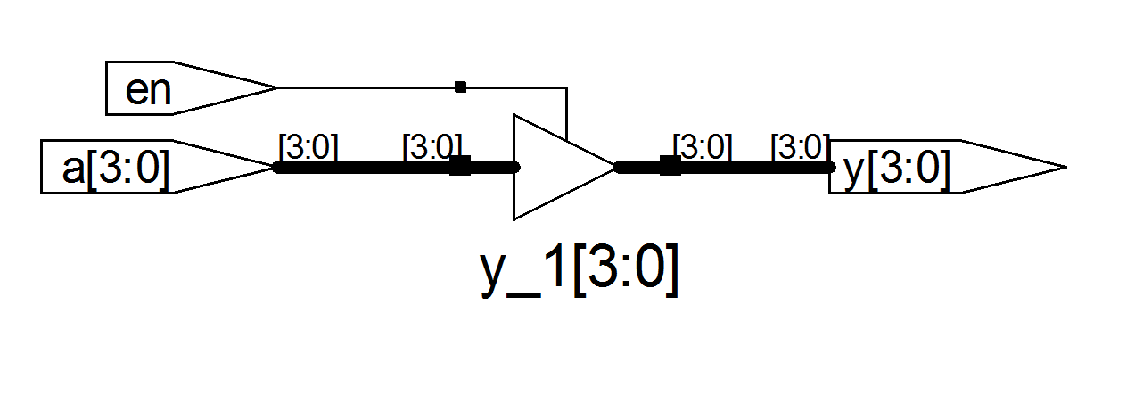
Z: Floating Output
Verilog:
module tristate(input [3:0] a,
input en,
output [3:0] y);
assign y = en ? a : 4'bz;
endmodule
Synthesis:

Slide 34
Verilog big idea: Time
Difference from normal prog. lang. is that time is part of the language
  part of what trying to describe is when things occur, or how long things will take
In both structural and behavoral Verilog, determine time with #n : event will take place in n time units
  structural: not #2(notX, X) says notX does not change until time advances 2 ns
  behavoral: Z = #2 A ^ B; says Z does not change until time advances 2 ns
  Default unit is nanoseconds; can change

Slide 35
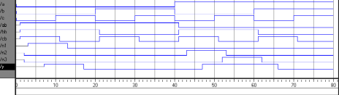
Time
module example(input a, b, c,
output y);
wire ab, bb, cb, n1, n2, n3;
assign #1 {ab, bb, cb} = ~{a, b, c};
assign #2 n1 = ab & bb & cb;
assign #2 n2 = a & bb & cb;
assign #2 n3 = a & bb & c;
assign #4 y = n1 | n2 | n3;
endmodule

Slide 36
Rising and Falling Edges and Verilog
Challenge of hardware is when do things change relative to clock?
  Rising clock edge?
  (“positive edge triggered”)
  Falling clock edge?
  (“negative edge triggered”)
  When logical level is reached?
  (“level sensitive”)
Verilog must support any “clocking methodology”
Includes events “posedge”, “negedge” to say when clock edge occur, and “wait” statements for level

Slide 37
Always Statement
General Structure:
always @ (sensitivity list)
statement;
Whenever the event in the sensitivity list occurs, the statement is executed

Slide 38
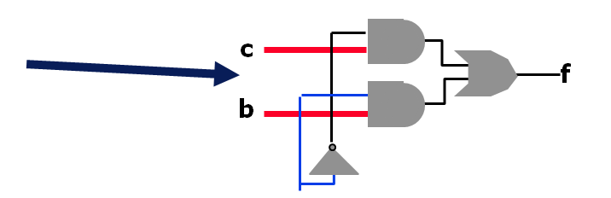
Is it really correct?
Problem?
  Where’s the register?
The synthesis tool figures out that this is a combinational circuit. Therefore, it doesn’t need a register.
The register is there as an “artifact” of the descriptions — things on the left-hand side have to be registers.
module test (f, sel, b, c);
output f;
input sel, b, c;
reg f;
always @ (sel or b or c)
if (sel == 1)
f = b;
else
f = c;
endmodule

Slide 39
Is it really correct?
Problem?
  How does it figure out that this is combinational?
    The output is only a function of the inputs (and not of previous values)
    Anytime an input changes, the output is re-evauated
  Think about the module as being a black box …
    Could you tell that there is a register in there?
module test (f, sel, b, c);
output f;
input sel, b, c;
reg f;
always @ (sel or b or c)
if (sel == 1)
f = b;
else
f = c;
endmodule

Slide 40
Resettable D Flip-Flop
module flopr(input clk,
input reset,
input [3:0] d,
output reg [3:0] q);
// synchronous reset
always @ (posedge clk)
if (reset) q <= 4'b0;
else q <= d;
endmodule

Slide 41
Resettable D Flip-Flop
module flopr(input clk,
input reset,
input [3:0] d,
output reg [3:0] q);
// asynchronous reset
?
endmodule

Slide 42
Resettable D Flip-Flop
module flopr(input clk,
input reset,
input [3:0] d,
output reg [3:0] q);
// asynchronous reset
always @ (posedge clk, posedge reset)
if (reset) q <= 4'b0;
else q <= d;
endmodule

Slide 43
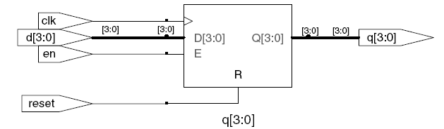
D Flip-Flop with Enable
module flopren(input clk,
input reset,
input en,
input [3:0] d,
output reg [3:0] q);
// asynchronous reset and enable
?
endmodule

Slide 44
D Flip-Flop with Enable
module flopren(input clk,
input reset,
input en,
input [3:0] d,
output reg [3:0] q);
// asynchronous reset and enable
always @ (posedge clk, posedge reset)
if (reset) q <= 4'b0;
else if (en) q <= d;
endmodule

Slide 45
Other Behavioral Statements
Statements that must be inside always statements:
  if / else
  case, casez
Reminder: Variables assigned in an always statement must be declared as reg (even if they’re not actually registered!)

Slide 46
Combinational Logic using always
// combinational logic using an always statement
module gates(input [3:0] a, b,
output reg [3:0] y1, y2, y3, y4, y5);
always @(*) // need begin/end because there is
begin // more than one statement in always
y1 = a & b; // AND
y2 = a | b; // OR
y3 = a ^ b; // XOR
y4 = ~(a & b); // NAND
y5 = ~(a | b); // NOR
end
endmodule
This hardware could be described with assign statements using fewer lines of code, so it’s better to use assign statements in this case.

Slide 47
Combinational Logic using case
module sevenseg(input [3:0] data,
output reg [6:0] segments);
always @(*)
case (data)
// abc_defg
0: segments = 7'b111_1110;
1: segments = 7'b011_0000;
2: segments = 7'b110_1101;
3: segments = 7'b111_1001;
4: segments = 7'b011_0011;
5: segments = 7'b101_1011;
6: segments = 7'b101_1111;
7: segments = 7'b111_0000;
8: segments = 7'b111_1111;
9: segments = 7'b111_1011;
default: segments = 7'b000_0000; // required
endcase
endmodule

Slide 48
Combinational Logic using case
In order for a case statement to imply combinational logic, all possible input combinations must be described by the HDL.
Remember to use a default statement when necessary.

Slide 49
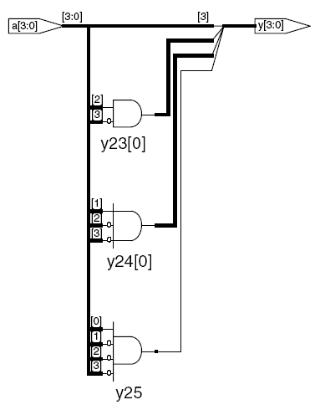
Combinational Logic using casez
module priority_casez(input [3:0] a,
output reg [3:0] y);
always @(*)
casez(a)
4'b1???: y = 4'b1000; // ? = don’t care
4'b01??: y = 4'b0100;
4'b001?: y = 4'b0010;
4'b0001: y = 4'b0001;
default: y = 4'b0000;
endcase
endmodule

Slide 50
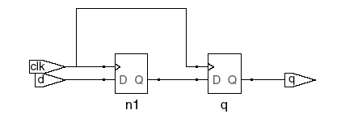

Blocking vs. Nonblocking Assignments
<= is a “nonblocking assignment”
  Occurs simultaneously with others
= is a “blocking assignment”
  Occurs in the order it appears in the file
// Good synchronizer using
// nonblocking assignments
module syncgood(input clk,
input d,
output reg q);
reg n1;
always @(posedge clk)
begin
n1 <= d; // nonblocking
q <= n1; // nonblocking
end
endmodule
// Bad synchronizer using
// blocking assignments
module syncbad(input clk,
input d,
output reg q);
reg n1;
always @(posedge clk)
begin
n1 = d; // blocking
q = n1; // blocking
end
endmodule

Slide 51
Rules for Signal Assignment
Use always @(posedge clk) and nonblocking assignments (<=) to model synchronous sequential logic
always @ (posedge clk)
q <= d; // nonblocking
Use continuous assignments (assign …)to model simple combinational logic.
assign y = a & b;
Do not make assignments to the same signal in more than one always statement or continuous assignment statement.

Slide 52

Finite State Machines (FSMs)
Three blocks:
  next state logic
  state register
  output logic

Slide 53
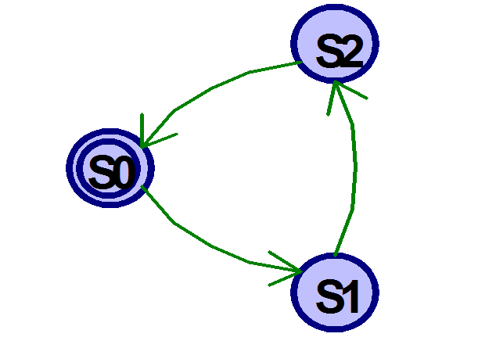
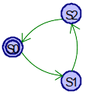
FSM Example: Divide by 3
The double circle indicates the reset state

Slide 54
FSM in Verilog
module divideby3FSM (input clk,
input reset,
output q);
reg [1:0] state, nextstate;
parameter S0 = 2'b00;
parameter S1 = 2'b01;
parameter S2 = 2'b10;
// state register
always @ (posedge clk, posedge reset)
if (reset) state <= S0;
else state <= nextstate;
// next state logic
always @ (*)
case (state)
S0: nextstate = S1;
S1: nextstate = S2;
S2: nextstate = S0;
default: nextstate = S0;
endcase
// output logic
assign q = (state == S0);
endmodule

Slide 55
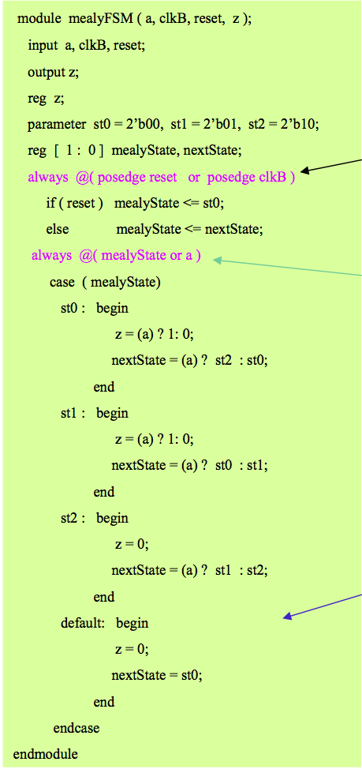
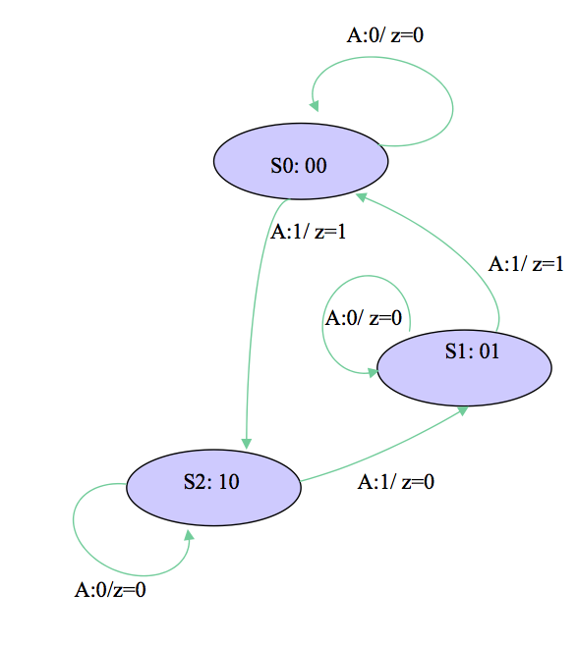
Mealy FSM
Sequential logic
Combinational logic
Default

Slide 56
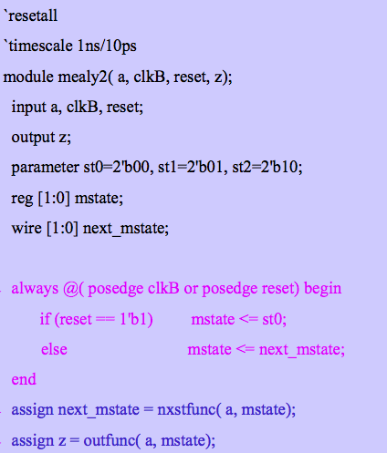
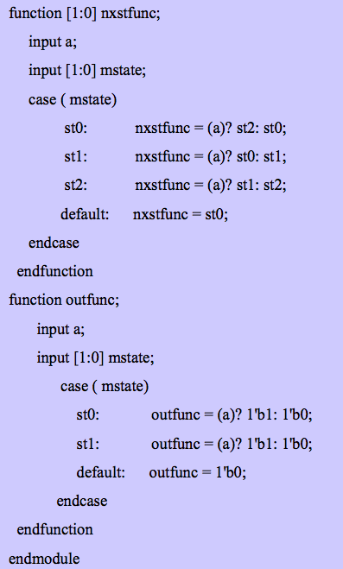
Mealy FSM

Slide 57
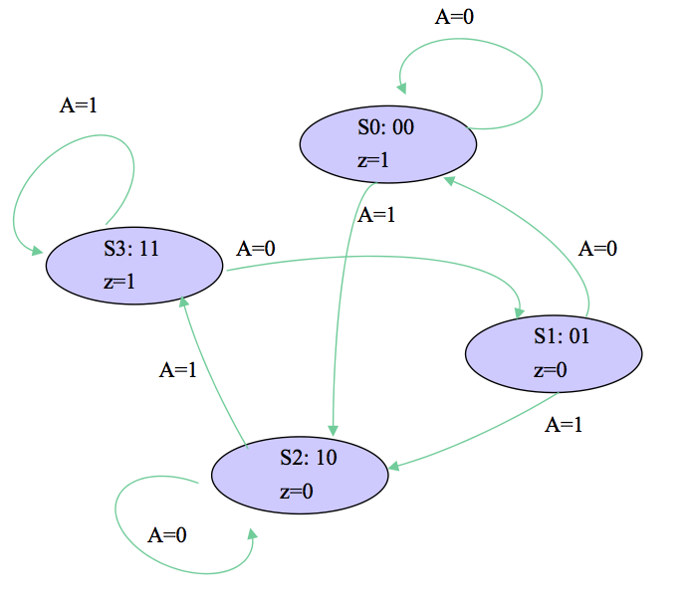
Moore FSM
Verilog?

Slide 58
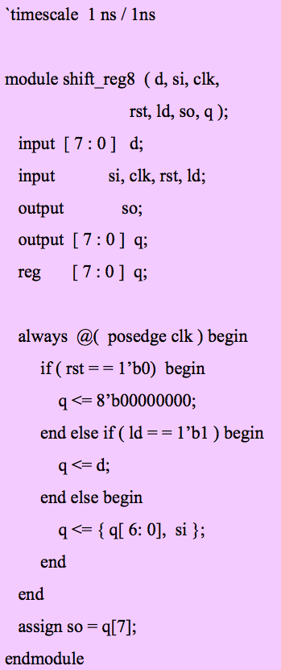
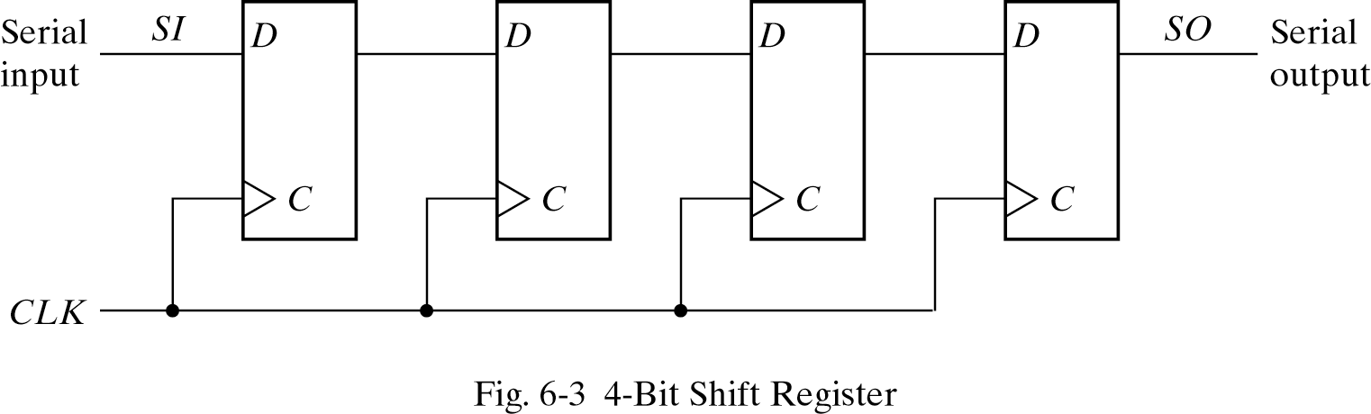
Verilog code
Cascade chain of Flip-Flops
Bits travel on Clock edges
Serial in – Serial out, can also have parallel load / read

Slide 59
Testbenches
HDL code written to test another HDL module, the device under test (dut), also called the unit under test (uut)
Not synthesizeable
Types of testbenches:
  Simple testbench
  Self-checking testbench
  Self-checking testbench with testvectors

Slide 60
Testing your designs
TESTBENCH is the final piece of hardware which
connect DESIGN with TEST so the inputs generated
go to the thing you want to test...
Another piece of hardware to generate interesting inputs
Your hardware

Slide 61
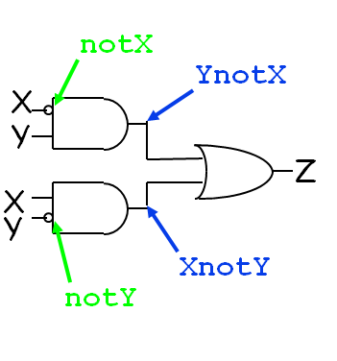
Example: Structural XOR
module xor(X, Y, Z);
input X, Y;
output Z;
wire notX, notY,
XnotY, YnotX;
not
(notX, X),
(notY, Y);
and
(YnotX, notX, Y),
(XnotY, X, notY);
or
(Z, YnotX, XnotY);
endmodule

Slide 62
Testing Verilog
Create a test module that instantiates xor:
module testxor;
reg x, y, expected; wire z;
xor myxor(.x(x), .y(y), .z(z));
/* add testing code */
endmodule
Syntax: declare registers, instantiate module.

Slide 63
Testing (continued)
Now we write code to try different inputs by assigning to registers:
…
initial
begin
x=0; y=0; expected=0;
#10 y=1; expected=1;
#10 x=1; y=0;
#10 y=1; expected=0;
end

Slide 64
Testing continued
Pound sign syntax (#10) indicates code should wait simulated time (10 nanoseconds in this case).
Values of registers can be changed with assignment statements.
So far we have the xor module and a testxor module that iterates over all the inputs. How do we see if it is correct?

Slide 65
Testing continued
Use $monitor to watch some signals and see every time they change:
…
initial
$monitor(“x=%b, y=%b, z=%b, exp=%b, time=%d”, x, y, z, expected, $time);
Our code now iterates over all inputs and for each one: prints out the inputs, the gate output, and the expected output.
$time is system function gives current time

Slide 66
Output
x=0, y=0, z=0, exp=0, time=0
x=0, y=1, z=1, exp=1, time=10
x=1, y=0, z=1, exp=1, time=20
x=1, y=1, z=0, exp=0, time=30
Expected value matches actual value, so Verilog works

Slide 67
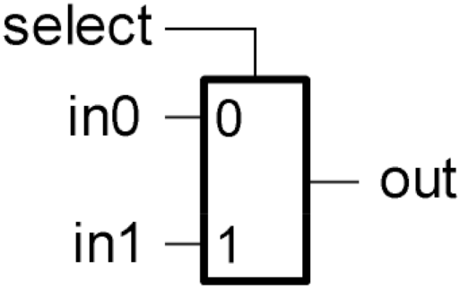
Example 1
// Test bench for 2-input multiplexor.
// Tests all input combinations.
module testmux2;
reg [2:0] c;
wire f;
reg expected;
mux2 myMux (.select(c[2]), .in0(c[0]), .in1(c[1]), .out(f));
initial
begin
c = 3'b000; expected=1'b0; ...

Slide 68
Example 2
… begin
c = 3'b000; expected=1'b0;
repeat(7)
begin
#10 c = c + 3'b001;
if (c[2]) expected=c[1];
else expected=c[0];
end
#10 $finish;
end

Slide 69
Example
Write Verilog code to implement the following
function in hardware:
y = bc + ab
Name the module sillyfunction

Slide 70
Example
Write Verilog code to implement the following
function in hardware:
y = bc + ab
Name the module sillyfunction
Verilog
module sillyfunction(input a, b, c,
output y);
assign y = ~b & ~c | a & ~b;
endmodule
How would you write a testbench for this code?

Slide 71
Simple Testbench
module testbench1();
reg a, b, c;
wire y;
// instantiate device under test
sillyfunction dut(a, b, c, y);
// apply inputs one at a time
initial begin
a = 0; b = 0; c = 0; #10;
c = 1; #10;
b = 1; c = 0; #10;
c = 1; #10;
a = 1; b = 0; c = 0; #10;
c = 1; #10;
b = 1; c = 0; #10;
c = 1; #10;
end
endmodule

Slide 72
Self-checking Testbench
module testbench2();
reg a, b, c;
wire y;
// instantiate device under test
sillyfunction dut(a, b, c, y);
// apply inputs one at a time
// checking results
initial begin
a = 0; b = 0; c = 0; #10;
if (y !== 1) $display("000 failed.");
c = 1; #10;
if (y !== 0) $display("001 failed.");
b = 1; c = 0; #10;
if (y !== 0) $display("010 failed.");
c = 1; #10;
if (y !== 0) $display("011 failed.");
a = 1; b = 0; c = 0; #10;
if (y !== 1) $display("100 failed.");
c = 1; #10;
if (y !== 1) $display("101 failed.");
b = 1; c = 0; #10;
if (y !== 0) $display("110 failed.");
c = 1; #10;
if (y !== 0) $display("111 failed.");
end
endmodule

Slide 73
Testbench with Testvectors
Write testvector file: inputs and expected outputs
Testbench:
  Generate clock for assigning inputs, reading outputs
  Read testvectors file into array
  Assign inputs, expected outputs
  Compare outputs to expected outputs and report errors

Slide 74

Testbench with Testvectors
Testbench clock is used to assign inputs (on the rising edge) and compare outputs with expected outputs (on the falling edge).
The testbench clock may also be used as the clock source for synchronous sequential circuits.

Slide 75
Testvectors File
File: example.tv – contains vectors of abc_yexpected
000_1
001_0
010_0
011_0
100_1
101_1
110_0
111_0

Slide 76
Testbench: 1. Generate Clock
module testbench3();
reg clk, reset;
reg a, b, c, yexpected;
wire y;
reg [31:0] vectornum, errors; // bookkeeping variables
reg [3:0] testvectors[10000:0]; // array of testvectors
// instantiate device under test
sillyfunction dut(a, b, c, y);
// generate clock
always // no sensitivity list, so it always executes
begin
clk = 1; #5; clk = 0; #5;
end

Slide 77
2. Read Testvectors into Array
// at start of test, load vectors
// and pulse reset
initial
begin
$readmemb("example.tv", testvectors);
vectornum = 0; errors = 0;
reset = 1; #27; reset = 0;
end
// Note: $readmemh reads testvector files written in
// hexadecimal

Slide 78
3. Assign Inputs and Expected Outputs
// apply test vectors on rising edge of clk
always @(posedge clk)
begin
#1; {a, b, c, yexpected} = testvectors[vectornum];
end

Slide 79
4. Compare Outputs with Expected Outputs
// check results on falling edge of clk
always @(negedge clk)
if (~reset) begin // skip during reset
if (y !== yexpected) begin
$display("Error: inputs = %b", {a, b, c});
$display(" outputs = %b (%b expected)",y,yexpected);
errors = errors + 1;
end
// Note: to print in hexadecimal, use %h. For example,
// $display(“Error: inputs = %h”, {a, b, c});

Slide 80
4. Compare Outputs with Expected Outputs
// increment array index and read next testvector
vectornum = vectornum + 1;
if (testvectors[vectornum] === 4'bx) begin
$display("%d tests completed with %d errors",
vectornum, errors);
$finish;
end
end
endmodule
// Note: === and !== can compare values that are
// x or z.

Slide 81
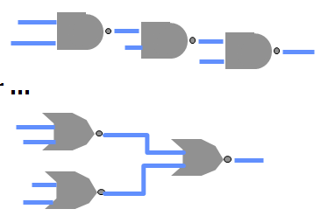
What do we mean by “Synthesis”?
Logic synthesis
  A program that “designs” logic from abstract descriptions of the logic
  takes constraints (e.g. size, speed)
  uses a library (e.g. 3-input gates)
How?
  You write an “abstract” Verilog description of the logic
  The synthesis tool provides alternative implementations
constraints
Verilog blah blah blah
synthesis
or …
library

Slide 82
In conclusion
Verilog describes hardware in hierarchical fashion, either its structure or its behavior or both
Time is explicit, unlike C or Java
Time must be updated for variable change to take effect
monitor print statement like a debugger; display, write, strobe more normal
Modules activated simply by updates to variables, not explicit calls as in C or Java

Slide 83
In conclusion
Verilog allows both structural and behavioral descriptions, helpful in testing
Syntax a mixture of C (operators, for, while, if, print) and Ada (begin… end, case…endcase, module …endmodule)
Some special features only in Hardware Description Languages
  # time delay, initial, monitor
Verilog can describe everything from single gate to full computer system; you get to design a simple processor

Slide 84
Review
Verilog easier to deal with when thought of as a hardware modeling tool, not as a prog lang.
Verilog can describe everything from single gate to full computer system; you get to design a simple processor
Using Verilog subset

