Slide 1
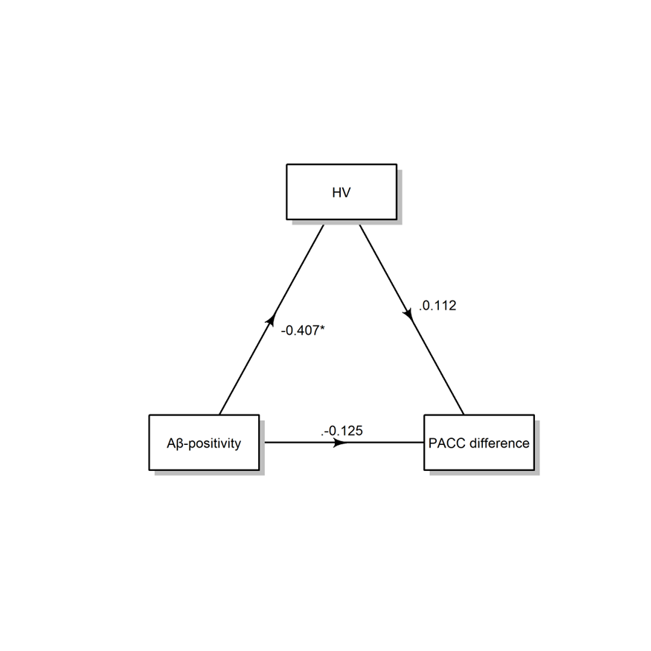
b
a
-0.407*
0.012*
Direct effect
c’
-0.125
-0.170*
Total effect
c
Indirect effect = a*b
-0.045, p = 0.036

