Slide 1

Lecture 02 – Language Models
Baojian Zhou
DATA130030.01 (自然语言处理)
School of Data Science Fudan University
03/01/2023

Slide 2
Outline
Introduction to N-grams
Estimating N-gram Probabilities
Evaluation and Perplexity
Smoothing

Slide 3
Assign a probability to a sentence
I want to … is often followed by
I want to go to the movies.
I want to learn how to play the guitar.
I want to read more books this year.
I want to improve my cooking skills.
I want to spend more time with my family.
But not
I want to my family.
I want to the time.
I want to guitar.

Slide 4
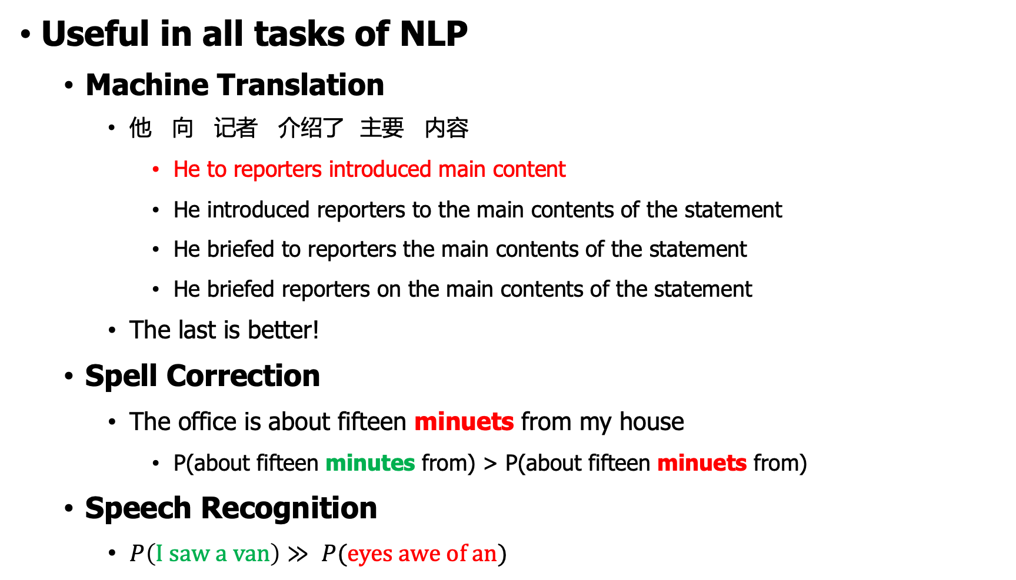
Assign a probability to a sentence
Useful in all tasks of NLP
Machine Translation
他 向 记者 介绍了 主要 内容
He to reporters introduced main content
He introduced reporters to the main contents of the statement
He briefed to reporters the main contents of the statement
He briefed reporters on the main contents of the statement
The last is better!
Spell Correction
The office is about fifteen minuets from my house
P(about fifteen minutes from) > P(about fifteen minuets from)
Speech Recognition
$P\left(I saw a van\right)≫ P(eyes awe of an)$

Slide 5
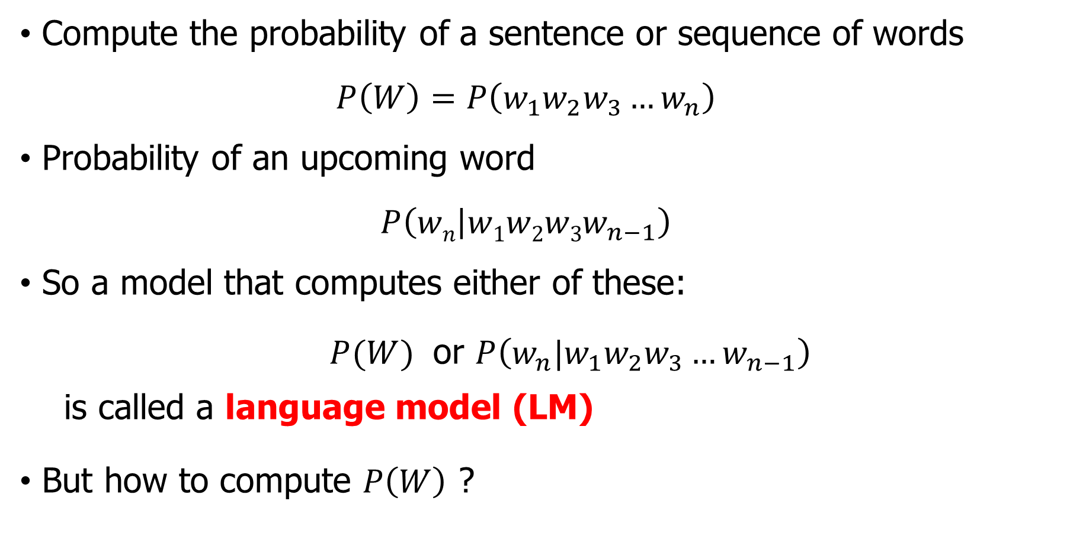
Probabilistic Language Modeling
Compute the probability of a sentence or sequence of words
$$P\left(W\right)=P\left(w_{1}w_{2}w_{3}…w_{n}\right)$$
Probability of an upcoming word
$$P\left(wn | w1w2w3w_{n−1}\right)$$
So a model that computes either of these:
$P(W)$ or $P\left(w_{n}|w_{1}w_{2}w_{3}…w_{n−1}\right)$
is called a language model (LM)
But how to compute $P\left(W\right)$ ?

Slide 6
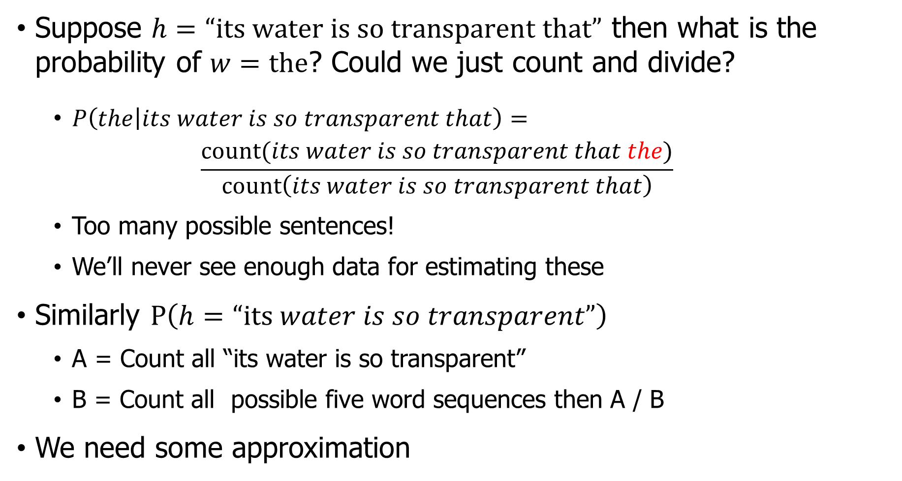
Computing $P\left(w|h\right)$ or $P\left(h\right)$
Suppose $h=“its water is so transparent that”$ then what is the probability of $w=the$? Could we just count and divide?
$P\left(the | its water is so transparent that\right)=$
$$\frac{count(its water is so transparent that the)}{count\left(its water is so transparent that\right)}$$
Too many possible sentences!
We’ll never see enough data for estimating these
Similarly $P\left(h=“its water is so transparent”\right)$
A = Count all “its water is so transparent”
B = Count all possible five word sequences then A / B
We need some approximation

Slide 7
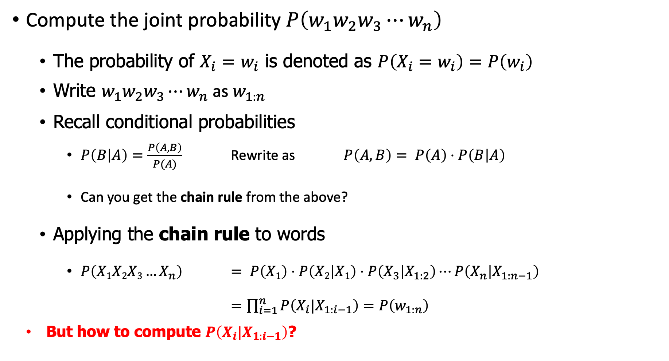
Compute $P(W)$
Compute the joint probability $P\left(w_{1}w_{2}w_{3}⋯w_{n}\right)$
The probability of $X_{i}=w_{i}$ is denoted as $P\left(X_{i}=w_{i}\right)=P\left(w_{i}\right)$
Write $w_{1}w_{2}w_{3}⋯w_{n}$ as $w_{1:n}$
Recall conditional probabilities
$P\left(B | A\right)=\frac{P\left(A,B\right)}{P(A)}$ Rewrite as $P\left(A,B\right)= P\left(A\right)⋅P\left(B | A\right)$
Can you get the chain rule from the above?
Applying the chain rule to words
$P\left(X1X2X3…X_{n}\right)$ $= P\left(X1\right)⋅P\left(X2 | X1\right)⋅P\left(X_{3} | X_{1:2}\right)⋯P\left(X_{n} | X_{1:n−1}\right)$
$=\prod_{i=1}^{n}{P\left(X_{i}|X_{1:i−1}\right)}=P\left(w_{1:n}\right)$
But how to compute $P\left(X_{i}|X_{1:i−1}\right)$?

Slide 8
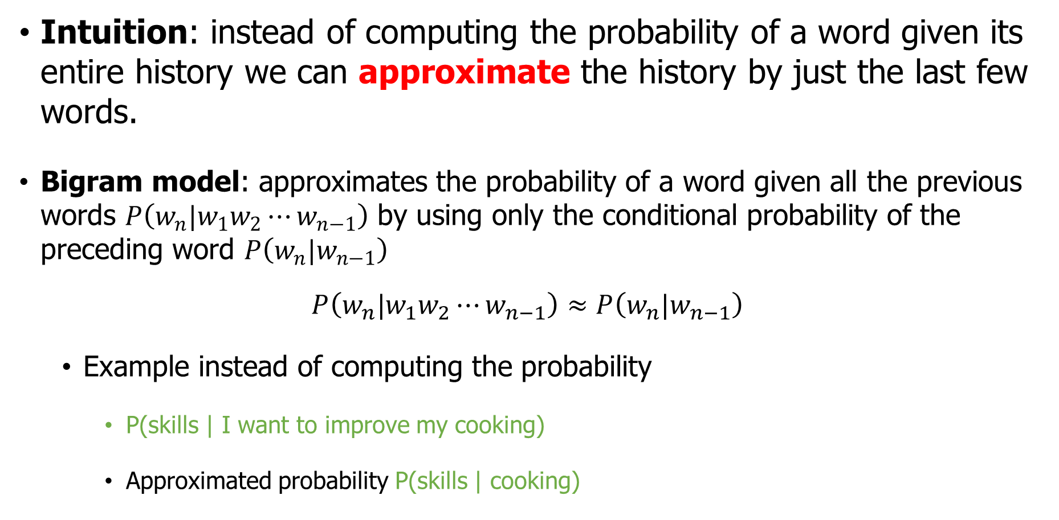
N-gram model
Intuition: instead of computing the probability of a word given its entire history we can approximate the history by just the last few words.
Bigram model: approximates the probability of a word given all the previous words $P\left(w_{n}|w_{1}w_{2}⋯w_{n−1}\right)$ by using only the conditional probability of the preceding word $P\left(w_{n}|w_{n−1}\right)$
$$P\left(w_{n}|w_{1}w_{2}⋯w_{n−1}\right)≈P\left(w_{n}|w_{n−1}\right)$$
Example instead of computing the probability
P(skills | I want to improve my cooking)
Approximated probability P(skills | cooking)

Slide 9
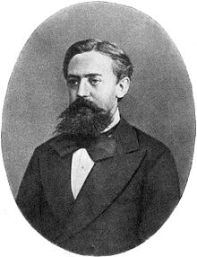
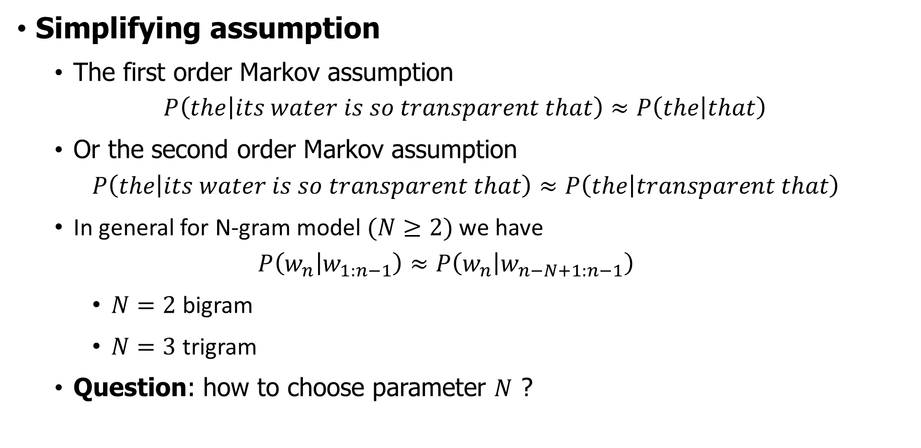
Link to Markov Assumption
Simplifying assumption
The first order Markov assumption
$$P\left(the | its water is so transparent that\right)≈P\left(the | that\right)$$
Or the second order Markov assumption
$$P\left(the | its water is so transparent that\right)≈P\left(the | transparent that\right)$$
In general for N-gram model $(N≥2)$ we have
$$P\left(w_{n} | w_{1:n−1}\right)≈P\left(w_{n} | w_{n−N+1:n−1}\right)$$
$N=2$ bigram
$N=3$ trigram
Question: how to choose parameter $N$ ?
Andrey Andreyevich Markov (14 June 1856 – 20 July 1922) was a Russian mathematician best known for his work on stochastic processes. A primary subject of his research later became known as Markov chains or Markov processes.

Slide 10
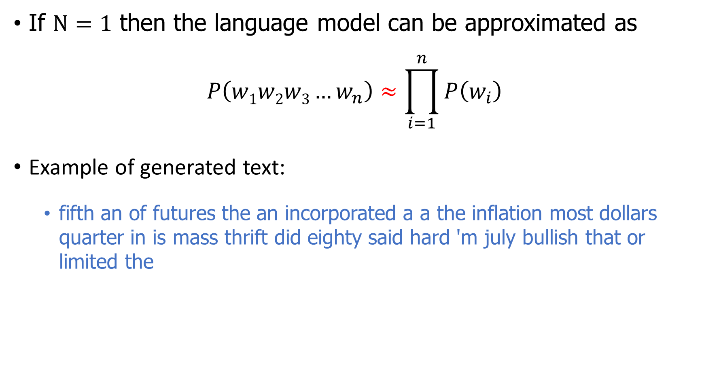
Case $N=1$ : Unigram model
If $N=1$ then the language model can be approximated as
$$P\left(w1w2w3…w_{n}\right)≈\prod_{i=1}^{n}{P\left(w_{i}\right)}$$
Example of generated text:
fifth an of futures the an incorporated a a the inflation most dollars quarter in is mass thrift did eighty said hard 'm july bullish that or limited the

Slide 11
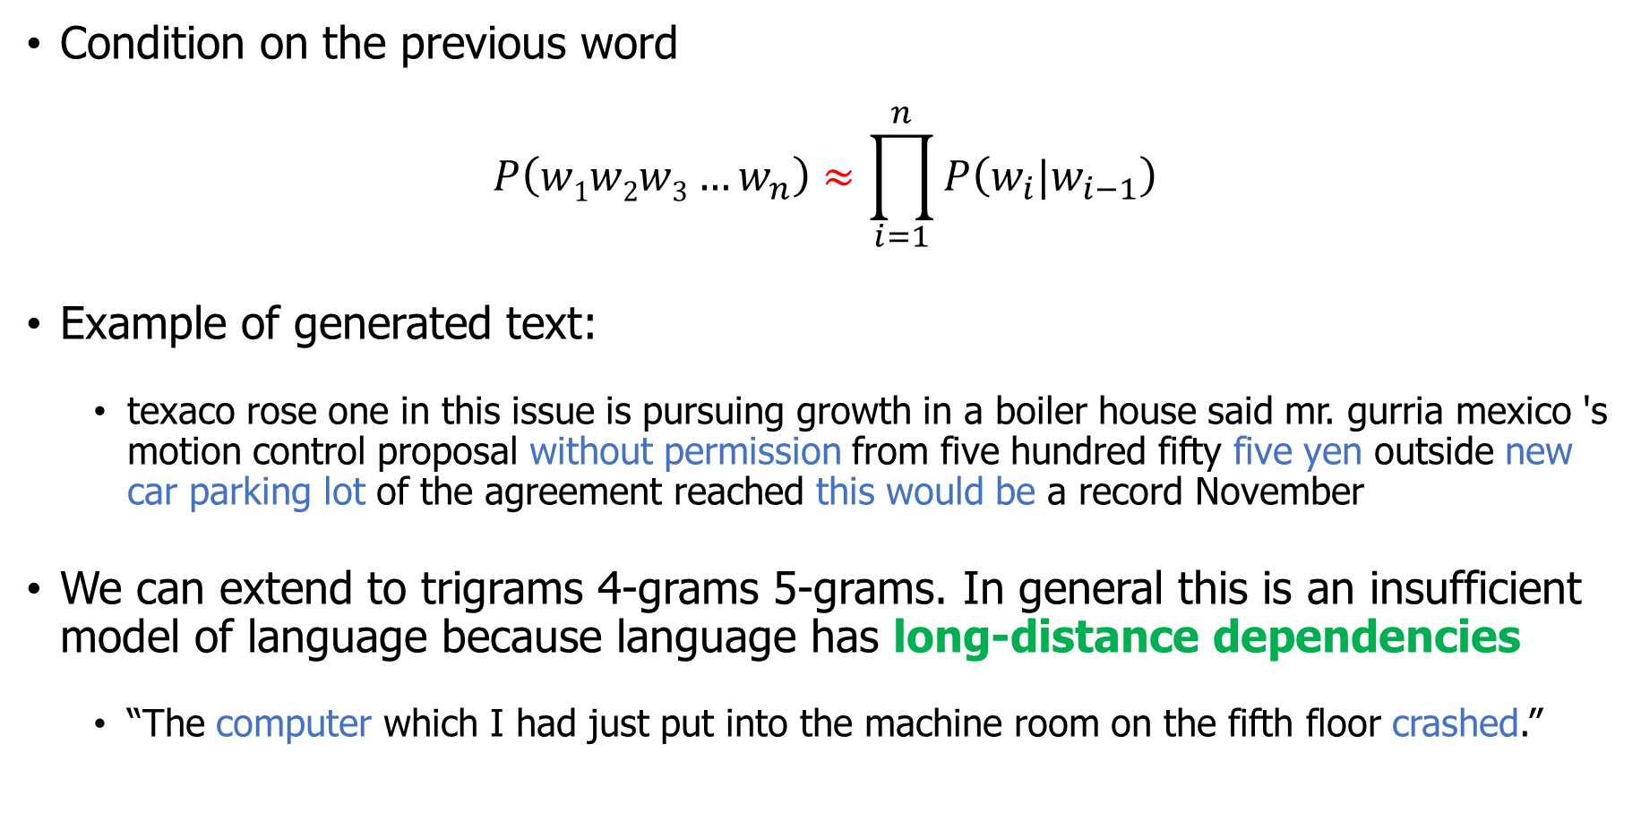
Case $N=2$: bigram model
Condition on the previous word
$$P\left(w1w2w3…w_{n}\right)≈\prod_{i=1}^{n}{P\left(w_{i}|w_{i−1}\right)}$$
Example of generated text:
texaco rose one in this issue is pursuing growth in a boiler house said mr. gurria mexico 's motion control proposal without permission from five hundred fifty five yen outside new car parking lot of the agreement reached this would be a record November
We can extend to trigrams 4-grams 5-grams. In general this is an insufficient model of language because language has long-distance dependencies
“The computer which I had just put into the machine room on the fifth floor crashed.”

Slide 12
Outline
Introduction to N-grams
Estimating N-gram Probabilities
Evaluation and Perplexity
Smoothing

Slide 13




Estimation of n-gram probabilities
The maximum likelihood estimate, for bigram model
$$P\left(w_{i} | w_{i−1}\right)=\frac{c\left(w_{i−1}w_{i}\right)}{\sum_{w∈V}{c\left(w_{i−1}w\right)}}=\frac{c\left(w_{i−1}w_{i}\right)}{c\left(w_{i−1}\right)}$$
$c(x)$ as the frequency of $x$ in the corpus
$V$ is the set of vocabulary of running text
An example corpus
Then we have
<s> I am Sam </s>
<s> Sam I am </s>
<s> I do not like eggs and ham </s>
$$P\left(I | <s>\right)=\frac{2}{3}=0.67$$
$$P\left(<s> | Sam\right)=\frac{1}{2}=0.5$$
$$P\left(Sam | <s>\right)=\frac{1}{3}=0.33$$
$$P\left(Sam | am\right)=\frac{1}{2}=0.5$$
$$P\left(am | I\right)=\frac{2}{3}=0.67$$
$$P\left(do | I\right)=\frac{1}{2}=0.5$$

Slide 14
Bigram of a restaurant review corpus
A corpus of resturant reviews (1000 sentences)
Wow... Loved this place.
Not tasty and the texture was just nasty. The selection on the menu was great and so were the prices.
Bigram counts
 | i | want | to | eat | in | this | place
i | 0 | 3 | 0 | 1 | 0 | 0 | 0
want | 0 | 0 | 7 | 0 | 0 | 0 | 0
to | 0 | 0 | 0 | 12 | 1 | 2 | 2
eat | 0 | 0 | 0 | 0 | 2 | 0 | 0
in | 0 | 0 | 3 | 0 | 0 | 2 | 0
this | 0 | 0 | 1 | 0 | 0 | 0 | 73
place | 2 | 0 | 10 | 0 | 2 | 0 | 0
Try the dataset: https://www.kaggle.com/datasets/vigneshwarsofficial/reviews

Slide 15

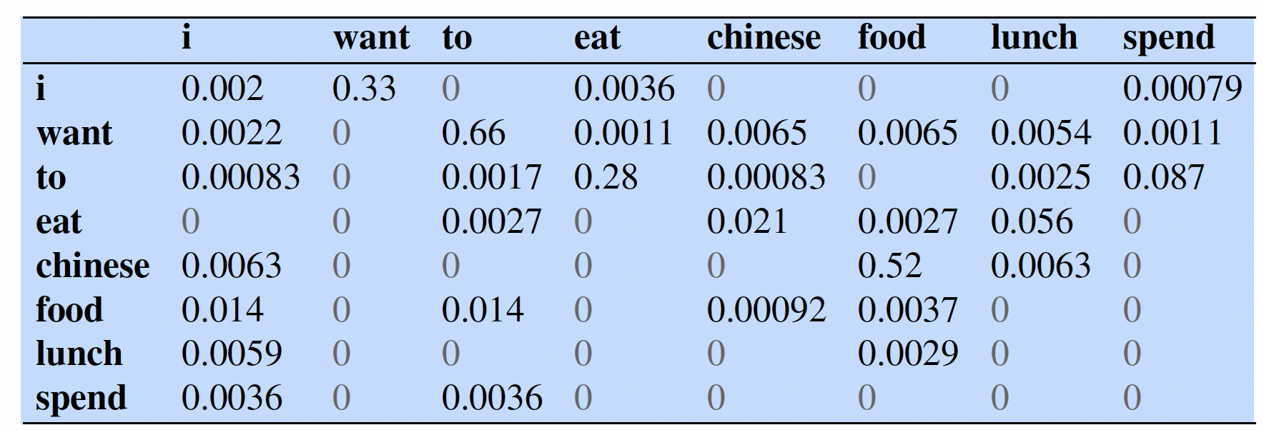
Berkeley Restaurant Project
A dialogue system that answered questions about a database of restaurants (corpus of 9332 sentences) in Berkeley, California (Jurafsky et al., 1994)
can you tell me about any good cantonese restaurants close by
mid priced thai food is what i’m looking for
Calculate P(<s> i want chinese food </s>) bigram probabilities?
P(i|<s>) = 0.25
P(</s>|food) = 0.68

Slide 16
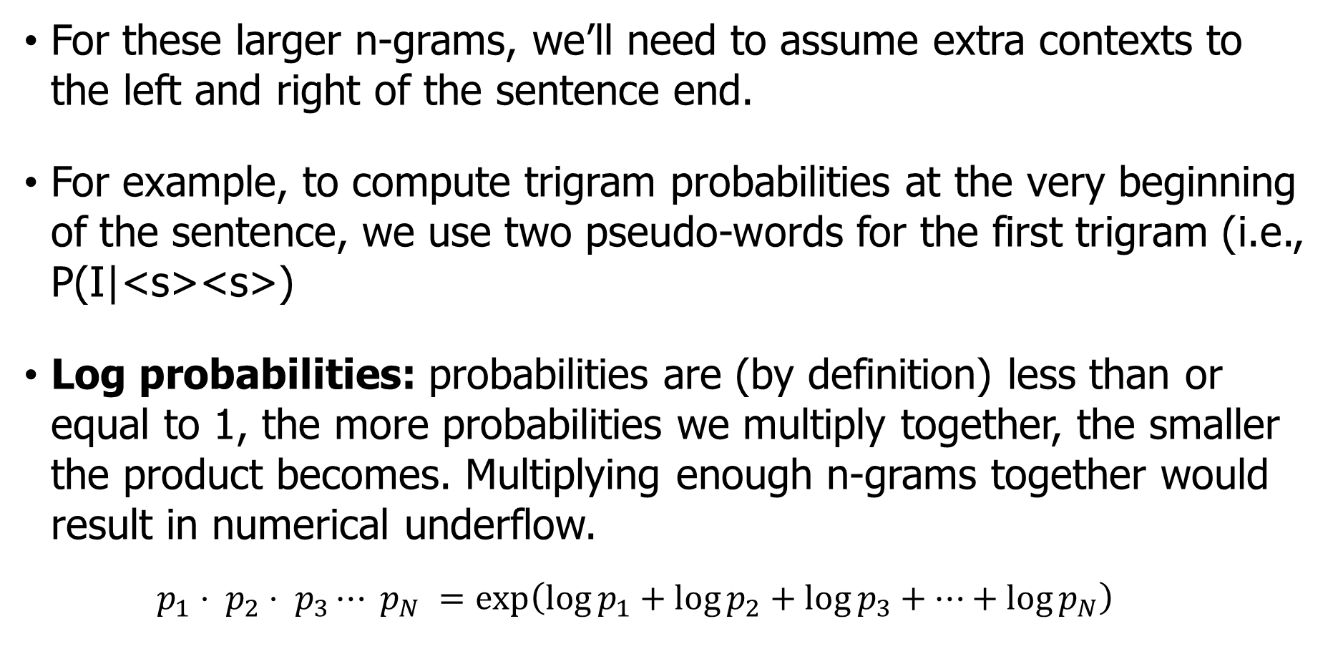
Some practical issues
For these larger n-grams, we’ll need to assume extra contexts to the left and right of the sentence end.
For example, to compute trigram probabilities at the very beginning of the sentence, we use two pseudo-words for the first trigram (i.e., P(I|<s><s>)
Log probabilities: probabilities are (by definition) less than or equal to 1, the more probabilities we multiply together, the smaller the product becomes. Multiplying enough n-grams together would result in numerical underflow.
$$p_{1}⋅ p_{2}⋅ p_{3}⋯ p_{N} =\exp\left(\log{p_{1}}+\log{p_{2}}+\log{p_{3}}+⋯+\log{p_{N}}\right)$$

Slide 17
Outline
Introduction to N-grams
Estimating N-gram Probabilities
Evaluation and Perplexity
Smoothing

Slide 18
Extrinsic evaluation
Best evaluation for comparing models A and B
Put each model in a task
spelling corrector / MT system
Run the task get an accuracy for A and for B
How many misspelled words corrected properly?
How many words translated correctly?
Compare accuracy for A and B
Time-consuming; can take days or weeks

Slide 19
Intrinsic evaluation of N-gram models
Does our language model prefer good sentences to bad ones?
Assign higher probability to “real” or “frequently observed” sentences than “ungrammatical” or “rarely observed” sentences?
Train parameters of our model on a training set. Test the model’s performance on data we haven’t seen
A test set is an unseen dataset which is totally unused
An evaluation metric tells us how well our model fits the test set
We can’t allow test sentences into the training set
What does it mean to “fit the test set”?
Probability-based metric: Whichever model assigns a higher probability to the test set—meaning it more accurately predicts the test set—is a better model.

Slide 20
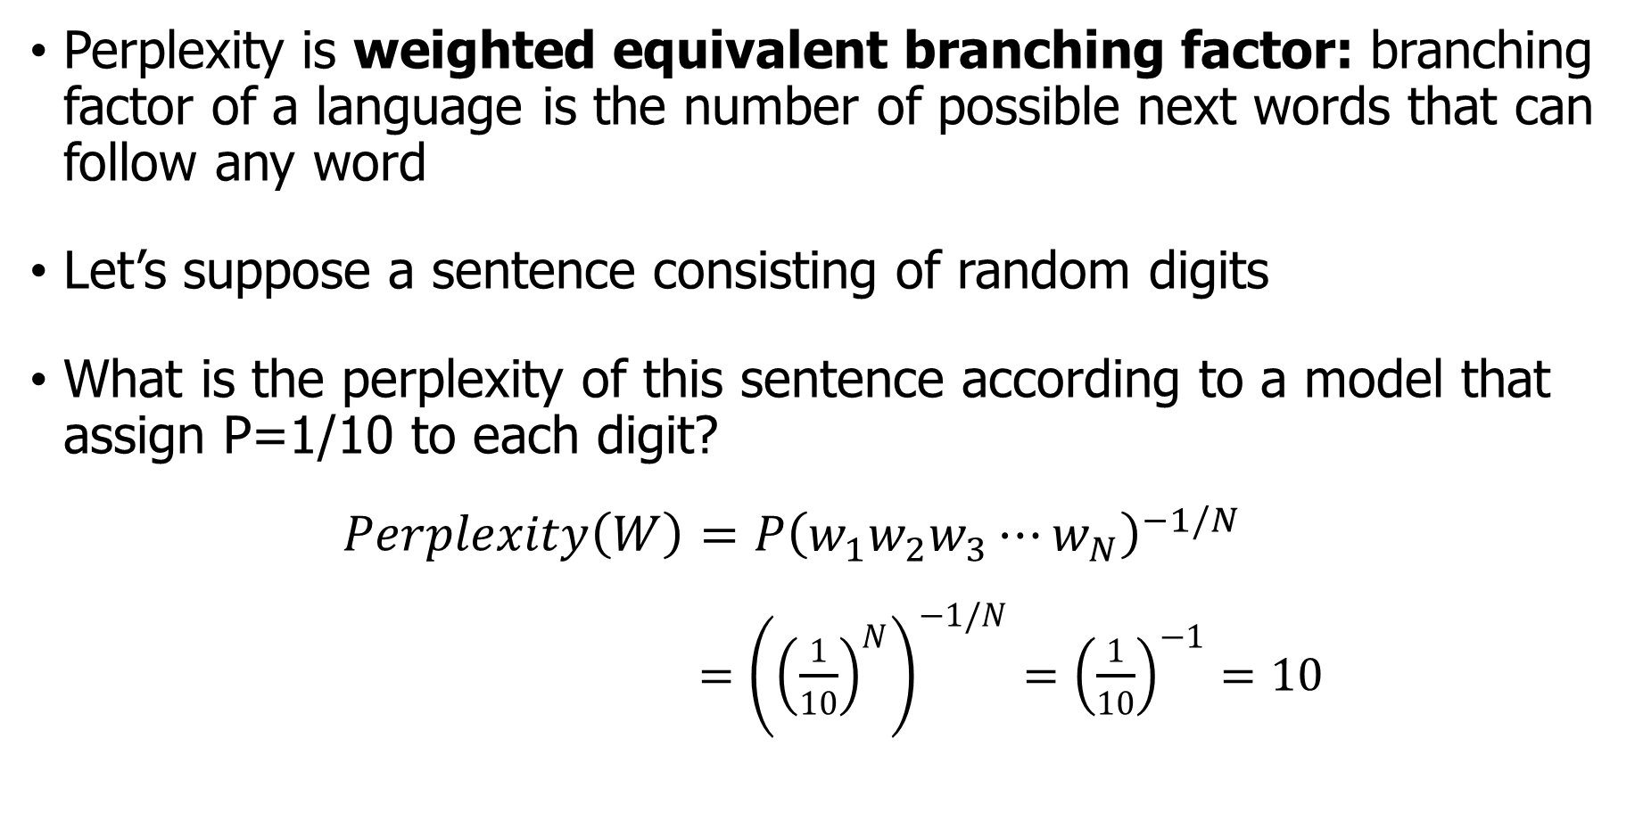
Intuition: Perplexity as branching factor
Perplexity is weighted equivalent branching factor: branching factor of a language is the number of possible next words that can follow any word
Let’s suppose a sentence consisting of random digits
What is the perplexity of this sentence according to a model that assign P=1/10 to each digit?
$$Perplexity\left(W\right)=P{\left(w_{1}w_{2}w_{3}⋯w_{N}\right)}^{−1/N}$$
$={\left({\left(\frac{1}{10}\right)}^{N}\right)}^{−1/N}={\left(\frac{1}{10}\right)}^{−1}=10$

Slide 21
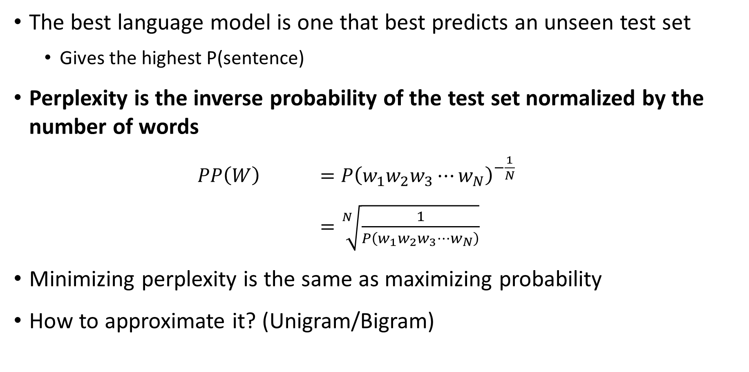
Perplexity
The best language model is one that best predicts an unseen test set
Gives the highest P(sentence)
Perplexity is the inverse probability of the test set normalized by the number of words
$PP\left(W\right)$ $=P{\left(w_{1}w_{2}w_{3}⋯w_{N}\right)}^{−\frac{1}{N}}$
$=\sqrt[N]{\frac{1}{P\left(w_{1}w_{2}w_{3}⋯w_{N}\right)}}$
Minimizing perplexity is the same as maximizing probability
How to approximate it? (Unigram/Bigram)

Slide 22
Lower perplexity – better model
Training 38 million words test 1.5 million words WSJ
The improvement in perplexity does not guarantee an (extrinsic) improvement in the performance of a language processing task like speech recognition or MT
Because perplexity often correlates with such improvements, it is commonly used as a quick check on an algorithm
https://arxiv.org/pdf/2005.14165.pdf (See how GPT-3 uses PPL)
N-gram Order | Unigram | Bigram | Trigram
Perplexity | 962 | 170 | 109

Slide 23
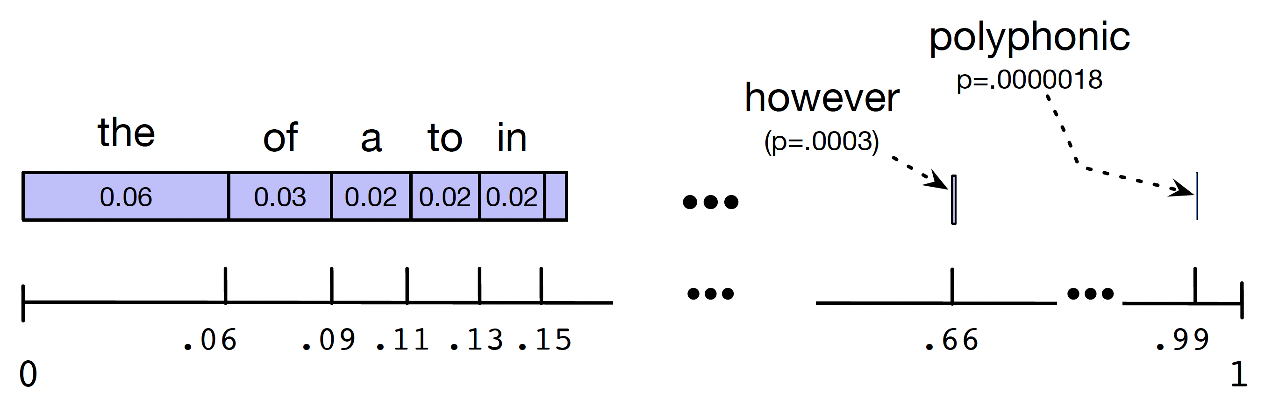
Sentence Sampling
For the unigram case.
Set all the words covering the probability space between 0 and 1, each word covering an interval proportional to its frequency
Choose a random value in [0,1], find that point on the probability line, and print the word whose interval includes this chosen value
Repeat the above step until we see </s>
What about bigram case?

Slide 24
Sampling from built LM
Built LM from Shakespeare’s works (885K tokens)
1-gram: To him swallowed confess hear both. Which. Of save on trail for are ay device and rote life have
2-gram: Why dost stand forth thy canopy, forsooth; he is this palpable hit the King Henry. Live king. Follow.
3-gram: Fly, and will rid me these news of price. Therefore the sadness of parting, as they say, ’tis done
4-gram: King Henry. What! I will go seek the traitor Gloucester. Exeunt some of the watch. A great banquet serv’d in; It cannot be but so.

Slide 25
Sampling from built LM
Built LM from the Wall Street Journal (40M)
1-gram: Months the my and issue of year foreign new exchange’s September were recession exchange new endorsed a acquire to six executives
2-gram: Last December through the way to preserve the Hudson corporation N. B. E. C. Taylor would seem to complete the major central planners one point five percent of U. S. E. has already old M. X. corporation of living on information such as more frequently fishing to keep her
3-gram: They also point to ninety nine point six billion dollars from two hundred four oh six three percent of the rates of interest stores as Mexico and Brazil on market conditions

Slide 26
Unknown Words
The word Baojian simply did not occur in our training set but in our test test
closed vocabulary system: the test set can only contain words from this known lexicon, and there will be no unknown words.
Unknown words, or out of vocabulary (OOV) words
Deal with words we haven’t seen before
Open vocabulary: pseudo-word called <UNK>
How to train the probabilities of the unknown word ?

Slide 27
Unknown Words
Have a prior vocabulary
Choose a vocabulary (word list) that is fixed in advance.
Convert any OOV word in the training set to <UNK>
Estimate the probabilities for <UNK> from its counts
Don’t have a prior vocabulary
Replace words in the training data by <UNK> based on their frequency that occur fewer than n times in the training set, where n is some small number, or equivalently select a vocabulary size V in advance (say 50,000) and choose the top V words by frequency and replace the rest by <UNK>.

Slide 28
Outline
Introduction to N-grams
Estimating N-gram Probabilities
Evaluation and Perplexity
Smoothing

Slide 29
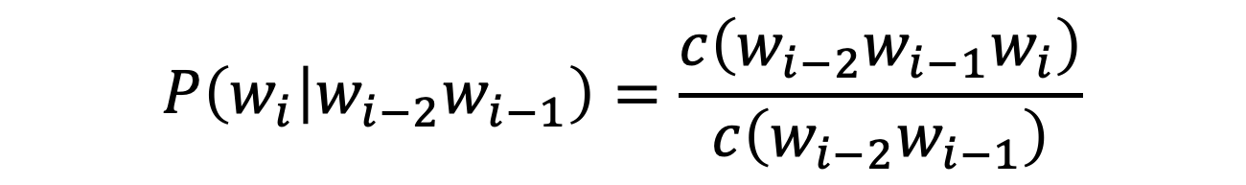
N-gram model estimation: Zeros
The Maximum Likelihood Estimate
Given the following datasets
$$P\left(w_{i} | w_{i−2}w_{i−1}\right)=\frac{c\left(w_{i−2}w_{i−1}w_{i}\right)}{c\left(w_{i−2}w_{i−1}\right)}$$
Training set:
… denied the allegations
… denied the reports
… denied the claims
… denied the request
Test set:
… denied the offer
… denied the loan
P(offer| denied the) ?
Trigrams with zero probability (assign 0 probability)
To compute perplexity how to avoid these zeros?

Slide 30
Smoothing: intuition
When we have sparse statistics
Steal probability mass to generalize better
How to steal?
3 2 1 1 0 0 0 …
P(w | denied the)
allegations
reports
outcome
claims
request
attack
…
man
P(w | denied the)
2.5 allegations
1.5 reports
0.5 claims
0.5 request
2 other
allegations
allegations
attack
man
outcome
reports
…
claims
request

Slide 31
Outline
Introduction to N-grams
Estimating N-gram Probabilities
Evaluation and Perplexity
Smoothing
Additive smoothing

Slide 32
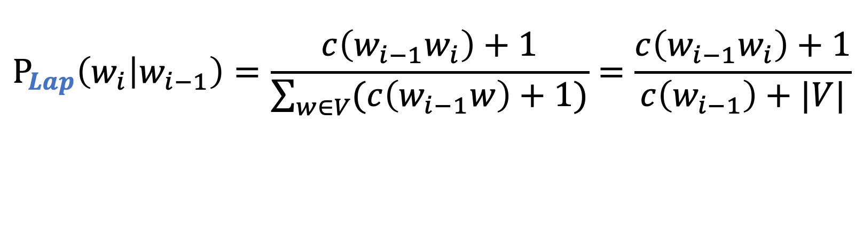
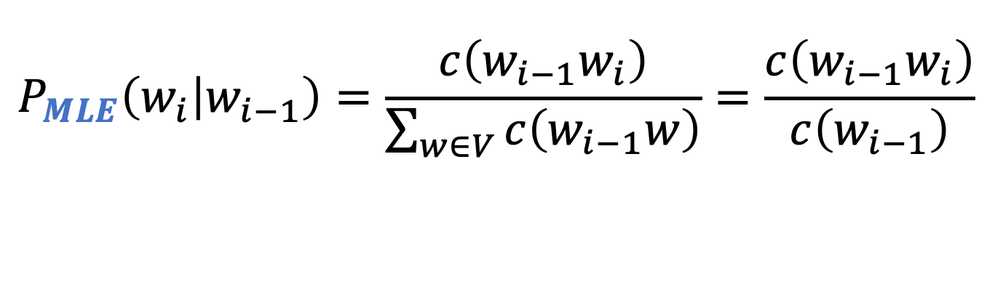
Add-one estimation (Laplace smoothing)
MLE estimate
Add-one estimate
pretend we saw each word one more time than we did
$$P_{MLE}\left(w_{i} | w_{i−1}\right)=\frac{c\left(w_{i−1}w_{i}\right)}{\sum_{w∈V}{c\left(w_{i−1}w\right)}}=\frac{c\left(w_{i−1}w_{i}\right)}{c\left(w_{i−1}\right)}$$
$$P_{Lap}\left(w_{i} | w_{i−1}\right)=\frac{c\left(w_{i−1}w_{i}\right)+1}{\sum_{w∈V}{(c\left(w_{i−1}w\right)+1)}}=\frac{c\left(w_{i−1}w_{i}\right)+1}{c\left(w_{i−1}\right)+|V|}$$

Slide 33
Raw bigram counts $c\left(w_{i−1}w_{i}\right)$
Training dataset (9222 sentences of restaurant reviews)
 | i | want | to | eat | chinese | food | lunch | spend
i | 5 | 827 | 0 | 9 | 0 | 0 | 0 | 2
want | 2 | 0 | 608 | 1 | 6 | 6 | 5 | 1
to | 2 | 0 | 4 | 686 | 2 | 0 | 6 | 211
eat | 0 | 0 | 2 | 0 | 16 | 2 | 42 | 0
chinese | 1 | 0 | 0 | 0 | 0 | 82 | 1 | 0
food | 15 | 0 | 15 | 0 | 1 | 4 | 0 | 0
lunch | 2 | 0 | 0 | 0 | 0 | 1 | 0 | 0
spend | 1 | 0 | 1 | 0 | 0 | 0 | 0 | 0

Slide 34
Laplace smoothed counts $c\left(w_{i−1}w_{i}\right)+1$
Add-one smoothing (Adding 1 to all bigram counts)
 | i | want | to | eat | chinese | food | lunch | spend
i | 6 | 828 | 1 | 10 | 1 | 1 | 1 | 3
want | 3 | 1 | 609 | 2 | 7 | 7 | 6 | 2
to | 3 | 1 | 5 | 687 | 3 | 1 | 7 | 212
eat | 1 | 1 | 3 | 1 | 17 | 3 | 43 | 1
chinese | 2 | 1 | 1 | 1 | 1 | 83 | 2 | 1
food | 16 | 1 | 16 | 1 | 2 | 5 | 1 | 1
lunch | 3 | 1 | 1 | 1 | 1 | 2 | 1 | 1
spend | 2 | 1 | 2 | 1 | 1 | 1 | 1 | 1

Slide 35

Raw bigram probabilities
Bigram probabilities using MLE $\frac{c\left(w_{i−1}w_{i}\right)}{c\left(w_{i−1}\right)}$
 | i | want | to | eat | chinese | food | lunch | spend
i | 0.0015 | 0.21 | 0.00025 | 0.0025 | 0.00025 | 0.00025 | 0.00025 | 0.00075
want | 0.0013 | 0.00042 | 0.26 | 0.00084 | 0.0029 | 0.0029 | 0.0025 | 0.00084
to | 0.00078 | 0.00026 | 0.0013 | 0.18 | 0.00078 | 0.00026 | 0.0018 | 0.055
eat | 0.00046 | 0.00046 | 0.0014 | 0.00046 | 0.0078 | 0.0014 | 0.02 | 0.00046
chinese | 0.0012 | 0.00062 | 0.00062 | 0.00062 | 0.00062 | 0.052 | 0.0012 | 0.00062
food | 0.0063 | 0.00039 | 0.0063 | 0.00039 | 0.00079 | 0.002 | 0.00039 | 0.00039
lunch | 0.0017 | 0.00056 | 0.00056 | 0.00056 | 0.00056 | 0.0011 | 0.00056 | 0.00056
spend | 0.0012 | 0.00058 | 0.0012 | 0.00058 | 0.00058 | 0.00058 | 0.00058 | 0.00058

Slide 36
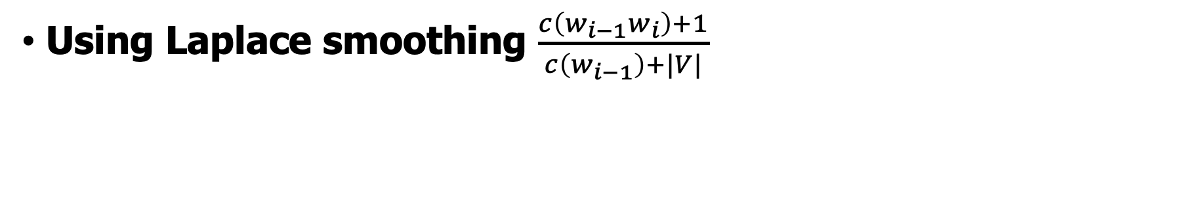
Laplace-smoothed bigrams
Using Laplace smoothing $\frac{c\left(w_{i−1}w_{i}\right)+1}{c\left(w_{i−1}\right)+|V|}$
 | i | want | to | eat | chinese | food | lunch | spend
i | 0.0015 | 0.21 | 0.00025 | 0.0025 | 0.00025 | 0.00025 | 0.00025 | 0.00075
want | 0.0013 | 0.00042 | 0.26 | 0.00084 | 0.0029 | 0.0029 | 0.0025 | 0.00084
to | 0.00078 | 0.00026 | 0.0013 | 0.18 | 0.00078 | 0.00026 | 0.0018 | 0.055
eat | 0.00046 | 0.00046 | 0.0014 | 0.00046 | 0.0078 | 0.0014 | 0.02 | 0.00046
chinese | 0.0012 | 0.00062 | 0.00062 | 0.00062 | 0.00062 | 0.052 | 0.0012 | 0.00062
food | 0.0063 | 0.00039 | 0.0063 | 0.00039 | 0.00079 | 0.002 | 0.00039 | 0.00039
lunch | 0.0017 | 0.00056 | 0.00056 | 0.00056 | 0.00056 | 0.0011 | 0.00056 | 0.00056
spend | 0.0012 | 0.00058 | 0.0012 | 0.00058 | 0.00058 | 0.00058 | 0.00058 | 0.00058

Slide 37
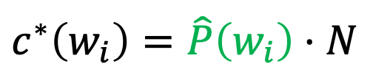
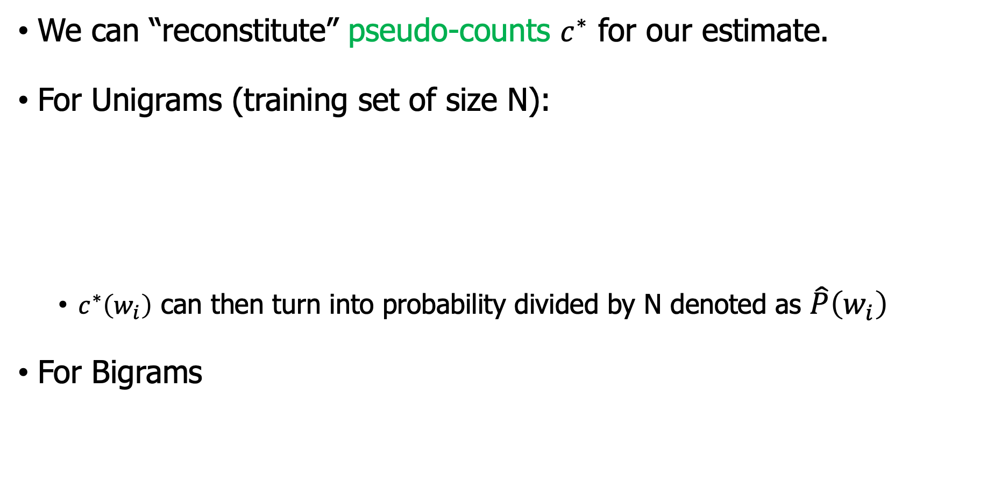
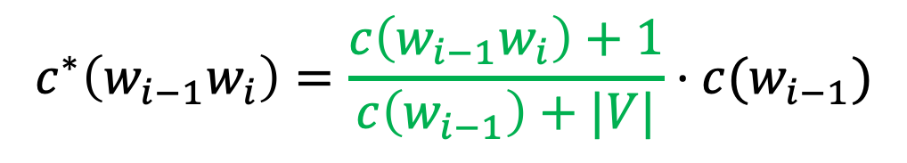
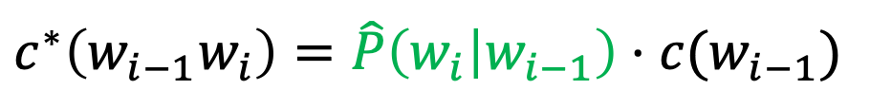
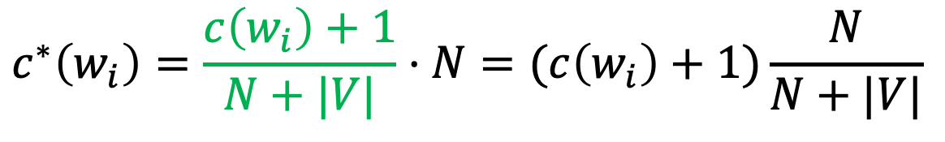
Reconstituted counts
We can “reconstitute” pseudo-counts $c^{∗}$ for our estimate.
For Unigrams (training set of size N):
$c^{∗}\left(w_{i}\right)$ can then turn into probability divided by N denoted as $\hat{P}\left(w_{i}\right)$
For Bigrams
$$c^{∗}\left(w_{i}\right)=\hat{P}\left(w_{i}\right)⋅N$$
$$c^{∗}\left(w_{i}\right)=\frac{c\left(w_{i}\right)+1}{N+|V|}⋅N=(c\left(w_{i}\right)+1)\frac{N}{N+|V|}$$
$$c^{∗}\left(w_{i−1}w_{i}\right)=\hat{P}\left(w_{i} | w_{i−1}\right)⋅c(w_{i−1})$$
$$c^{∗}\left(w_{i−1}w_{i}\right)=\frac{c\left(w_{i−1}w_{i}\right)+1}{c\left(w_{i−1}\right)+|V|}⋅c(w_{i−1})$$

Slide 38
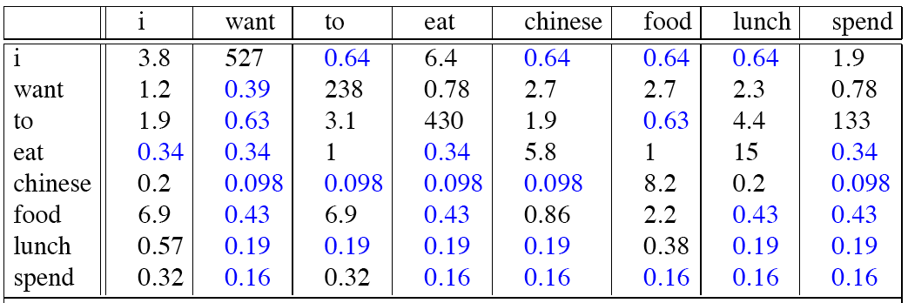
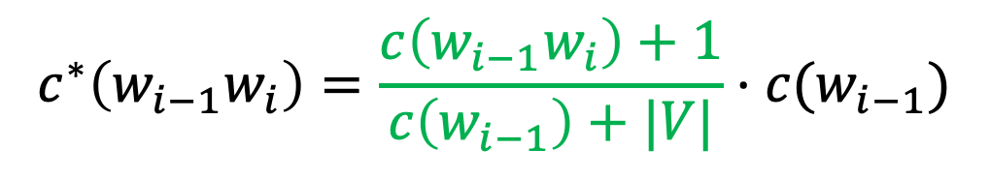
Reconstituted counts for bigram model
Recall the reconstituted counts
$$c^{∗}\left(w_{i−1}w_{i}\right)=\frac{c\left(w_{i−1}w_{i}\right)+1}{c\left(w_{i−1}\right)+|V|}⋅c(w_{i−1})$$

Slide 39
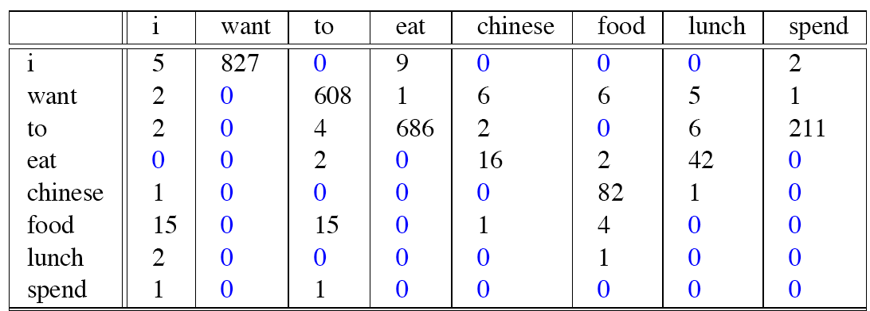
Reconstituted counts
Before Add-one Smoothing
After Add-one Smoothing

Slide 40
Add-1 smoothing
Add-1 is a blunt instrument
C(“want to”) went from 609 to 238!
P(to | want) from .66 to .26!
So add-1 isn’t used for N-grams:
We’ll see better methods
But add-1 is used to smooth other NLP models
For text classification
In domains where the number of zeros isn’t so huge.

Slide 41
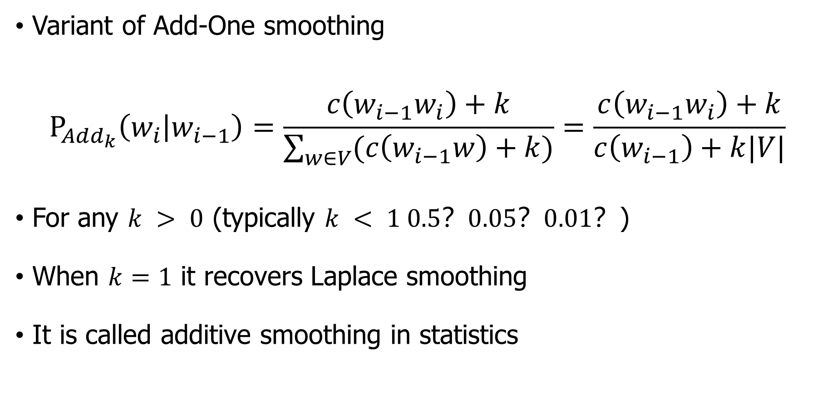
Add-$k$smoothing
Variant of Add-One smoothing
$$P_{Add_{k}}\left(w_{i} | w_{i−1}\right)=\frac{c\left(w_{i−1}w_{i}\right)+k}{\sum_{w∈V}{(c\left(w_{i−1}w\right)+k)}}=\frac{c\left(w_{i−1}w_{i}\right)+k}{c\left(w_{i−1}\right)+k|V|}$$
For any $k > 0$ (typically $k < 1 0.5？0.05？0.01？$)
When $k=1$ it recovers Laplace smoothing
It is called additive smoothing in statistics

Slide 42
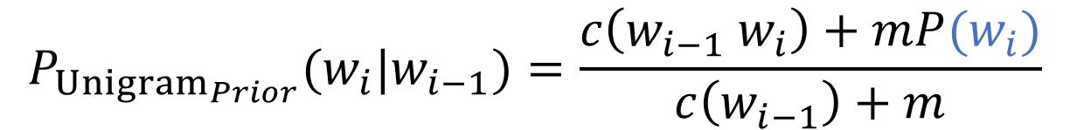
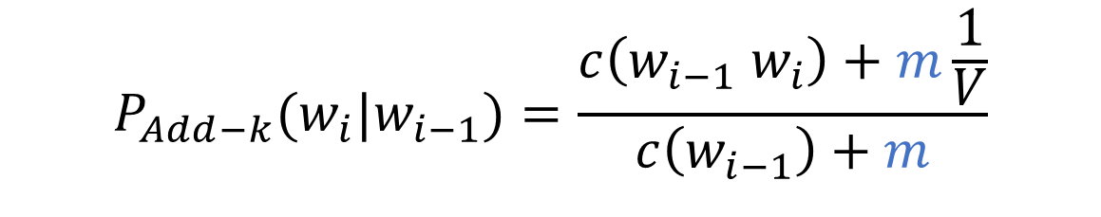
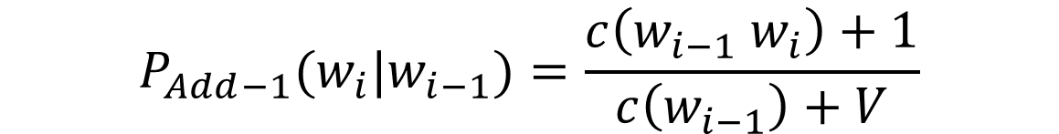
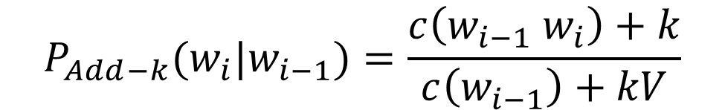
Add-K smoothing: variants
Variants of add-k smoothing
These are still too simple to work well
$$P_{Add−1}(w_{i}|w_{i−1})=\frac{c\left(w_{i−1} w_{i}\right)+1}{c\left(w_{i−1}\right)+V}$$
$$P_{Add−k}(w_{i}|w_{i−1})=\frac{c\left(w_{i−1} w_{i}\right)+k}{c\left(w_{i−1}\right)+kV}$$
$$P_{Add−k}(w_{i}|w_{i−1})=\frac{c\left(w_{i−1} w_{i}\right)+m\frac{1}{V}}{c\left(w_{i−1}\right)+m}$$
$$P_{{Unigram}_{Prior}}(w_{i}|w_{i−1})=\frac{c\left(w_{i−1} w_{i}\right)+mP(w_{i})}{c\left(w_{i−1}\right)+m}$$

Slide 43
Outline
Introduction to N-grams
Estimating N-gram Probabilities
Evaluation and Perplexity
Smoothing
Additive smoothing
Advanced smoothing

Slide 44
Advanced Smoothing methods
Use the count of things we’ve seen once
To help estimate the count of things we’ve never seen
Intuition used by many smoothing algorithms
Good-Turing
Kneser-Ney
Witten-Bell

Slide 45
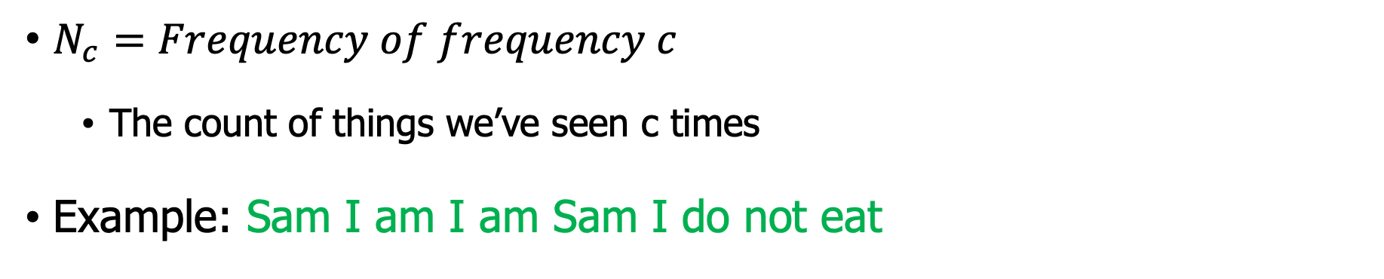



Frequency of frequency c
$N_{c}=Frequency of frequency c$
The count of things we’ve seen c times
Example: Sam I am I am Sam I do not eat
Unigram | Count
I | 3
Sam | 2
am | 2
do | 1
not | 1
eat | 1
$$N_{1}=3$$
$$N_{2}=2$$
$$N_{3}=1$$

Slide 46

Good-Turing
Use the following
$$c^{∗}=\frac{(c+1)N_{c+1}}{N_{c}}$$

Slide 47
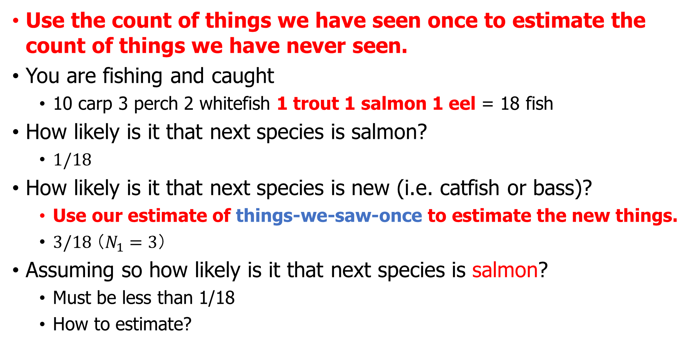
Good-Turing smoothing: intuition
Use the count of things we have seen once to estimate the count of things we have never seen.
You are fishing and caught
10 carp 3 perch 2 whitefish 1 trout 1 salmon 1 eel = 18 fish
How likely is it that next species is salmon?
$1/18$
How likely is it that next species is new (i.e. catfish or bass)?
Use our estimate of things-we-saw-once to estimate the new things.
$3/18 （N_{1}=3）$
Assuming so how likely is it that next species is salmon?
Must be less than 1/18
How to estimate?

Slide 48
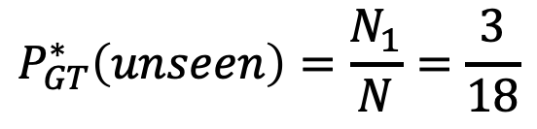
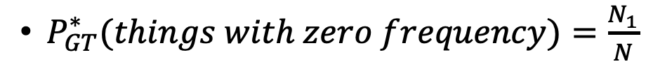
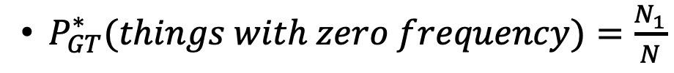
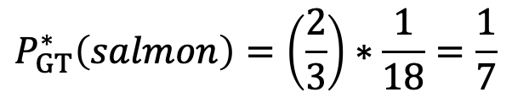
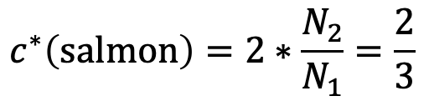
Good-Turing smoothing: calculations
$P_{GT}^{∗}(things with zero frequency)=\frac{N_{1}}{N}$
Unseen (bass or catfish)
c = 0:
MLE: p = 0/18 = 0
Seen once (salmon)
c = 1
MLE: p = 1/18
$$P_{GT}^{∗}\left(unseen\right)=\frac{N_{1}}{N}=\frac{3}{18}$$
$P_{GT}^{∗}(things with zero frequency)=\frac{N_{1}}{N}$
$$c^{∗}\left(\text{salmon}\right)=2∗\frac{N_{2}}{N_{1}}=\frac{2}{3}$$
$$P_{GT}^{∗}\left(salmon\right)=\left(\frac{2}{3}\right)∗\frac{1}{18}=\frac{1}{7}$$

Slide 49
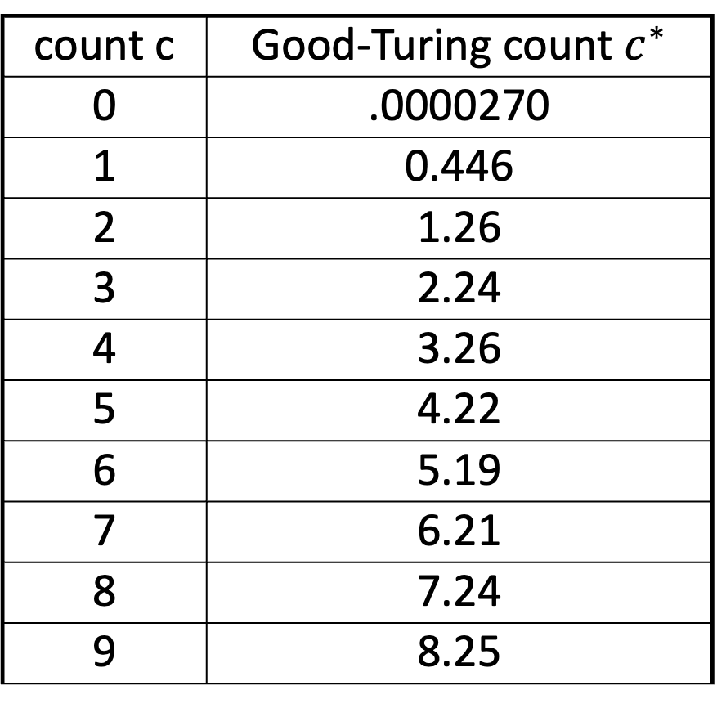

Resulting Good-Turing numbers
22 million words of AP Newswire
$c^{∗}=\frac{(c+1)N_{c+1}}{N_{c}}$
count c | Good-Turing count $c^{∗}$
0 | .0000270
1 | 0.446
2 | 1.26
3 | 2.24
4 | 3.26
5 | 4.22
6 | 5.19
7 | 6.21
8 | 7.24
9 | 8.25

Slide 50
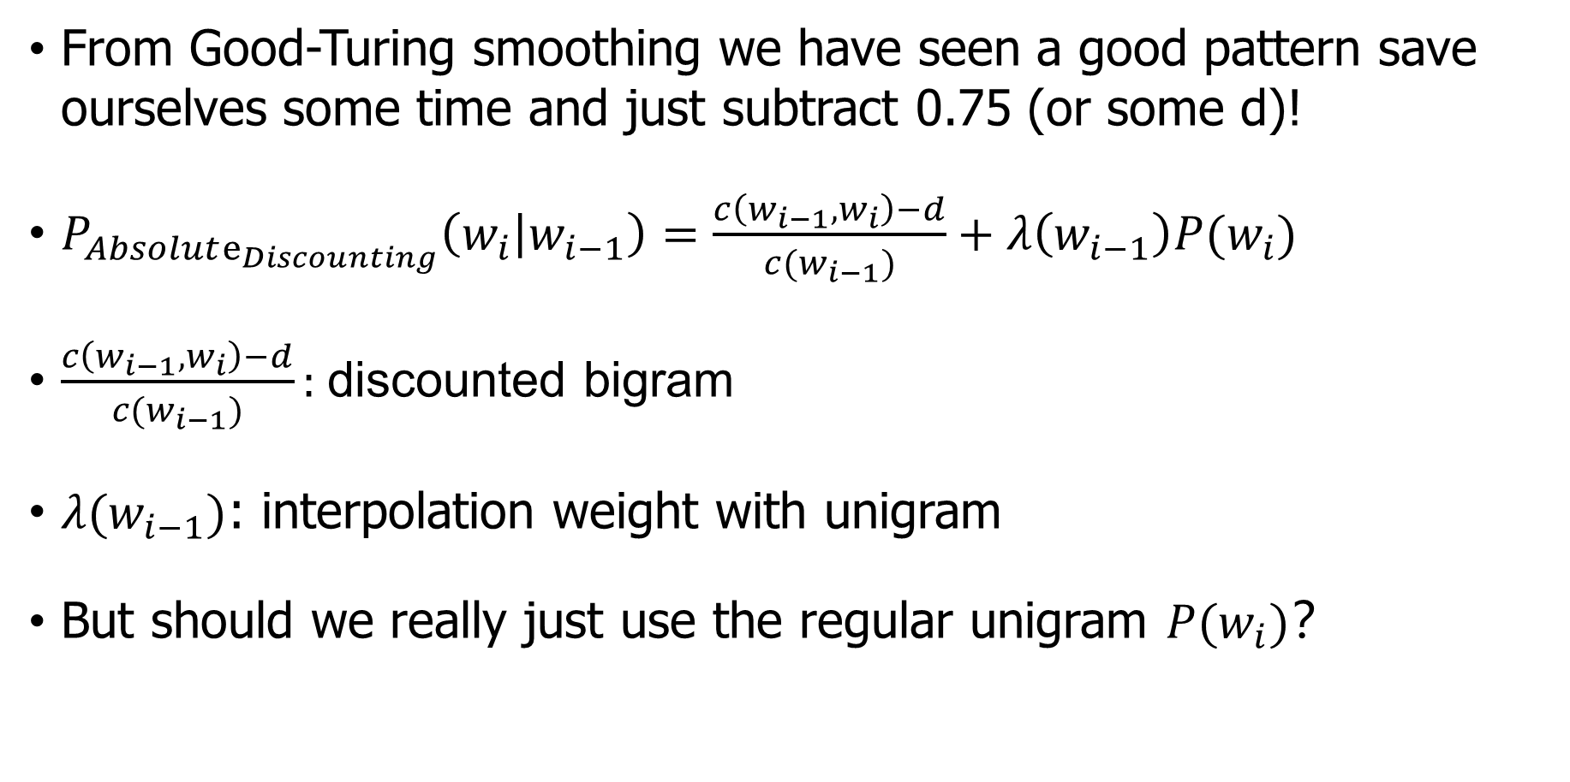
Absolute Discounting Interpolation
From Good-Turing smoothing we have seen a good pattern save ourselves some time and just subtract 0.75 (or some d)!
$P_{Absolute_{Discounting}}\left(w_{i} | w_{i−1}\right)=\frac{c\left(w_{i−1},w_{i}\right)−d}{c(w_{i−1})}+λ\left(w_{i−1}\right)P(w_{i})$
$\frac{c\left(w_{i−1},w_{i}\right)−d}{c(w_{i−1})}:$ discounted bigram
$λ(w_{i−1})$: interpolation weight with unigram
But should we really just use the regular unigram $P(w_{i})$？

Slide 51
N-gram Smoothing Summary
Add-1 smoothing:
Not good for language modeling
The most commonly used method:
Extended Interpolated Kneser-Ney
For very large N-grams like the Web:
Stupid backoff

Slide 52
Language model toolkits
SRILM
http://www.speech.sri.com/projects/srilm/
KenLM
https://kheafield.com/code/kenlm/
Google N-Gram Release August 2006
https://ai.googleblog.com/2006/08/all-our-n-gram-are-belong-to-you.html
Number of tokens: 1,024,908,267,229 number of sentences: 95,119,665,584 number of unigrams: 13,588,391 … number of fivegrams: 1,176,470,663

Slide 53
Summary
You have learned
A simple language model (N-Grams):
MLE + Smoothing
How to measure the quality of a language model
Perplexity
Cross Entropy

Slide 54
Exercises and readings
Alias method (https://www.keithschwarz.com/darts-dice-coins/ )
Read Chapter 4. Naive Bayes and Sentiment Classification

