Slide 1

Lecture 04 – Logistic Regression in NLP
Baojian Zhou
DATA130030.01 (自然语言处理)
School of Data Science Fudan University
03/08/2023
Adopted from Dan’s slides: https://web.stanford.edu/~jurafsky/slp3/

Slide 2
Outline
Two types of classifiers

Slide 3
Logistic Regression
Important analytic tool in natural and social sciences
Baseline supervised machine learning tool for classification
Is also the foundation of neural networks
Naive Bayes is a generative classifier
by contrast:
Logistic regression is a discriminative classifier

Slide 4


Generative and Discriminative Classifiers
Suppose we're distinguishing cat from dog images

Slide 5
Generative Classifier
Build a model of what's in a cat image
Knows about whiskers, ears, eyes
Assigns a probability to any image
how cat-y is this image?
Also build a model for dog images
Now given a new image:
Run both models and see which one fits better

Slide 6
Discriminative Classifier
Just try to distinguish dogs from cats
Oh look, dogs have collars! Let's ignore everything else

Slide 7
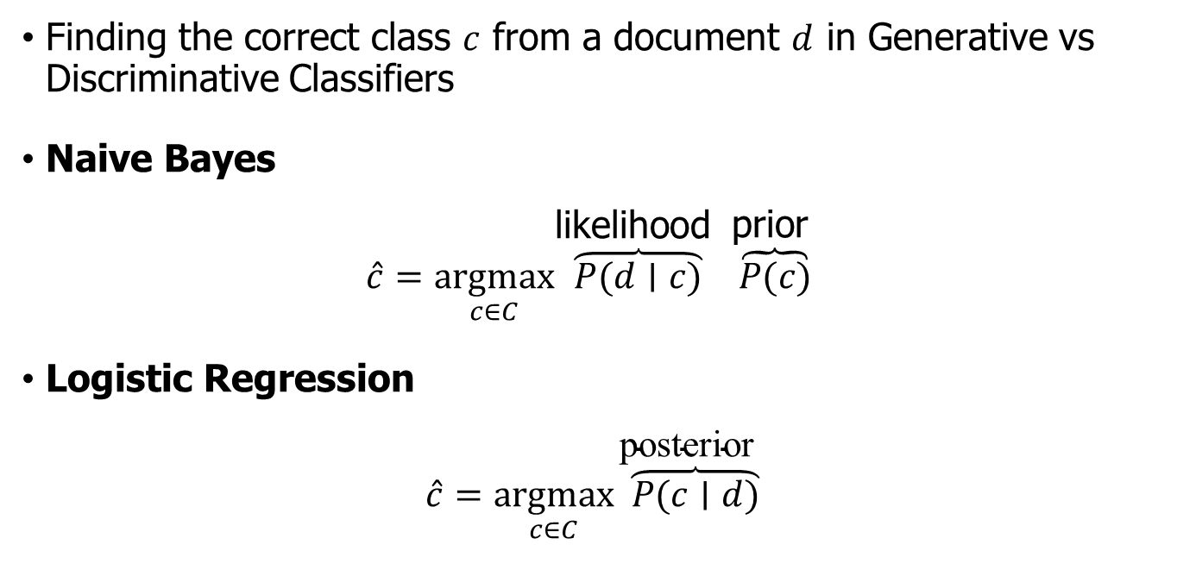
Difference
Finding the correct class $c$ from a document $d$ in Generative vs Discriminative Classifiers
Naive Bayes
$$\hat{c}=\underset{c∈C}{argmax}\overset{\text{likelihood} }{\overset{⏞}{P(d∣c)}} \overset{\text{prior} }{\overset{⏞}{P(c)}}$$
Logistic Regression
$$\hat{c}=\underset{c∈C}{argmax}\overset{\text{posterior}}{ \overset{⏞}{P(c∣d)}}$$

Slide 8
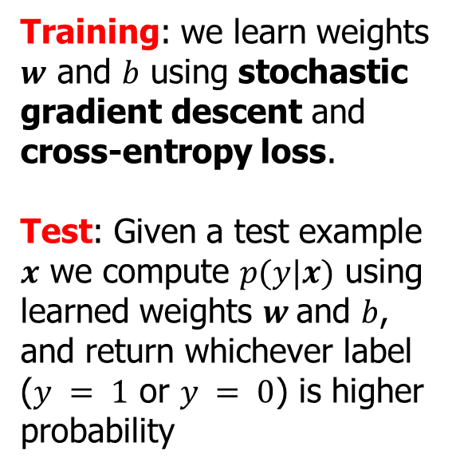
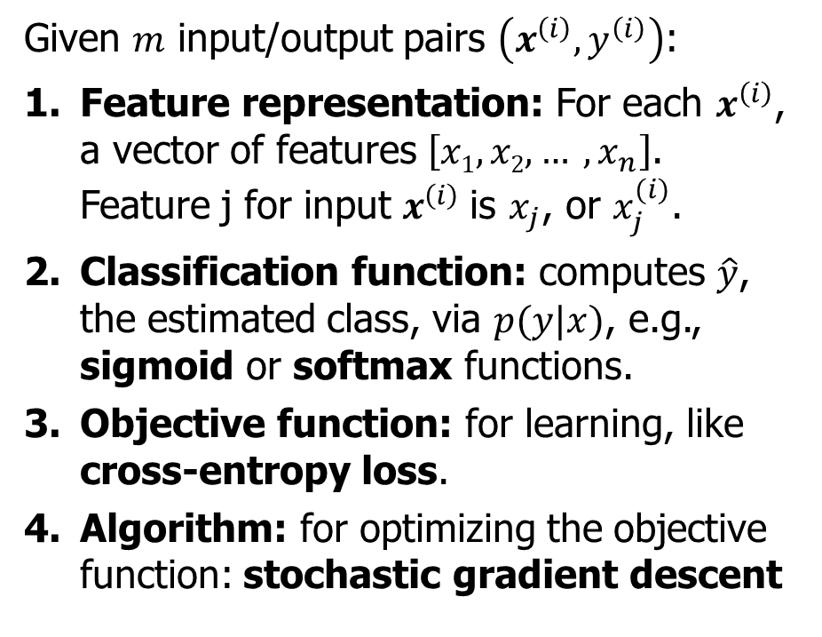
Building a probabilistic classifier
Given $m$ input/output pairs $\left(x^{\left(i\right)},y^{\left(i\right)}\right)$:
Feature representation: For each $x^{\left(i\right)}$, a vector of features $\left[x1, x2, … , x_{n}\right]$. Feature j for input $x^{\left(i\right)}$is $x_{j}$, or $x_{j}^{(i)}$.
Classification function: computes $\hat{y}$, the estimated class, via $p(y|x)$, e.g., sigmoid or softmax functions.
Objective function: for learning, like cross-entropy loss.
Algorithm: for optimizing the objective function: stochastic gradient descent
The two phases of logistic regression
Training: we learn weights $w$ and $b$ using stochastic gradient descent and cross-entropy loss.
Test: Given a test example $x$ we compute $p(y|x)$ using learned weights $w$and $b$, and return whichever label ($y = 1$ or $y = 0$) is higher probability

Slide 9
Outline
Two types of classifiers
Logistic Regression (LR)

Slide 10
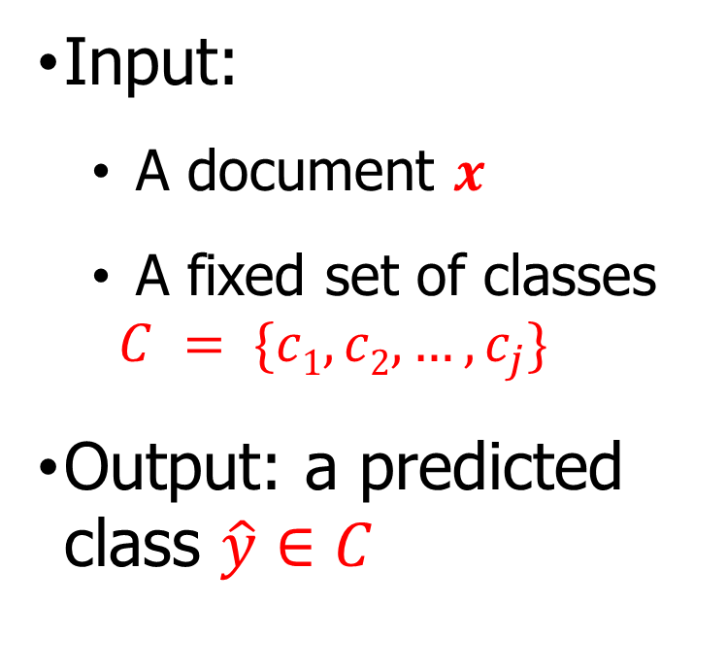
Text Classification: definition
Input:
A document $x$
A fixed set of classes $C = \{c1, c2,…, c_{j}\}$
Output: a predicted class $\hat{y}∈C$
Applications
Positive/negative sentiment
Spam/not spam
Authorship attribution (Hamilton or Madison?)

Slide 11
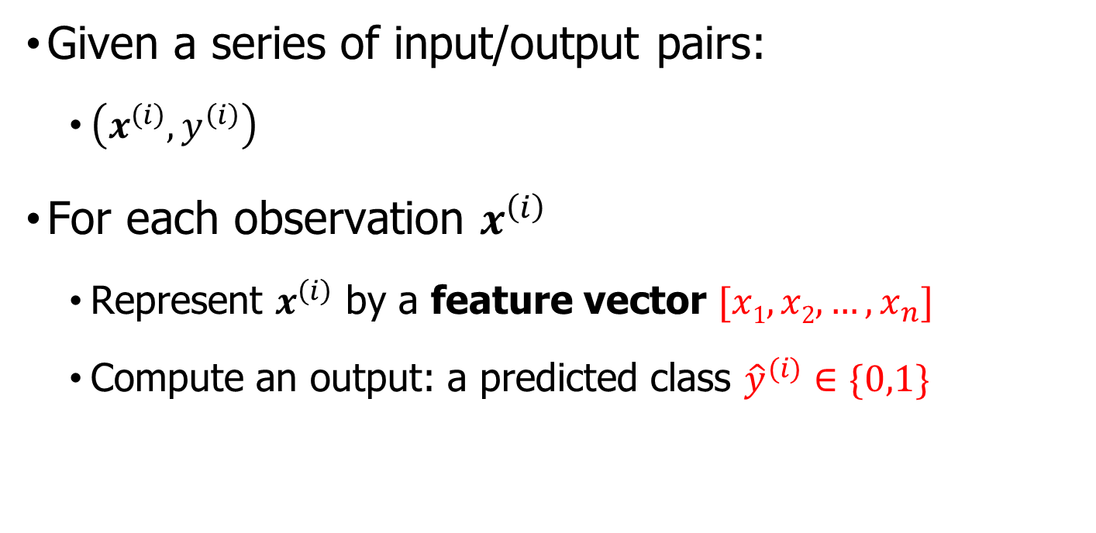
Binary Classification in LR
Given a series of input/output pairs:
$\left(x^{\left(i\right)},y^{\left(i\right)}\right)$
For each observation $x^{\left(i\right)}$
Represent $x^{\left(i\right)}$ by a feature vector $[x1, x2,…, x_{n}]$
Compute an output: a predicted class ${\hat{y}}^{(i)}∈\{0,1\}$

Slide 12
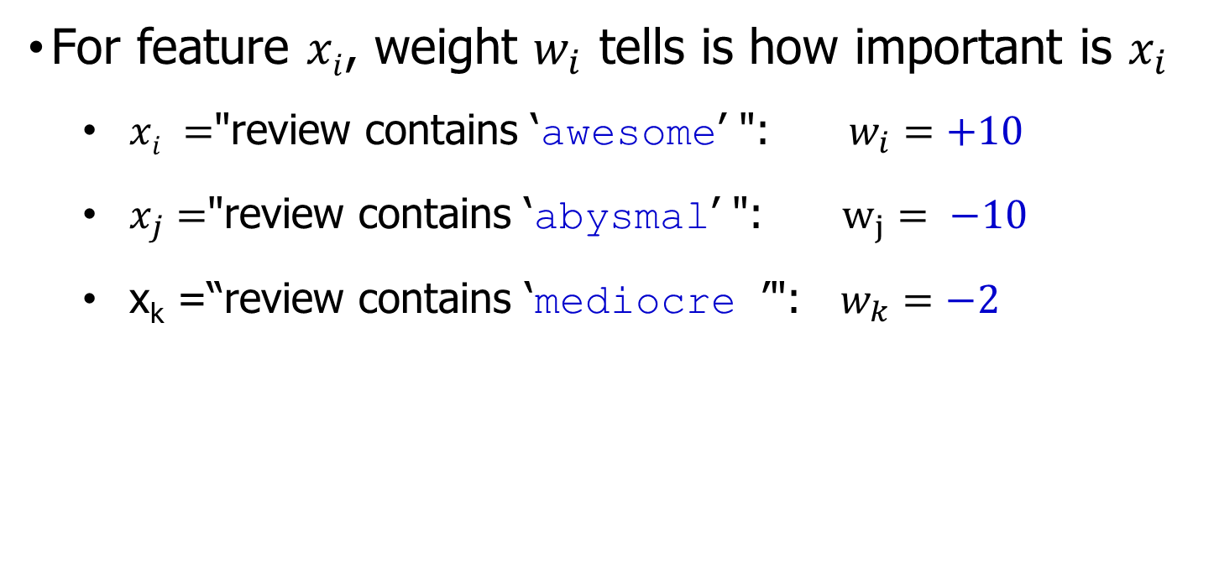
Features in logistic regression
For feature $xi$, weight $w_{i}$ tells is how important is $x_{i}$
$xi =$"review contains ‘awesome’ ": $w_{i}=+10$
$x_{j}=$"review contains ‘abysmal’ ": $w_{j}= −10$
x_{k} =“review contains ‘mediocre ’": $w_{k}=−2$

Slide 13
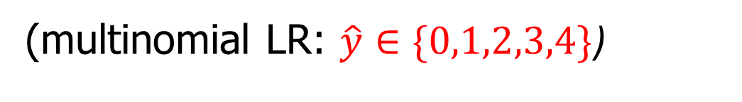
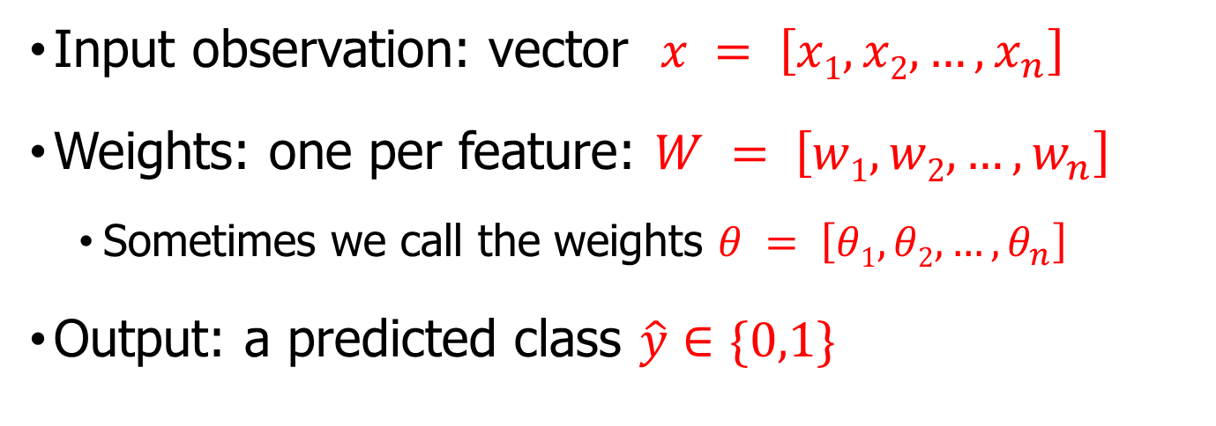
LR for one observation x
Input observation: vector $x = \left[x1, x2,…, x_{n}\right]$
Weights: one per feature: $W = \left[w1, w2,…, w_{n}\right]$
Sometimes we call the weights $θ = \left[θ1, θ2,…, θ_{n}\right]$
Output: a predicted class $\hat{y}∈\{0,1\}$
(multinomial LR: $\hat{y}∈\{0,1,2,3,4\}$)

Slide 14
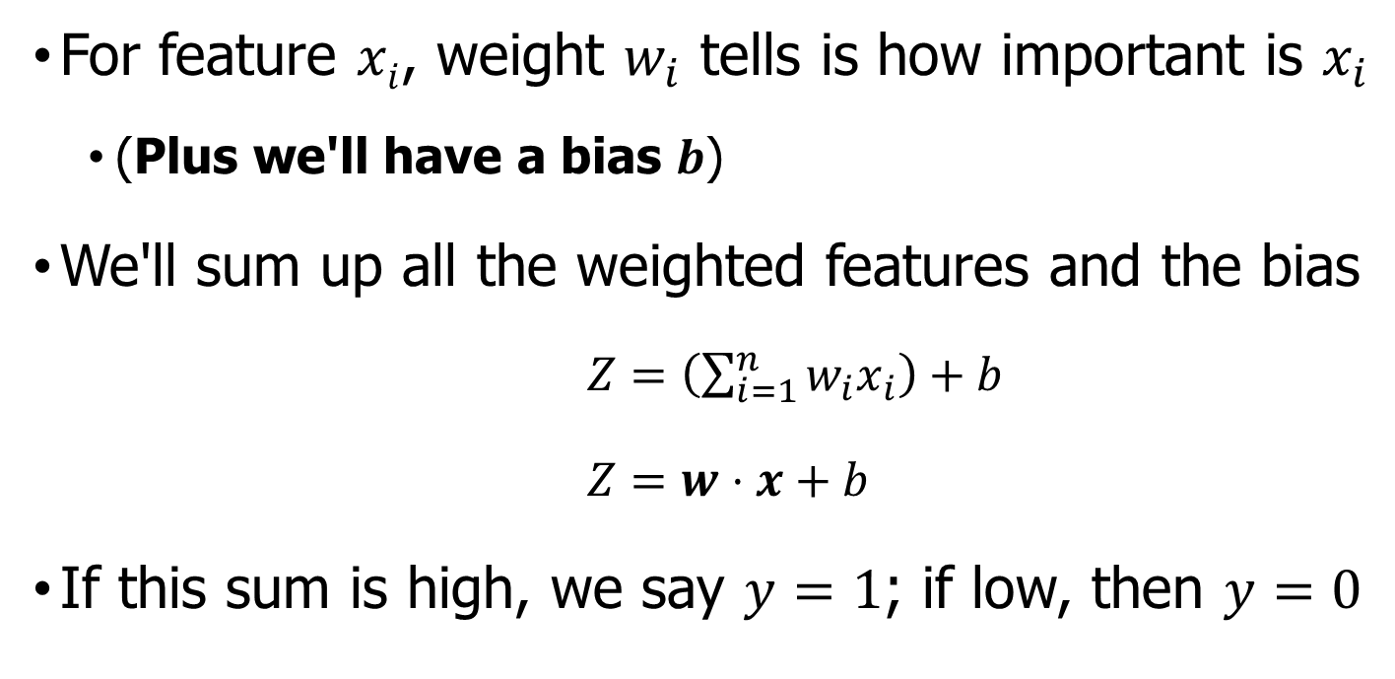
How to do classification
For feature $xi$, weight $w_{i}$ tells is how important is $x_{i}$
(Plus we'll have a bias $b$)
We'll sum up all the weighted features and the bias
$Z=\left(\sum_{i=1}^{n}{w_{i}x_{i}}\right)+b$
$Z=w⋅x+b$
If this sum is high, we say $y=1$; if low, then $y=0$

Slide 15
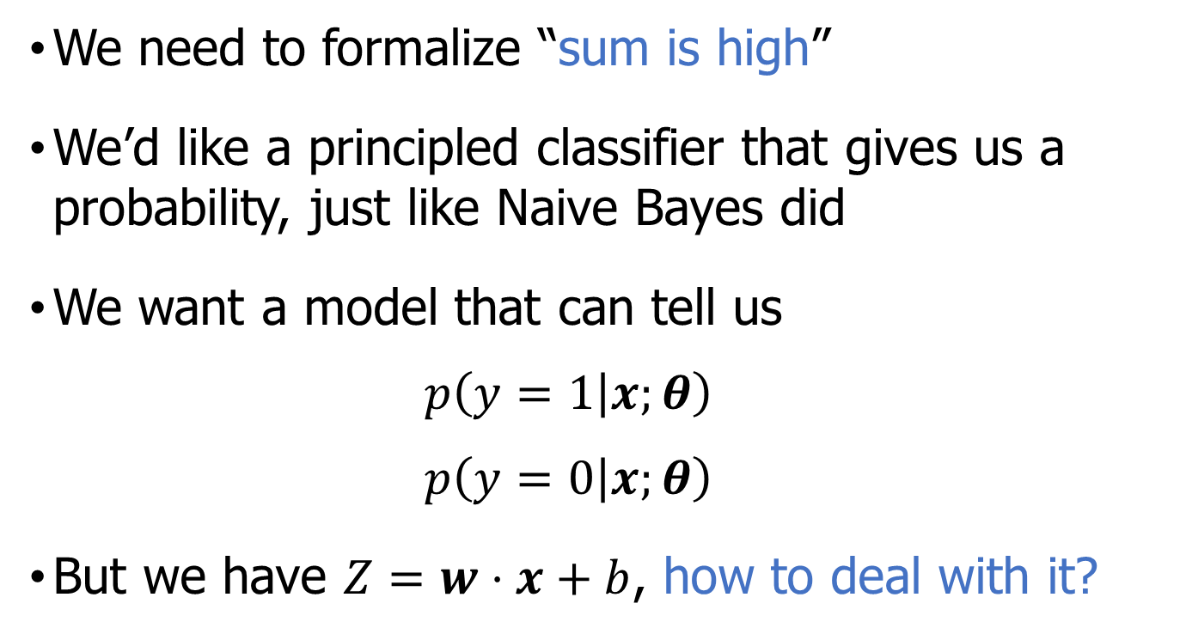
But we want a probabilistic classifier
We need to formalize “sum is high”
We’d like a principled classifier that gives us a probability, just like Naive Bayes did
We want a model that can tell us
$$p\left(y=1 | x;θ\right)$$
$$p\left(y=0 | x;θ\right)$$
But we have $Z=w⋅x+b$, how to deal with it?

Slide 16
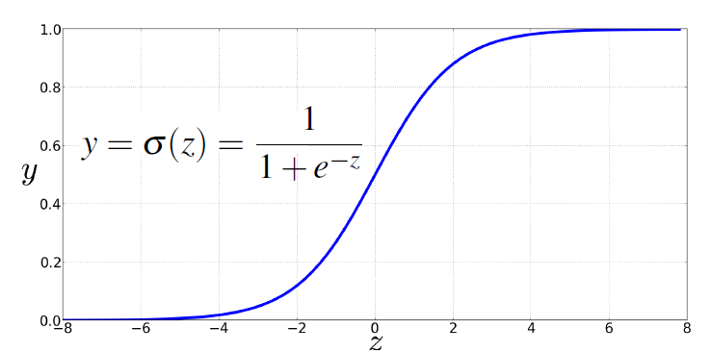
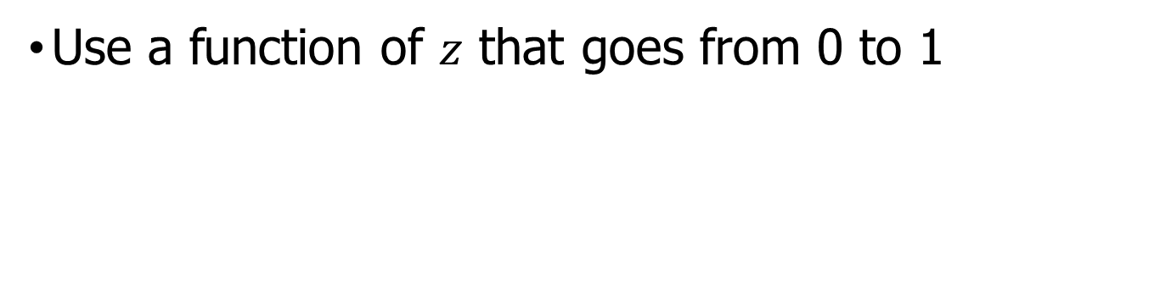

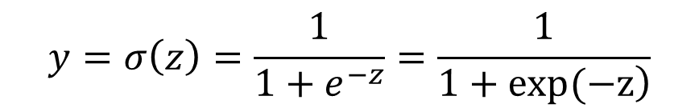

Solution: sigmoid
Use a function of $z$ that goes from 0 to 1
$$z=w⋅x+b$$
The sigmoid function transforms $z$ to a value between 0 and 1, making it useful for standardizing the output range of arbitrary input values and interpreting them as probabilities.
$$y=σ\left(z\right)=\frac{1}{1+e^{−z}}=\frac{1}{\left.1+exp(−z\right)}$$

Slide 17
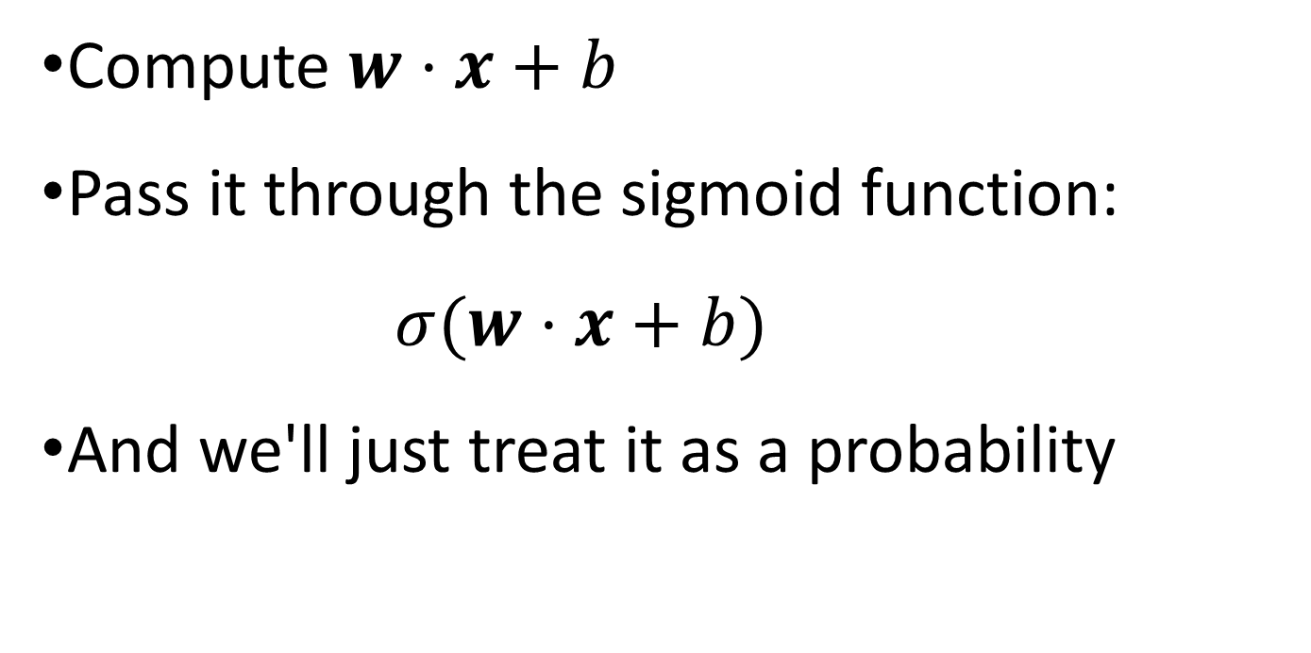
Idea of LR
Compute $w⋅x+b$
Pass it through the sigmoid function:
$σ(w⋅x+b)$
And we'll just treat it as a probability

Slide 18
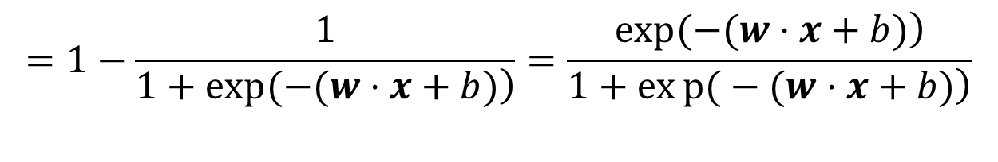
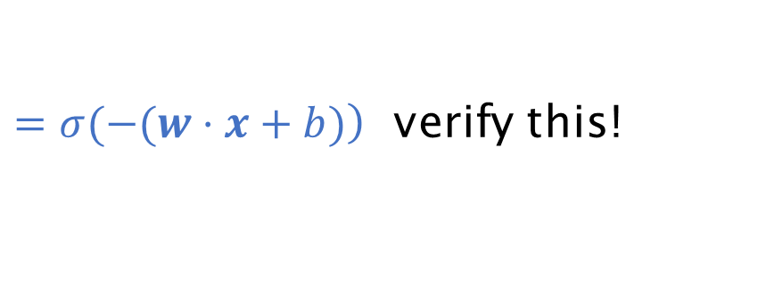

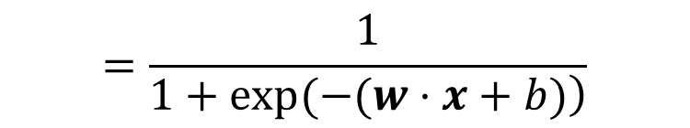

Making probabilities with sigmoids
$$P(y=1)=σ(w⋅x+b$$
$$=\frac{1}{\left.1+exp(−(w⋅x+b)\right)}$$
$$P(y=0)=1−σ\left(w⋅x+b\right)$$
$$=1−\frac{1}{\left.1+exp(−(w⋅x+b)\right)}=\frac{\left.exp(−(w⋅x+b)\right)}{\left.1+exp{(}−(w⋅x+b)\right)}$$
$\left.=σ(−(w⋅x+b)\right)$ verify this!

Slide 19
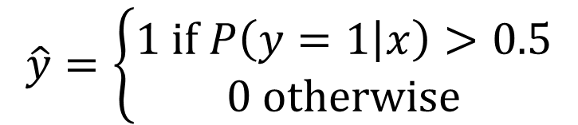



Turning a probability into a classifier
$$\hat{y}=\left\{\begin{aligned}1 if P\left(y=1 | x\right)>0.5 \\ 0 otherwise\end{aligned}\right.$$
0.5 here is called the decision boundary
$$P(y=1)$$
$$w⋅x+b$$
$$w⋅x+b>0?$$

Slide 20
Outline
Two types of classifiers
Logistic Regression (LR)
LR for sentiment classification

Slide 21

Sentiment example: $y=1$ or $y=0$?
Given the following movie review text
It's hokey. There are virtually no surprises, and the writing is second-rate. So why was it so enjoyable? For one thing , the cast is great. Another nice touch is the music. I was overcome with the urge to get off the couch and start dancing. It sucked me in, and it'll do the same to you.

Slide 22
LR: Working example
It's hokey . There are virtually no surprises , and the writing is second-rate .So why was it so enjoyable ? For one thing , the cast is great . Another nice touch is the music . I was overcome with the urge to get off the couch and start dancing . It sucked me in , and it'll do the same to you .
What about ! Or how many words in this review?

Slide 23

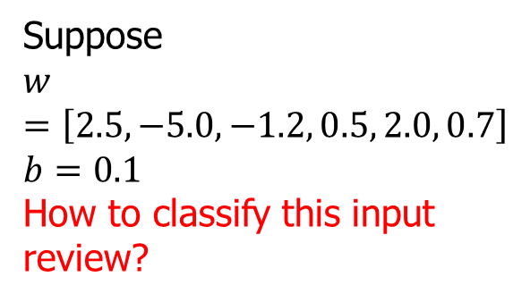
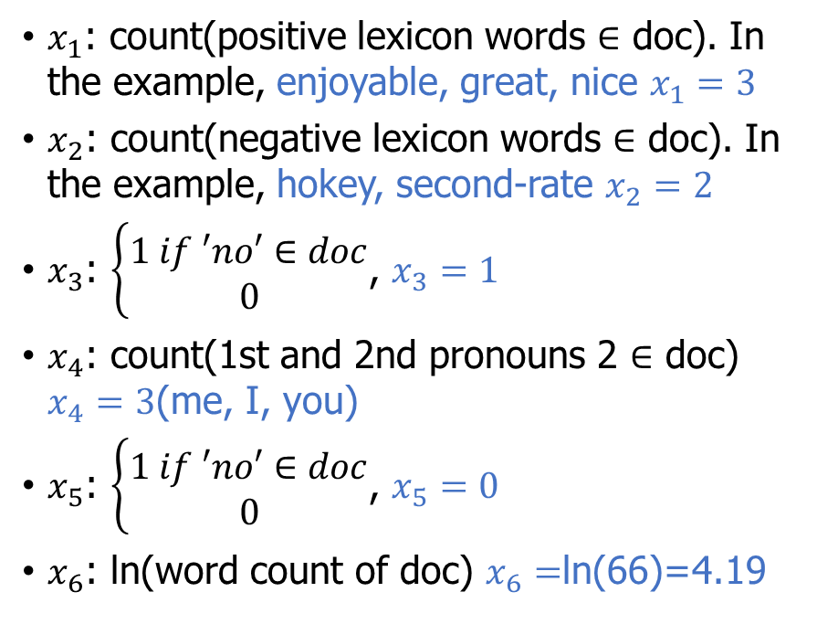
Classifying sentiment for input $x$
$x_{1}$: count(positive lexicon words $∈$ doc). In the example, enjoyable, great, nice $x_{1}=3$
$x_{2}$: count(negative lexicon words $∈$ doc). In the example, hokey, second-rate $x_{2}=2$
$x_{3}$: $\left\{\begin{aligned}1 if ′no′∈doc \\ 0\end{aligned}\right.$, $x_{3}=1$
$x_{4}$: count(1st and 2nd pronouns 2 $∈$ doc) $x_{4}=3$(me, I, you)
$x_{5}$: $\left\{\begin{aligned}1 if ′no′∈doc \\ 0\end{aligned}\right.$, $x_{5}=0$
$x_{6}$: ln(word count of doc) $x_{6}=$ln(66)=4.19
Suppose
$$w =\left[2.5,−5.0,−1.2, 0.5, 2.0, 0.7\right]$$
$$b=0.1$$
How to classify this input review?

Slide 24
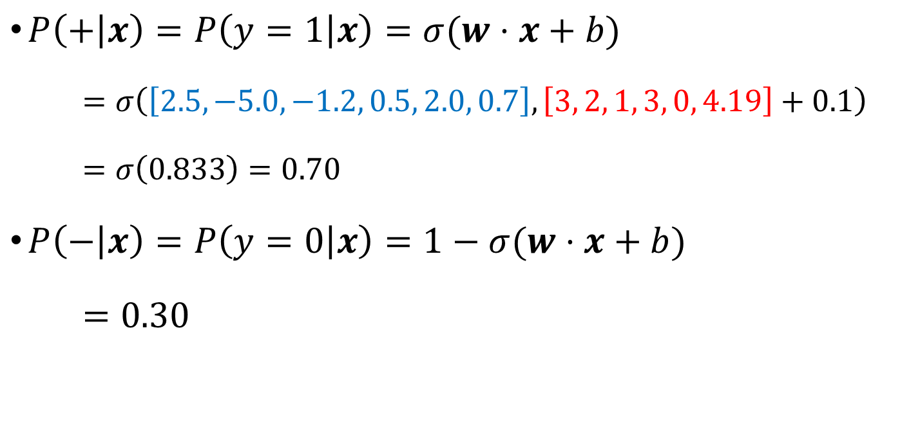
Classifying sentiment for input x
$P\left(+ | x\right)=P\left(y=1 | x\right)=σ(w⋅x+b)$
$=σ\left(\left[2.5,−5.0,−1.2, 0.5, 2.0, 0.7\right],\left[3, 2, 1, 3, 0, 4.19\right]+0.1\right)$
$=σ\left(0.833\right)=0.70$
$P\left(− | x\right)=P\left(y=0 | x\right)=1−σ(w⋅x+b)$
$=0.30$

Slide 25
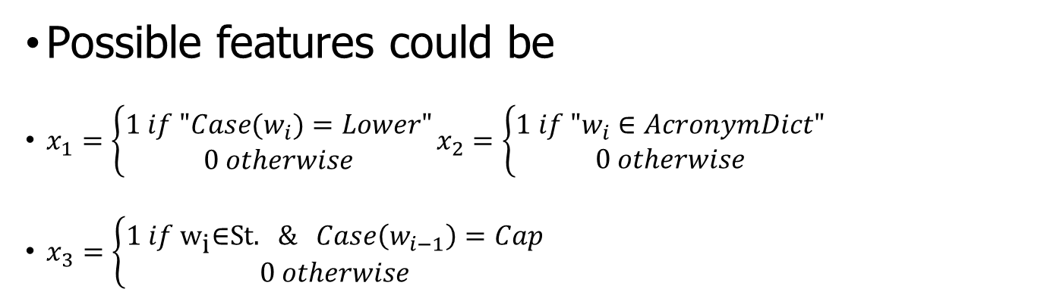
LR for period disambiguation
End of sentence
This ends in a period.
The house at 465 Main St. is new.
Not end
Possible features could be
$x_{1}=\left\{\begin{aligned}1 if "Case(w_{i})=Lower" \\ 0 otherwise\end{aligned}\right.x_{2}=\left\{\begin{aligned}1 if "w_{i}∈AcronymDict" \\ 0 otherwise\end{aligned}\right.$
$x_{3}=\left\{\begin{aligned}1 if {\text{w}}_{\text{i}}\text{∈}\text{S}\text{t}\text{.} && Case\left(w_{i−1}\right)=Cap \\ 0 otherwise\end{aligned}\right.$

Slide 26
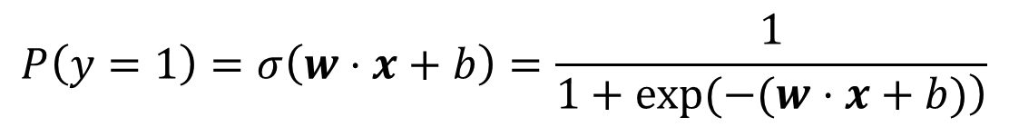
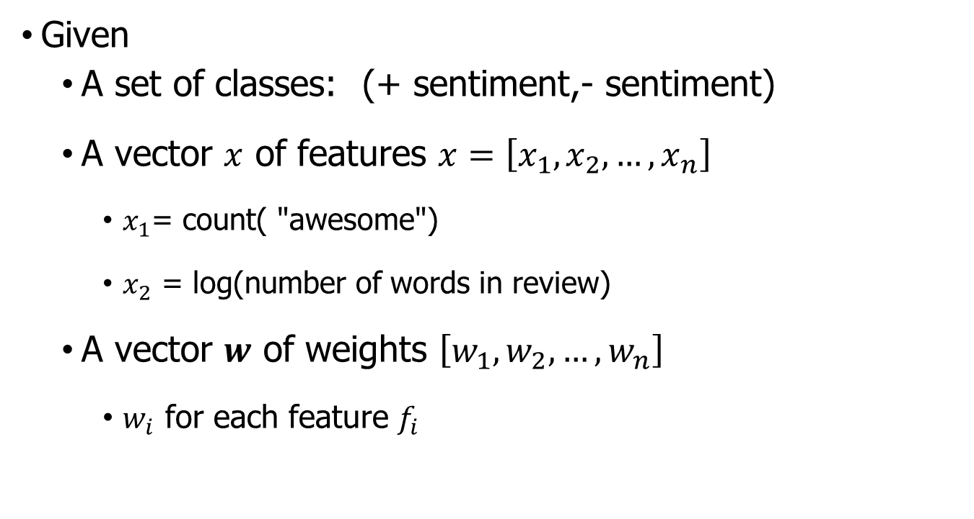
Classification in binary LR: summary
Given
A set of classes: (+ sentiment,- sentiment)
A vector $x$ of features $x=\left[x_{1},x_{2},…, x_{n}\right]$
$x_{1}$= count( "awesome")
$x_{2}$ = log(number of words in review)
A vector $w$ of weights $\left[w_{1},w_{2},…, w_{n}\right]$
$w_{i}$ for each feature $f_{i}$
$$P\left(y=1\right)=σ\left(w⋅x+b\right)=\frac{1}{\left.1+exp(−(w⋅x+b)\right)}$$

Slide 27
Outline
Two types of classifiers
Logistic Regression (LR)
LR for sentiment classification
Learning: cross-Entropy Loss

Slide 28

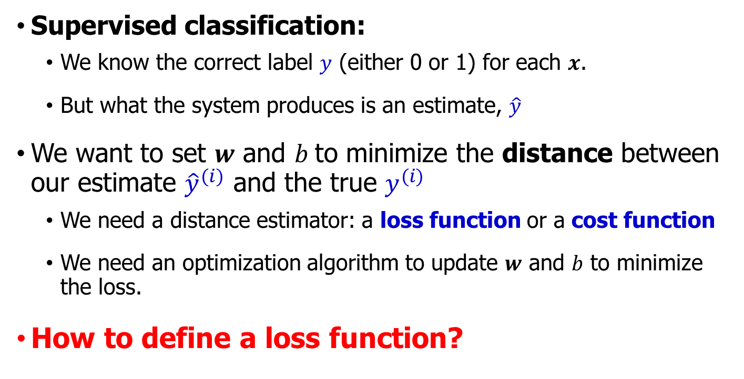
Where did the $w$’s come from?
Supervised classification:
We know the correct label $y$ (either 0 or 1) for each $x$.
But what the system produces is an estimate, $\hat{y}$
We want to set $w$ and $b$to minimize the distance between our estimate ${\hat{y}}^{(i)}$ and the true $y^{(i)}$
We need a distance estimator: a loss function or a cost function
We need an optimization algorithm to update $w$ and $b$ to minimize the loss.
How to define a loss function?

Slide 29

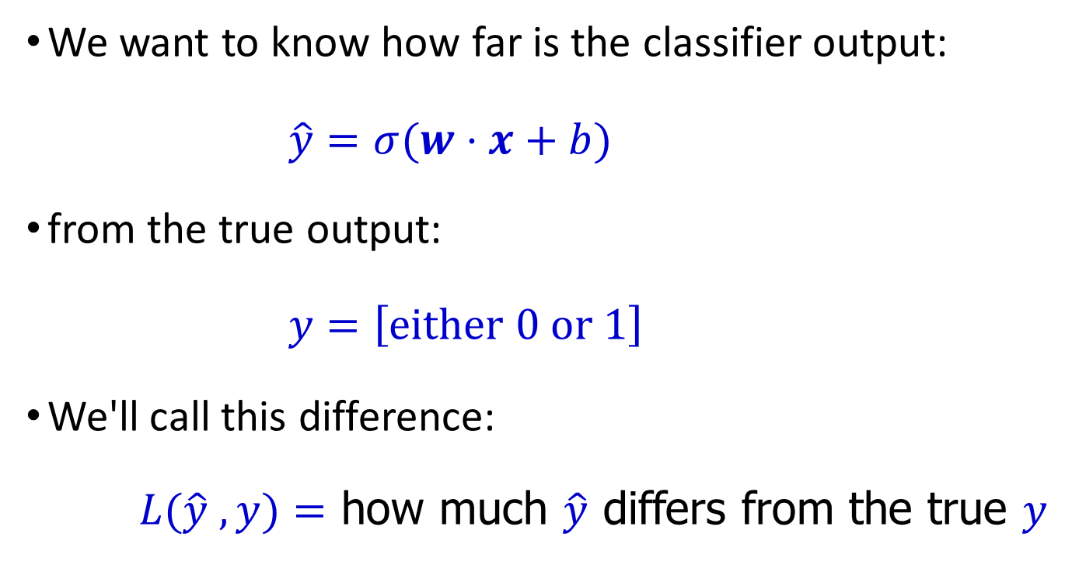
The distance between $\hat{y}$and $y$
We want to know how far is the classifier output:
$\hat{y}=σ(w⋅x+b)$
from the true output:
$y=\left[either 0 or 1\right]$
We'll call this difference:
$L(\hat{y} ,y)=$ how much $\hat{y}$ differs from the true $y$

Slide 30

Intuition of negative log likelihood loss = cross-entropy loss
A case of conditional maximum likelihood estimation
We choose the parameters $w,b$ that maximize
the log probability of the true y labels in the training data given the observations x

Slide 31
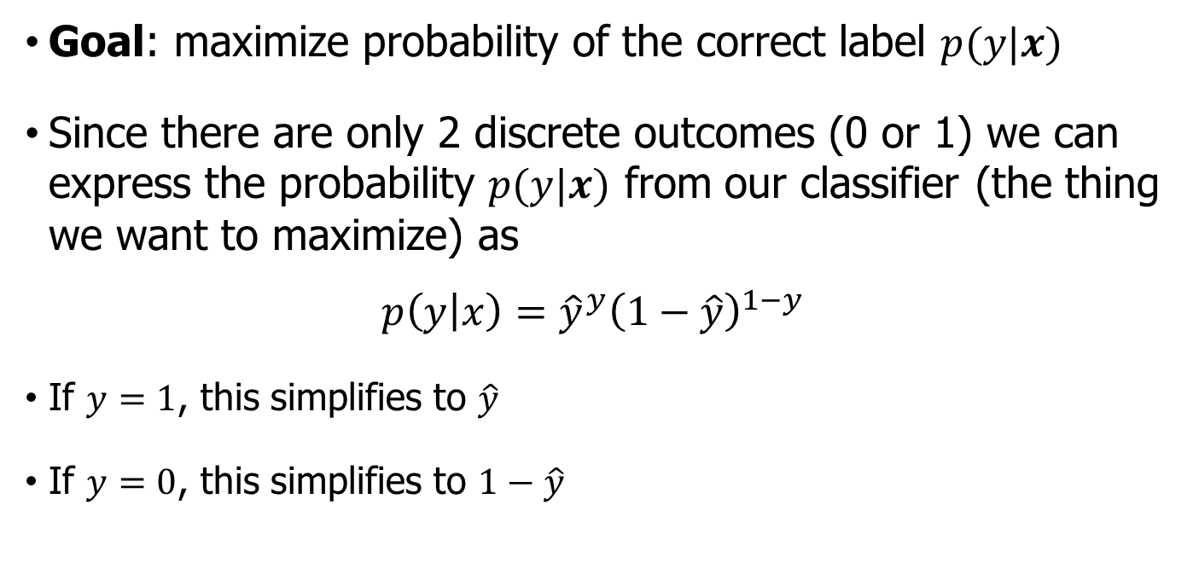
Deriving cross-entropy loss for a single $x$
Goal: maximize probability of the correct label $p(y|x)$
Since there are only 2 discrete outcomes (0 or 1) we can express the probability $p(y|x)$ from our classifier (the thing we want to maximize) as
$$p\left(y | x\right)={\hat{y}}^{y}{\left(1−\hat{y}\right)}^{1−y}$$
If $y=1$, this simplifies to $\hat{y}$
If $y=0$, this simplifies to $1−\hat{y}$

Slide 32
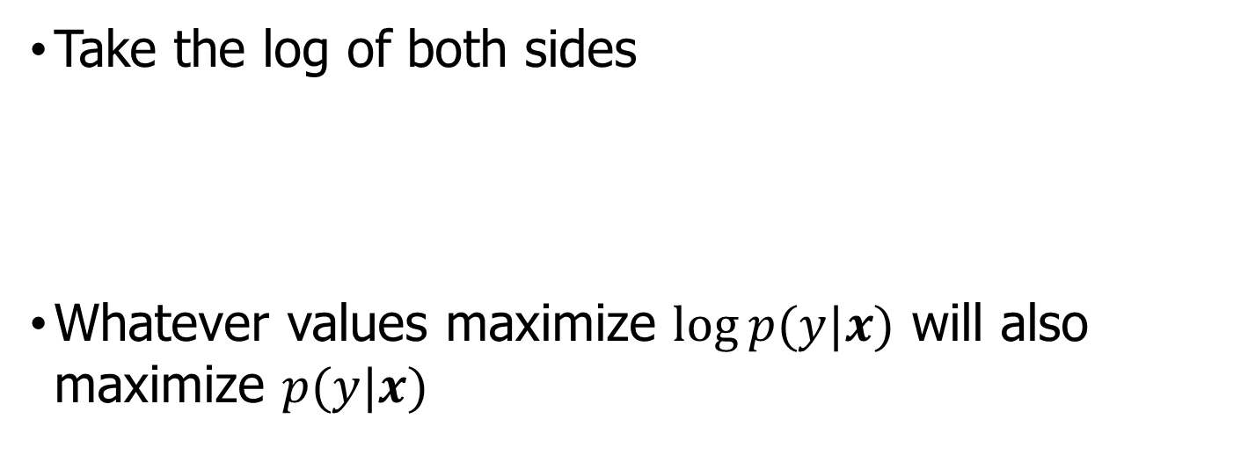

Deriving CE loss for a single $x$
Goal: maximize probability of the correct label $p(y|x)$
Maximize:
$$p\left(y | x\right)={\hat{y}}^{y}{\left(1−\hat{y}\right)}^{1−y}$$
Take the log of both sides
Whatever values maximize $\log{p(y|x)}$ will also maximize $p(y|x)$
Maximize:
$$\log{p\left(y | x\right)}=y\log{\hat{y}}+\left(1−y\right)\log\left(1−\hat{y}\right)$$

Slide 33
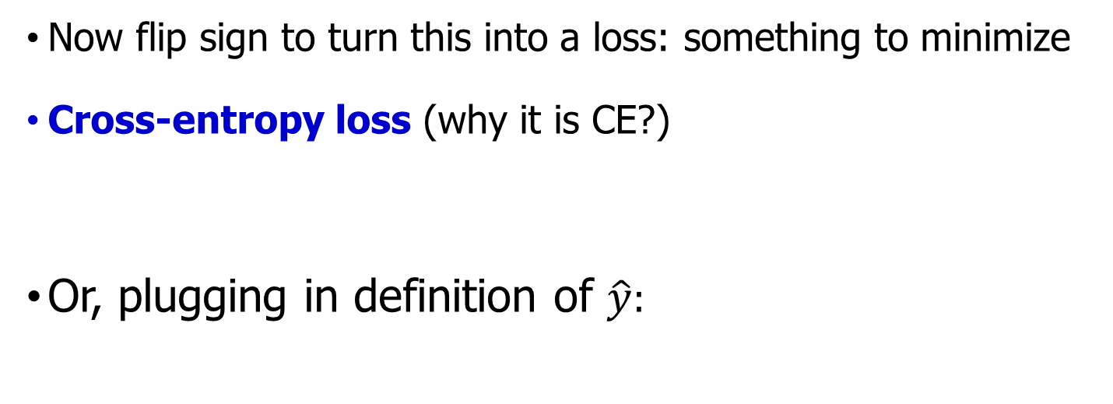
Deriving CE loss for a single $x$
Goal: maximize probability of the correct label $p(y|x)$
Maximize:
$$\log{p\left(y | x\right)}=y\log{\hat{y}}+\left(1−y\right)\log\left(1−\hat{y}\right)$$
Now flip sign to turn this into a loss: something to minimize
Cross-entropy loss (why it is CE?)
Or, plugging in definition of $\hat{y}:$
Minimize:
$$L_{CE}\left(\hat{y},y\right)=−[y\log{\hat{y}}+\left(1−y\right)\log\left(1−\hat{y}\right)]$$
$$L_{CE}\left(\hat{y},y\right)=−[y\log{σ(w⋅x+b)}+\left(1−y\right)\log\left(1−σ(w⋅x+b)\right)]$$

Slide 34

Check for our sentiment example
We want loss to be
smaller if the model estimate is close to correct
bigger if model is confused
Let's first suppose the true label of this is $y=1$ (positive)
It's hokey . There are virtually no surprises , and the writing is second-rate . So why was it so enjoyable ? For one thing , the cast is great . Another nice touch is the music . I was overcome with the urge to get off the couch and start dancing . It sucked me in , and it'll do the same to you .

Slide 35
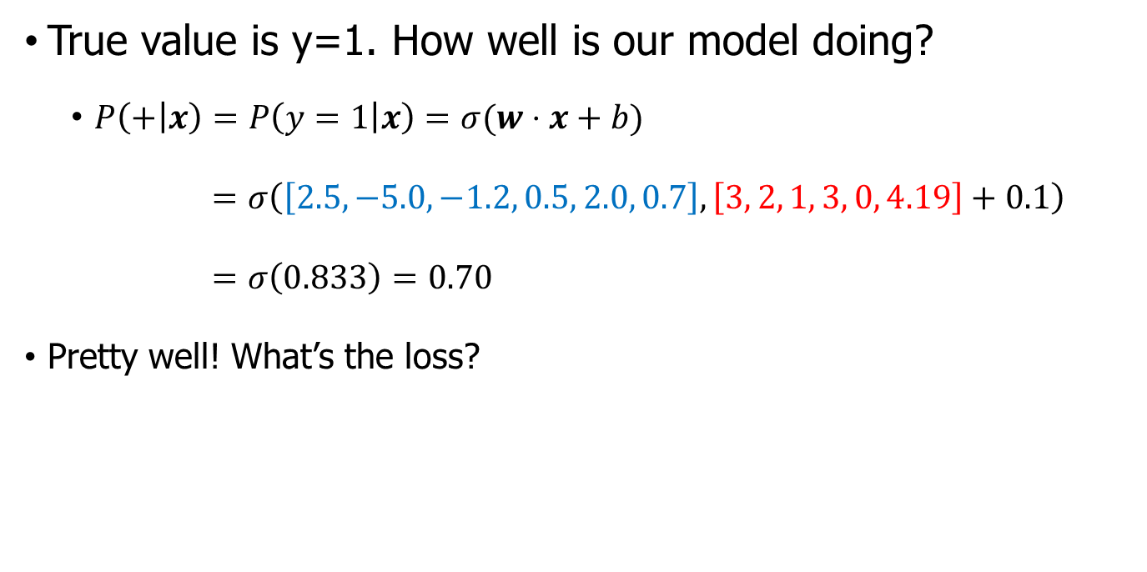
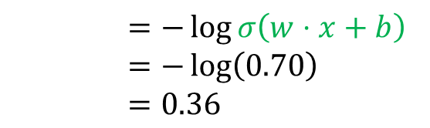
Check for our sentiment example
True value is y=1. How well is our model doing?
$P\left(+ | x\right)=P\left(y=1 | x\right)=σ(w⋅x+b)$
$=σ\left(\left[2.5,−5.0,−1.2, 0.5, 2.0, 0.7\right],\left[3, 2, 1, 3, 0, 4.19\right]+0.1\right)$
$=σ\left(0.833\right)=0.70$
Pretty well! What’s the loss?
$$L_{CE}\left(\hat{y},y\right)=−[y\log{σ(w⋅x+b)}+\left(1−y\right)\log\left(1−σ(w⋅x+b)\right)]$$
$=−\log{σ\left(w⋅x+b\right)}$
$=−\log\left(0.70\right)$
$=0.36$

Slide 36
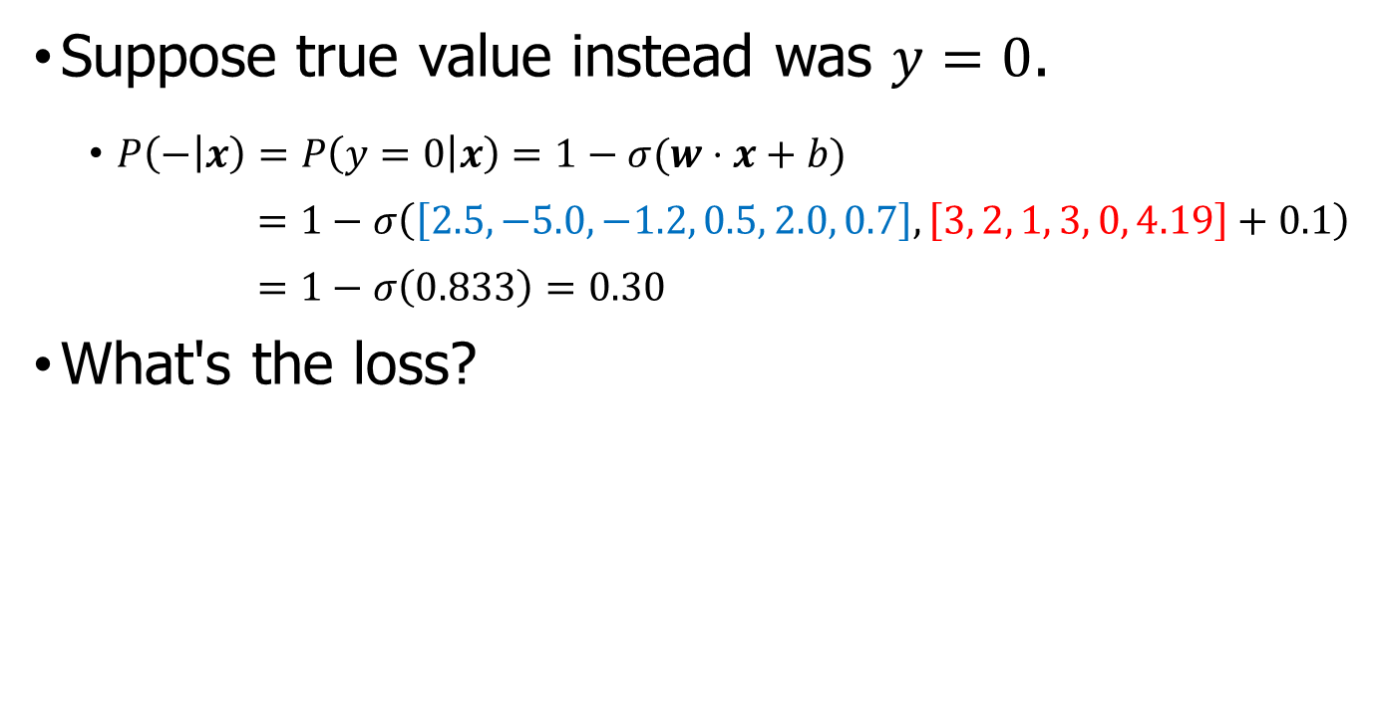
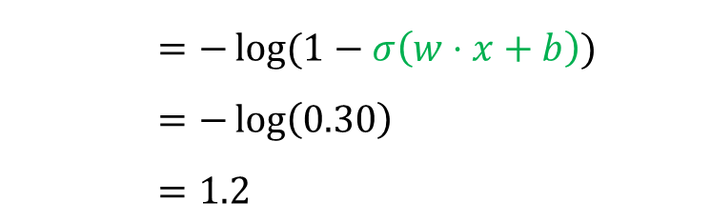
Check for our sentiment example
Suppose true value instead was $y=0$.
$P\left(− | x\right)=P\left(y=0 | x\right)=1−σ(w⋅x+b)$
$=1−σ\left(\left[2.5,−5.0,−1.2, 0.5, 2.0, 0.7\right],\left[3, 2, 1, 3, 0, 4.19\right]+0.1\right)$
$=1−σ\left(0.833\right)=0.30$
What's the loss?
$$L_{CE}\left(\hat{y},y\right)=−[y\log{σ(w⋅x+b)}+\left(1−y\right)\log\left(1−σ(w⋅x+b)\right)]$$
$=−\log{(1−σ\left(w⋅x+b\right))}$
$=−\log\left(0.30\right)$
$=1.2$

Slide 37

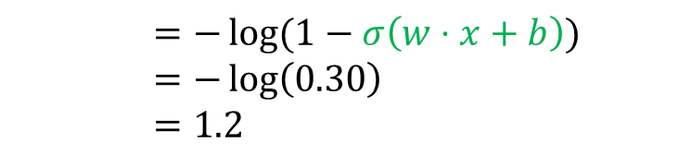
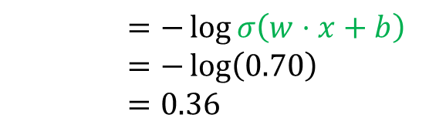
Let's see if this works for our sentiment example
The loss when model was right (if true $y=1$)
Is lower than the loss when model was wrong (if true $y=0$):
Sure enough, loss was bigger when model was wrong!
$$L_{CE}\left(\hat{y},y\right)=−[y\log{σ(w⋅x+b)}+\left(1−y\right)\log\left(1−σ(w⋅x+b)\right)]$$
$=−\log{σ\left(w⋅x+b\right)}$
$=−\log\left(0.70\right)$
$=0.36$
$$L_{CE}\left(\hat{y},y\right)=−[y\log{σ(w⋅x+b)}+\left(1−y\right)\log\left(1−σ(w⋅x+b)\right)]$$
$=−\log{(1−σ\left(w⋅x+b\right))}$
$=−\log\left(0.30\right)$
$=1.2$

Slide 38
Outline
Two types of classifiers
Logistic Regression (LR)
LR for sentiment classification
Learning: cross-Entropy Loss
Optimization: Gradient Descent(GD)

Slide 39
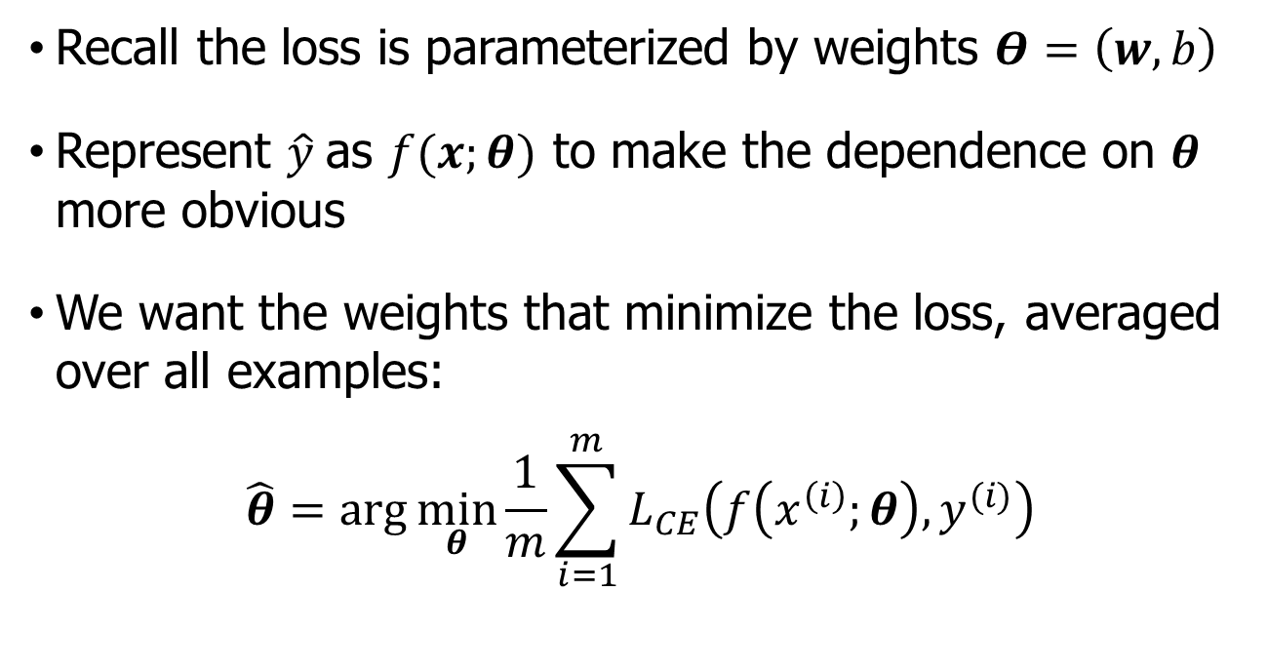
Our goal: minimize the loss
Recall the loss is parameterized by weights $Θ=\left(w,b\right)$
Represent $\hat{y}$as $f(x;θ)$ to make the dependence on $θ$ more obvious
We want the weights that minimize the loss, averaged over all examples:
$$\hat{θ}=\arg{\min_{θ}{\frac{1}{m}\sum_{i=1}^{m}{L_{CE}\left(f\left(x^{\left(i\right)};θ\right),y^{(i)}\right)}}}$$

Slide 40


Intuition of gradient descent
How do I get to the bottom of this river canyon?
Look around me 360∘
Find the direction of steepest slope down
Go that way
$$x$$

Slide 41
Our goal: minimize the loss
For logistic regression, loss function is convex
A convex function has just one minimum
Gradient descent starting from any point is guaranteed to find the minimum
(Loss for neural networks is non-convex)

Slide 42
Let's first visualize for a single scalar $w$
Q: Given current $w$, should we make it bigger or smaller?
A: Move $w$ in the reverse direction from the slope of the function

Slide 43
Let's first visualize for a single scalar w
Q: Given current w, should we make it bigger or smaller?
A: Move w in the reverse direction from the slope of the function
So we'll move positive

Slide 44
Let's first visualize for a single scalar w
Q: Given current w, should we make it bigger or smaller?
A: Move w in the reverse direction from the slope of the function
So we'll move positive

Slide 45
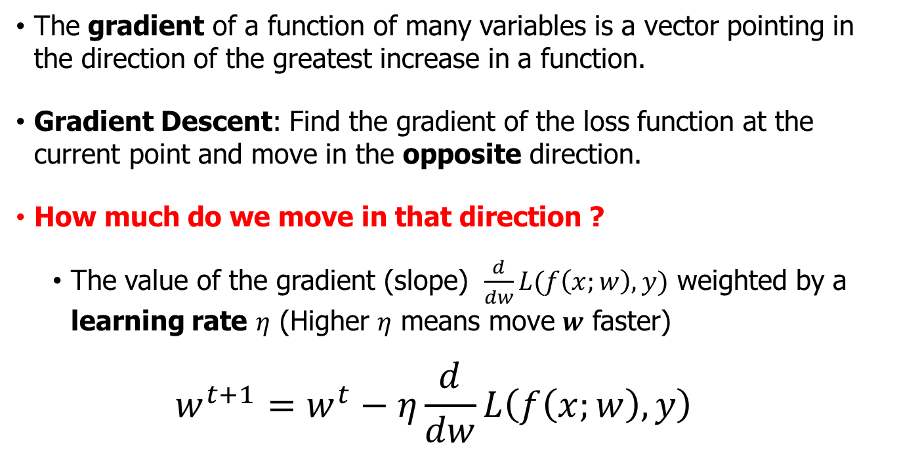
Gradients and gradient descent
The gradient of a function of many variables is a vector pointing in the direction of the greatest increase in a function.
Gradient Descent: Find the gradient of the loss function at the current point and move in the opposite direction.
How much do we move in that direction ?
The value of the gradient (slope) $\frac{d}{dw}L(f\left(x;w\right),y)$ weighted by a learning rate $η$ (Higher $η$ means move $w$ faster)
$$w^{t+1}=w^{t}−η\frac{d}{dw}L\left(f\left(x;w\right),y\right)$$

Slide 46
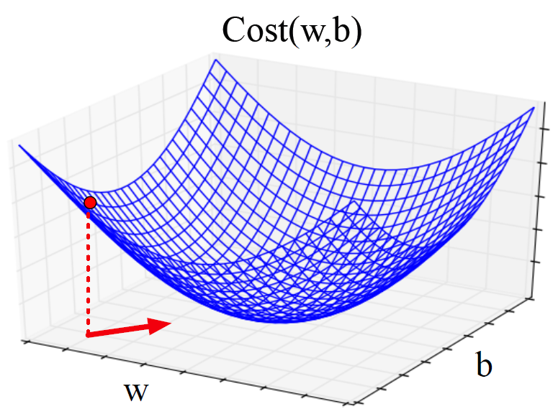

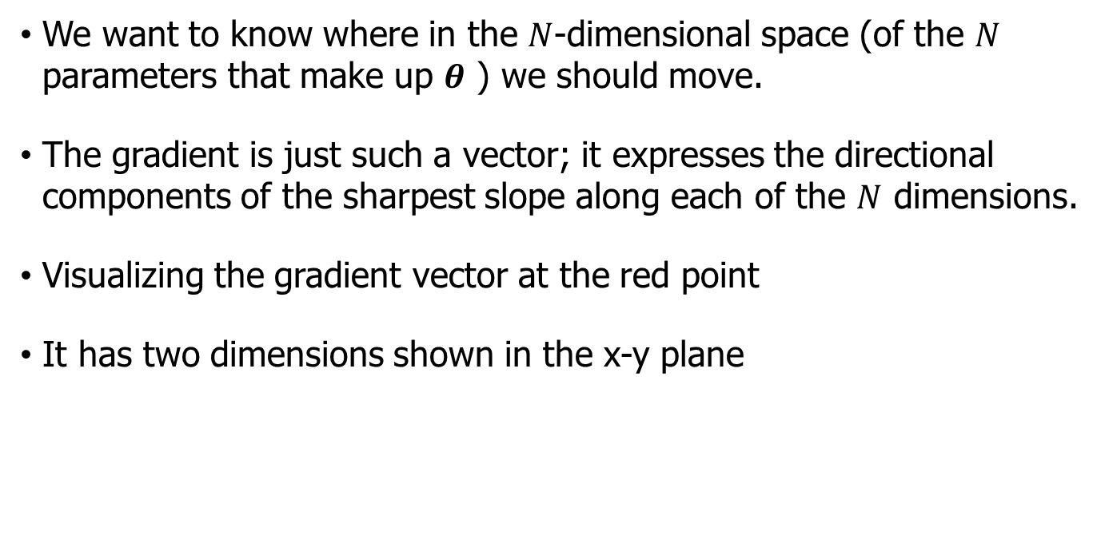
Consider $N$ dimensions
We want to know where in the $N$-dimensional space (of the $N$ parameters that make up $θ$ ) we should move.
The gradient is just such a vector; it expresses the directional components of the sharpest slope along each of the $N$ dimensions.
Visualizing the gradient vector at the red point
It has two dimensions shown in the x-y plane

Slide 47
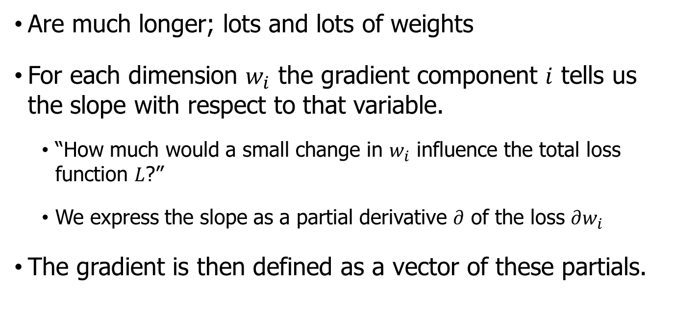
Gradients
Are much longer; lots and lots of weights
For each dimension $w_{i}$ the gradient component $i$ tells us the slope with respect to that variable.
“How much would a small change in $w_{i}$ influence the total loss function $L$?”
We express the slope as a partial derivative $∂$ of the loss $∂w_{i}$
The gradient is then defined as a vector of these partials.

Slide 48
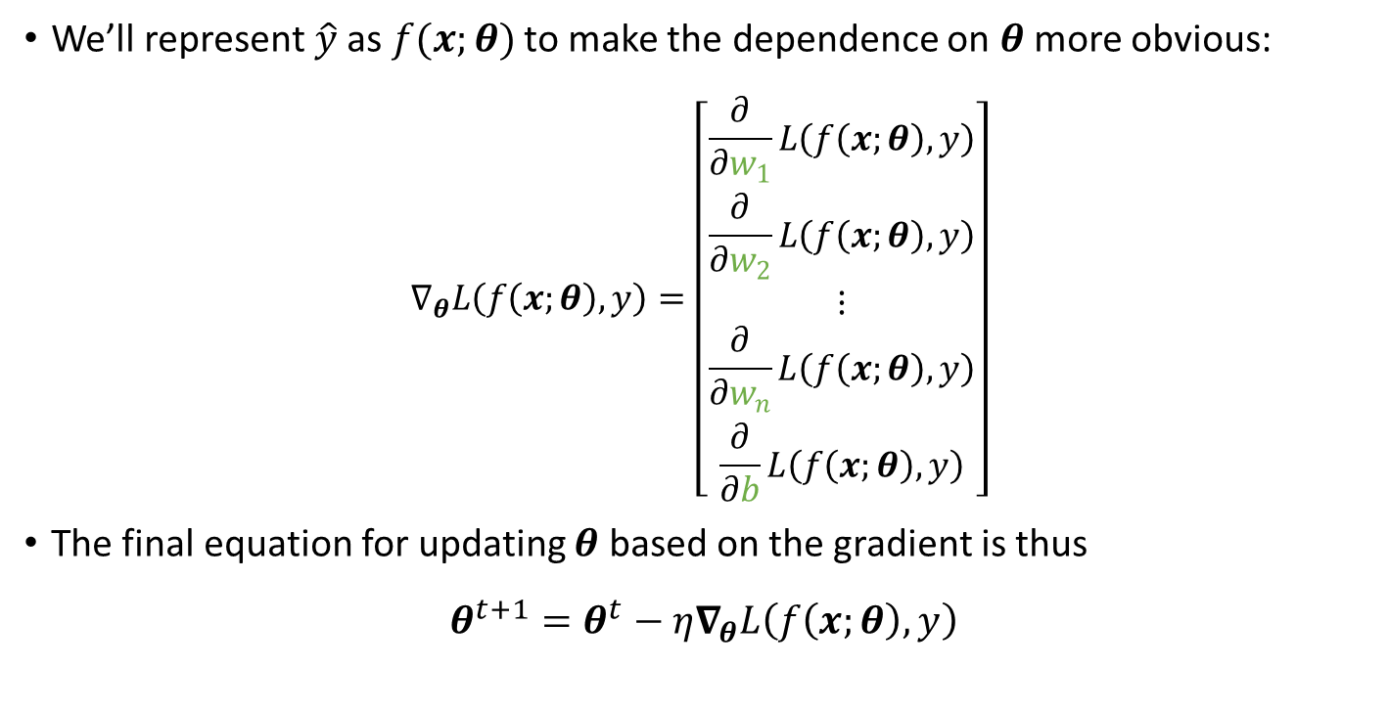
Gradients
We’ll represent $\hat{y}$as $f(x;θ)$ to make the dependence on $θ$ more obvious:
$$∇_{θ}L\left(f\left(x;θ\right),y\right)=\left[\begin{aligned}\begin{matrix}\frac{∂}{∂w_{1}}L\left(f\left(x;θ\right),y\right) \\ \frac{∂}{∂w_{2}}L\left(f\left(x;θ\right),y\right) \\ ⋮\end{matrix} \\ \frac{∂}{∂w_{n}}L\left(f\left(x;θ\right),y\right) \\ \frac{∂}{∂b}L\left(f\left(x;θ\right),y\right)\end{aligned}\right]$$
The final equation for updating $θ$ based on the gradient is thus
$θ^{t+1}=θ^{t}−η∇_{θ}L\left(f\left(x;θ\right),y\right)$

Slide 49
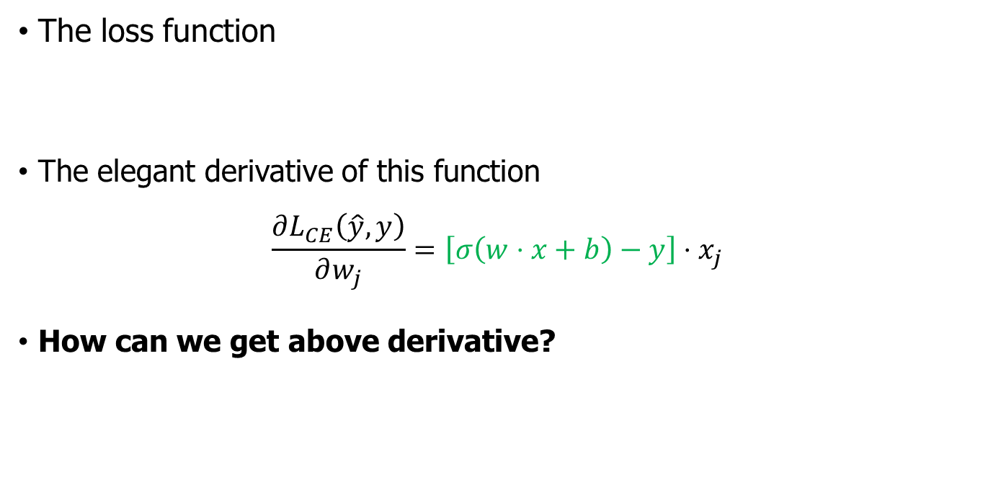
Partial derivatives for LR
The loss function
The elegant derivative of this function
$$\frac{∂L_{CE}\left(\hat{y},y\right)}{∂w_{j}}=\left[σ\left(w⋅x+b\right)−y\right]⋅x_{j}$$
How can we get above derivative?
$$L_{CE}\left(\hat{y},y\right)=−[y\log{σ(w⋅x+b)}+\left(1−y\right)\log\left(1−σ(w⋅x+b)\right)]$$

Slide 51
Hyperparameters
The learning rate η is a hyperparameter
too high: the learner will take big steps and overshoot
too low: the learner will take too long
Hyperparameters:
Briefly, a special kind of parameter for an ML model
Instead of being learned by algorithm from supervision (like regular parameters), they are chosen by algorithm designer.

Slide 52
Outline
Two types of classifiers
Logistic Regression (LR)
LR for sentiment classification
Learning: cross-Entropy Loss
Optimization: Gradient Descent (GD)
Optimization: Stochastic GD(SGD)

Slide 53
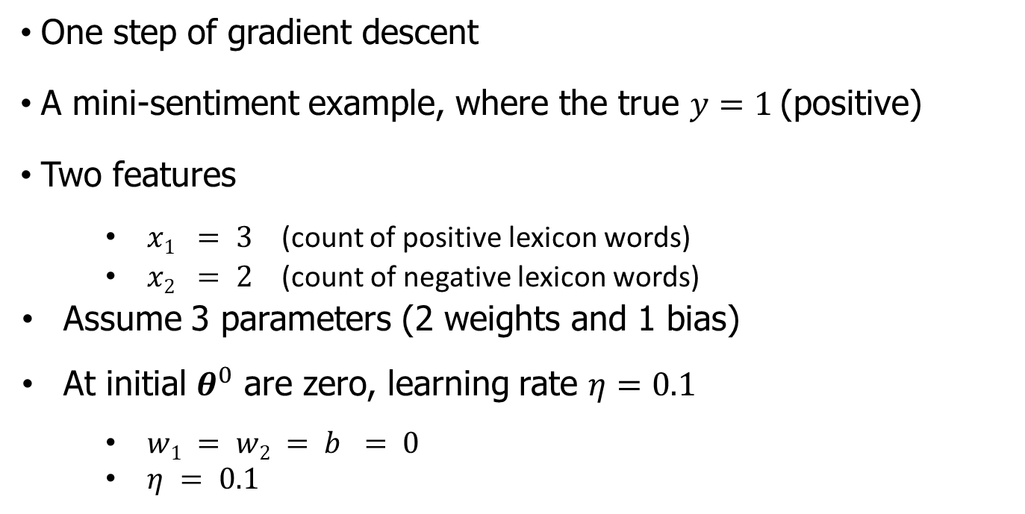
SGD: Working through an example
One step of gradient descent
A mini-sentiment example, where the true $y=1$(positive)
Two features
$x1 = 3$ (count of positive lexicon words)
$x2 = 2$ (count of negative lexicon words)
Assume 3 parameters (2 weights and 1 bias)
At initial $θ^{0}$ are zero, learning rate $η=0.1$
$w1 = w2 = b = 0$
$η = 0.1$

Slide 54
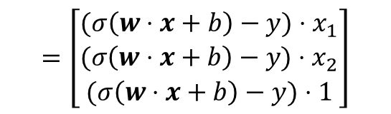







Example of gradient descent
$$w1=w2=b=0$$
$$x1=3; x2 =2$$
Update step for update $θ$ is:
where recall that
Gradient vector has 3 dimensions:
$θ^{t+1}=θ^{t}−η∇_{θ}L\left(f\left(x;θ\right),y\right)$
$$\frac{∂L\left(\hat{y},y\right)}{∂w_{j}}=\left[σ\left(w⋅x+b\right)−y\right]⋅x_{j}$$
$$∇_{θ}=∇_{w,b}=\left[\begin{matrix}\frac{∂L\left(\hat{y},y\right)}{∂w_{1}} \\ \frac{∂L\left(\hat{y},y\right)}{∂w_{2}} \\ \frac{∂L\left(\hat{y},y\right)}{∂b}\end{matrix}\right]$$
$$=\left[\begin{aligned}(σ\left(w⋅x+b\right)−y)⋅x_{1} \\ (σ\left(w⋅x+b\right)−y)⋅x_{2} \\ (σ\left(w⋅x+b\right)−y)⋅1\end{aligned}\right]$$
$$=\left[\begin{aligned}(σ\left(0\right)−1)⋅x_{1} \\ (σ\left(0\right)−1)⋅x_{2} \\ (σ\left(0\right)−1)⋅1\end{aligned}\right]$$
$$=\left[\begin{aligned}−0.5⋅x_{1} \\ −0.5⋅x_{2} \\ −0.5⋅1\end{aligned}\right]=\left[\begin{aligned}−1.5 \\ −1.0 \\ −0.5\end{aligned}\right]$$

Slide 55






Example of gradient descent
$$∇_{θ}=∇_{w,b}=\left[\begin{matrix}\frac{∂L\left(\hat{y},y\right)}{∂w_{1}} \\ \frac{∂L\left(\hat{y},y\right)}{∂w_{2}} \\ \frac{∂L\left(\hat{y},y\right)}{∂b}\end{matrix}\right]$$
$$=\left[\begin{aligned}−0.5⋅x_{1} \\ −0.5⋅x_{2} \\ −0.5⋅1\end{aligned}\right]=\left[\begin{aligned}−1.5 \\ −1.0 \\ −0.5\end{aligned}\right]$$
Now that we have a gradient, we compute the new parameter vector $θ1$ by moving $θ0$ in the opposite direction from the gradient:
$θ^{t+1}=θ^{t}−η∇_{θ}L\left(f\left(x;θ\right),y\right)$
$η = 0.1$ $w1=w2=b=0$
$$θ^{1}=θ^{0}−η∇_{θ}=\left[\begin{aligned}w_{1} \\ w_{2} \\ b\end{aligned}\right]−η\left[\begin{aligned}−1.5 \\ −1.0 \\ −0.5\end{aligned}\right]=\left[\begin{aligned}0 \\ 0 \\ 0\end{aligned}\right]−0.1\left[\begin{aligned}−1.5 \\ −1.0 \\ −0.5\end{aligned}\right]=\left[\begin{aligned}0.15 \\ 0.1 \\ 0.05\end{aligned}\right]$$
Enough negative examples would eventually make $w2$ negative

Slide 56

More practical: Mini-batch training
Stochastic gradient descent chooses a single random example at a time that can result in choppy movements
More common to compute gradient over batches of training instances.
Batch training: entire dataset
Mini-batch training: $m$ examples (512, or 1024), notice when $m=1$, we recover the SGD training.

Slide 57
Outline
Two types of classifiers
Logistic Regression (LR)
LR for sentiment classification
Learning: cross-Entropy Loss
Optimization: Gradient Descent (GD)
Optimization: Stochastic GD(SGD)
Regularization

Slide 58

Overfitting
A model that perfectly match the training data has a problem.
It will also overfit to the data, modeling noise
A random word that perfectly predicts $y$ (it happens to only occur in one class) will get a very high weight.
Failing to generalize to a test set without this word.
A good model should be able to generalize

Slide 59
Overfitting
+
Useful or harmless features
X1 = "this"
X2 = "movie
X3 = "hated"
This movie drew me in, and it'll do the same to you.
-
X4 = "drew me in"
4-gram features that just "memorize" training set and might cause problems
I can't tell you how much I hated this movie. It sucked.
X5 = "the same to you"
X7 = "tell you how much"

Slide 60
Overfitting
4-gram model on tiny data will just memorize the data
100% accuracy on the training set
But it will be surprised by the novel 4-grams in the test data
Low accuracy on test set
Models that are too powerful can overfit the data
Fitting the details of the training data so exactly that the model doesn't generalize well to the test set
How to avoid overfitting?
Regularization in logistic regression
Dropout in neural networks

Slide 61


Regularization
A solution for overfitting
Add a regularization term $R(θ)$ to the loss
Idea: choose an $R(θ)$ that penalizes large weights
fitting the data well with lots of big weights not as good as fitting the data a little less well, with small weights
$$\hat{θ}=\arg{\max_{θ}{\sum_{i=1}^{m}{\log{P\left(y^{\left(i\right)} | x^{\left(i\right)}\right)−α⋅R(θ)}}}}$$

Slide 62



$ℓ_{2}$-Regularization
The sum of the squares of the weights
The name is because this is the (square of the) $ℓ_{2}$-norm, the Euclidean distance of $θ$ to the origin.
$$R\left(θ\right)=||θ||_{2}^{2}=\sum_{j=1}^{n}{θ_{j}^{2}}$$
$ℓ_{2}$-regularized objective function:
$$\hat{θ}=\arg{\max_{θ}{\sum_{i=1}^{m}{\log{P\left(y^{\left(i\right)} | x^{\left(i\right)}\right)−α⋅\sum_{j=1}^{n}{θ_{j}^{2}}}}}}$$

Slide 63



$ℓ_{1}$- Regularization
The sum of the (absolute value of the) weights
Named after the $ℓ_{1}$-norm , = sum of the absolute values of the weights, = Manhattan distance
$$R\left(θ\right)=||θ||_{1}=\sum_{j=1}^{n}{|θ_{j}|}$$
$ℓ_{1}$-regularized objective function:
$$\hat{θ}=\arg{\max_{θ}{\sum_{i=1}^{m}{\log{P\left(y^{\left(i\right)} | x^{\left(i\right)}\right)−α⋅\sum_{j=1}^{n}{\left|θ_{j}\right|}}}}}$$

Slide 64
Outline
Two types of classifiers
Logistic Regression (LR)
LR for sentiment classification
Learning: cross-Entropy Loss
Optimization: Gradient Descent (GD)
Optimization: Stochastic GD(SGD)
Regularization
Multinomial LR

Slide 65
Multinomial Logistic Regression
Often we need more than 2 classes
Positive/negative/neutral
Parts of speech (noun, verb, adjective, adverb, preposition, etc.)
Classify emergency SMSs into different actionable classes
If >2 classes we use multinomial logistic regression
= Softmax regression
= Multinomial logit
= (defunct names : Maximum entropy modeling or MaxEnt
So "logistic regression" will just mean binary (2 output classes)

Slide 66

Multinomial Logistic Regression
The probability of everything must still sum to 1
$$P(positive|doc) + P(negative|doc) + P(neutral|doc) = 1$$
Need a generalization of the sigmoid called the softmax
Takes a vector $z=[z_{1},z_{2},…,z_{k}]$ of $k$ arbitrary values
Outputs a probability distribution
each value in the range $[0,1]$
all the values summing to 1

Slide 67

The softmax function
Turns a vector $z=[z_{1},z_{2},…,z_{k}]$ of $k$ arbitrary values into probabilities
$$softmax\left(z_{i}\right)=\frac{\exp\left(z_{i}\right)}{\sum_{j=1}^{k}{\exp\left(z_{j}\right)}}, 1≤i≤k$$
The denominator $\sum_{j=1}^{k}{\exp\left(z_{j}\right)}$ is used to normalize all the values into probabilities.
$$softmax\left(z\right)=\left[\frac{\exp\left(z_{1}\right)}{\sum_{j=1}^{k}{\exp\left(z_{j}\right)}} ,\frac{\exp\left(z_{2}\right)}{\sum_{j=1}^{k}{\exp\left(z_{j}\right)}} ,…, \frac{\exp\left(z_{k}\right)}{\sum_{j=1}^{k}{\exp\left(z_{j}\right)}}\right]$$

Slide 68


The softmax function
Turns a vector $z=[z_{1},z_{2},…,z_{k}]$ of $k$ arbitrary values into probabilities
$$z=\left[0.6, 1.1, −1.5, 1.2, 3.2,−1.1\right]$$
$$softmax\left(z\right)=\left[\frac{\exp\left(z_{1}\right)}{\sum_{j=1}^{6}{\exp\left(z_{j}\right)}} ,\frac{\exp\left(z_{2}\right)}{\sum_{j=1}^{6}{\exp\left(z_{j}\right)}} ,…, \frac{\exp\left(z_{6}\right)}{\sum_{j=1}^{6}{\exp\left(z_{j}\right)}}\right]$$
$=\left[0.055;0.090;0.006;0.099;0.74;0.010\right]$

Slide 69



Softmax in multinomial LR
Probability of each of output classes $\hat{y_{k}}$ can thus be computed as:
$$p\left(y=c | x\right)=\frac{\exp\left(w_{c}⋅x+b_{c}\right)}{\sum_{j=1}^{k}{\exp\left(w_{j}⋅x+b_{j}\right)}}$$
Input is still the dot product between weight vector $w$ and input vector $x$
But now we’ll need separate weight vectors for each of the $K$ classes.

Slide 70

Features in multinomial LR
Binary: positive weight → y=1 neg weight → y=0
$x_{5}$: $\left\{\begin{aligned}1 if ′!′∈doc \\ 0\end{aligned}\right.$, $x_{5}=3.0$
Multinominal: separate weights for each class:
w₅ = 3.0

Slide 71
Summary
You have learned
What is generative model/discriminate model
What is Logistic regression
How to build a logistic regression for classification problem
How to optimize cross-entropy loss
How to resolve the regularization problem

