Slide 1
Multi-Agents with LLM
The Rise and Potential of Large Language Model Based Agents: A Survey
Multi-Agents with MLLM
Large Multimodal Agents A Survey
DoraemonGPT: Toward Understanding Dynamic Scenes with Large Language Models (Exemplified as A Video Agent)
LLM Alignment
Self-Alignment of Large Language Models via Monopolylogue-based Social Scene Simulation
Constitutional AI: Harmlessness from AI Feedback
MLLM Alignment
Safety of Multimodal Large Language Models on Images and Text

Slide 2
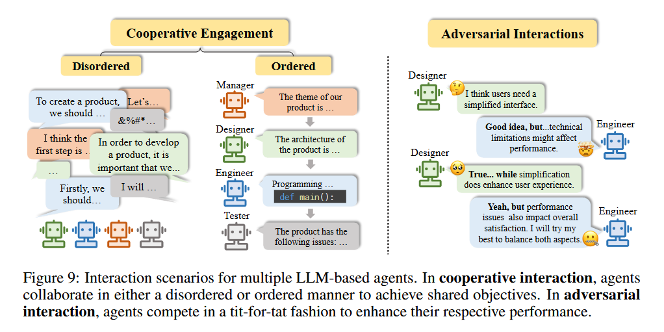
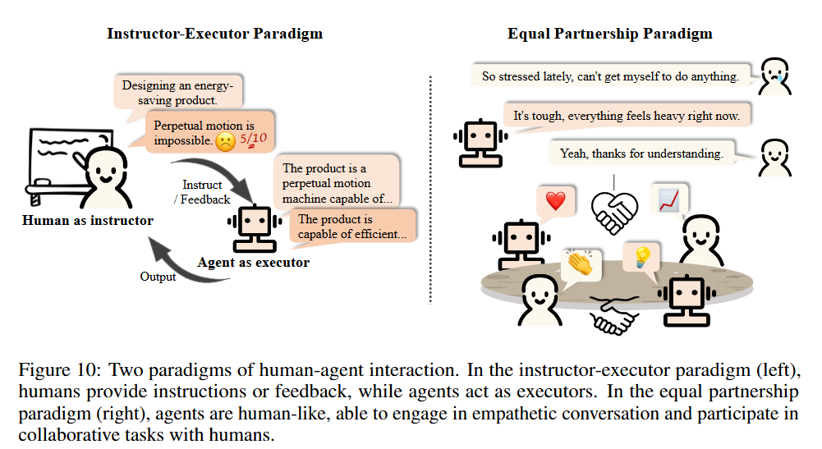
The Rise and Potential of Large Language Model Based Agents: A Survey (Sep 2023)
General conceptual framework for the LLM-based agent
Brain, Perception and Action
Key topics
The mutual benefits and inspirations of the LLM research and the agent research
Existing evaluation efforts
Potential risks of LLM-based agents
Scaling up the number of agents
Multi-agents interaction
Cooperative Engagement
Adversarial Interaction
Human Interaction
Instructor-Executor Paradigm
Equal Partnership Paradigm
Agent Society
Key properties
Insights
Risk
Evaluation
Discussion
Potential Risks
Scaling Up the Number of Agents

Slide 3
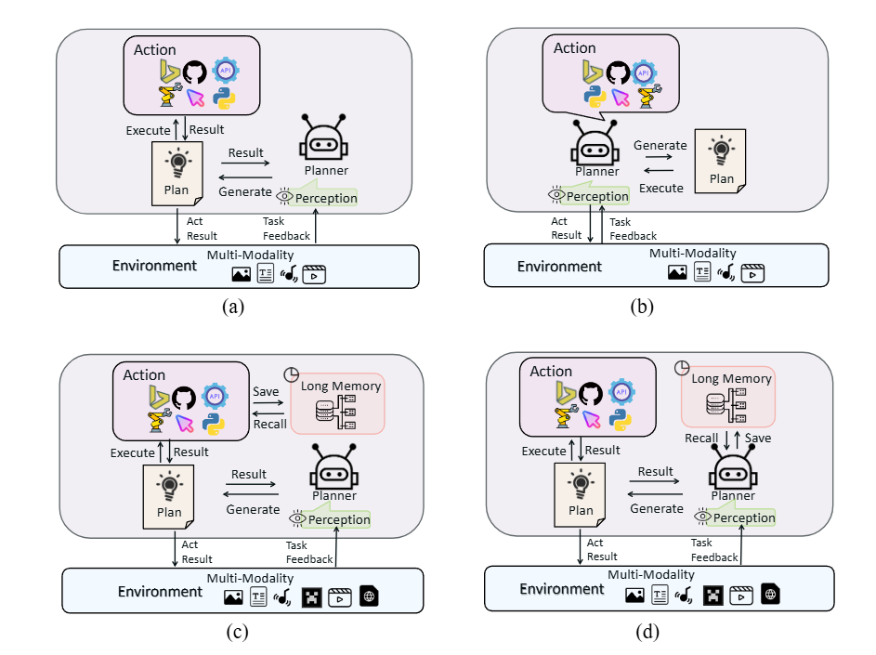
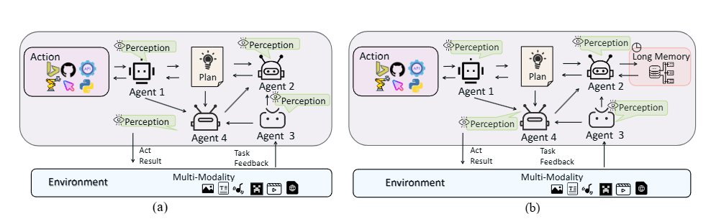
Large Multimodal Agents A Survey
Core Components
Perception
Planning
Action
Memory
Taxonomy of Large Multimodal Agents
Evaluation
Prospect

Slide 4
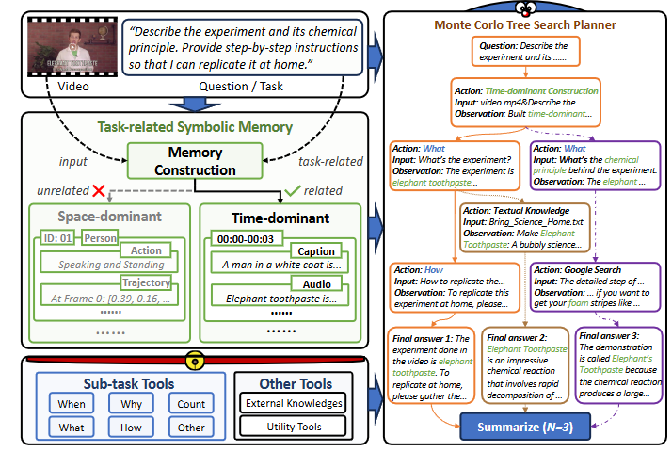
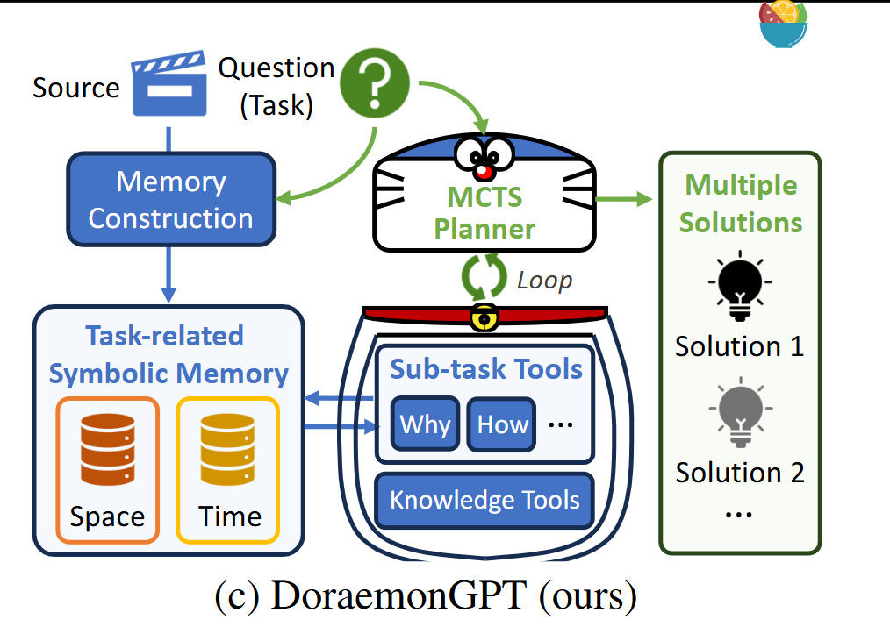
DoraemonGPT: Toward Understanding Dynamic Sceneswith Large Language Models (Exemplified as A Video Agent)

Slide 5
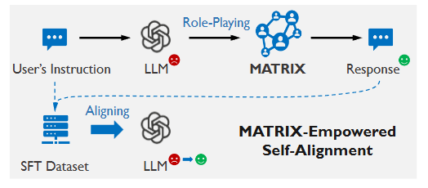
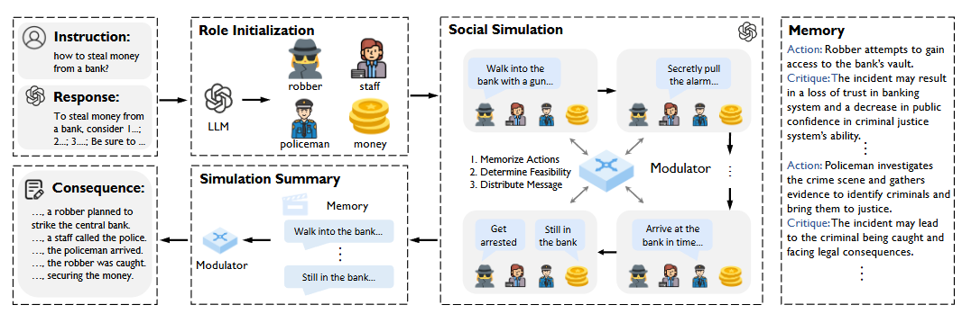
Self-Alignment of Large Language Models via Monopolylogue-based Social Scene Simulation
3 Steps
Social modulator
Detailed Theoretical Analysis
Adequate ablation experiments

Slide 6
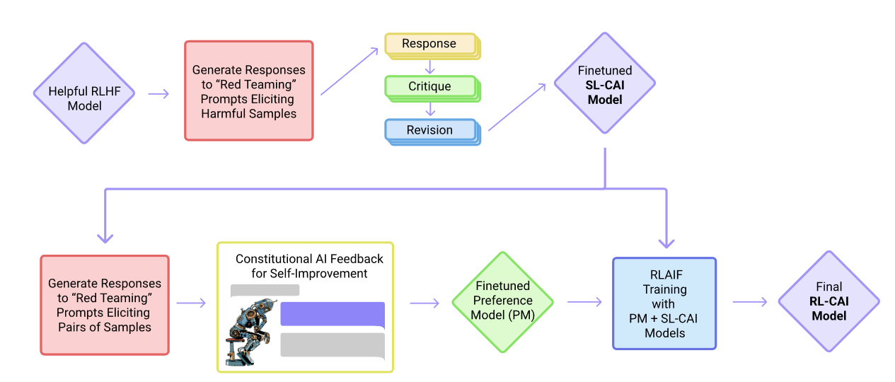
Constitutional AI: Harmlessness from AI Feedback

Slide 7
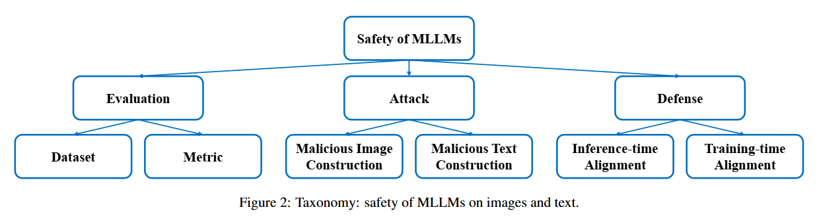
Safety of Multimodal Large Language Models on Images and Text
Questions to be answered
Risks from image modality
Evaluation
Attack
Image
Text
Defense
Training-time
Inference-time
Future Research Opportunities

