Slide 1

Detecting Fraudulent Credit Card Purchases
----------------------------------------------
Caleb L. Baechtold
Senior Consultant – DIG CYBER
Baechtold_caleb@bah.com

Slide 2
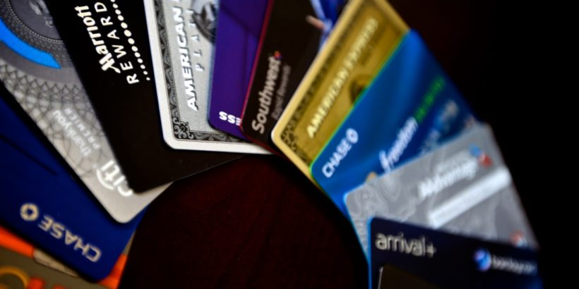
Problem Statement
26.2B credit card transaction in the United States in 2012
Overwhelming majority of these are legitimate transactions
Can a model identify the “needles in the haystack”?

Slide 3
Data Set
Labeled transaction data from Kaggle
https://www.kaggle.com/dalpozz/creditcardfraud
284,807 transactions from European cardholders over two-day period in September 2013
Data already transformed using PCA (29 components) to obfuscate raw data
Limits interpretability of model
Also limits EDA
Original data source:
Andrea Dal Pozzolo, Olivier Caelen, Reid A. Johnson and Gianluca Bontempi. Calibrating Probability with Undersampling for Unbalanced Classification. In Symposium on Computational Intelligence and Data Mining (CIDM), IEEE, 2015

Slide 4
Modeling Approach
Assess purchase validity using classification algorithms
Logistic Regression
Random Forest Classifier
Why?
Simple coefficients
Orthogonality of Principal Components
Choose desired input features using simple Logistic Regression iterating through Principal Components
Perform additional parameter tuning

Slide 5
Logistic Regression Classifier
Initial Logistic Regression model yielded 99.9% accuracy on test split of dataset!
But wait…
Label | Count | % of Total
Legitimate | 284,315 | 99.82%
Fraudulent | 492 | 0.172%
Overwhelming majority of credit card purchases are legitimate
Simple accuracy is no longer an effective measure of model performance
“Needle in a haystack…”

Slide 6
Dealing With Unbalanced Classes
Many methods for dealing with unbalanced target classes
Simple undersampling proves to be quite effective
Build a fake dataset that has an even distribution of target classes to split into train/test sets
Assess model performance using AUROC, TPR, FPR in addition to accuracy score

Slide 7
Logistic Regression Classifier
Input features
Top 9 Principal Components ranked according to correlation with target label
Purchase Amount (just for kicks)
Used train/test split on a balanced dataset sampling 250 transactions from the original 284K transactions
 | TPR | FPR | AUROC | Accuracy
Test | 94.64% | 1.44% | .966 | 96.8%
Original 284K | 91.87% | 4.13% | .939 | 95.9%

Slide 8
Random Forest Classifier
Input features
Top 9 Principal Components ranked according to correlation with target label
Purchase Amount (just for kicks)
Used train/test split on a balanced dataset sampling 250 transactions from the original 284K transactions
 | TPR | FPR | AUROC | Accuracy
Test | 92.85% | 2.90% | .950 | 95.2%
Original 284K | 92.27% | 4.85% | .937 | 95.1%

Slide 9
Comparing LR/RF
Model | Dataset | TPR | FPR | AUROC | Accuracy
Logistic Regression | Test | 94.64% | 1.44% | .966 | 96.8%
 | Original 284K | 91.87% | 4.13% | .939 | 95.9%
Random Forest | Test | 92.85% | 2.90% | .950 | 95.2%
 | Original 284K | 92.27% | 4.85% | .937 | 95.1%
LR
Higher AUROC/Accuracy, interpretable coefficients
RF
Improved TPR, indications of feature importance

Slide 10
Random Forest On Unbalanced Data
Input features
Top 9 Principal Components ranked according to correlation with target label
Purchase Amount (just for kicks)
Used train/test split on the original 284K transactions
 | TPR | FPR | AUROC | Accuracy
RF Test | 71.67% | .01% | .858 | 99.9%

Slide 11
Random Forest On Unbalanced Data
Input features
Top 9 Principal Components ranked according to correlation with target label
Purchase Amount (just for kicks)
Used train/test split on the original 284K transactions
 | TPR | FPR | AUROC | Accuracy
RF Test | 71.67% | .01% | .858 | 99.9%
LR Test | 54.16% | .01% | .770 | 99.9%

Slide 12
Results
Simple models are successful in identifying fraudulent activity
Low number of base estimators for RF
Unnecessary to modify LR threshold
Significant underlying assumptions:
Ability to replicate PCA-transform
Two-day sample reflective of standard purchasing behaviors (lacks dimension of temporality)
Simple Logistic Regression on ORIGINAL features could be an effective productized solution

Slide 13
Questions?

