Slide 1
Introduction to Machine Learning and OLS in Python
Basics of Machine Learning and the sm.OLS Function

Slide 2
Basics of Machine Learning
Machine Learning (ML) involves training algorithms to identify patterns in data and make predictions. Common ML algorithms:
- Linear Regression
- Decision Trees
- Neural Networks

Slide 3
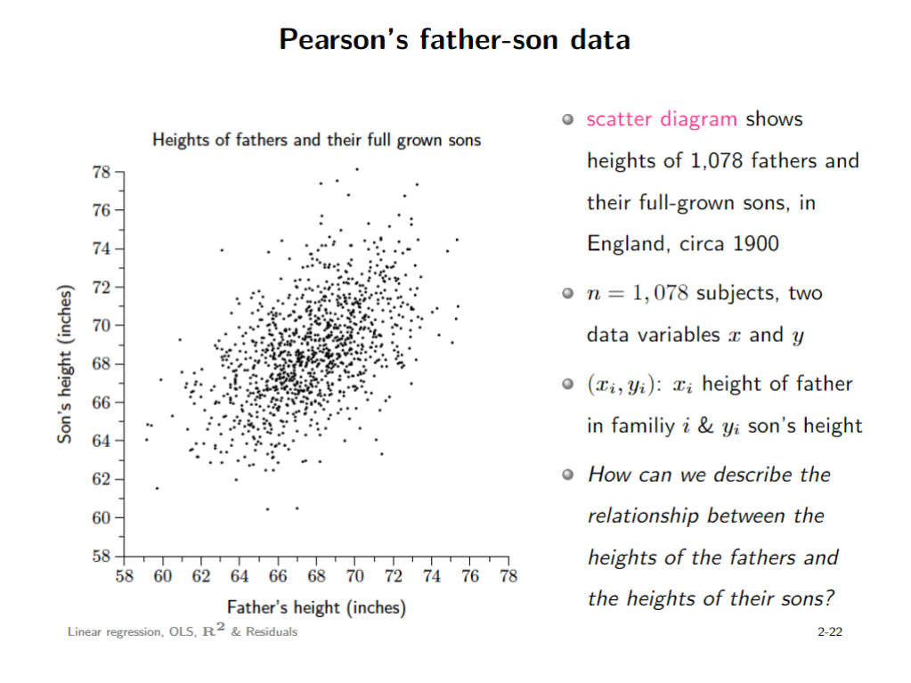

Slide 4
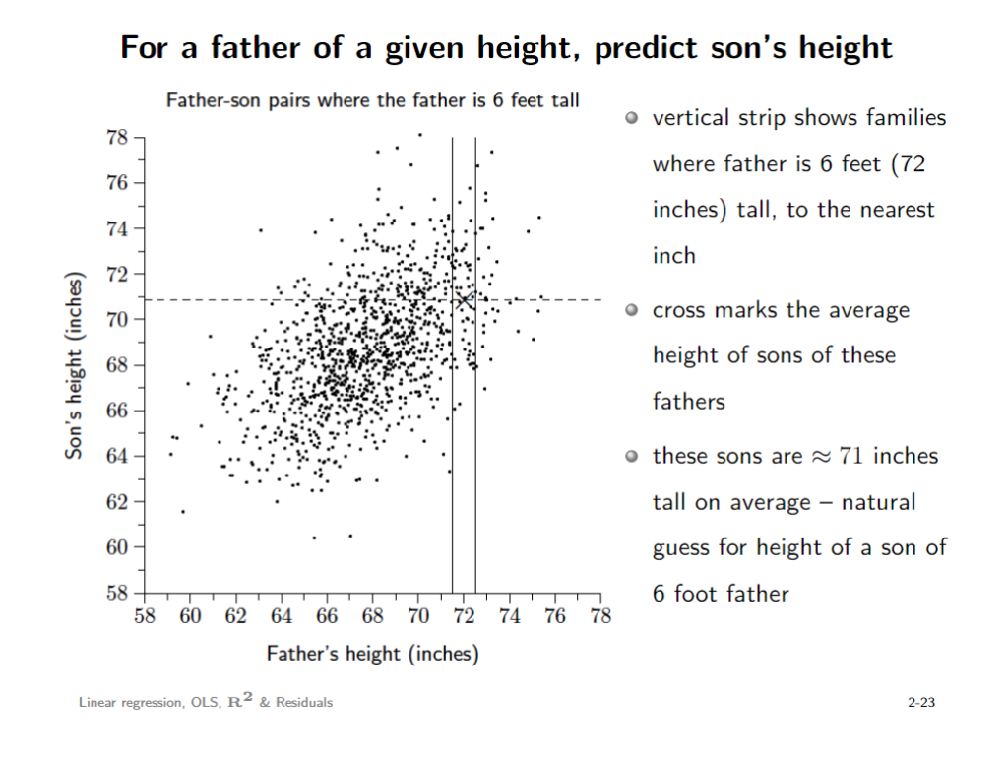

Slide 5
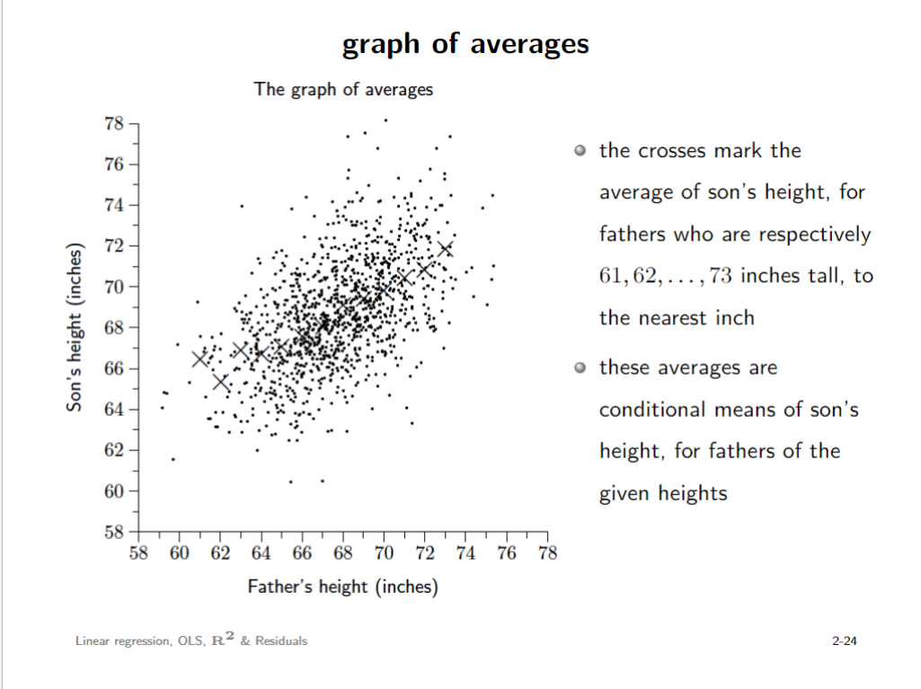

Slide 6
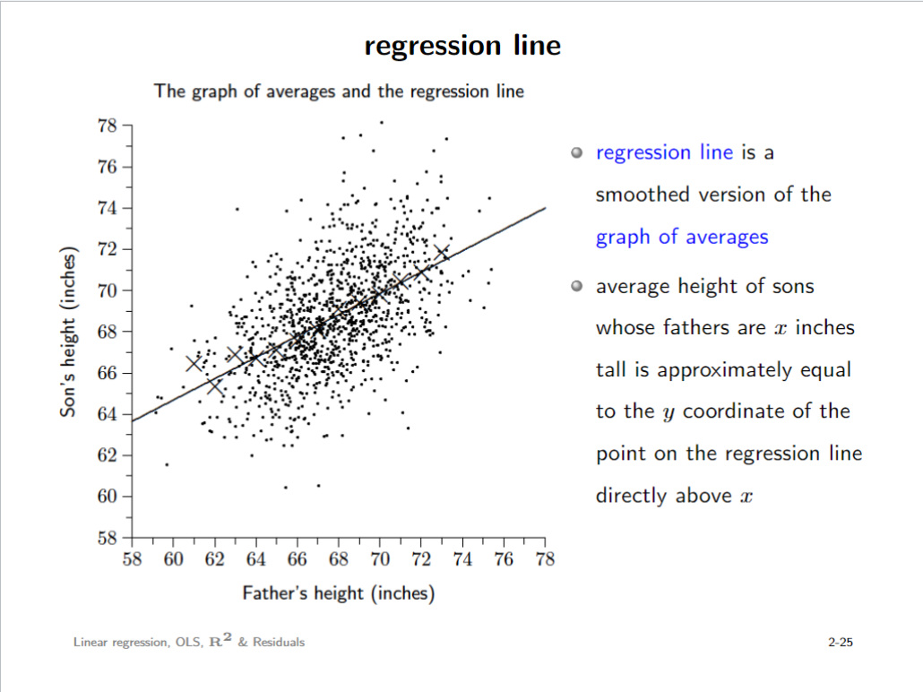

Slide 7
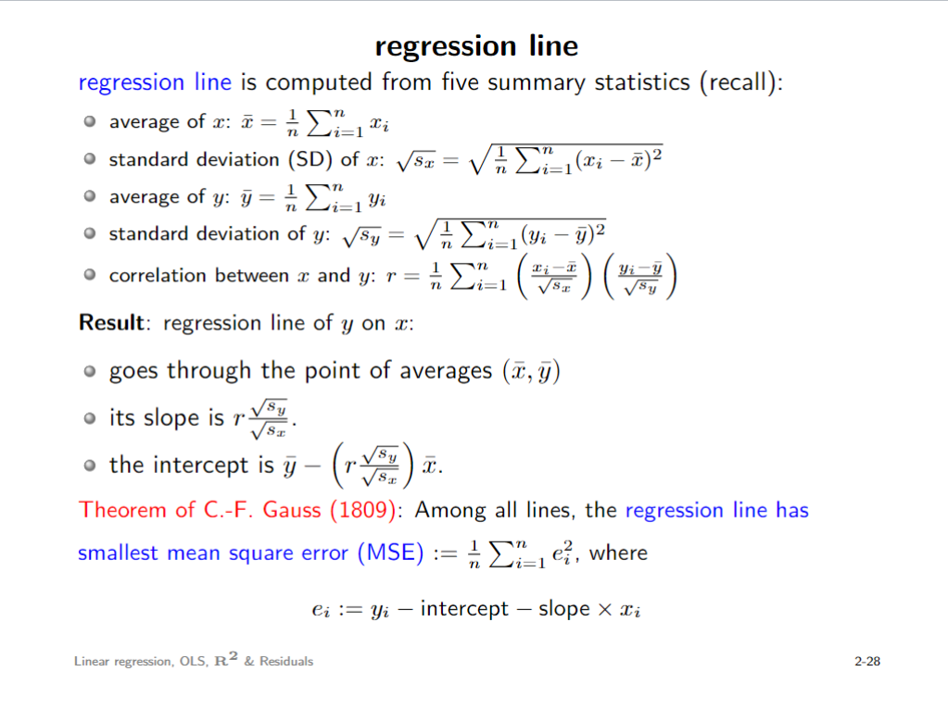

Slide 8
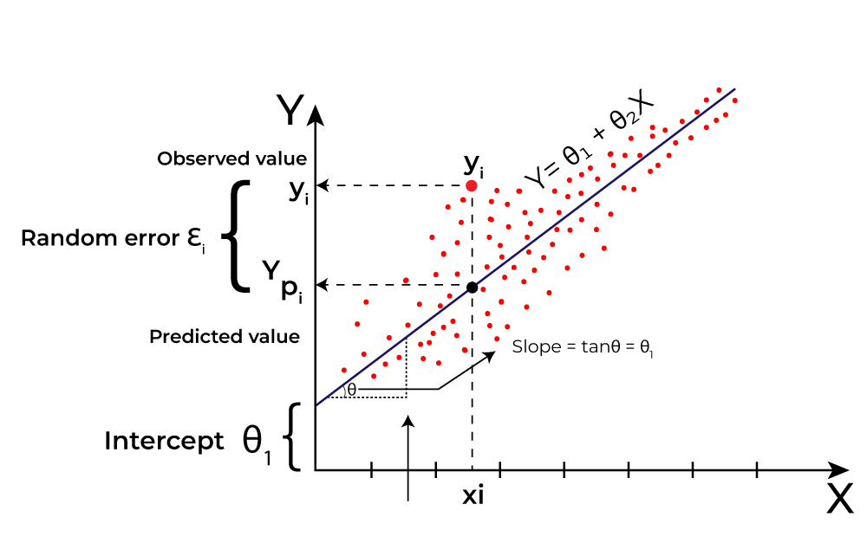

Slide 9
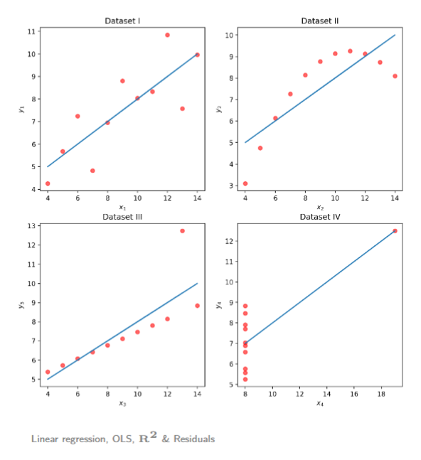
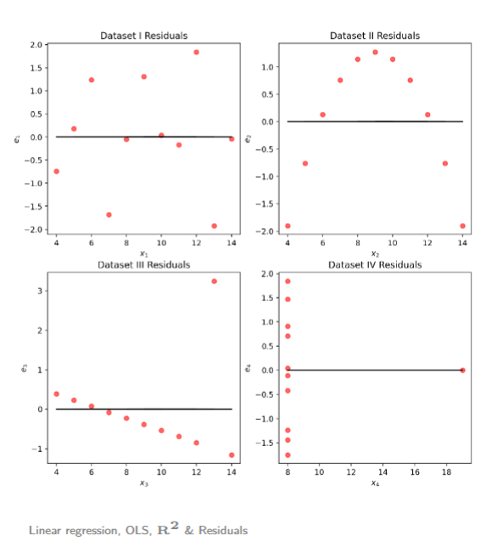

Slide 10
Steps in a Machine Learning Workflow
1. Data Collection: Gathering data for training.
2. Data Preprocessing: Cleaning and transforming data.
3. Model Training: Applying algorithms to data.
4. Model Evaluation: Checking model performance.
5. Model Deployment: Using the model for predictions.

Slide 11
The sm.OLS Function in Python
sm.OLS (Ordinary Least Squares) is used for linear regression in statsmodels.
It models the relationship between a dependent variable (Y) and one or more independent variables (X).
Syntax:
model = sm.OLS(Y, X).fit()
forecast = model.precit(x_test)
Attributes of the results object:
- results.params: estimated coefficients
- results.summary(): summary of the regression model

Slide 12
Example of Using sm.OLS
Example:
import statsmodels.api as sm
X = sm.add_constant(X) # Add constant for intercept
model = sm.OLS(Y, X)
results = model.fit()
print(results.summary())

Slide 13
Interpreting the Results
Key elements in the regression summary:
- R-squared: Proportion of variance explained by the model.
- p-value: Test the null hypothesis (e.g., whether the coefficient is zero).
- Coefficients: Values that represent the impact of each predictor on the outcome.

Slide 14

Saving and reading CSV files
CSV stands for “Comma Separated Values”, like an excel file
Right now you should have a variable that stores the data frame.
It’s useful to write that variable into a csv file
We can later read that file again

Slide 15
Saving and reading CSV files
CSV stands for “Comma Separated Values”, like an excel file
Right now you should have a variable that stores the data frame.
It’s useful to write that variable into a csv file
We can later read that file again
How do we know if it worked?

Slide 16
Saving and reading CSV files
CSV stands for “Comma Separated Values”, like an excel file
Right now you should have a variable that stores the data frame.
It’s useful to write that variable into a csv file
We can later read that file again
How do we know if it worked?
PRINT!!!!

Slide 17
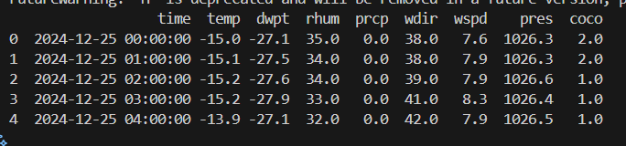
Saving and reading CSV files
Something’s wrong

Slide 18
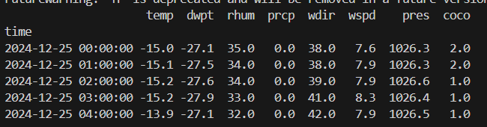
Saving and reading CSV files
Something’s wrong

Slide 19
Saving and reading CSV files
index is messed up

Slide 20

Saving and reading CSV files
CSV stands for “Comma Separated Values”, like an excel file
Right now you should have a variable that stores the data frame.
It’s useful to write that variable into a csv file
We can later read that file again
How do we know if it worked?
PRINT!!!!

Slide 21
Saving and reading CSV files
CSV stands for “Comma Separated Values”, like an excel file
Right now you should have a variable that stores the data frame.
It’s useful to write that variable into a csv file
We can later read that file again
How do we know if it worked?
It works!!!!

Slide 22
Next part of the project: data acquisition (again)
Navigate to this website:
https://demanda.ree.es/visiona/peninsula/demandaqh/tablas/2024-12-10/2

Slide 23
Error handling
Most of your time when programming, you will spend it debugging
Errors are a clear sign of some sort f bug
When you see an error, you should not be scared and give up
You should identify where the error is happening
Read and try to understand what it’s saying
Find the reason why it’s happening
Fix the error

Slide 24
Error handling
Error messages are a tool!

Slide 25
Error handling and AI
One of the most useful tools you have at your disposal, is AI
They have a great ability at reading erros and translating them to you
A good and efficient practice when programming is using AI to help you debug!

Slide 26
Error handling and AI
Copy your code
Copy the error message
Copy any data types that you might be working with
Explain your goal

Slide 27
Controlled error handling
Let’s look at how errors might appear in our work
Using AI, what find out what the error means and ways to solve it
Give it all the information that it might need

Slide 28
Controlled error handling
AI is powerful but it can’t always find the answer
In those instances you have to try different things to try to fix the error
One methodology that is particular is to look at instance or example where the action you’re performing works and see what’s the difference with what you’re doing now

Slide 29
Controlled error handling
Maybe the issue is in the file that we are reading!!

Slide 30
Controlled error handling
What’s wrong with the file we’re trying to read compared to the one we read before???

Slide 31
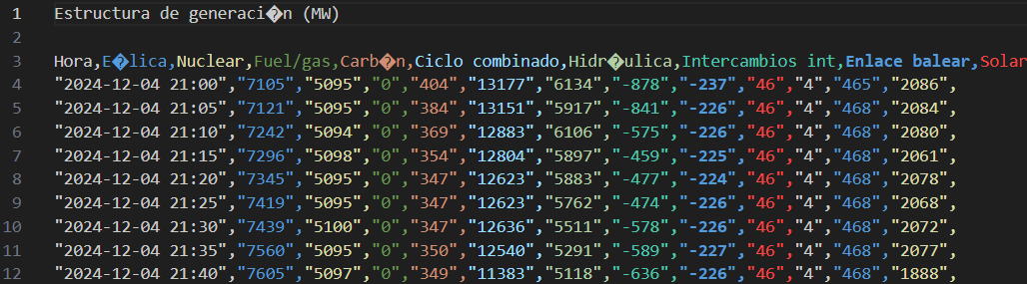
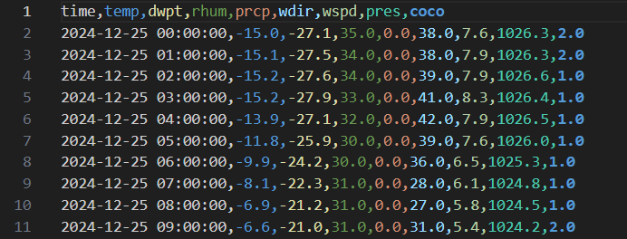
Controlled error handling
What’s wrong with the file we’re trying to read compared to the one we read before???

Slide 32
Controlled error handling
What’s wrong with the file we’re trying to read compared to the one we read before???

Slide 33
Controlled error handling

Slide 34
Manipulating files in your directory with python
Right now, we can read the files we downloaded
But we have a lot of files (a lot!!) in our folder
Going through them one by one would take wayyy too much time
To manipulate all these files, we will use a new library
os

Slide 35
OS
We have a lot of files that we want to work with
Going through them one by one would take wayyy too much time
os library allows us to manipulate the files in our directory
import os

Slide 36

OS
We’re gonna use this library to change the name of the files of interest in our directory
Get the directory we are working on at the moment
Get all the files in the directory

Slide 37
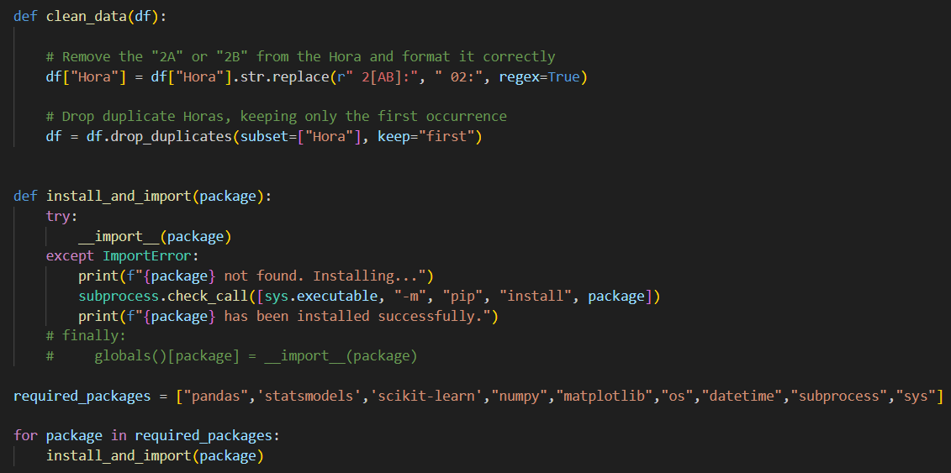

Slide 38
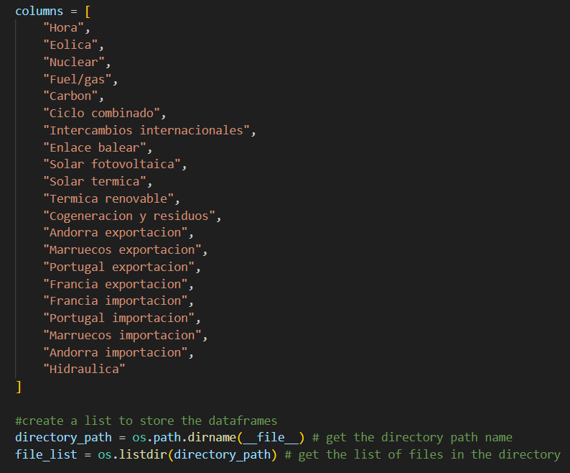

Slide 39
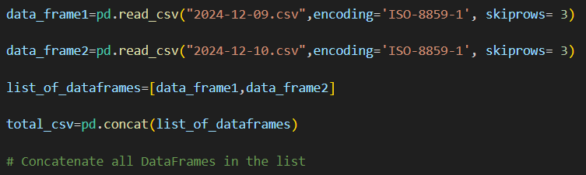
Concatonating
Now that we can successfully read the files we downloaded with error we’ll perform a small exercise
I’d like to combine all the files we downloaded into 1 large csv file
We can combine multiple csv files as follows

Slide 40
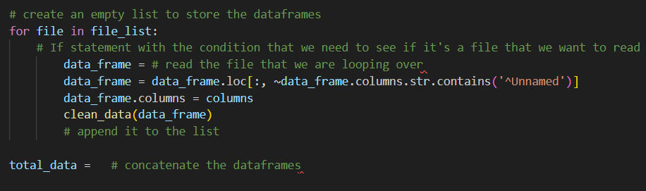
First task

Slide 41
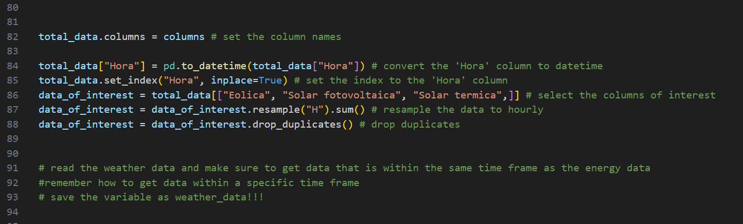
Second task

Slide 42
