Slide 1
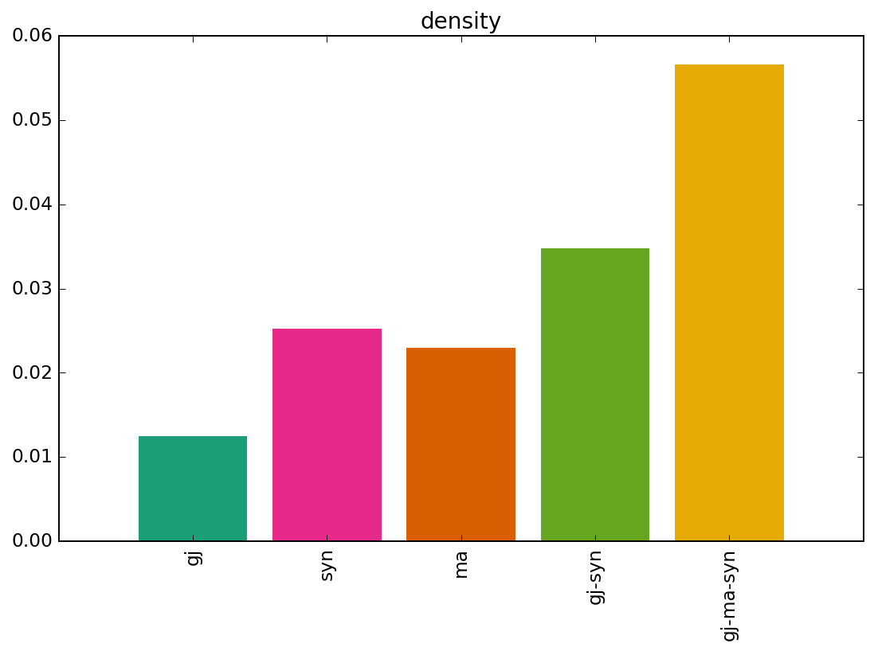
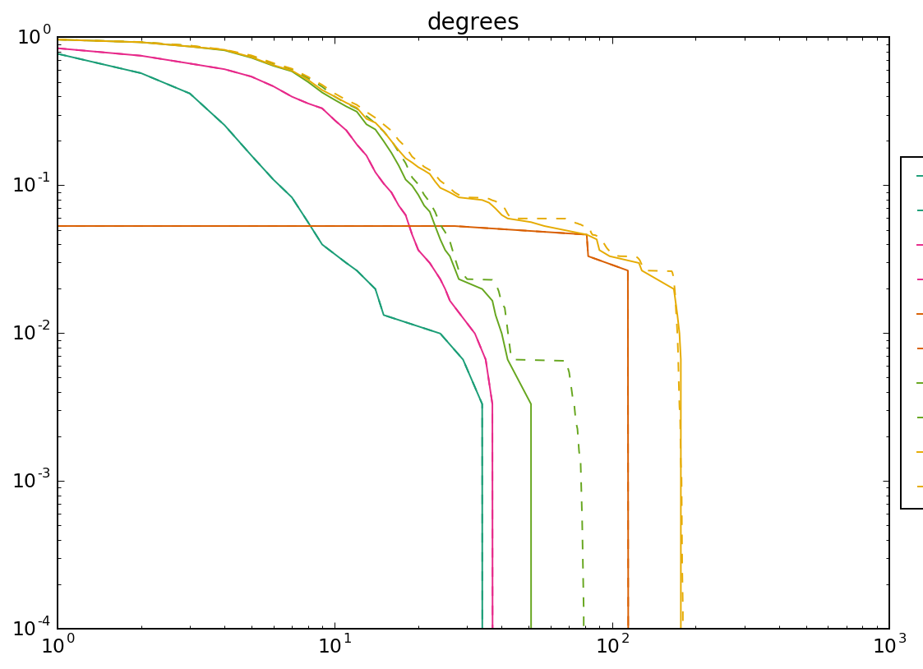
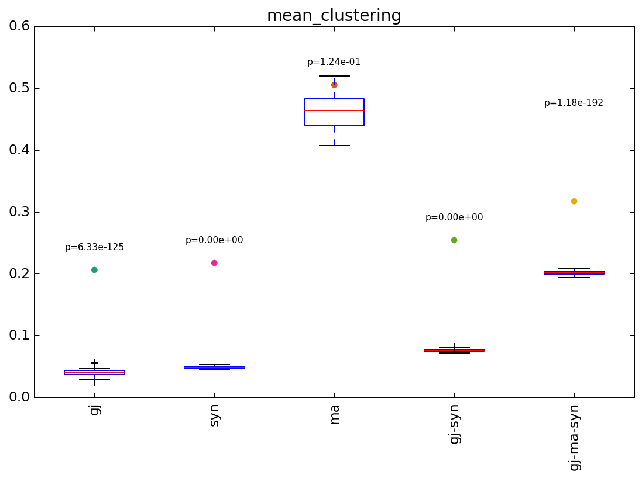
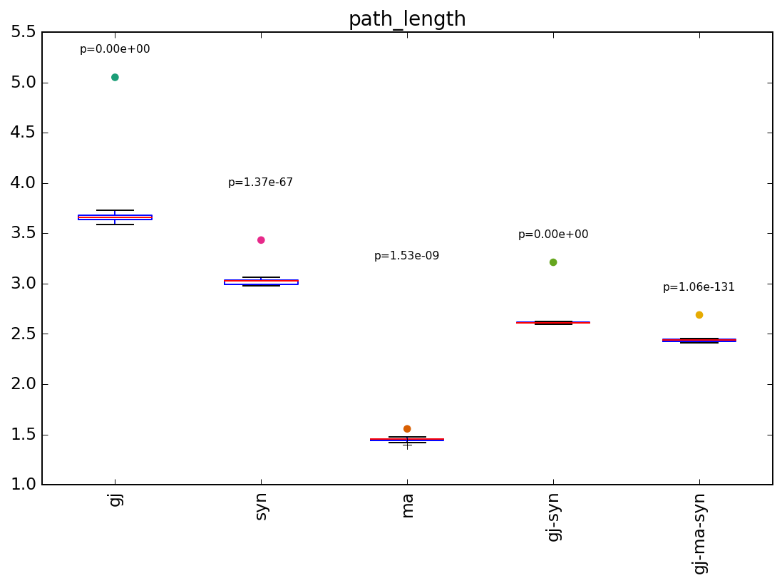
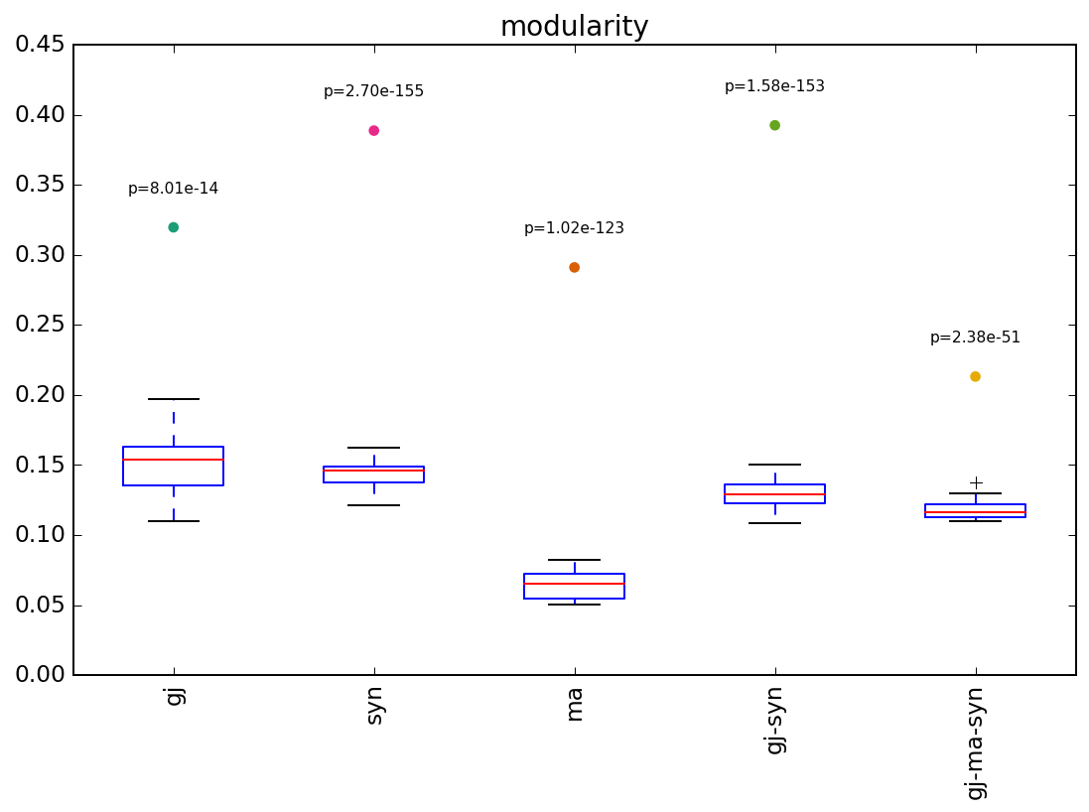
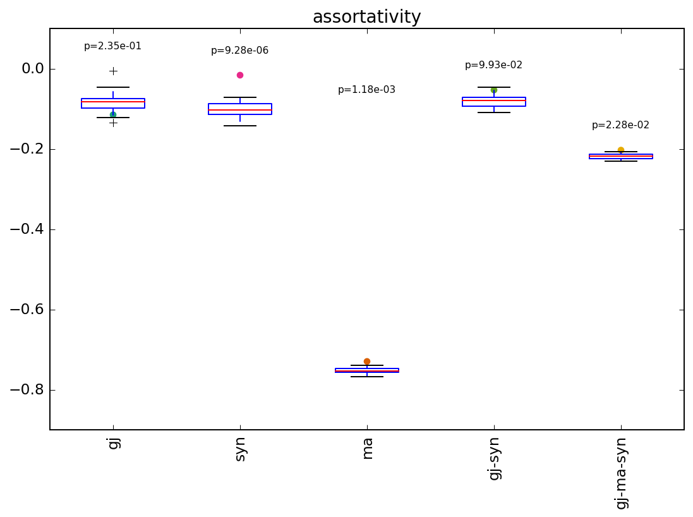
a
b
In Figure 3a we show the density of each network layer as well as the density of connections in aggregate networks combining several layers. Aggregating the two physical networks (synapses + gap junctions) leads to sparser binary connectivity than the sum of the two individual layer densities (0.35 < 0.13 +0.26 – get precise numbers), highlighting the fact that a significant proportion of synapses and gap junctions overlap. The overlap however is much less substantial with the monoamine layer (0.58 ~ 0.35 + 0.23 – get precise numbers). As described in the methods section, the null model used throughout the figure is based on randomizing each layer of the network individually, preserving its degree distribution, then aggregating the randomized networks to form null models for the aggregates. Figure 3b once again confirms that the two physical layers significantly interact, forming fewer high degree hubs than would be expected by chance due to the significantly larger than expected number of overlapping edges.
gj
syn
syn-gj
ma
syn-gj-ma
c
d
e
f

Slide 2
a
b
The degree distribution of the monoamine layer also has a significant impact on other network metrics characterizing its topology. For example the null models for the monoamine layer alone have significantly higher clustering (Figure 3c) [WHY? Is it because many nodes have k=1 and these are counted as C=1?] and significantly shorter path lengths (Figure 3d) than the null models of other layers. Despite the strong topological role of the broadcasting hubs, however, the monoamine layer displays some complex network properties with higher modularity (Figure 3e) compared to the corresponding null model and significantly longer path lengths than expected by chance. Clustering is not significantly increased for monoamines alone but the aggregate network including all three layers remains significantly modular, clustered and small-world (calculate value).
Comparing the aggregate physical network to the aggregate network including the monoamine layer, we find that the extrasynaptic connectivity reduces the modularity and average path lengths in the overall network, thus increasing the efficiency of integrative information processing by providing shortcuts between more segregated subgraphs of the physical network [5].
(To really say this is would be good to also compare gj-syn-ma to a randomized networks resulting from keeping real gj-syn and adding a randomized ma net preserving its degree distribution.
ALSO: would be good to show plot or at least quote numbers for the proportion of ma links that fall with or between modules of the physical network – copared to what one might expect by chance).
Interestingly however clustering is increased (I wonder whether this is an artifact of k=1 as described above?).
gj
syn
syn-gj
ma
syn-gj-ma
c
d
e
f

Slide 3
Finally, Figure 3f shows that all layers tend to be weakly disassortative. This feature is widely observed in biological and technological networks [1] and is known to be relevant for the organization of networks into collective dynamics, such as synchronization [2] and cooperation behaviour [3,4]. Interestingly the monoamine network alone is very strongly disassortative due to its degree distribution. Indeed the monoamine network comprises a number of key hubs broadcasting monoamine signals to a large number cells with appropriate receptors. This is in contract to the networked pairwise communication that characterizes gap junctions and synapses. Interestingly, however, both synaptic and monoamine layers are significantly more assortative than expected by chance given their degree distribution. This suggests greater communication between the broadcasting monoamine hubs than expected by chance.
As might be expected, the addition of monoamines increases the disassortativity of the physical network due to the modified overall degree distribution. However this extrasynaptic layer also induces more assortativity than expected given the degree distribution of additional layer. [To really say this we should also compare gj-ma-syn toa randomized networks resulting from keeping real gj-syn and adding a randomized ma net preserving its degree distribution].
-> transition to rich clubs
a
b
gj
syn
syn-gj
ma
syn-gj-ma
c
d
e
f

Slide 4
References
Newman, M. E. J. The structure and function of complex networks. SIAM Rev. 45, 167 (2003).
Sorrentino, F., Di Bernardo, M., Cuellar, G. H. & Boccaletti, S. Synchronization in weighted scale-free networks with degree-degree correlation. Physica D 224, 123–129 (2006).
Perc, M., Gómez-Gardeñes, J., Szolnoki, A., Floría, L. M. & Moreno, Y. Evolutionary dynamics of group interactions on structured populations: a review. J. R. Soc. Interface 10, 20120997 (2013).
Wang, S., Szalay, M. S., Zhang, C. & Csermely, P. Learning and innovative elements of strategy adoption rules expand cooperative network topologies. PLoS ONE 3, e1917 (2008).
Sporns, O. Network attributes for segregation and integration in the human brain. Current opinion in neurobiology 23, 162-171 (2013).

