Slide 1
Predicting Strokes Based on Healthcare Data
Collin Brueggeman

Slide 2
Problem Statement and Project Context
Stroke is one of the leading causes of death and disability worldwide. Early prediction of stroke risk can lead to preventive healthcare interventions and reduce healthcare costs. Existing research shows that machine learning models can effectively identify high-risk individuals using health and lifestyle indicators.
The objective of this project is to use predictive analytics to develop a model that predicts the likelihood of stroke occurrence based on patient health attributes. This application of predictive analytics has practical significance for healthcare providers seeking to provide preventive care resources more effectively and can also help individuals make better health decisions.

Slide 3
Critical Prior Work
Dataset Acquisition: “Stroke Prediction Dataset” from Kaggle. 5110 patient records, 12 features.
EDA Insights
Class Imbalance (only 4.87% strokes)
Correlation Analysis: Age(0.25), Hypertension(0.13), heart disease(0.13)
PCA: > 0.99 of variance explained by average glucose level, age, and BMI.

Slide 4
Data Preparation Summary
Missing Values: Imputed using median imputation
Outliers: Handled by capping to 99th percentile
Irrelevant fields were dropped (id)
Encoding:
Binary Encoding
One-hot Encoding
Feature Scaling: Done with StandardScaler()
Class Imbalance: SMOTE

Slide 5
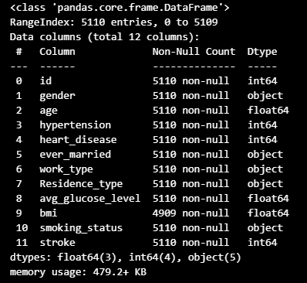
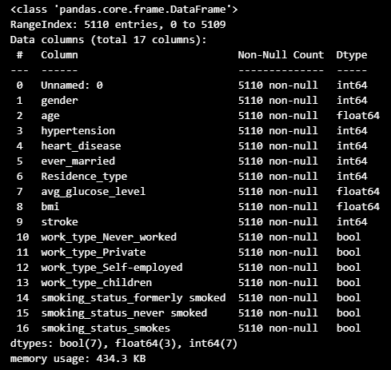
Before vs After

Slide 6
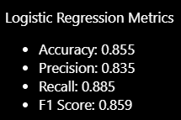
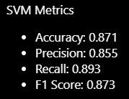
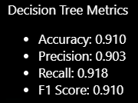
Model Deployment
Logistic Regression
Strong baseline
Interpretable coefficients
SVM
Kernel functions allow SVM to capture complex decision boundaries.
Decision Tree
Very interpretable

Slide 7
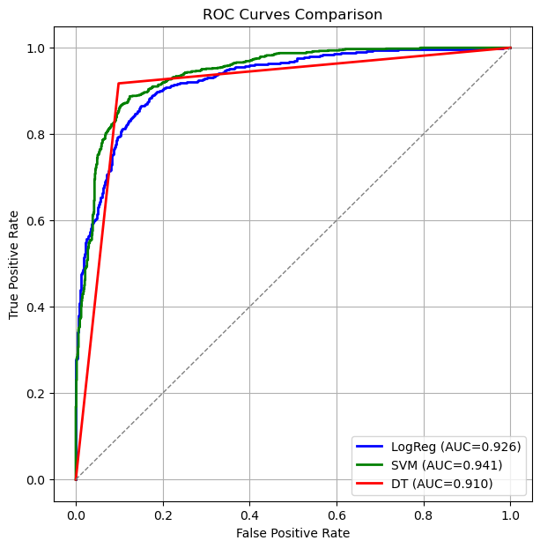
Results (ROC/AUC)

Slide 8
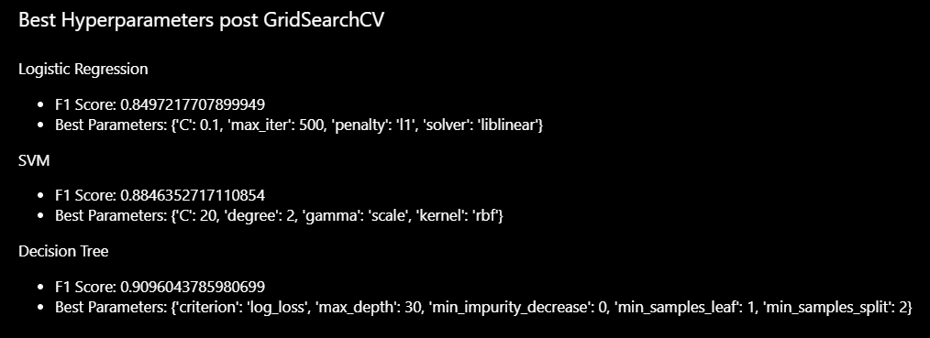
Results Post-Tuning
Model | Accuracy | Precision | Recall | F1 Score
Logistic Regression | 0.857 | 0.833 | 0.891 | 0.861
SVM | 0.887 | 0.859 | 0.927 | 0.891
Decision Tree | 0.914 | 0.908 | 0.922 | 0.915

Slide 9
Best Model: Decision Tree
Best Accuracy (0.914)
Best F1 Score (0.915)
Strong interpretability
Better predictive power and interpretability versus other models deployed.

Slide 10
Lessons Learned
Highlights:
Highly effective models overall, especially decision tree.
Strong data cleaning.
Lowlights:
SMOTE
Best practice vs Scholarly
Improvements
More populous dataset.
Different implementation of SMOTE.

Slide 11
Deployment Plan
DEPLOYR Framework
Exposed as a REST API.
HTTPS request using electronic medical records.
Inference performed on real-time data.
Sent to dashboard for continuous monitoring.
Strong in-house security needed.
Bias from a certain group of individuals needs to be kept an eye on.

Slide 12

Thank you!

