Slide 1
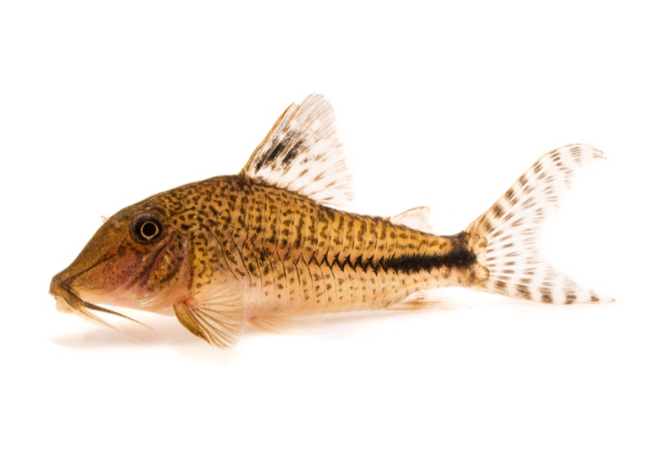
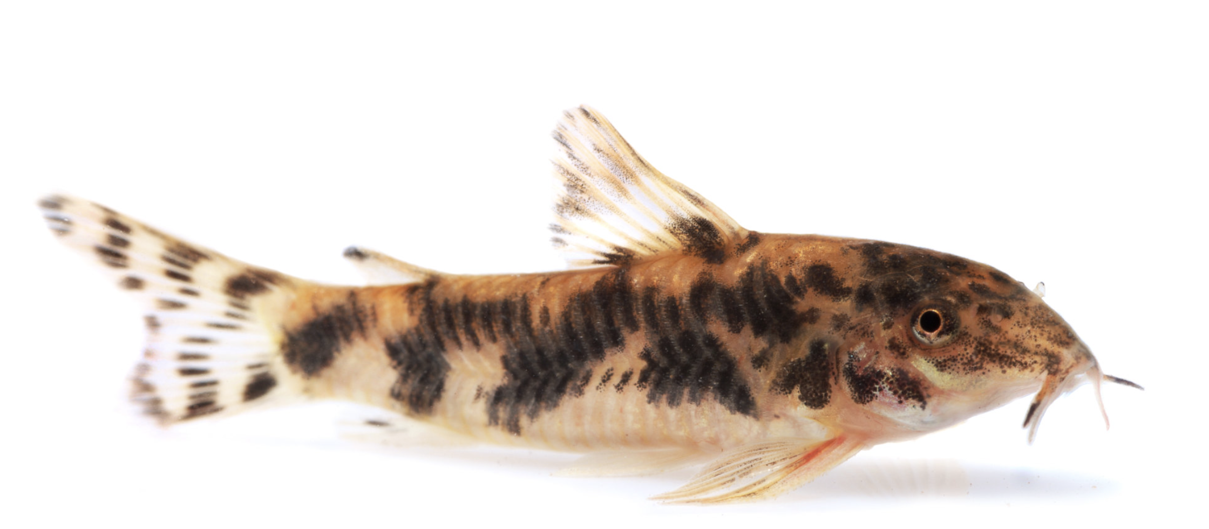
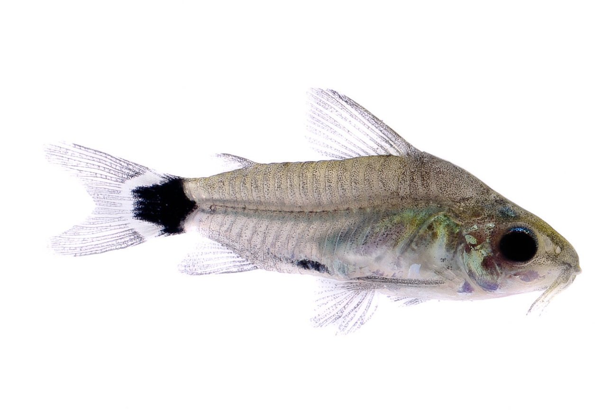
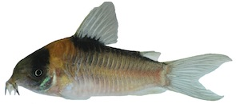
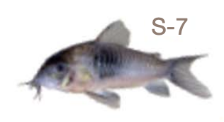
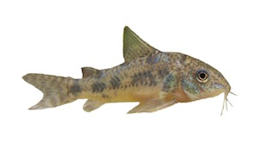
Nuclear Phylogeny
mtDNA Phylogeny
Lineage 1
The ‘true’ Corydoras
Lineage 2
The Aspidoras genus
Lineage 3
The Scleromystax genus
Lineage 4
The ‘dwarf’ Corydoras
Lineage 5
The ‘elegant’ Corydoras
Lineage 7
The ‘aeneus’ Corydoras
Lineage 8
The ‘long-nose, deep-body’
Corydoras
Lineage 6
The ‘false long nose’ Corydoras
Lineage 9
The ‘short-snout’ Corydoras

