Slide 1
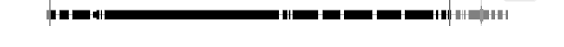
A
B
5’
3’
5’
3’
MMP13-a ORF
Lineage 1
MMP13-a
Lineage 1 :
ctg60
Lineage 2
Lineage 3
Lineage4
TE
MMP13-aa
ctg591
Lineage 9 :
TE
Lineage 5
MMP13-aa
TE
ctg11358
Lineage 9 :
TE
Lineage 7
Lineage 8
Lineage 9
TE
*
MMP13-ab
ctg65801
Lineage 6
TE
Lineage 9 :
TE
1kb
1kb

