Slide 1
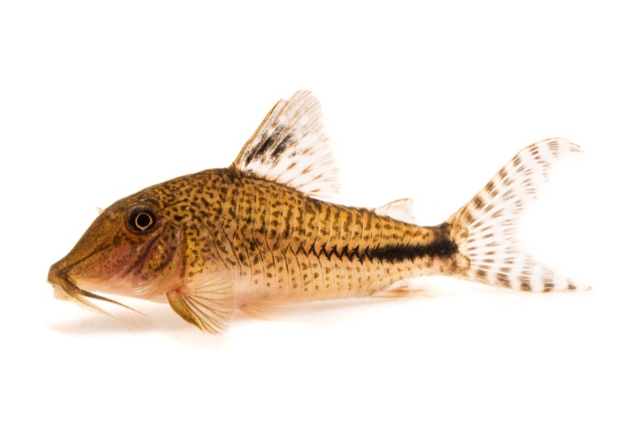
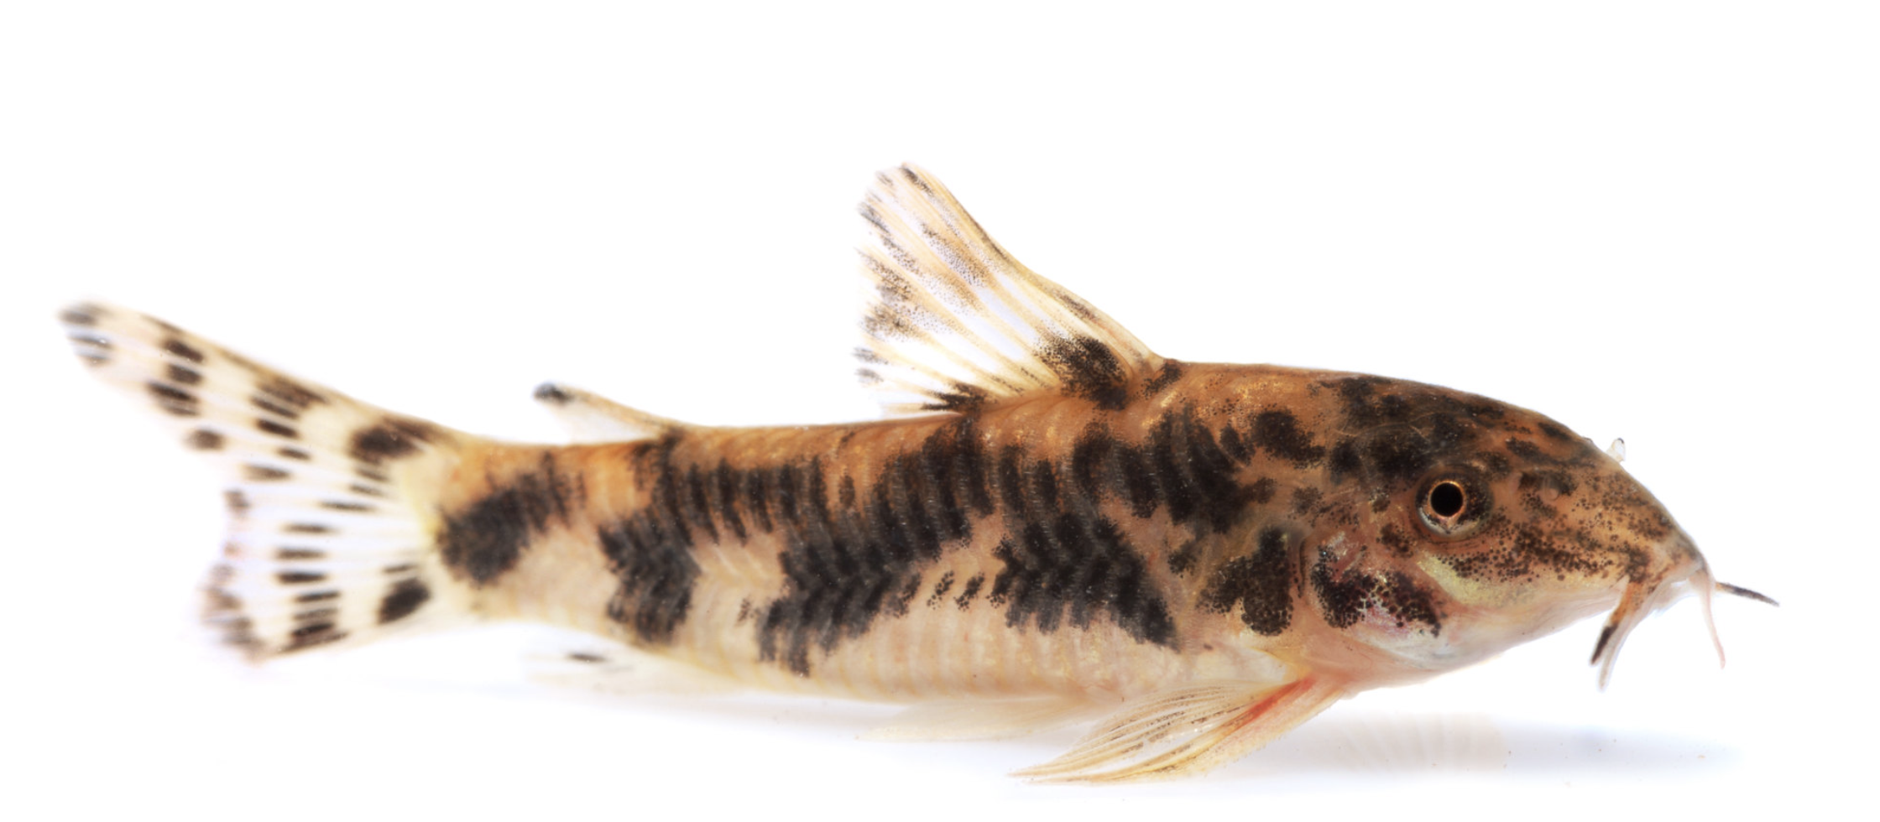
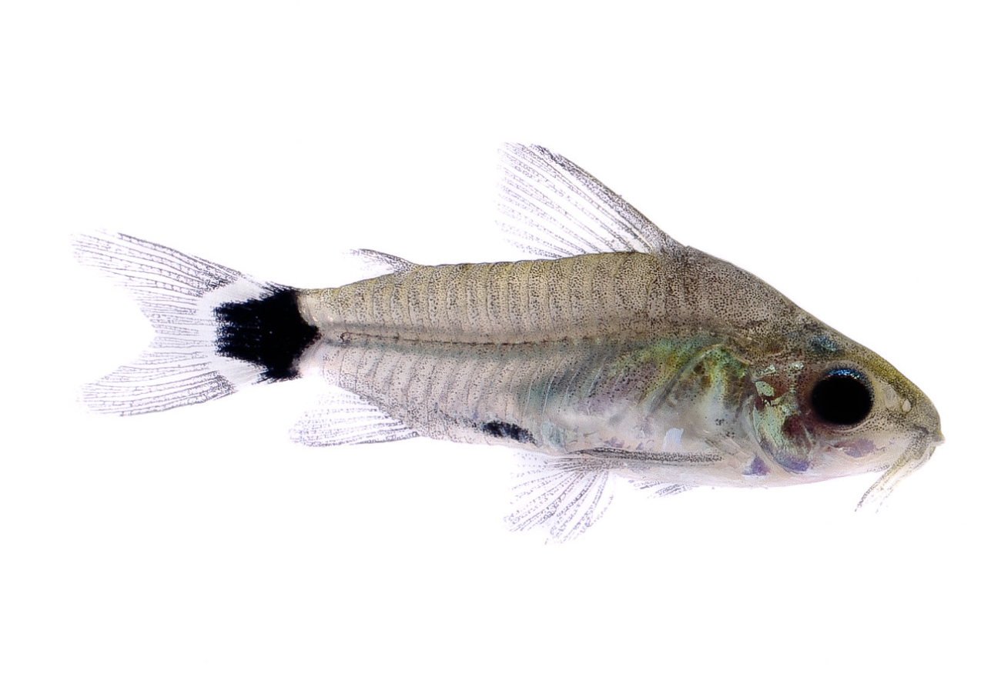
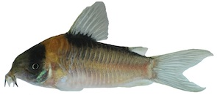
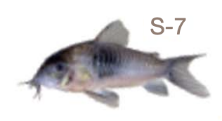
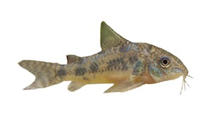
Nuclear Phylogeny
mtDNA Phylogeny
Lineage 1
Lineage 2
Lineage 3
Lineage 4
Lineage 5
Lineage 7
Lineage 8
Lineage 6
Lineage 9

