Slide 1
CS 309A- Database Management Systems

Slide 2
What is a Database System?
Database:
A very large collection of related data
Models a real world enterprise:
Entities (e.g., teams, games / students, courses)
Relationships (e.g., a student can choose many courses)
DBMS: A software system that can be used to store, manage and retrieve data from databases
Database System: DBMS+data (+ applications)

Slide 3
Why Study Databases
Wide-range of database applications:
Banking: transactions
Airlines: reservations, schedules
Colleges: registration, grades
Sales: customers, products, purchases
Online retailers: order tracking, customized recommendations
Manufacturing: production, inventory, orders, supply chain
Human resources: employee records, salaries, tax deductions

Slide 4
University Database Example
Application program examples
Add new students, instructors, and courses
Register students for courses, and generate class rosters
Assign grades to students, compute grade point averages (GPA) and generate transcripts
In the early days, database applications were built directly on top of file systems

Slide 5
Why Databases?
Why not store everything in flat files:
i.e., use the file system of the OS, cheap/simple…
Name, Course, Grade
John Smith, CS113, B
Mike Stonebraker, CS205, A
Jim Gray, CS405, A
John Smith, CS315, B+
……
This is how things were
in the “Bad Old Days”

Slide 6
Problem 1
Data redundancy and inconsistency
Multiple file formats,
duplication of information in different files
Name, Course, Email, Grade Name, Email, Course, Grade
John Smith, CS113, js@etown.edu, B Mike Stonebraker, ms@etown.edu, CS234, A
Jim Gray, CS560, jg@etown.edu, A J. Smith, js@etown.edu, CS560, B+
John Smith, CS560, js@etown.edu, B+
Why is this a problem?
Wasted space
Potential inconsistencies
(e.g., multiple formats, John Smith vs J. Smith)

Slide 7
Problem 2
Data retrieval:
Find the students who took CS113
Find the students with GPA > 3.5
For every query we need to write a program!
We need the retrieval to be:
Easy to write
Execute efficiently

Slide 8
Problem 3
Data Integrity
No support for sharing:
Prevent simultaneous modifications
No coping mechanisms for system crashes
No means of Preventing Data Entry Errors (checks must be hard-coded in the programs)
Security problems: hard to provide user access to some, but not all, data
Database systems offer solutions to all the above problems

Slide 9
Problem 4
Long-lived data ➔ Evolution
What happens if I need to change my mind about how the data is stored?
Access patterns change
Don’t want to have to re-write all my applications.
Solution: Data independence!

Slide 10
Database
A database is a shared, integrated computer structure.
The data stored in a database includes:
End-user data: raw facts of interest to the end user
Metadata: data about data
The metadata
describe the data characteristics and relationships in data.
present a more complete picture of the data in the database.

Slide 11
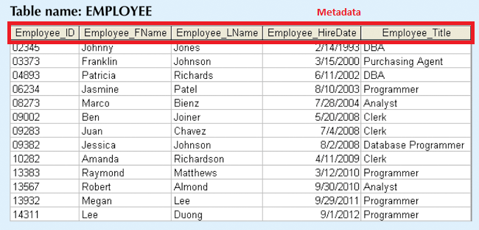
End-user data vs. Metadata
End-user data

Slide 12
Metadata
Data characteristics
name of data element
Data types (numeric, dates, or text)
Empty or not
Relationships
important component of database design
often defined by their environment, e.g., EMPLOYEE and JOB

Slide 13
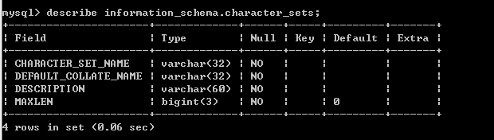
An example of metadata

Slide 14
Database Management System (DBMS)
a collection of programs
Manages the database structure
Controls access to the data stored in the database

Slide 15
Role of the DBMS
DBMS is the intermediary between the user and the database
Database structure stored as file collection
Can only access files through the DBMS
DBMS enables data to be shared
DBMS integrates many users’ views of the data

Slide 16
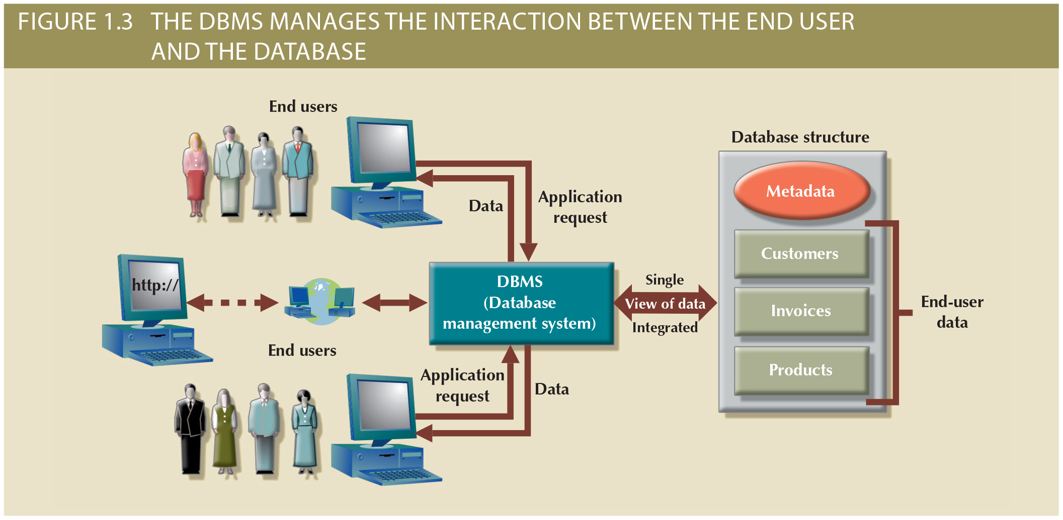
Role of the DBMS

Slide 17
Advantages of the DBMS
Better data integration and less data inconsistency
Data inconsistency: Different versions of the same data appear in different places
Increased end-user productivity
Improved:
Data sharing
Data security
Data access
Decision making
Data quality: Accuracy, validity, and timeliness of data

Slide 18
Levels of Abstraction
Physical level: describes how a record (e.g., instructor) is stored.
Logical level: describes data stored in database, and the relationships among the data.
type instructor = record
ID : string; name : string; dept_name : string; salary : integer;
end;
View level: application programs hide details of data types. Views can also hide information (such as an employee’s salary) for security purposes.

Slide 19
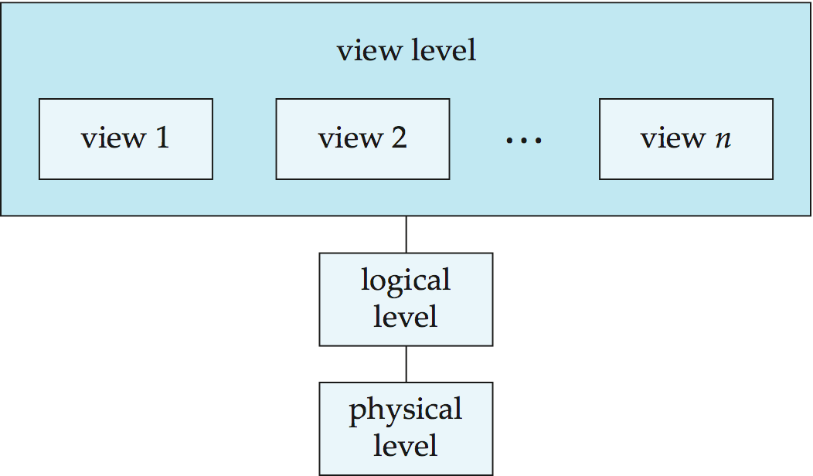
An architecture for a database system

Slide 20
Instances and Schemas
Similar to types and variables in programming languages
Logical Schema – the overall logical structure of the database
Example: The database consists of information about a set of customers and accounts in a bank and the relationship between them
Analogous to type information of a variable in a program
Physical schema– the overall physical structure of the database
Instance – the actual content of the database at a particular point in time
Analogous to the value of a variable

Slide 21
Physical Data Independence
the ability to modify the physical schema without changing the logical schema
Applications depend on the logical schema
In general, the interfaces between the various levels and components should be well defined so that changes in some parts do not seriously influence others.

Slide 22
Data Models
A collection of tools for describing
Data
Data relationships
Data semantics
Data constraints
Relational model (most widely used)
Entity-Relationship data model (mainly for database design)
Object-based data models (Object-oriented and Object-relational)
Semistructured data model (XML)

Slide 23
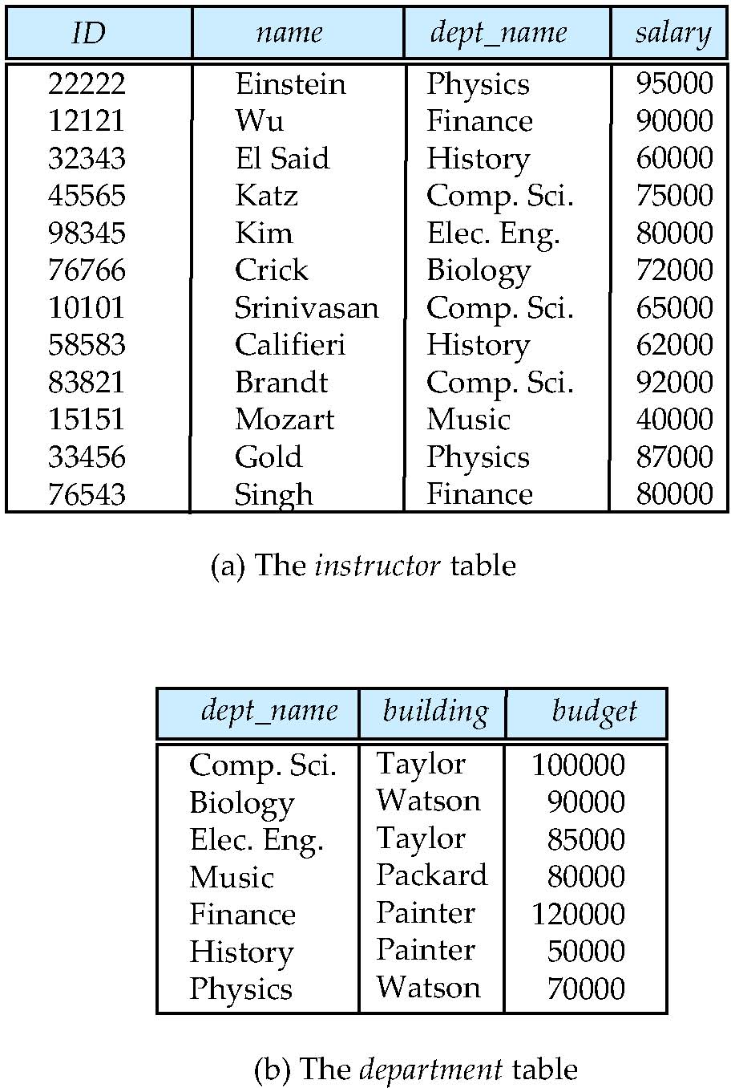
Relational Model
All the data is stored in various tables.
Example of tabular data in the relational model

Slide 24
A Sample Relational Database
Notes:
24

Slide 25
Data Definition Language (DDL)
Specification notation for defining the database schema
Example: create table instructor ( ID char(5), name varchar(20), dept_name varchar(20), salary numeric(8,2))
DDL compiler generates a set of table templates stored in a Data Dictionary
Data dictionary contains metadata (i.e., data about data)
Database schema
Integrity constraints
Primary key (ID uniquely identifies instructors)
Authorization
Who can access what

Slide 26
Data Manipulation Language (DML)
Language for accessing and manipulating the data organized by the appropriate data model
Procedural – what and how
Declarative (nonprocedural) – what not how
Query language: the portion of a DML that involves information retrieval
Often use the term query language and DML synonymously

Slide 27
Query language
Pure (formal relational)– used for proving properties about computational power and for optimization
Relational Algebra
Tuple relational calculus
Domain relational calculus
Commercial – used in commercial systems
SQL(Structured Query Language) is the most widely used commercial language

Slide 28
SQL
Nonprocedural
Takes several tables(possibly only one) and always return a single table
To be able to compute complex functions, SQL is usually embedded in some higher-level language
Application programs generally access databases through one of
Language extensions to allow embedded SQL
Application program interface (e.g., ODBC/JDBC) which allow SQL queries to be sent to a database

Slide 29
Database Design
The process of designing the general structure of the database:
Logical Design – Deciding on the database schema. Database design requires that we find a “good” collection of relation schemas.
Business decision – What attributes should we record in the database?
Computer Science decision – What relation schemas should we have and how should the attributes be distributed among the various relation schemas?
Physical Design – Deciding on the physical layout of the database

Slide 30
Discussion
database design for a University organization
Interviews with database users
Designer’s own analysis
Major characteristics of the university

Slide 31
Design Approaches
Need to come up with a methodology to ensure that each of the relations in the database is “good”
Two ways of doing so:
Entity Relationship Model
Models an enterprise as a collection of entities and relationships
Represented diagrammatically by an entity-relationship diagram:
Normalization Theory
Formalize what designs are bad, and test for them

Slide 32
Object-Relational Data Models
Relational model: flat, “atomic” values
Object Relational Data Models
Extend the relational data model by including object orientation and constructs to deal with added data types.
Allow attributes of tuples to have complex types, including non-atomic values such as nested relations.
Preserve relational foundations, in particular the declarative access to data, while extending modeling power.
Provide upward compatibility with existing relational languages.

Slide 33
XML: Extensible Markup Language
Defined by the WWW Consortium (W3C)
Originally intended as a document markup language not a database language
The ability to specify new tags, and to create nested tag structures made XML a great way to exchange data, not just documents
XML has become the basis for all new generation data interchange formats.
A wide variety of tools is available for parsing, browsing and querying XML documents/data

Slide 34
Database classification: types of Databases
Databases can be classified according to:
Number of users
Database location(s)
Type of data stored
Intended data usage
Degree to which the data are structured

Slide 35
Number of users supported
Single-user database supports only one user at a time
Desktop database: single-user; runs on PC
Multiuser database supports multiple users at the same time
Workgroup and enterprise databases

Slide 36
The type of data stored
General-purpose databases contain a wide variety of data used in multiple disciplines.
A census database contains general demographical data.
The ProQuest database contains newspaper, magazine, and journal articles for a variety of topics.
Discipline-specific databases contain specific subject area data.
ComputStat and CRSP databases store financial data.
Geographic information system (GIS) databases store geospatial and related data.
Medical databases store confidential medical history data.

Slide 37
Intended data usage
Operational database supports a company’s day-to-day operations
Transactional or production database
Analytical databases supports for tactical or strategic decision making
Data warehouse: data stored is used for tactical or strategic decisions
Online analytical processing(OLAP) front end: a set of tools that work together to provide an advanced data analysis environment for retrieving, processing, and modeling data from the data warehouse.

Slide 38
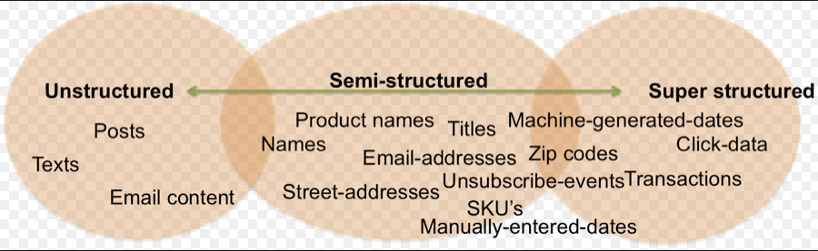
Degree the data are structured
Unstructured data exist in their original state
Structured data result from formatting
Structure applied based on type of processing to be performed
Semistructured data have been processed to some extent

Slide 39
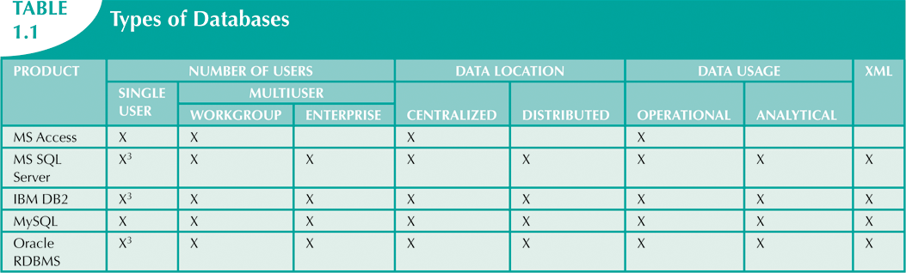
Databases provided by various DBMS vendors

Slide 40
History of Database Systems
1950s and early 1960s:
Data processing using magnetic tapes for storage
Tapes provided only sequential access
Punched cards for input
Late 1960s and 1970s:
Hard disks allowed direct access to data
Network and hierarchical data models in widespread use
Ted Codd defines the relational data model
won the ACM Turing Award for this work
High-performance (for the era) transaction processing

Slide 41
History of Database Systems
1980s:
Research relational prototypes evolve into commercial systems
SQL becomes industrial standard
Parallel and distributed database systems
Object-oriented database systems
1990s:
Large decision support and data-mining applications
Large multi-terabyte data warehouses
Emergence of Web commerce

Slide 42
History of Database Systems
Early 2000s:
XML and XQuery standards
Automated database administration
Later 2000s:
Giant data storage systems
Google BigTable
Amazon Database on AWS

Slide 43

Thank you & Questions

